Slide 1
Developing Scalable Bioinformatics Workflows on the Cancer Genomics Cloud
Dr. Jeffrey Grover
Genomics Scientist
Seven Bridges

Slide 2
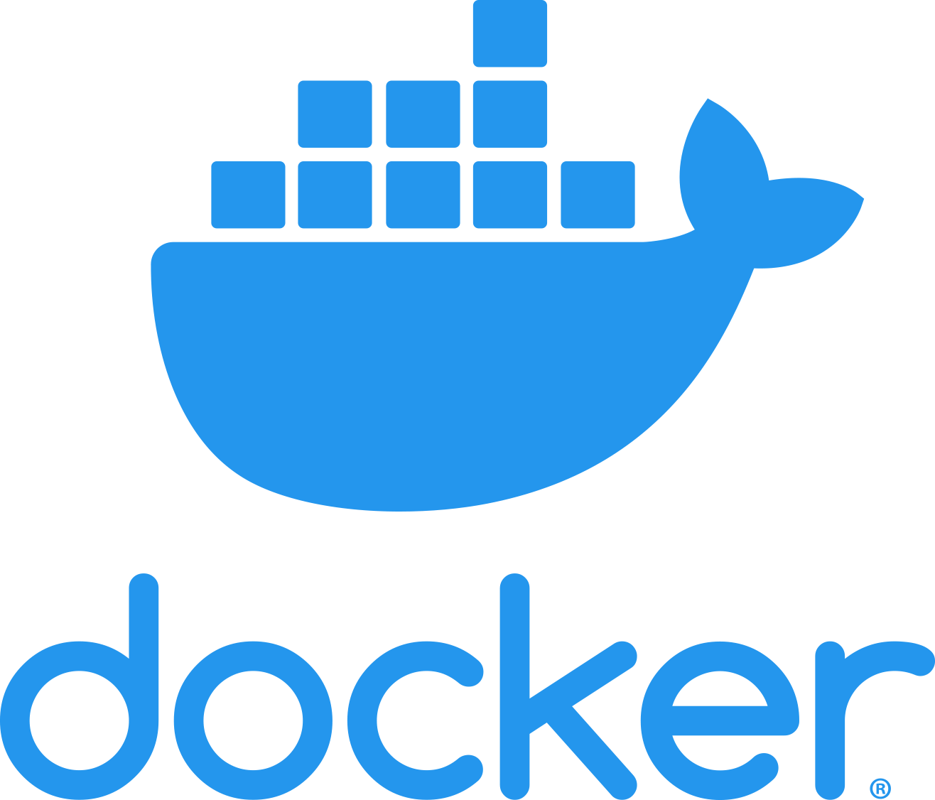
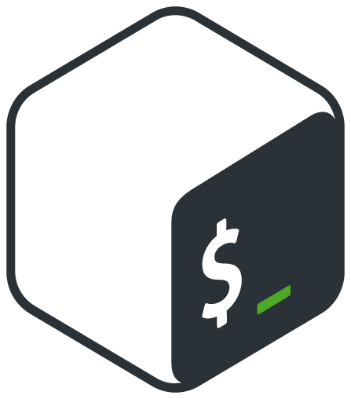
About Me
Jeff Grover
Ph.D. Molecular and Cellular Biology
Epigenetics
Gene Expression
NGS
Workflow Development
DevOps/Sysadmin
Genomics Scientist at Seven Bridges
Prototype technical solutions
Expand our bioinformatics offerings
Assist with running large public programs
Notes:
Basically, I’m what happens when a biologist is also a computer nerd and learns that there’s a way to combine the two.
I’ve worked in areas ranging from plant genomics to cancer, and have a background ranging from wet lab molecular biology to being an (unofficial) sysadmin.
These days I’m happy to work with the great folks at Seven Bridges to help create fantastic cloud platforms to help analyze -omics data at massive scale.

Slide 3
Outline
Introduction to The Cancer Genomics Cloud (CGC)
Introduction to Workflows
Developing Workflows on the CGC
Advanced Development Tools
Examples
Emerging Areas in Workflow Development
Notes:
By the end of this presentation you should:
Know what the CGC is
How it helps solve challenges in bioinformatics and facilitates easier workflow development
Know about the various tools we offer to assist your workflow development and how this can streamline and integrate with best practices
Areas we’re looking into in the future

Slide 4
Introduction to the Cancer Genomics Cloud

Slide 5
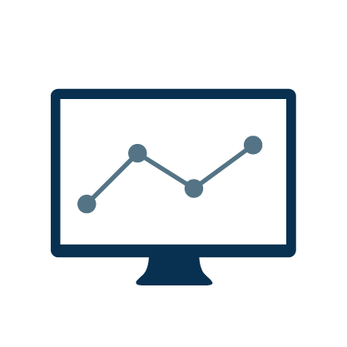
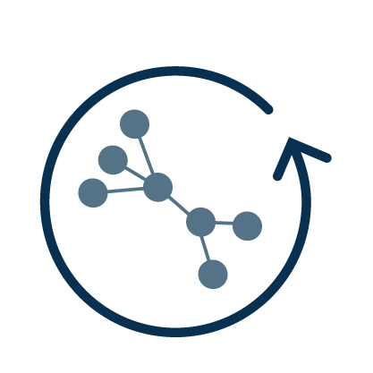
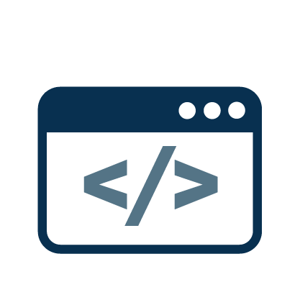
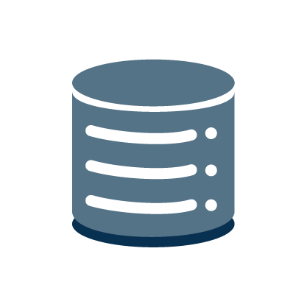
The Cancer Genomics Cloud
A stable, secure, and highly customizable cloud storage and computing platform
A user-friendly portal for collaborative analysis of petabytes of public data alongside private data
An optimized venue for reproducible data analysis using validated tools and pipelines
Easy data management
Scalable computation
Optimized bioinformatics algorithms
Secure collaboration
Flexible & fully reproducible methods
Extensible and developer-friendly
platform
Notes:
Say that we deliver these 3 things
customizable (and secure)
collaborative analysis even on multi-peta byte data
Sentence per figure - use animation, bold text that’s relevant as we walk through the slide
reproducible

Slide 6
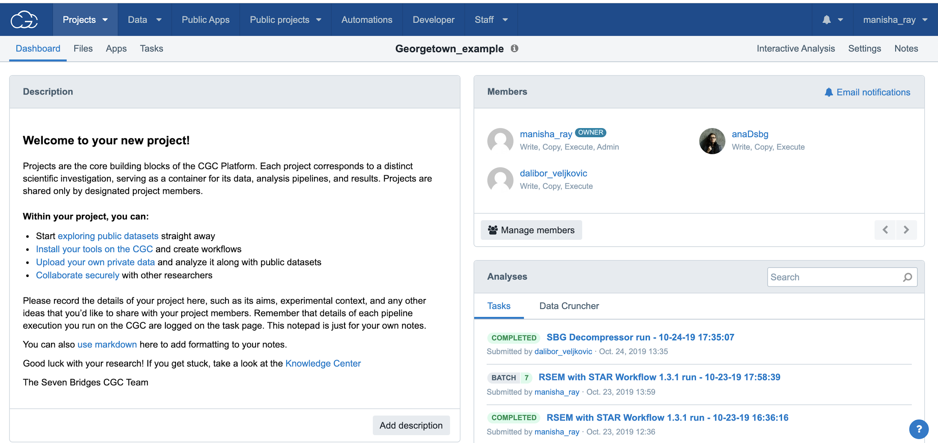
Projects organize files, methods, and results
Project owner
Also known as workspaces or sandboxes
Easily manage collaborators and permissions
Project owners can add collaborators to the project and define permissions
Project
Files
Apps
Tasks
File 1
App 1
Task 1
File 2
App 2
A user selects the files, apps, and parameters to create tasks
...
...
File n
New file 1
Completed tasks generate new files that are stored in the project
...
Notes:
collaborate slide is next

Slide 7
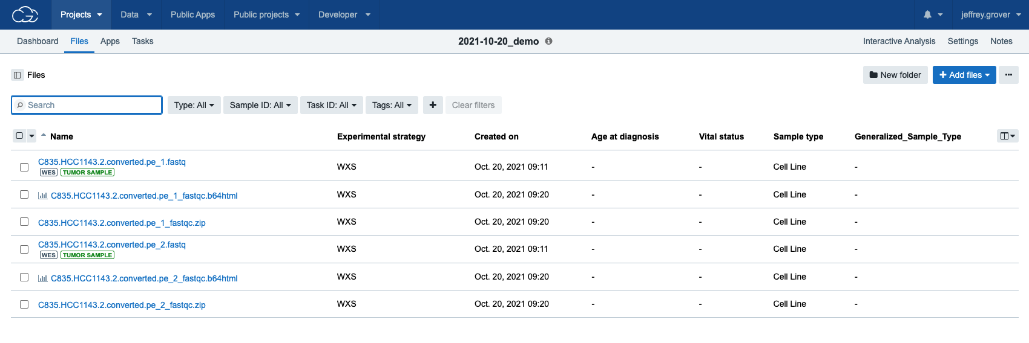
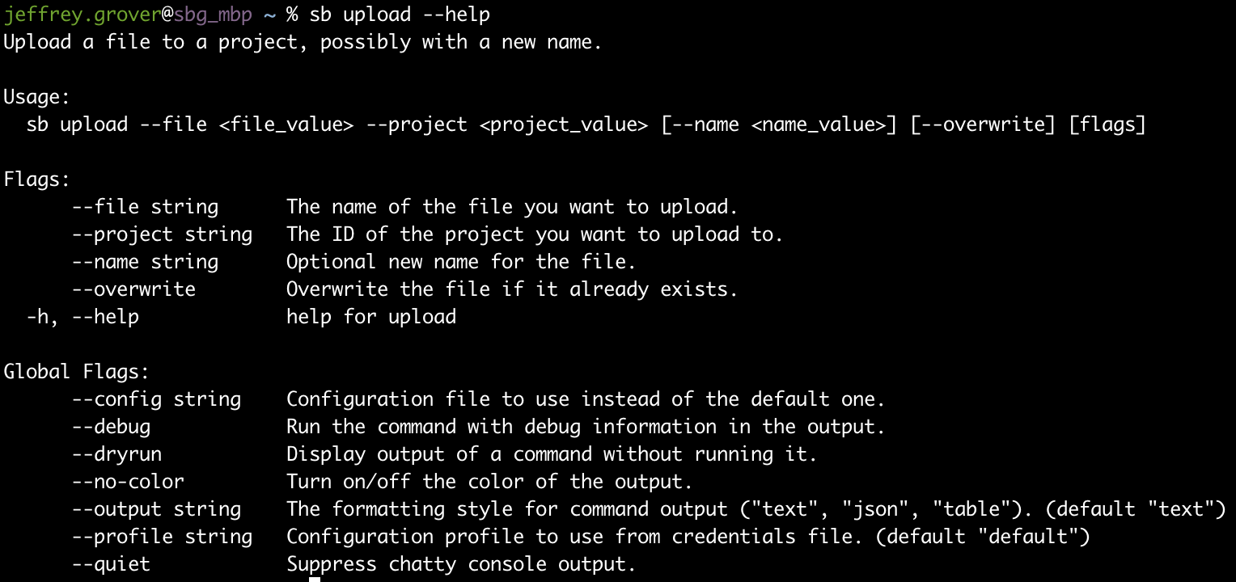
Getting Data
Hosted data (TCGA, et al.)
Ways to bring your private data:
Seven Bridges CLI
Connect Cloud Storage (Volumes)
FTP Uploader
SBFS (Seven Bridges File System)
Platform GUI
Data behaves identically regardless of source

Slide 8
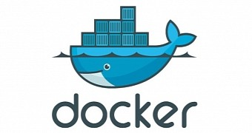
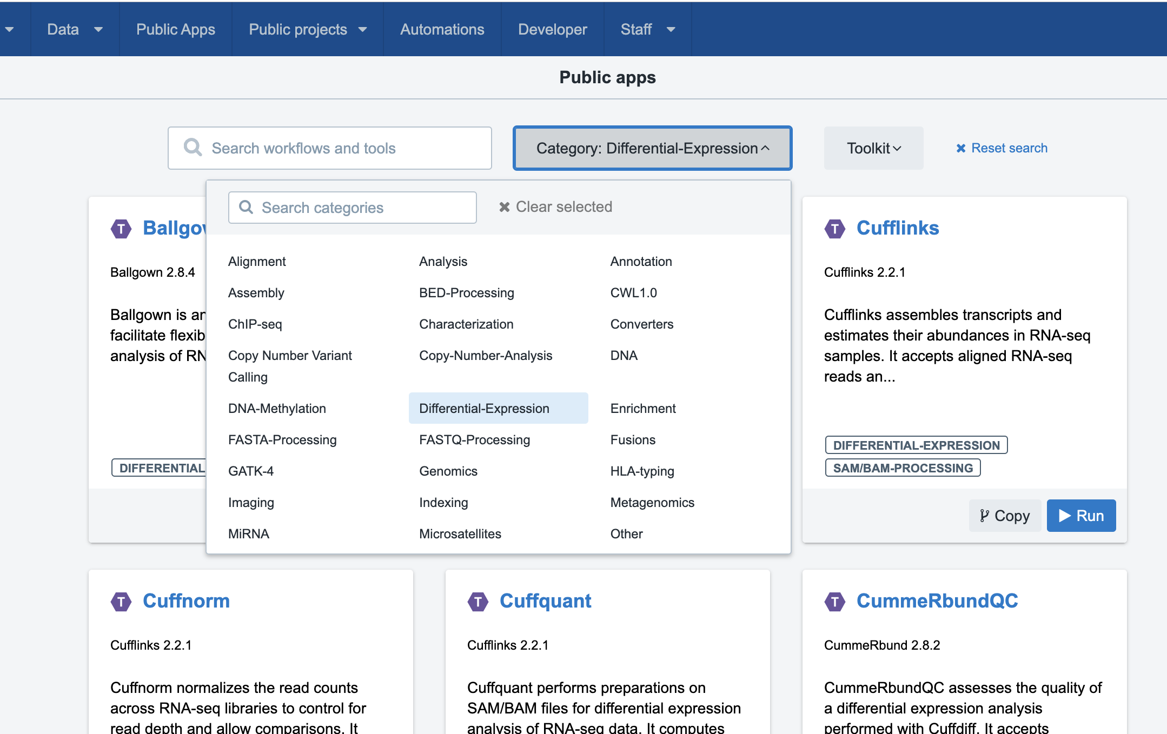
Use or Create Reproducible Workflows
Common Workflow Language enables portability; reproducibility; & scalability.
Use or combine hundreds of optimized tools and workflows to construct your analysis.
Seamlessly import workflows from external public repos (e.g. Dockstore).
Create your own apps with a graphical workflow editor
Notes:
Highlight important words in bold, and the audience can focus on them and follow along better

Slide 9
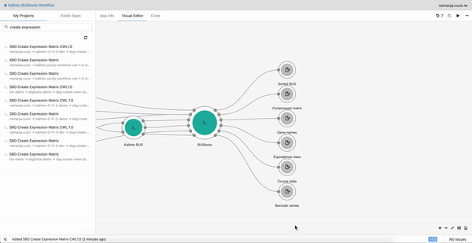
Create and Edit Workflows Using a GUI

Slide 10
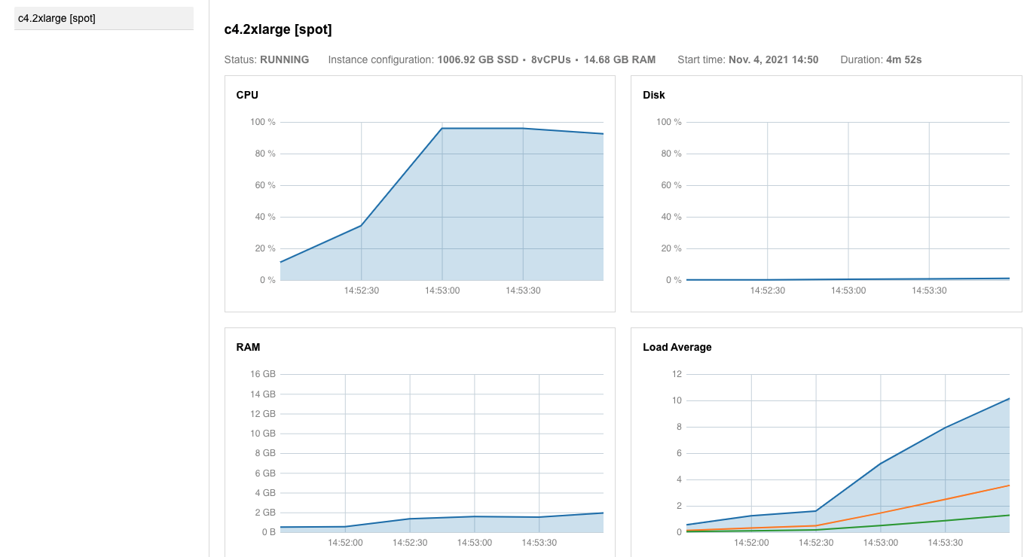
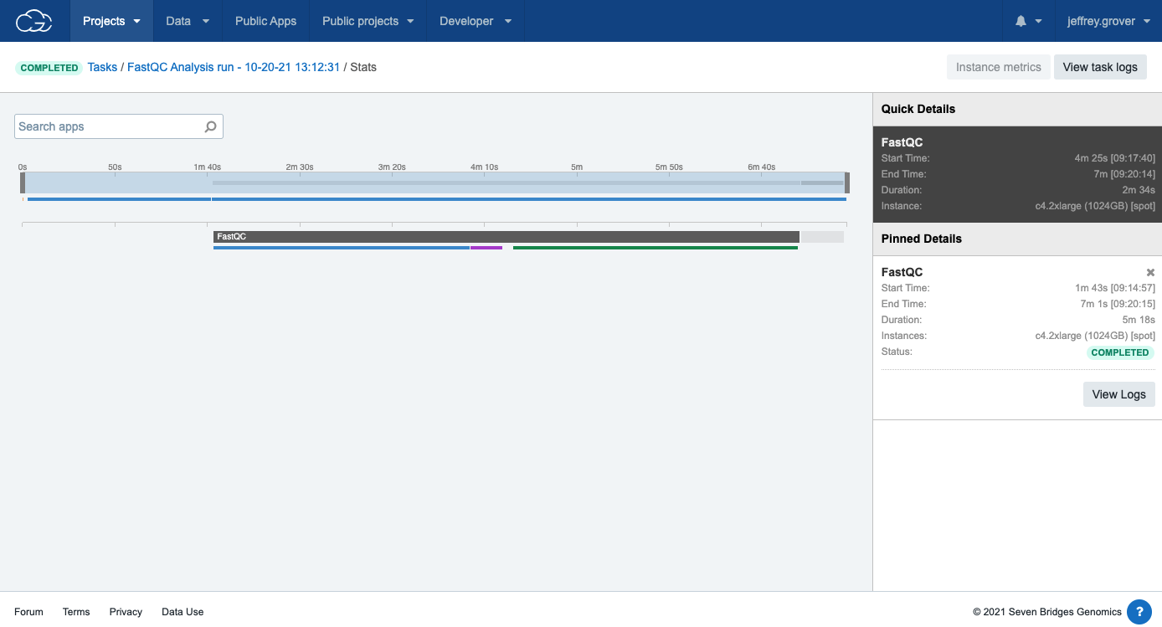
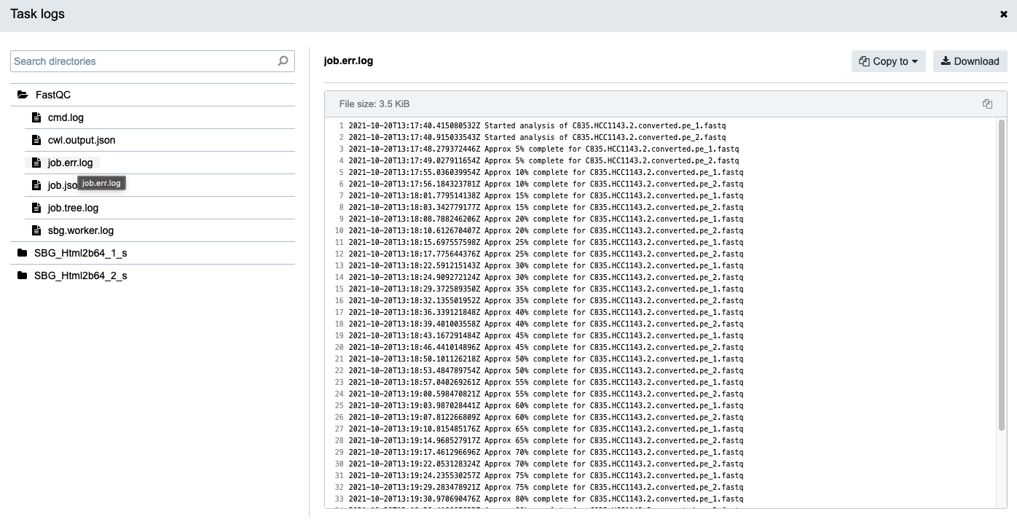
Monitor Progress and Capture Logs

Slide 11
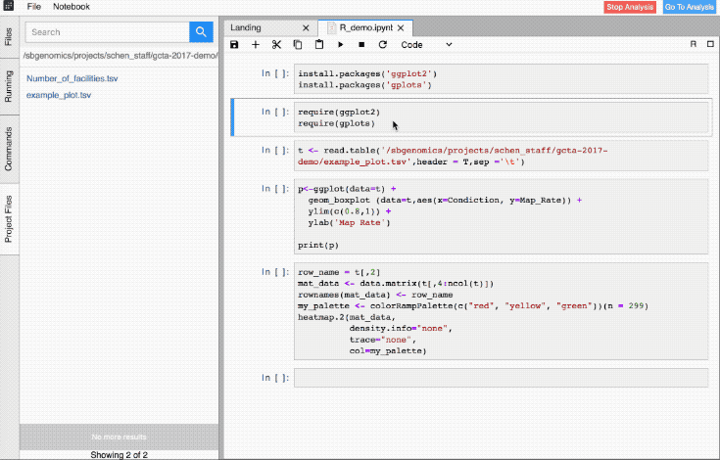
Data Cruncher for Interactive Analyses
Seven Bridges Data Cruncher
Perform interactive and exploratory data analysis.
Jupyter and R Studio for interactive analysis.
Operate on your data in-place.
Files
Project
Instance

Slide 12
The Cancer Genomics Cloud: Advantages
Operate on data in-place, in the cloud.
Public, curated, selection of tools and workflows
Implemeted in CWL
https://cgc.sbgenomics.com/public/apps
Collaboration
Share data and workflows in your CGC projects
Flexibility
Bring your own data or favorite tools
Explore data and results in Jupyter and R notebooks
Computational resources when you need them

Slide 13
Workflows

Slide 14
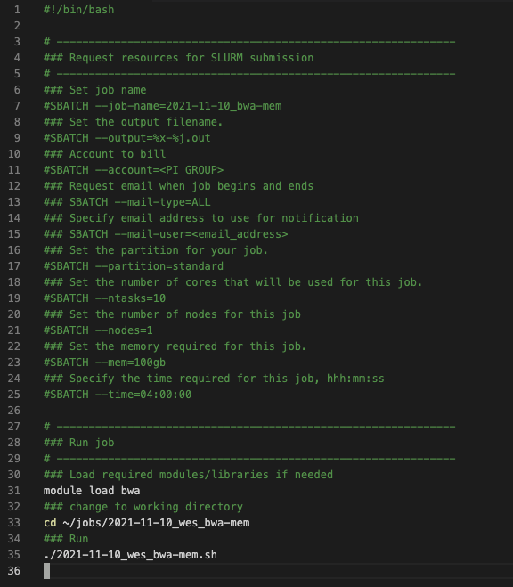
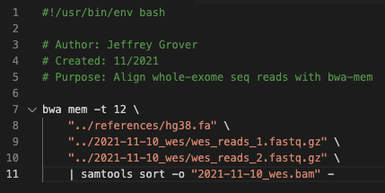
A Typical Progression
“I just need this to run.”
“I need to run that again… what settings did I use?”
“I need to run this at scale.”
“I need to run this at an even bigger scale, and want each step to run efficiently.”
“All the previous, but now my data are in the cloud and I want to operate on it in-place.”

Slide 15
The CGC Addresses Challenges in Workflow Development
Justification
Choice of workflow management framework
Choice of execution environment
Where do you store your data?
Setting up a development environment
How to design an efficient workflow?
Provenance and logging

Slide 16
Workflow Development Principles
Break workflows into smaller modules
Reuse intermediate files
Take advantage of parallelization
Use containers
Test
Don’t try to be too clever

Slide 17
Advanced Workflow Development Tools

Slide 18
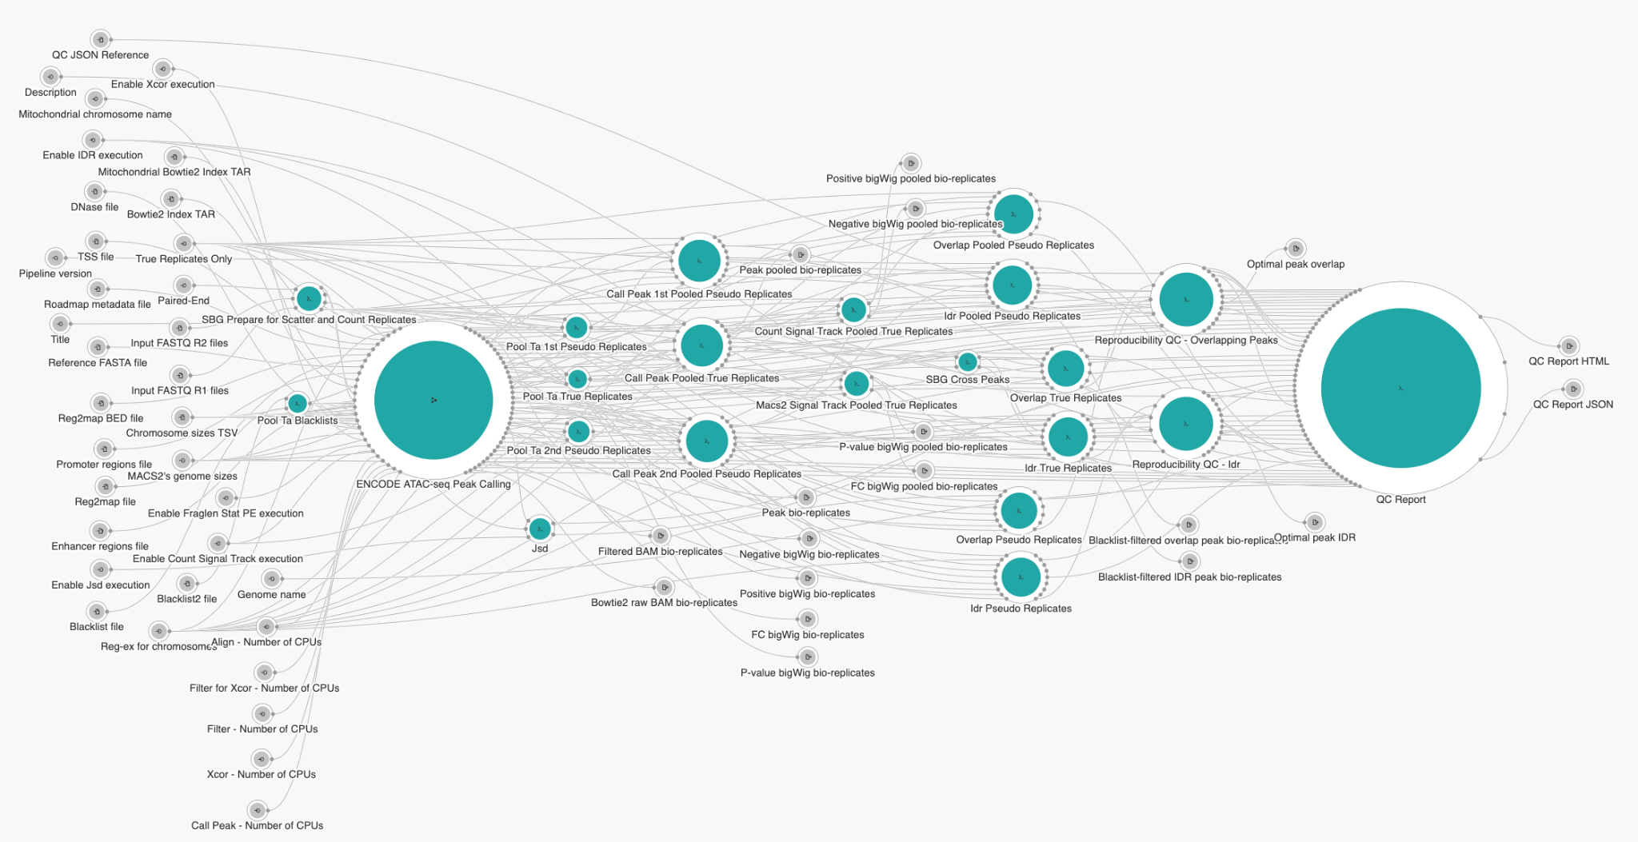
Complex Workflow Are Hard to Visualize
Notes:
ATACseq workflow from ENCODE.
At this level of complexity, some may find working with a GUI to be more of a hindrance than help. It can be hard to tell what connects with what.
And we’re aware of this fact.

Slide 19
Reasons to Move Beyond the GUI
The more complex the workflow, the harder it is to visualize.
Take advantage of software engineering best practices.
Version control
Unit testing
Customize your development environment.
Orchestrate complex executions.
If you can script it, you can do it

Slide 20
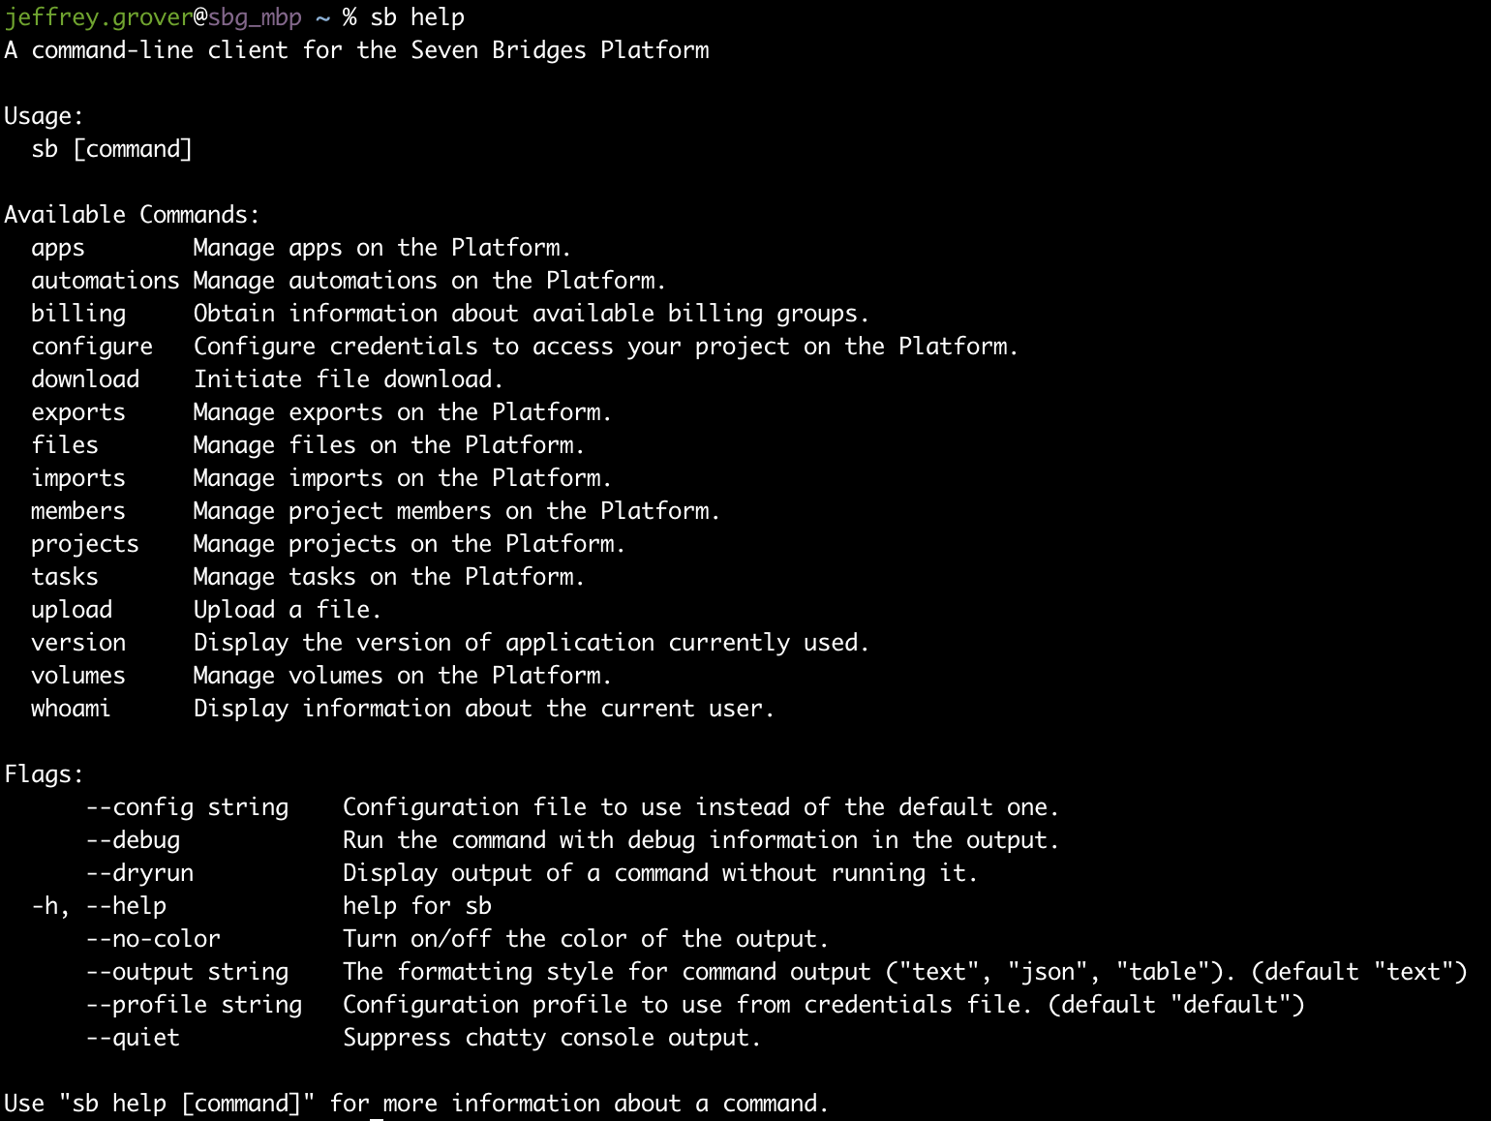
Advanced Tooling From Seven Bridges
sb CLI
Upload/download data
Execute tasks
List project contents
Query billing information
Automatable with shell scripting
...and more

Slide 21
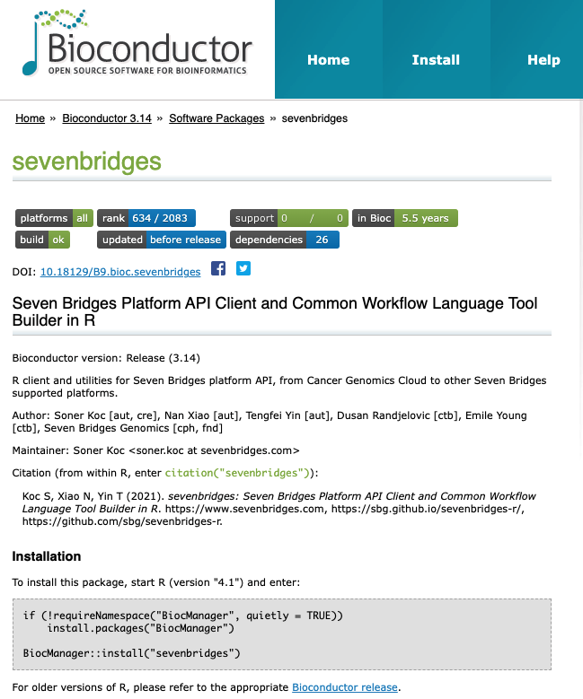
Advanced Tooling From Seven Bridges
sevenbridges R Library
Programmatically interact with the platform
Treats projects, tasks, etc. as R objects
Create workflows and CWL from R
Pull execution information
Orchestrate tasks with API calls
Works great in notebooks!
https://bioconductor.org/packages/release/bioc/html/sevenbridges.html
https://github.com/sbg/sevenbridges-r

Slide 22
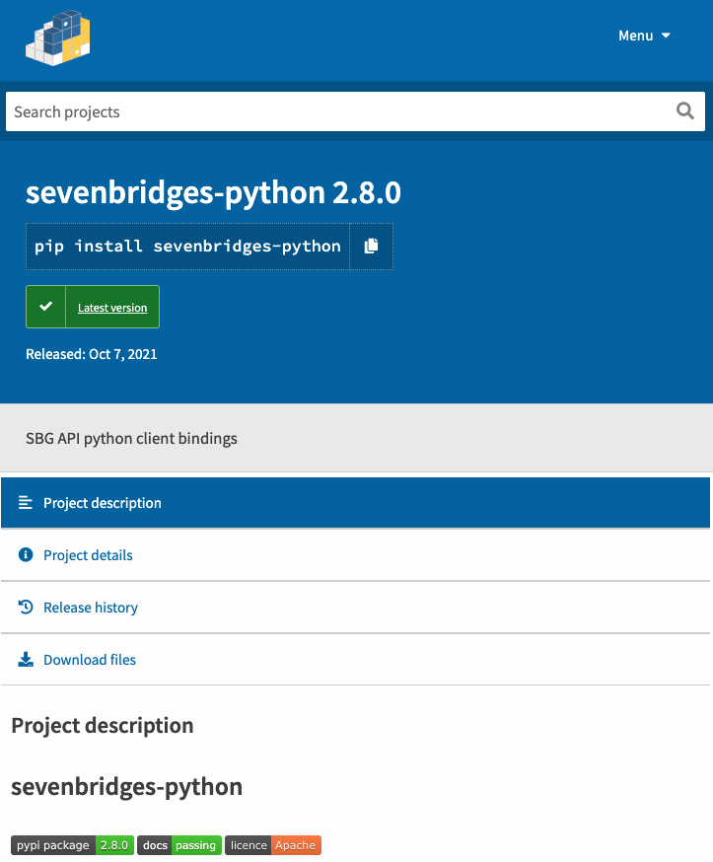
Advanced Tooling From Seven Bridges
sevenbridges Python package
Programmatically interact with the platform
Treats projects, tasks, etc. as Python objects
Create workflows and CWL from Python
Pull execution information
Orchestrate tasks with API calls
Works great in notebooks!
https://pypi.org/project/sevenbridges-python/
https://github.com/sbg/sevenbridges-python

Slide 23
Rabix - Open Source Tools
Tools, libraries, and examples for the advanced/code curious user.
Make workflow development and interaction with Seven Bridges platforms more frictionless.
https://rabix.io/
https://github.com/rabix

Slide 24
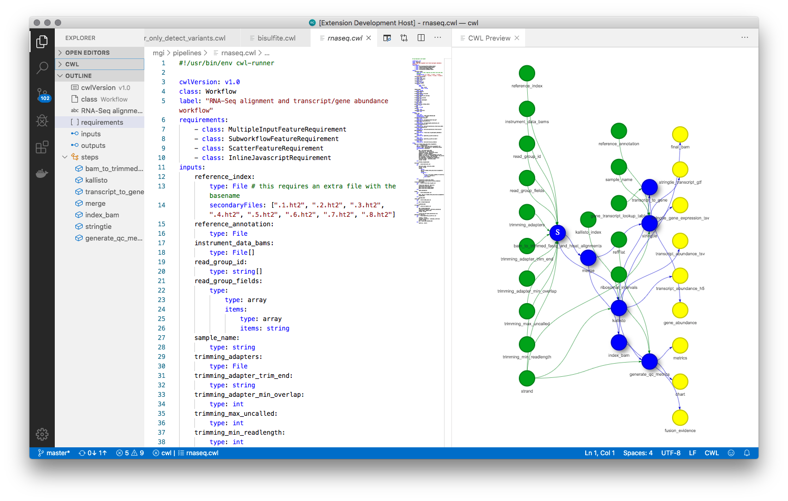
Rabix - Open Source Tools
Benten
Language server for local CWL development
Code intelligence for CWL
VSCode Extension
Vim compatible

Slide 25
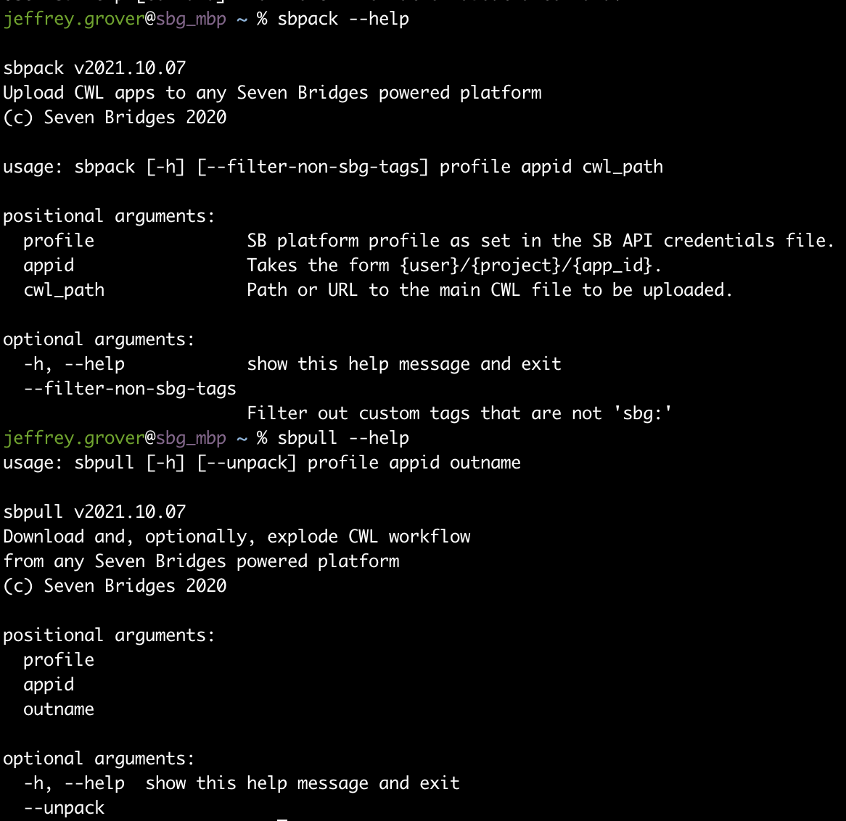
Rabix - Open Source Tools
sbpack
Download CWL from the platform
“Pack”/“Unpack” workflows
Upload CWL to the platform
Can be used to create a local development environment
https://github.com/rabix/sbpack
https://pypi.org/project/sbpack/

Slide 26
Advanced Features In Action

Slide 27
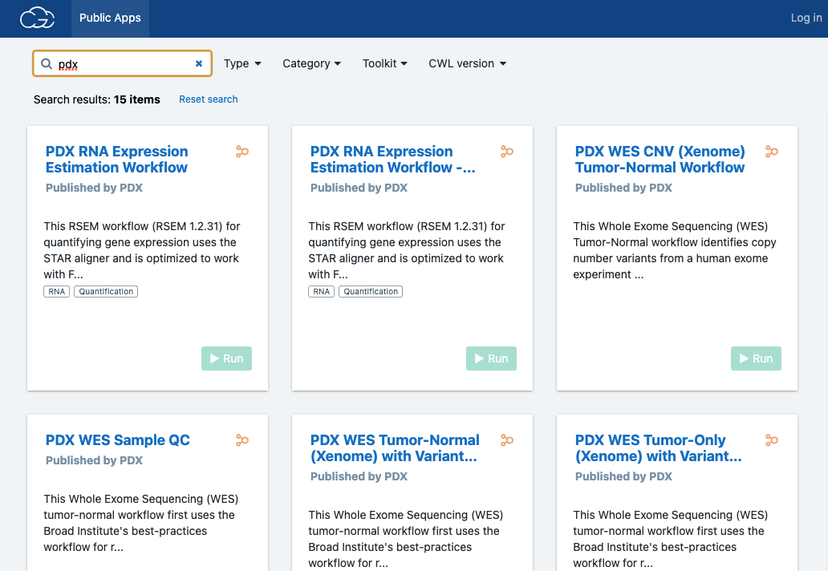
Example 1
NCI-Funded Consortium to Study Patient-derived Xenograft models
> 80TB of RNAseq and WES
Workflows developed with JAX on CGC
Originally, end-to-end workflows
Limited re-use of intermediate files
Constrained analysis of complex experiments
Reorganized workflows
Split up alignment and variant-calling
Cost savings and avoided unnecessary steps
https://www.pdxnetwork.org/

Slide 28
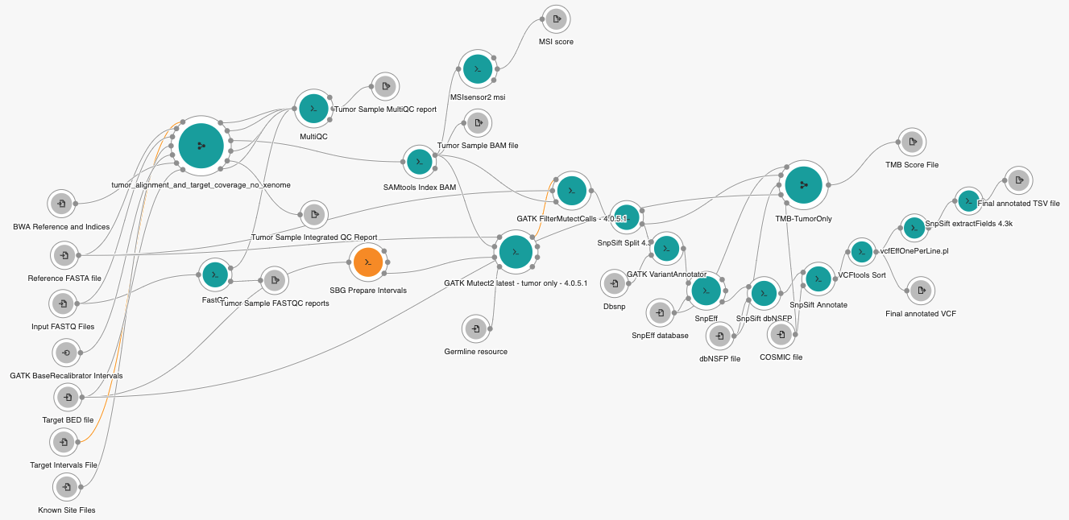
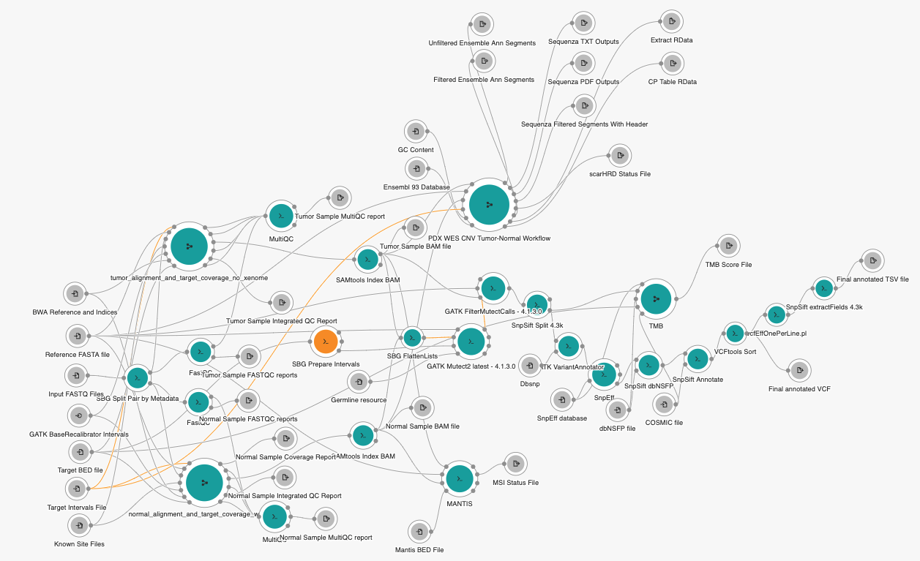
End-to-End PDX WES Workflows
Tumor-Normal End-to-End Workflow
Tumor-only End-to-End Workflow

Slide 29
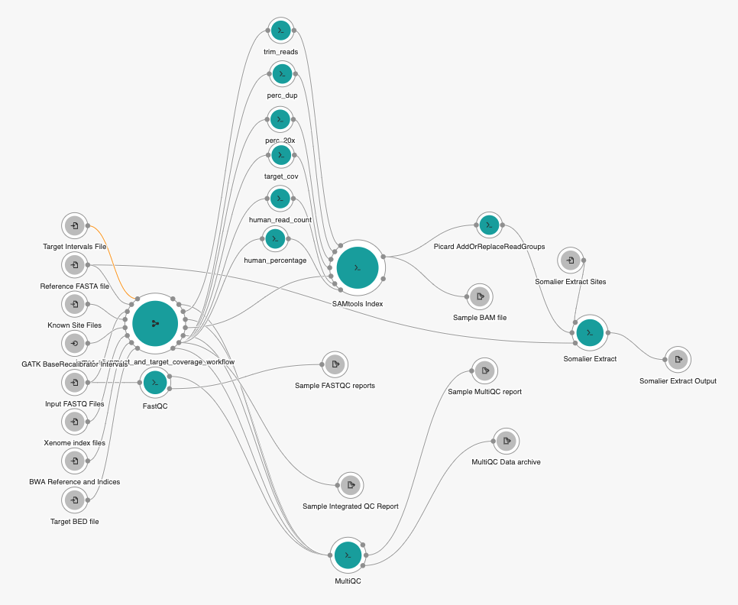
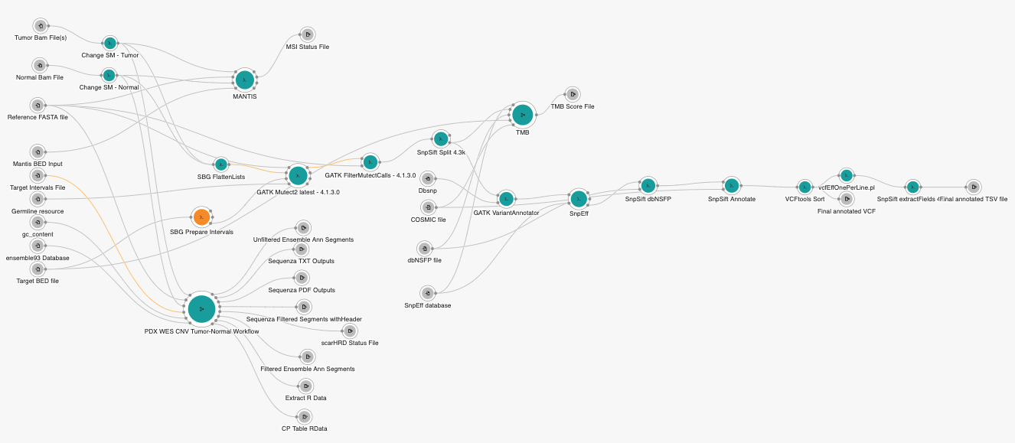
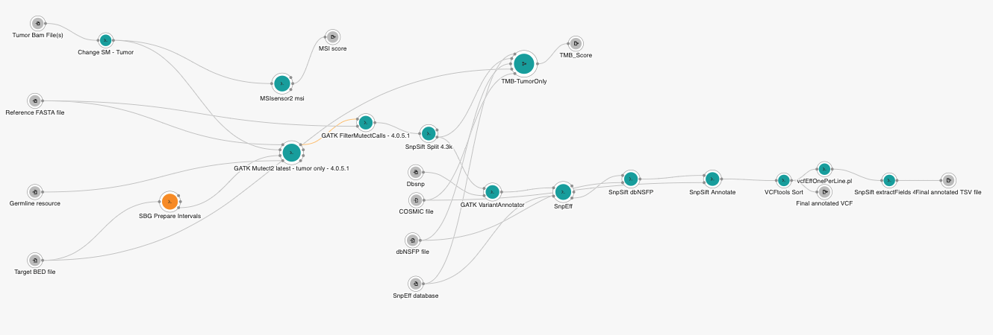
Split Alignment/QC and Variant Calling
Alignment and QC
Tumor-Normal Variant Workflow
Tumor Only Variant Workflow

Slide 30
Automation to Handle Complex Study Designs
Take advantage of R/Python Libraries
Complex batching
Programmatic workflow execution
Saved thousands of clicks while getting all the benefits of the CGC
Orchestrating AWS instances
Capturing execution logs
Operating on data in-place
Output
Variant Calling
X
1,000s
Individuals
QC
QC
QC
…
QC
Alignment
Alignment
Alignment
…
Alignment
Normal
Tumor1
Tumor2
Tumor100

Slide 31
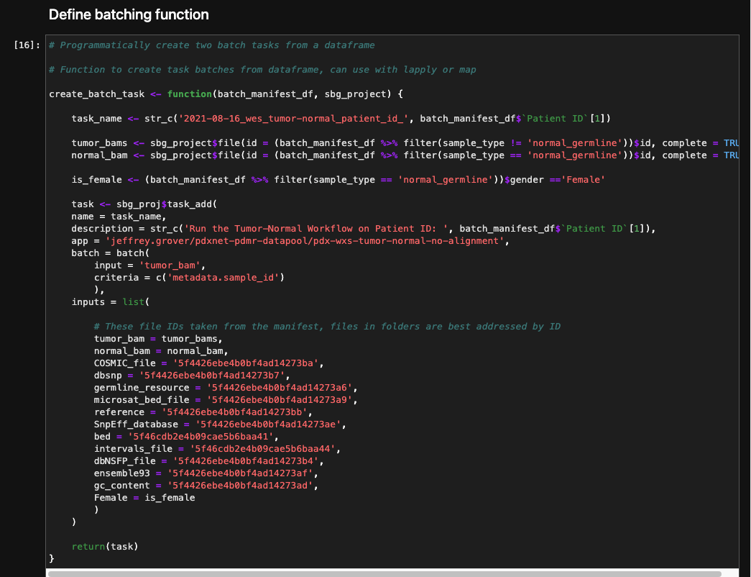
Solution: The Seven Bridges R/Python Libraries

Slide 32
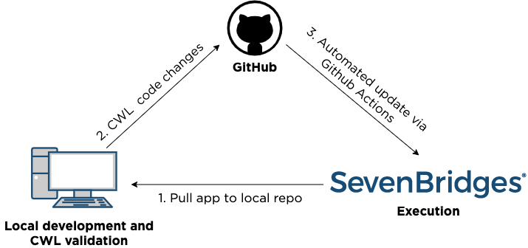
Example 2 - Continuous Integration and Deployment
Some bioinformaticians:
“I want to use git/version control.”
“I use multiple execution environments.”
“I like to use vim/emacs/VSCode, etc.”
Using Seven Bridges and CWL tools you can:
Develop locally (Benten + sbpack)
Automate CWL validation (pre-commit hook)
Deploy from Github to CGC (Github Actions + sbpack)
https://github.com/rabix/sb-ci

Slide 33
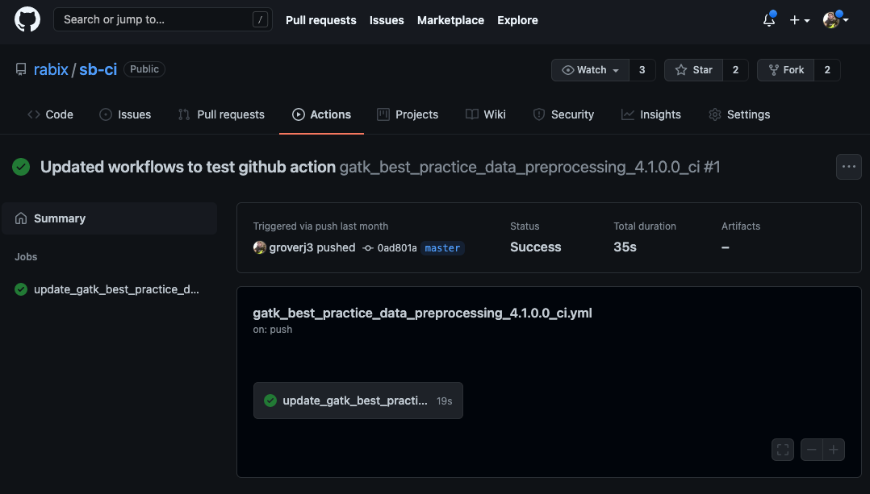
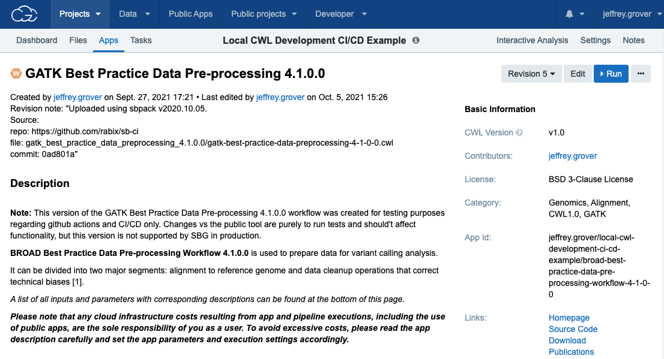
Automating Workflow Deployment
Github Action
Deployed
.git/pre-commit

Slide 34
Emerging Areas

Slide 35
Managing Complexity
Nested workflows:
Composable
Easier to visualize
Enables users to run portions as needed
Natural use case for conditional execution
Level of complexity should be considered from the beginning of development:
Which results do I need to keep?
Which steps are computationally expensive?
Storage cost vs recomputation cost?
Does my workflow have branching points?
Are there manual decisions that can be automated with conditionals?

Slide 36
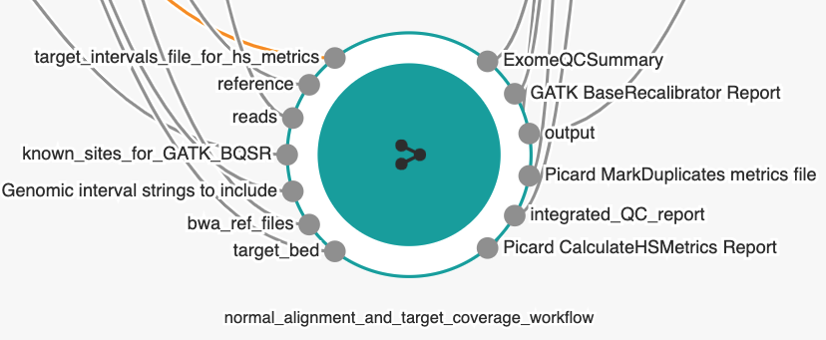
Nested Workflows Are Supported on the CGC

Slide 37
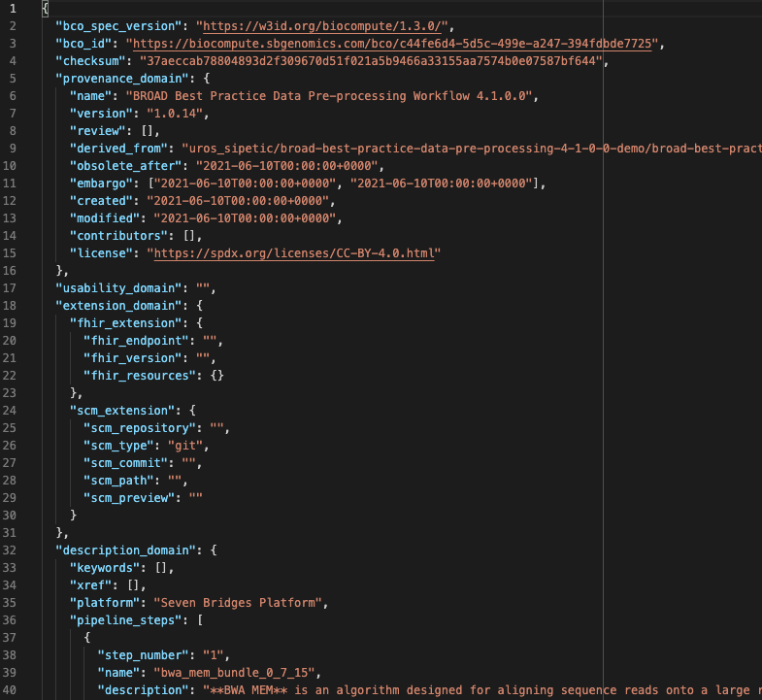
Documenting an Analysis
Biocompute Objects:
Emerging standard to document an analysis
Includes data, workflows, environment
Human and machine-readable formats
IEEE standard
https://biocomputeobject.org/
Seven Bridges Biocompute App/R library:
Create BCOs from the R and CGC
In development
https://github.com/sbg/bco-app
https://sbg.github.io/biocompute/

Slide 38
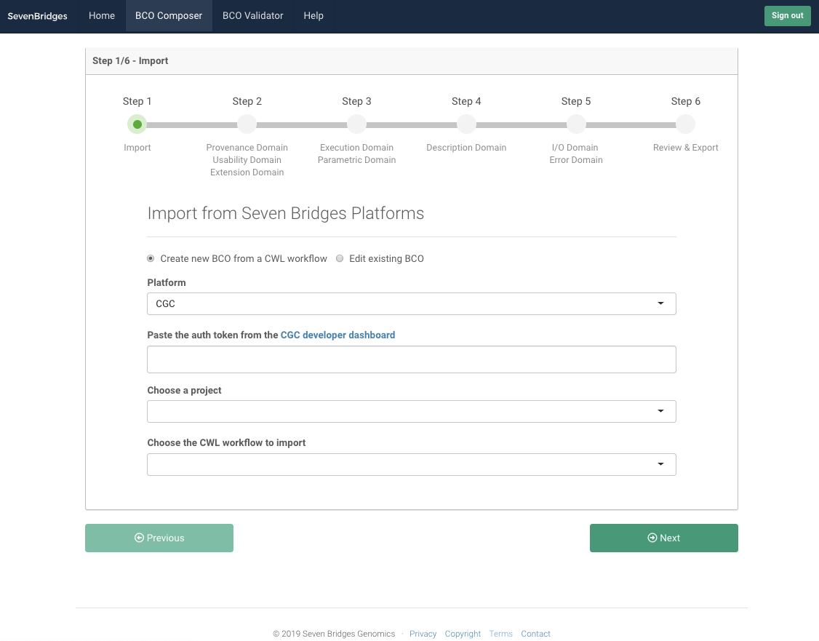
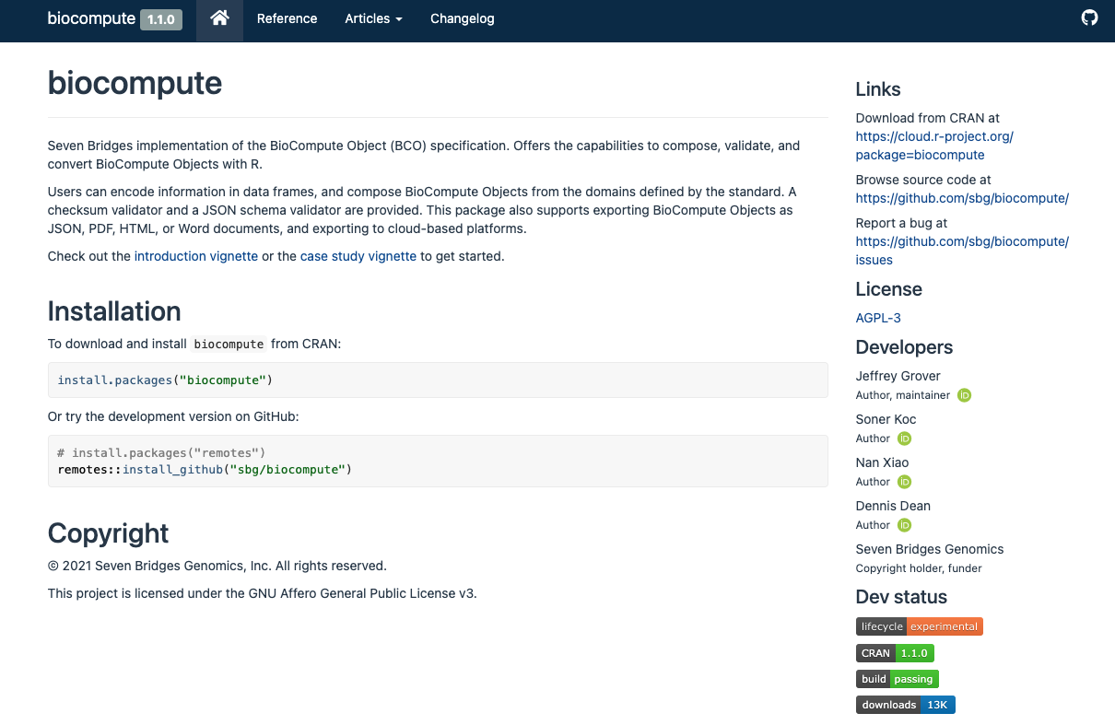
Biocompute Object Tools

Slide 39
Questions?

