Slide 1
CWIG: Use of Containers for
Custom Software Development
at the NCI for AWS Cloud and On Premises

Slide 2
Introductions
Cloud Platforms at NCI
Container Technologies – AWS
Solution Pattern
CBIIT Container Technologies
  Reference Architecture
  Container Pipeline Architecture
  Container Pipeline Options
  Container Security
  Container Monitoring
  Container Governance
Question and Answers

Slide 3
Introductions
Digital Services and Solutions Branch (NCI/CBIIT/OCIO)
  Krish Seshadri – Federal Manager, Systems Engineering and Cloud Platform Engineering and Operations
    Dave Breslin – Tech Lead, Systems Engineering Team
    Cuong Ngyuen – Sr Systems Engineer
    Mike Thompson – Systems Engineer
Lawrence (Larry) Brem – Federal Manager for Software Development
  Madhu Kanigicherla and team
  Clint Malone and team
  Rene Pineda and team
Notes:
Center for Biomedical informatics and Information Technology

Slide 4
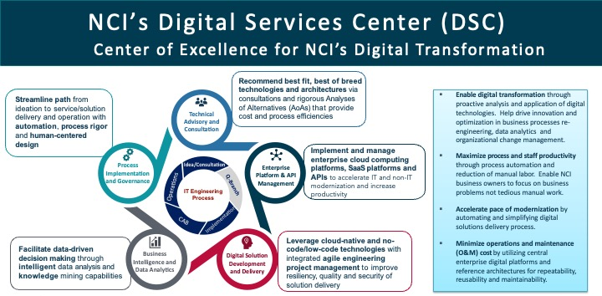
Digital Services and Solutions Branch (DSSB)
Operates NCI’s Digital Services Center (DSC), providing a spectrum of professional services that support NCI’s adoption and application of emerging digital technologies and modernization of business processes and IT service management.
  Provides technical advisory and consultation for digital solution architecture and engineering design.
  Provides governance and lifecycle management of cloud computing platforms and enterprise Software-as-a-Service (SaaS) platforms and tools.
  Develops and delivers security-accredited digital solutions.
  Provides process implementation and governance for IT engineering and IT service management with a focus on human-centered design.
  Implements business intelligence and data analytics in support of data driven decision making.

Slide 5
Who We Are
System Engineering team provides
Technical consultation regarding systems provisioning, systems architecture, and systems integration
Architecture/Design : Interface with other IT SMEs to arrive at a solution
Strategic Planning for Infrastructure Automation
Systems/Infrastructure Technology Portfolio Management
SOPs and Knowledge Article
Cloud Platform Engineering and Support team provides
Cloud SME support during consultations
Cloud platform engineering, automation
Operationalize new cloud service(s)
Cloud platform governance
Cloud deployment and migration
Cloud operations support

Slide 6


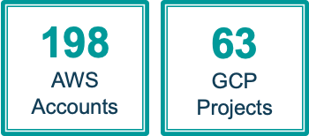
Cloud Platforms at NCI
Two cloud computing platforms managed by NCI CBIIT
  IaaS and PaaS, FedRAMP services only
NCI Cloud One –NCI managed Amazon Web Services (AWS) platform
  In full production with FISMA Moderate ATO as General Support System (GSS)
  Support for sensitive data
  Mature IT support model and assistance with cloud migration and consultation
NCI Cloud Two –NCI managed Google Cloud Platform (GCP)
  In full production FISMA Moderate ATO’ed platform
  IT support model to support cloud migration and consultation
Cloud Platform Engineering
Cloud Operations
Cloud One
Cloud Two

Slide 7
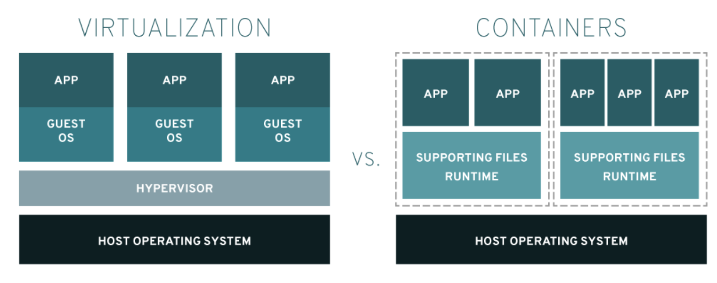
Container Technologies
"Containers are lightweight packages of your application code together with dependencies such as specific versions of programming language runtimes and libraries required to run your software services."
  Containers Overview
    Containers vs. VMs
    Benefits
      Separation of responsibility
      Workload portability
      Application isolation
  Container Pattern Development
    Patterns are developed based on analyzing the requirements that we receive from various consultations with our customers across NCI

Slide 8
NCI CBIIT AWS Container Infrastructure Services & Reference Architectures
Deploying the AWS Cloud Infrastructure Services and Solutions for our Customers

Slide 9
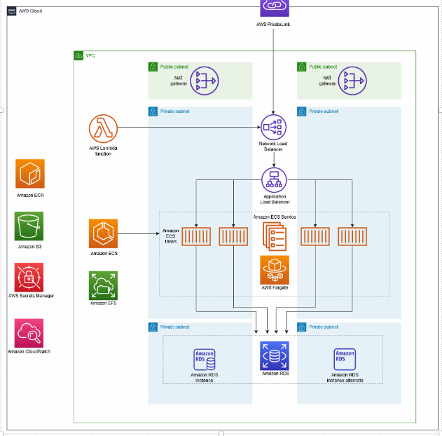
NCI Container Infrastructure Services – AWS Technologies
Amazon ECS – highly scalable, fast, container management service that makes it easy to run, stop, and manage containers on a cluster.
Amazon ECR – managed AWS container image registry service that is secure, scalable, and reliable.
Amazon EFS – simple, scalable, fully managed elastic NFS file system for use with AWS Cloud services and on-premises resources.
AWS Fargate – use with Amazon ECS to run containers without having to manage servers or clusters
Amazon RDS – web service that makes it easier to set up, operate, and scale a relational database
AWS Secrets Manager – helps you replace hardcoded credentials in your code, including passwords,
Elastic Load Balancing – distributes incoming application or network traffic across multiple targets

Slide 10
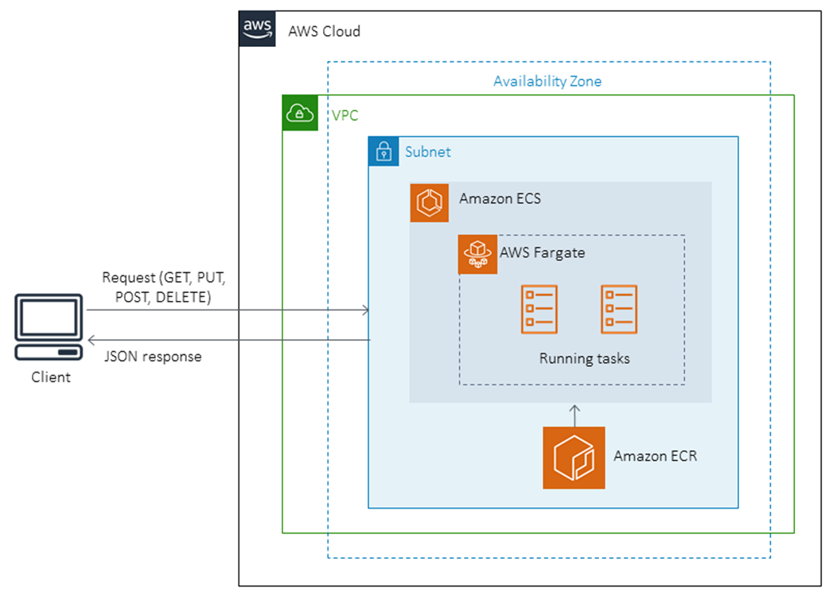
NCI AWS Ref. Architecture – Java Microservices On-Prem

Slide 11
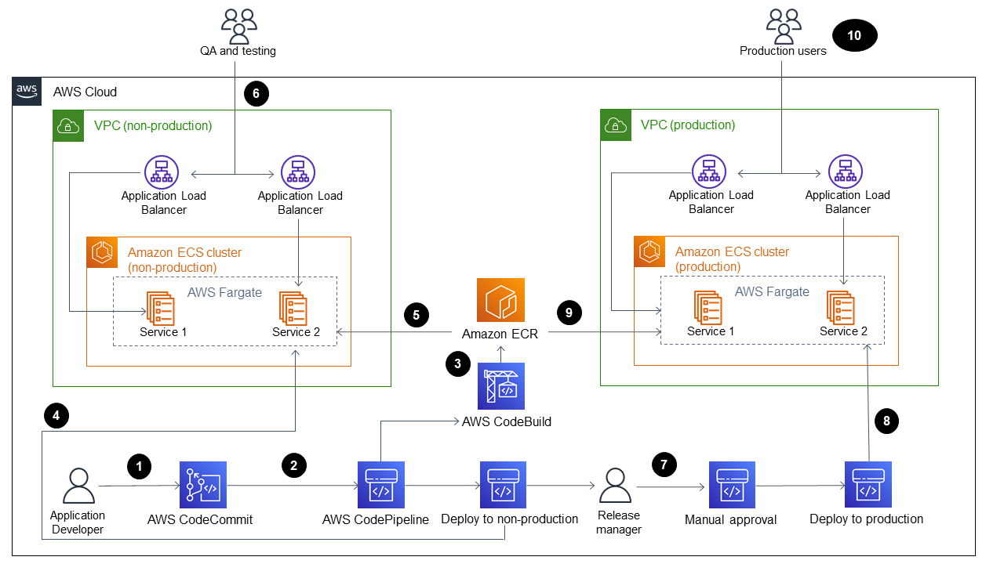
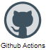

CI/CD Deployment Workflow: Compute & Application Pipelines
The diagram shows the following workflow:
An application developer commits code to a code repository.
A pipeline is initiated.
Build agent builds and pushes the Docker image to a customer's repo
Github Actions (GHA) + TF deploys a new image to an existing Fargate service in a non-production Amazon ECS cluster.
Amazon ECS pulls the image from the Amazon ECR repository into a non-production Fargate service.
Testing is performed using a non-production URL.
The release manager approves the production deployment.
GHA/TF deploys the new image to an existing Fargate service in a production Amazon ECS cluster
Amazon ECS pulls the image from the Amazon ECR repository into the production Fargate service.
Production users access your feature by using a production URL.
NCI Docker Repos
Amazon ECR
NCIDockerHub
Build & Push Image to Customer repo
Terraform/GHA
PrismaCloud
Jenkins
AWS CodeBuild
Commits Code
GitHub Repo*
NCIDockerHub
AWS CodeCommit
Pipeline Initiated
GitHub Actions* (GHA) workflow
Jenkins*
AWS CodePipeline

Slide 12
NCI CBIIT Containerization
Security & Governance Solutions
Presented by Cuong Nguyen

Slide 13
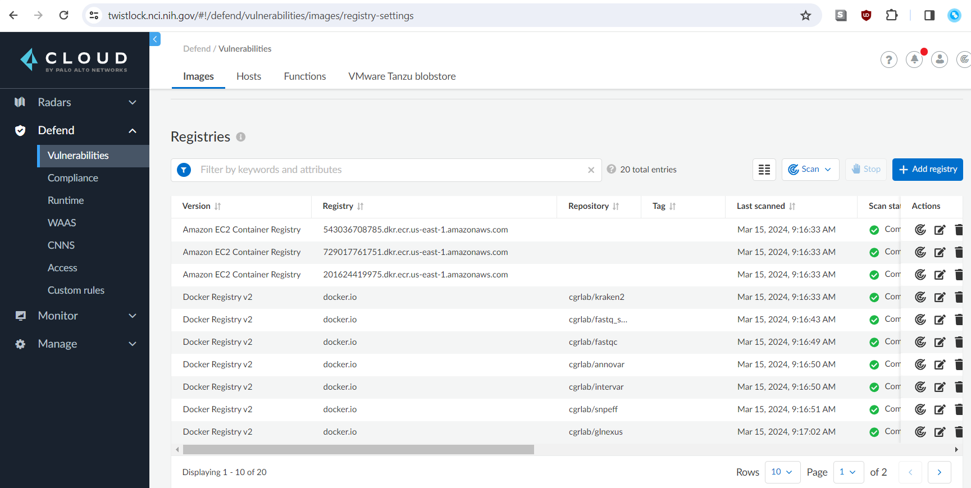
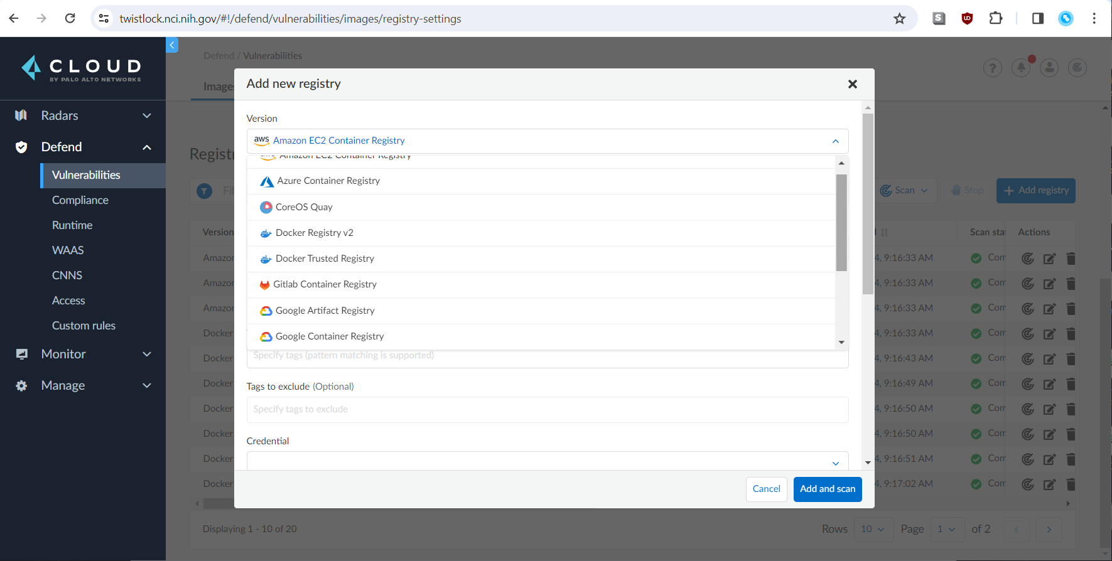
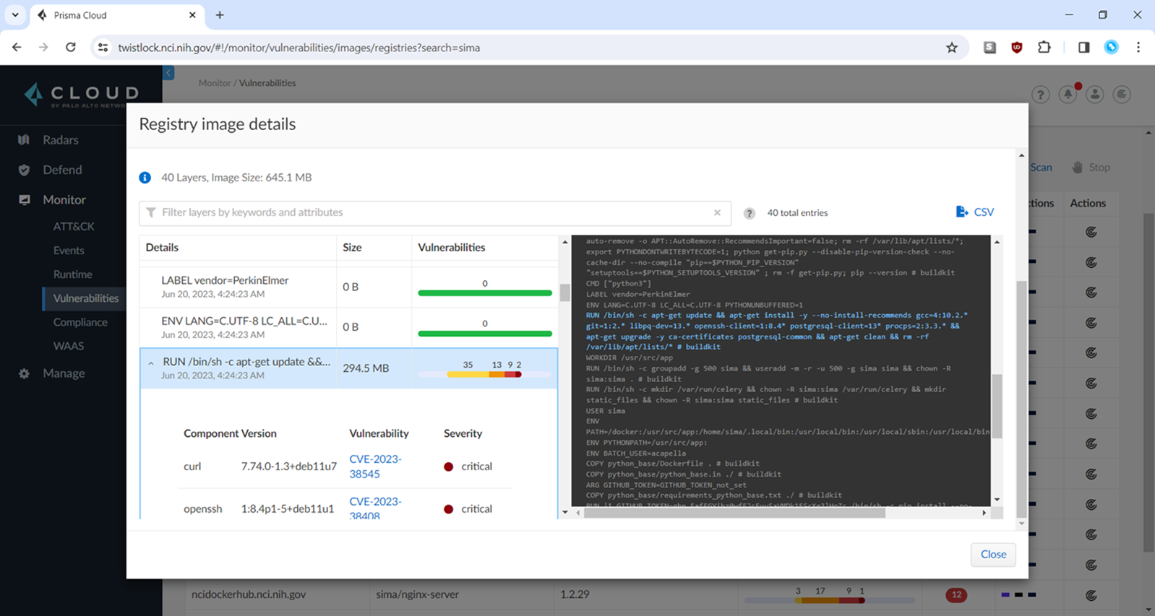
NCI CBIIT Container Security Technologies
Prisma Cloud/Twistlock
Image repository scanning (Continuous Monitoring)
Running containers
Code repository scans

Slide 14
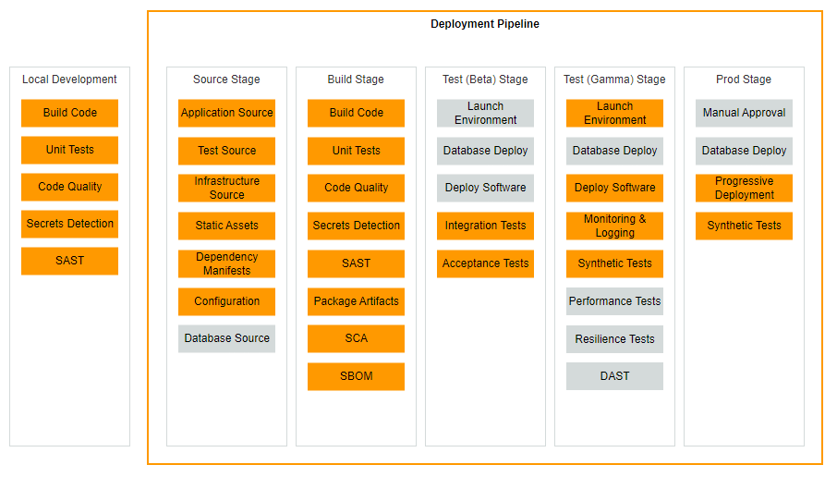
Deployment Pipelines – CI/CD Pipeline Activities
This pipeline type will take source code files, tests, static analysis, database deployment, configuration, and other code to perform build, test, deploy, and release processes.
The pipeline launches an environment from the compute image artifacts generated in the compute image pipeline.
Automated tests are run on the environment(s) as part of the deployment pipeline.
Every commit to the trunk has a change to go to production if all steps of the pipeline complete successfully.

Slide 15
NCI Container Security & Compliance Services Demo & Walk-thru

Slide 16
NCI CBIIT DevOps Pipelines
Presented by Mike Thompson

Slide 17
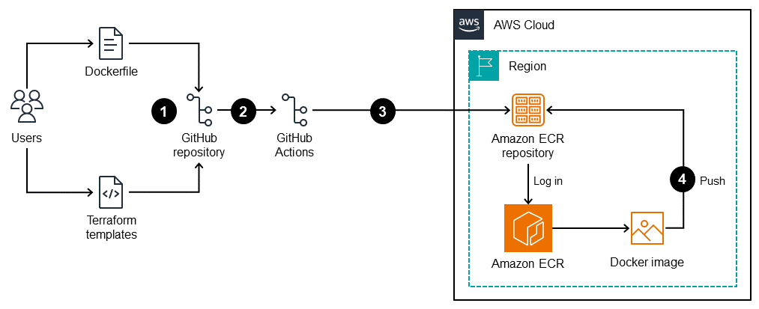
Deployment Pipelines – Compute Image Pipeline
The diagram illustrates the following:
A user adds a Dockerfile and Terraform templates to the GitHub repository.
These additions initiate a GitHub Actions workflow.
The workflow builds the Dockerfile and pushes the image to the Amazon ECR repository.

Slide 18
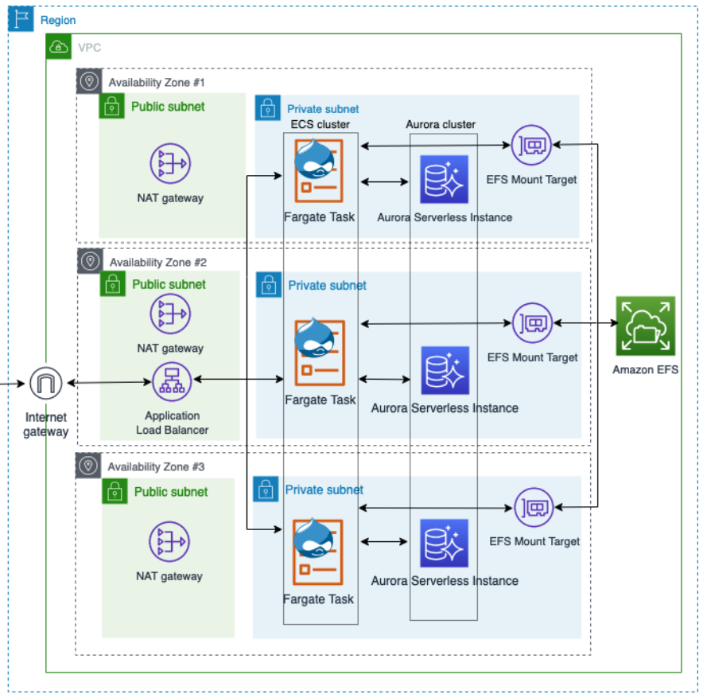
NCI AWS Ref. Architecture - Drupal on ECS / Fargate
The Application Load Balancer (ALB) that inspects the client request. Based on routing rules, the load balancer directs the request to an instance and port from the target group that matches the state.
A target group for each ECS Service. The target groups are used by the corresponding services to automatically register the service's IP address.
An Amazon ECS cluster that hosts the containers for each microservice.
An Amazon Virtual Private Cloud (Amazon VPC) network for hosting the Amazon ECS cluster and associated security groups.
An Amazon Elastic Container Registry (Amazon ECR) repository for each microservice.
A service or task definition for each microservice, which spins up containers on the instances of the Amazon ECS cluster.
ECS Service can automatically manage autoscaling with ECS Fargate based on task count and CPU utilization.

Slide 19
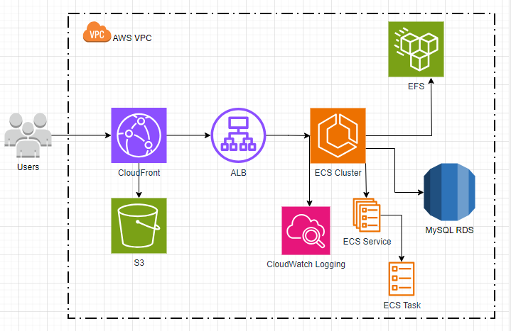
NCI AWS Drupal Ref. Architecture on ECS Fargate

Slide 20
NCI CBIIT Compute & Infrastructure Pipelines
Demo & Walk-thru

Slide 21
NCI Software Engineering
& Support
Presented by: Larry Brem & Team

Slide 22
Container usage in the Digital Services Center
Drupal Website Development
  Genomic Data Commons (GDC), Enterprise Vocabulary Services (EVS), BRIDG Model, Events Registration (soon)
Business Applications
  Electronic Individual Development Program (eIDP), Manuscript Review System (MRS)(soon), others
Analysis Tools
  mSigPortal
  Meythlscape
  Many others

Slide 23
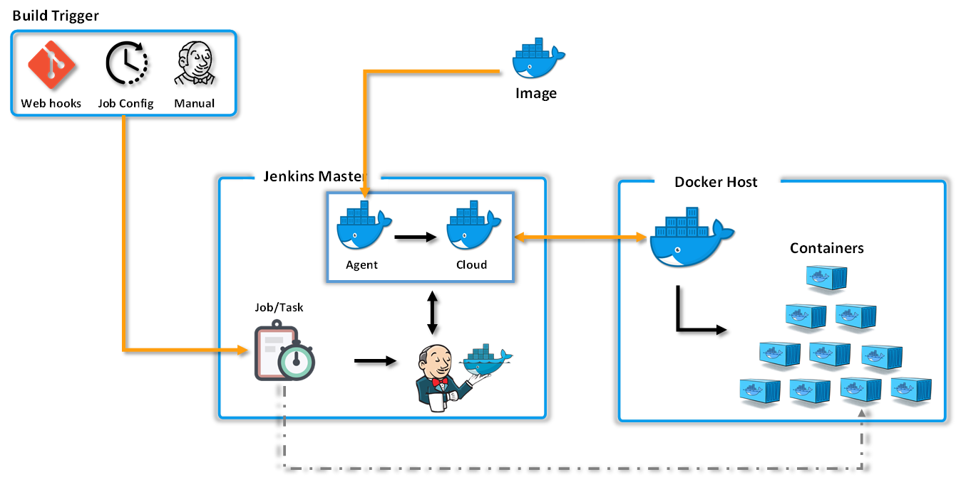

Drupal DevOps Jenkins/Docker Architecture
CBIIT CentOS
Drupal Image

Slide 24
Drupal Docker Container LAMP Stack
Amazon RDS Database Service (MySQL)
Drupal
PHP
Apache
AlpineOS
Docker
Amazon S3 File Storage
CloudOne(AWS)

Slide 25
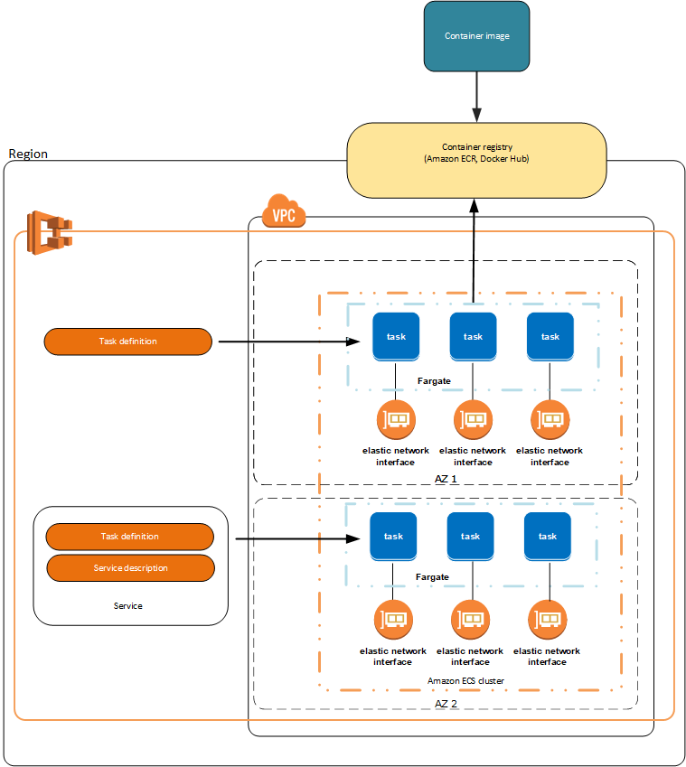
Drupal Amazon AWS Fargate hosting environment (CloudOne)
Drupal Docker images stored in Amazon ECR
Task Definitions used to build system environments on ECS in multiple tiers (DEV, STAGE, PROD)
Currently using one Availability Zone (AZ – Northern Virginia)
ECS will automatically replicate tasks to add more system capability when certain performance threshold is reached (ex: 70% CPU utilization create an additional task)

Slide 26
eIDP Technology Stack
  RDS PostgreSQL 14
  Amazon Corretto Java 11
  Tomcat 8.5
  Spring Framework 5
  Hibernate 5
  Bootstrap 3
  jQuery 3
Hosted in AWS
Deployed via Fargate
Multiple endpoints for some Institutes
  NIAID has their own instance

Slide 27
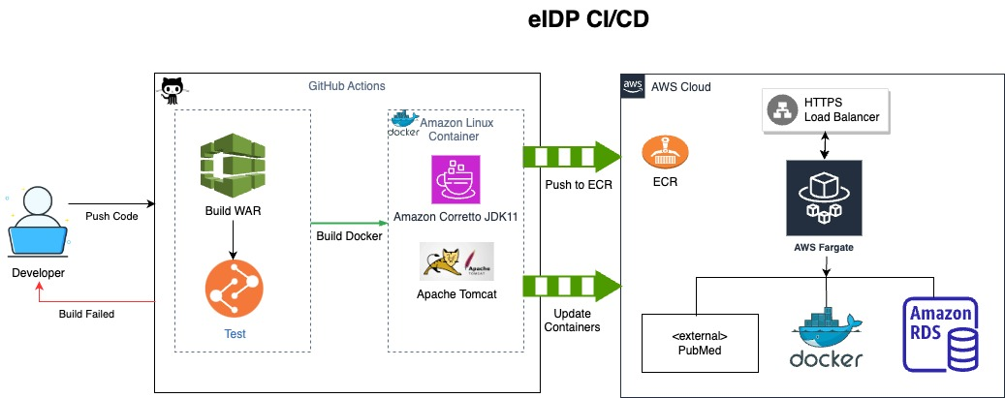
Java Containerization Example
Electronic Individual Development Program (eIDP)

Slide 28
Analysis Tools
All AWS based tools
Mix of technologies
Uses Jenkins for the CI/CD pipeline
Many use EC2’s, but moving more towards Fargate
Containerized Applications
mSigPortal
Methylscape

Slide 29
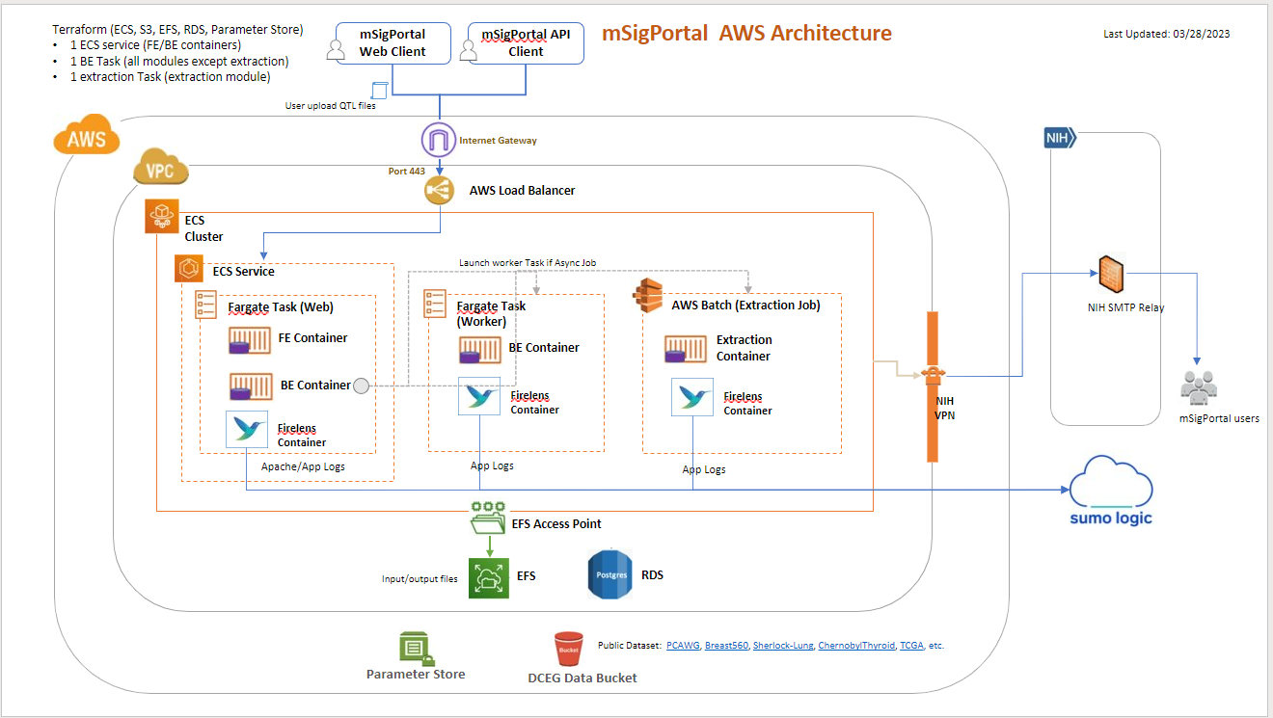
mSigPortal Architecture

Slide 30
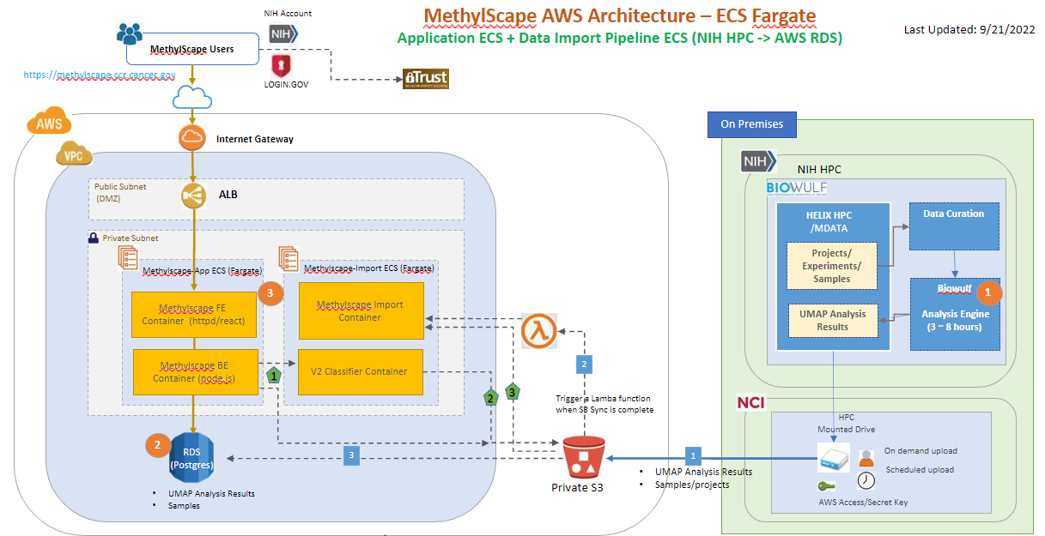
MethylScape Architecture

Slide 31
Question & Answer Session
CWIG: Use of Containers for Custom Software Development at the NCI for AWS Cloud and On-Premises

