Slide 1
(Im)patient Data Scientist
The Chasm Between Realities
Amanda J. Borens, MS Patient & Chief Data Officer at Aridhia Informatics
Cancer Research Data Exchange Summit
May 9, 2024
Notes:
Example title speaker slide

Slide 2
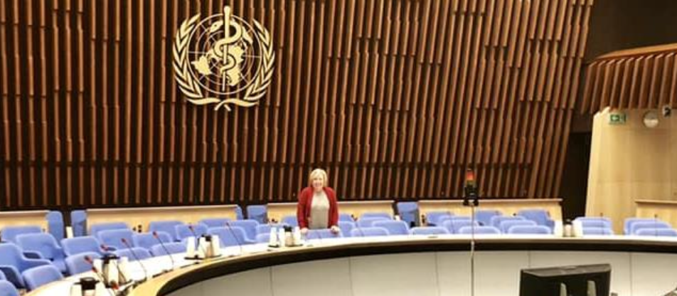
Background
DATA SCIENTIST with broad experience across 30 years
EHR development – anatomic pathology focus
Big Data - GIS and metagenomics research in ecology
Medical device development and trial
Global health platforms (WHO, FDA, EMA, PMDA) – trials, ‘omics, RWD, DHTs
Secure, cloud-based environments for hospitals and biotech

Slide 3
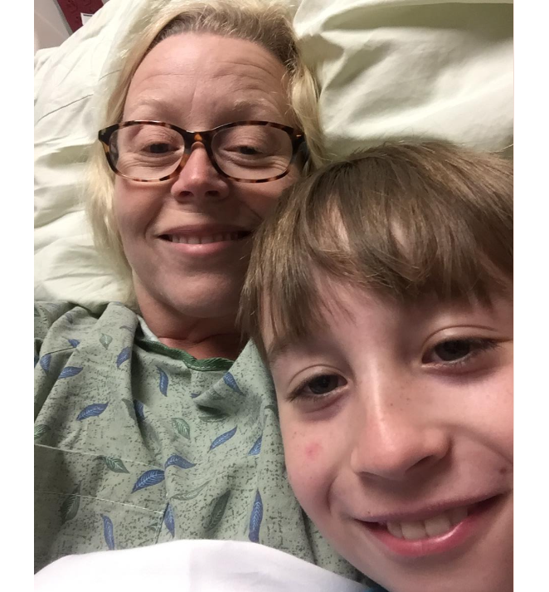
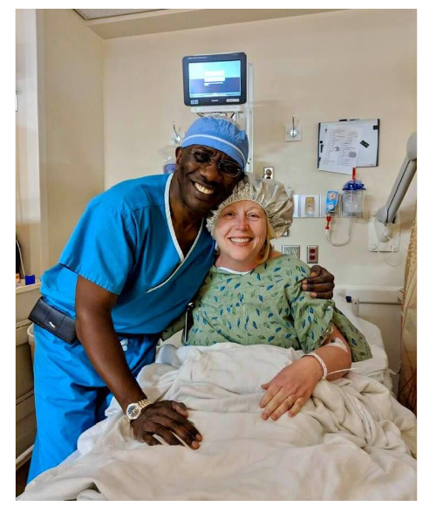
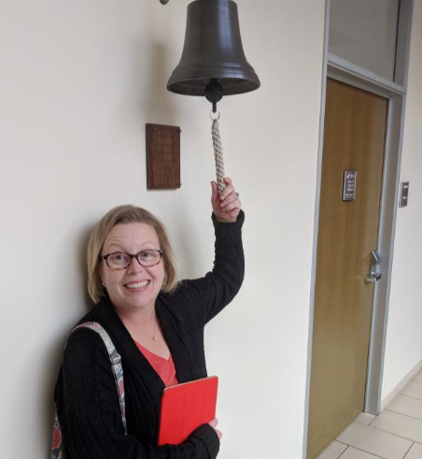
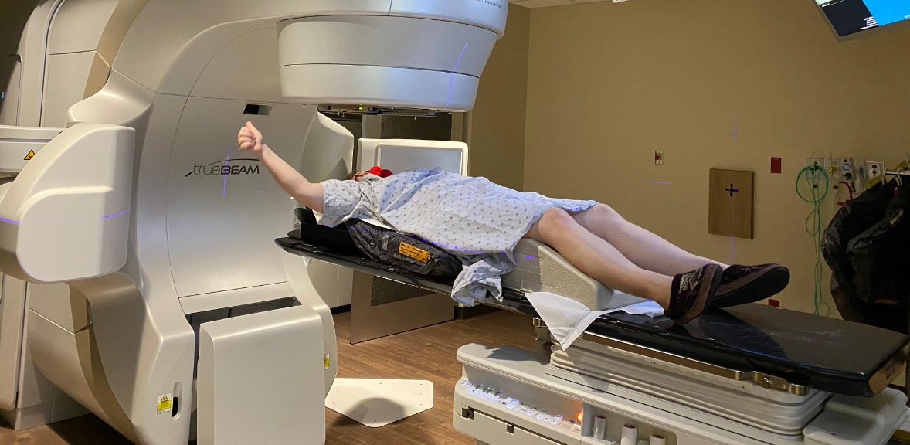
Background
PATIENT in cancer treatment 2017-present
Currently treated at 2 NCI-designated cancer centers, consultations at 3 other cancer centers across California, Arizona, and Texas
6 months FOLFOX, 12 months FOLFIRI, 3.3 years capecitabine
6 months hormone blockers, denosumab, ribociclib
4 weeks SBRT
3 major surgeries at 3 unaffiliated hospitals, 2 inpatient stays ~3 weeks
10 PET, 27 CT, 10 MRI, 3 x-ray, 6 ultrasound, 3 EKG, 1 ECG, 3 mammo
Miscellaneous specialists at various offices
Endocrinology, Gyn, Cardiology, PCP
Participant in three clinical studies

Slide 4
Chasm Between Realities

Slide 5
Expectations vs. Reality
25 years ago
terms like EPR, CPR, and broad interoperability were forecasted in 1998 – HL7 interfaces commonplace
20 years ago
Synoptic Reporting Module for CoPathPlus product at Sunquest in 2004
13 years ago
GIS systems for large habitat models in 2012 using my laptop (thinking GIS + EHR = magic)
12 years ago
metagenomics work shows molecular biology moves at warp speed with data sharing across continents

Slide 6
Expectations vs. Reality
7 years ago to present
TB platform enables sharing globally, even low-resource settings
Technology available to address ‘omics, imaging, TB of DHT data
Data aggregation from clinical trials and registries brings semantic challenges, but not so big as data quality issues
…and yet
As a patient, none of my expectations were met
RWD experiences on 2 grants were extremely disappointing

Slide 7
Frustrations as a Data Scientist
Lack of interoperability
Lack of longitudinality
Stale, single-use data sets (huge effort for one question)
”Repositories” will never tell us about corner cases, or how effective an intervention might be in low-income settings, and so on
Security and privacy prevents consistent access and processing
Estimation of bias, transparency are potentially compromised, esp. for things like imaging and notes when derived results are shared instead

Slide 8
Frustrations as a Patient
EHR systems primarily focused on individual result reporting and on billing/cost analysis – my billing codes are what gets paid
Within hospital: labs, AP, medications!, notes – uneven access, quality
Story of patient journey is not accessible from doctor offices, hospitals, pharmacies, community settings
What about patient genomics, liquid biopsies, tumor genomics, etc.?
Don’t get me started about ERRORS when records transferred
Clinical research is in a separate, unrelated silo
Why is it so hard for my clinician to see/find relevant info?
Why do I have to tell you the same thing so often – and you still get it wrong?

Slide 9
Exploring Proposed Solutions

Slide 10
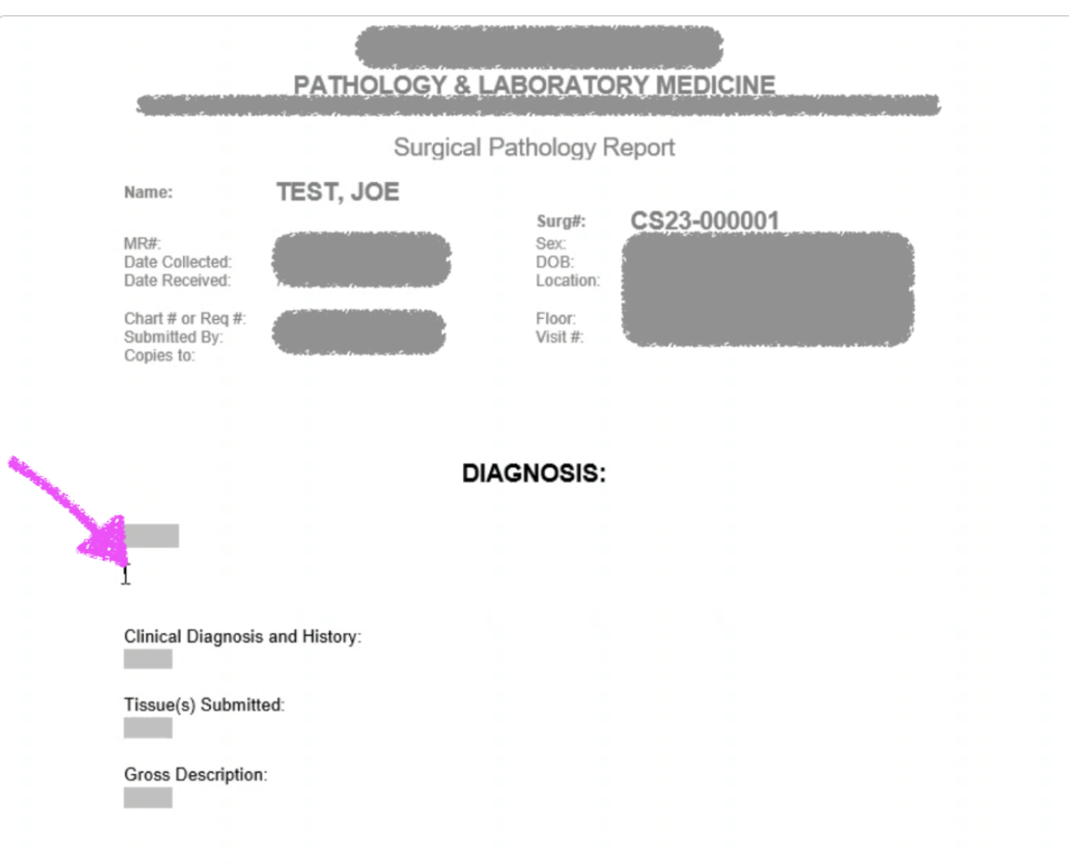
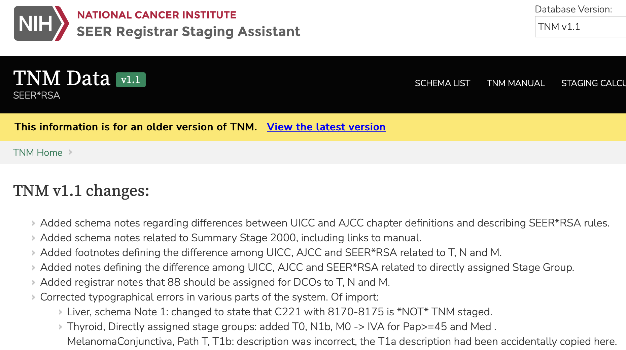
Standardizing Free Text

Slide 11
Standardizing Free Text

Slide 12
AI Tools to Deal with Free Text
AI tools such as machine learning, natural language processing
Automation of semantic tools such as metadata automation

Slide 13
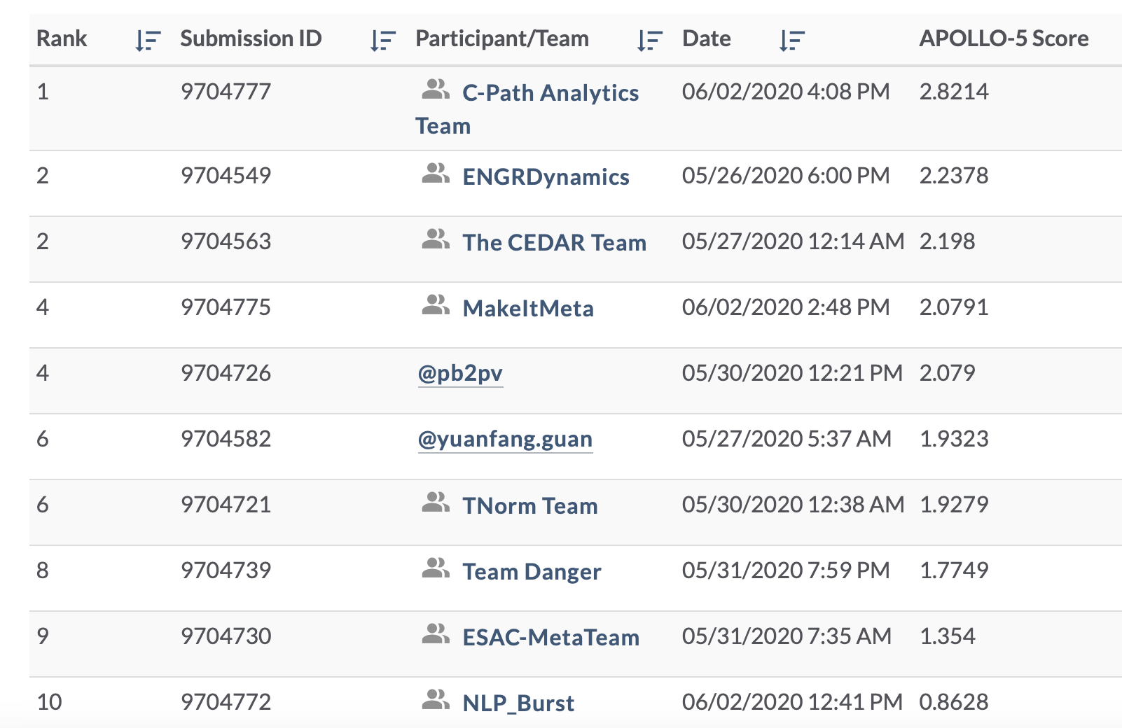

Slide 14
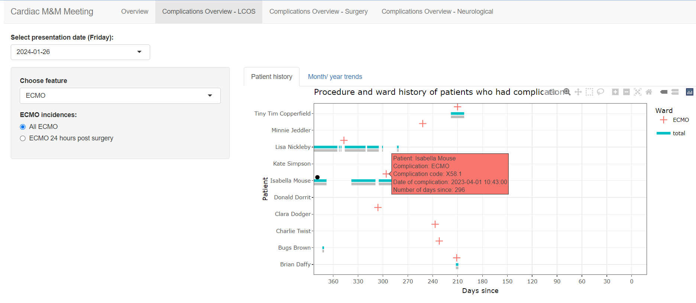
Clinicians and Researchers
Access to EHR for clinical researchers, dashboards for clinicians
Deeply phenotyped patients

Slide 15
Resetting Expectations
SHORT TERM
Repositories needed for now
Static datasets and steep preprocessing curve necessary
Also increase access for hospitals’ and clinicians’ collaborations across research and RWD across sites
LONG TERM
Work toward broad interoperability and longitudinality
Training for AI requires more than sampling of available patients
Dynamic and continuous, (near) real-time access to RWD
Patients should have access to a unified record!

