Slide 1
Working Together to Maximize Data Utility in Cancer Research
W. Kimryn Rathmell, M.D., Ph.D.
Director, National Cancer Institute
Cancer Research Data Exchange Summit
May 8, 2024
@NCIDirector​
@TheNCI​

Slide 2
My background in brief

Slide 3
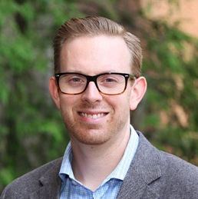
The Cancer Genome Atlas (TCGA):
Beyond VHL
Aguirre deCubas, PhD
Postdoc, Vanderbilt
Asst Prof MUSC
A. Rose Brannon, PhD
PhD student
Asst Prof MSKCC
Scott Haake, MD, PhD
Resident/Fellow
Asst Prof VUMC
Cell Rep. 2018 Apr 3;23(1):313-326.e5.
Mol Cancer Res. 2016 Jul;14(7):589-98.
N Engl J Med. 2016 Jan 14;374(2):135-45.
Oncoscience. 2015 Feb 20;2(2):81-90.
Mol Cell Oncol. 2015 Jan 20;2(2):e979686.
Cancer Cell. 2014 Sep 8;26(3):319-330.
Catherine Fahey, MD, PhD
MD-PhD student
Asst Prof UNC
Samira Brooks, PhD
PhD Student
(Postdoc NIH)
Amgen
Nature. 2013 Jul 4;499(7456):43-9.

Slide 4
Lessons
Value of team science
Seeing tumors for their more complete identity
Discovering new areas to do work (new doorways)
Nationwide effort
Many new collaborations
Developed a generation of scientists

Slide 5
Goals of the reignited Cancer Moonshot
Reduce U.S. cancer mortality rate by 50% by 2047
Improve the experience of people and their families living with and surviving cancer
www.whitehouse.gov/cancermoonshot
www.cancer.gov/moonshot

Slide 7
How NCI will fuel progress
Funding innovative research
Fostering tomorrow’s cancer research workforce
Engaging with collaborators and communities
Leaning in to the National Cancer Plan
– Everyone has a role

Slide 8
Examples of NCI efforts

Slide 9
Artificial intelligence applications in oncology
Modeling and interpreting features of target molecules – to accelerate drug discovery (e.g., KRAS protein interaction with cell membrane)
Extracting tumor features automatically from pathology reports – saving thousands of hours of manual processing
Automated detection of precancerous lesions from digital images
Identifying gene mutations from tumor pathology images
Image generated by AI.
Ongoing efforts are being led by NCI investigators and coordinated by NCI’s AI working group.

Slide 10
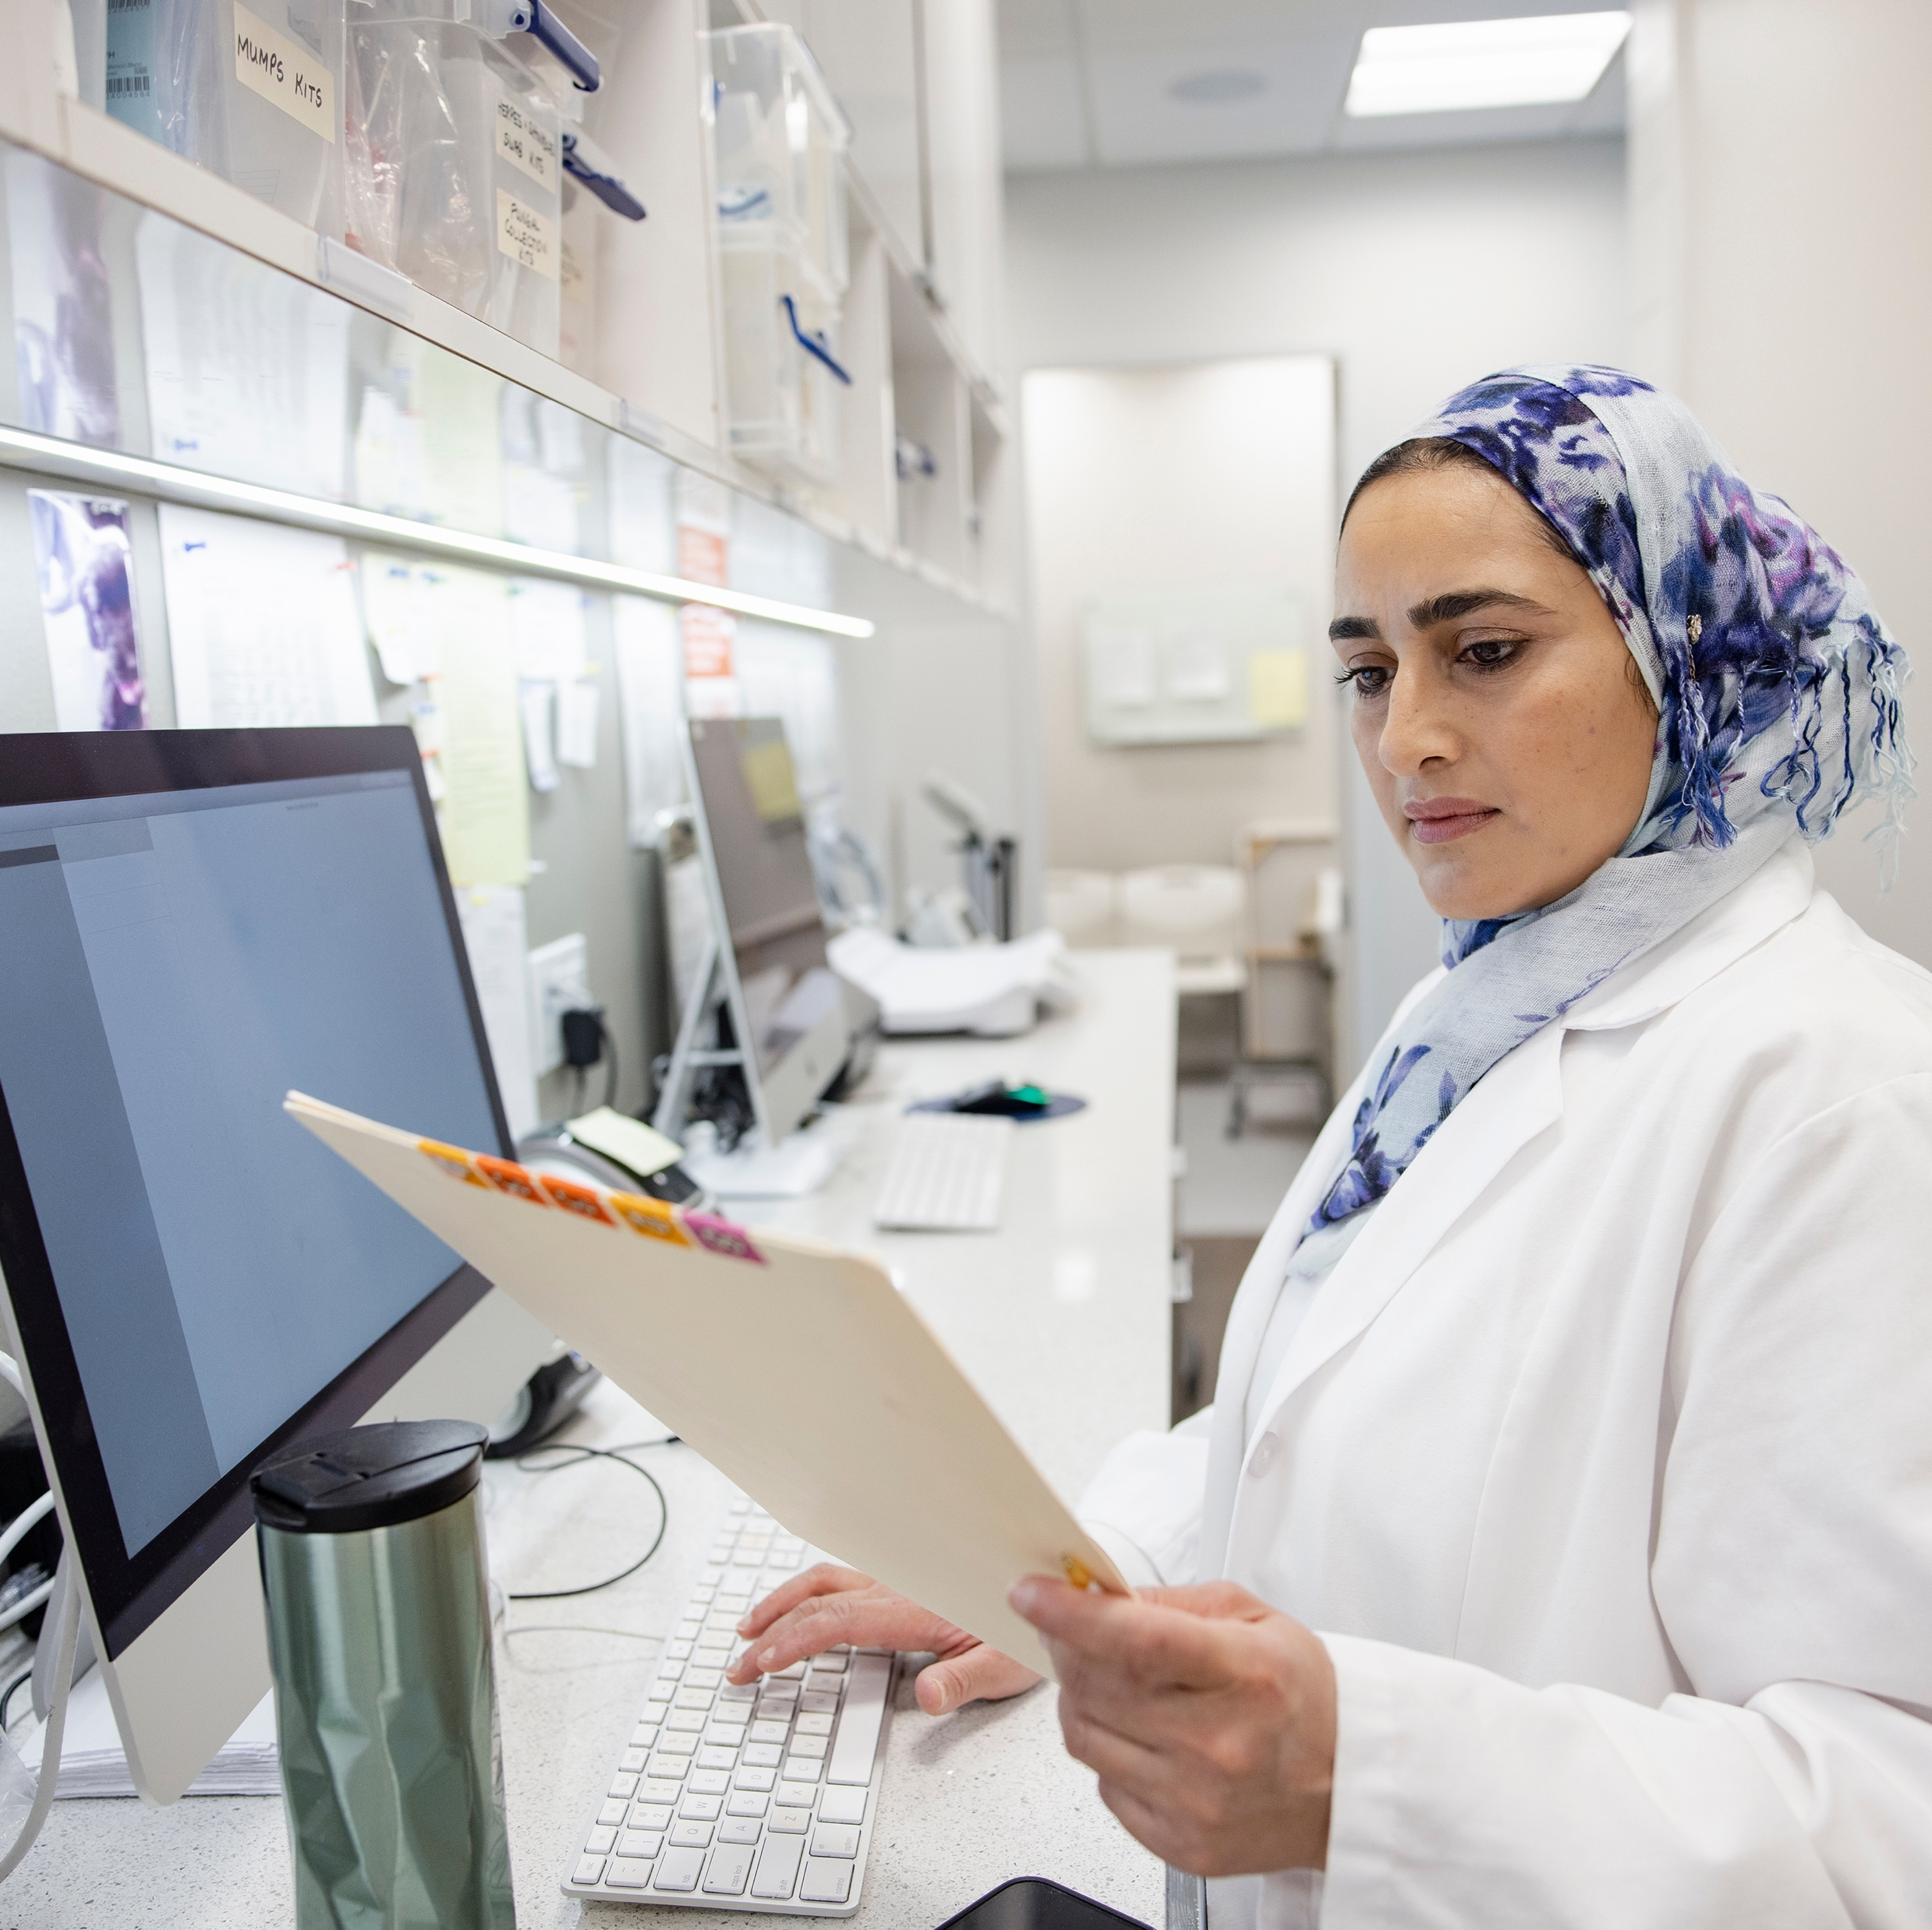
Transforming and modernizing clinical trials
Focus on essential endpoints
Cutting out unnecessary data collection
Virtual staff support
Broadening access, enhancing diversity and representation of participants
Partnering with government, industry, and academia
Including beneficiaries in research (e.g., self-sampling)
Notes:
NCI is leading efforts to transform the way we do clinical trials
These are some ‘principles’ or elements of innovation that we’re employing in these efforts. (don’t read all of them)
Remaining challenges to address:
Staff shortages, declining workforce
Low (and slow) participation in clinical trials
Participants still not representative enough of the real population
Collecting unused, unnecessary data (wasted time and resources)

Slide 11
Examples of NCI programs and collaborations that are maximizing data utility
USCDI+Cancer: United States Core Data for Interoperability Plus Cancer
CCDI: Childhood Cancer Data Initiative
CC-DIRECT: Childhood Cancer–Data Integration for Research, Education, Care, and Clinical Trials
CRDC: Cancer Research Data Commons
SEER: Surveillance, Epidemiology, and End Results program
…and more

Slide 12
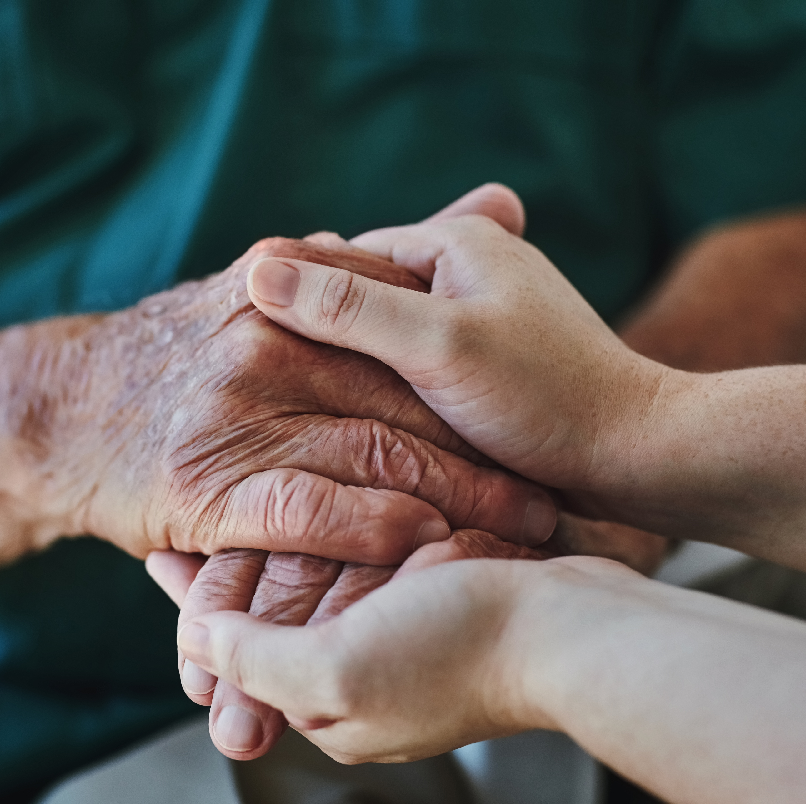
Closing thoughts
Our work is ultimately/always about people…
…both in terms of the workforce as well as our beneficiaries, the people whose lives we can change with our research and by maximizing data utility.

Slide 13
Thank You!

