Slide 1
Cancer Research Data Exchange Summit Session 2: Introduction to the use cases and user perspectives
May 8 – 9, 2024

Slide 2
USCDI+ Cancer
Office of the National Coordinator (ONC) has partnered with the National Cancer Institute (NCI), Centers for Medicare and Medicaid Innovation (CMMI), the Centers for Disease Control and Prevention (CDC), and the US Food and Drug Administration (FDA) to support the White House Cancer Moonshot Initiative by establishing USCDI+ Cancer.
USCDI+ Cancer aims:
Capture the data needs for Cancer reporting that fall outside the scope of USCDI.
Harmonize Cancer data elements into a common data element list that addresses multiple partner needs and use cases.
Support the integration of federal data systems.
Identify opportunities for policy alignment around Cancer reporting programs under existing authorities across Health and Human Services (HHS) agencies.

Slide 3
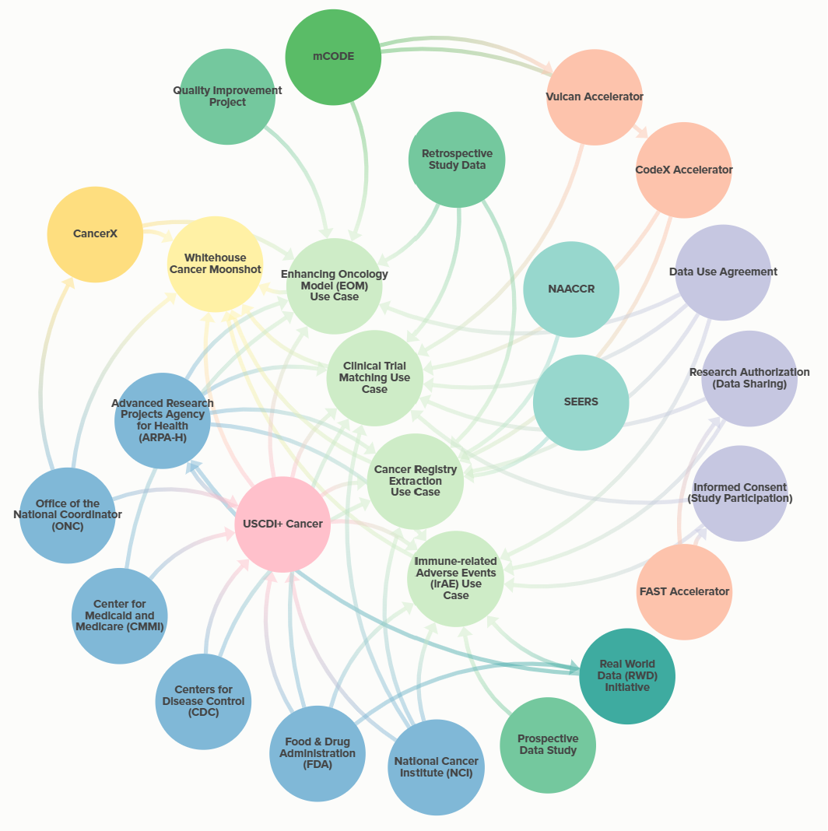
USCDI+ Cancer: Overview of Scope, Interested Parties, and Standards

Slide 4
Scope of Summit
Table of Contents

Slide 5
Scope of Cancer Research Data Exchange Summit Activities
Summarize Opportunities and Challenges: Identify opportunities, and challenges related to data collection, interoperability, and standards for advancing cancer research through data exchange
Align on Key Data Concepts: Clarify data needs related to cancer data for USCDI+ Cancer use cases
Leverage Data Standards and Methods: Consider existing data standards (such as FHIR, HL7, etc.) for cancer data and best practices for data collection and extraction methods
Ensure Alignment on Future State: Refine the desired future state for cancer data exchange, understand gaps between the current state and the desired future state and review approaches to filling them
Refine Data Collection and Exchange: Prioritize data elements based on their impact and feasibility
Explore Barriers and Enablers: Capture possible short and long term actions to address barriers to data collection and exchange
Develop a List of Existing Technologies: Identify technologies or requirements that address current barriers and enablers, considering both short-term and long-term solutions
Table of Contents

Slide 6
Data Element Evaluation Considerations
Immediate Opportunities: Data elements that can be implemented now. Consider the following criteria:
Importance to Workflow: Choose elements that directly impact the data flow of the use case
Electronic Query Availability: Select elements that can be queried electronically within the next 12 months
Alignment with Data Standards: Prioritize elements that align with or can be adapted to existing data standards (e.g., mCode, FHIR, or other data models)
Moderate to Longer-Term Availability: May involve FHIR/mCODE but require additional considerations:
Extraction from Unstructured Data: Some data elements may exist in unstructured formats (e.g., free-text notes, narratives). Consider how to extract and standardize these elements
Derived Elements: Elements derived from multiple sources (e.g., combining different levels of terminology) may be necessary. Define how to create these derived elements
No Mappings: Some elements may lack direct mappings to existing standards. Explore ways to address this gap
Aspirational Elements: Identify aspirational elements that align with long-term goals, even if they are not immediately feasible
Table of Contents

Slide 7
Use Cases
Table of Contents

Slide 8
Clinical Trial Matching Use Case Description
There is increasing evidence that patients on clinical trials, regardless of cancer type, have better outcomes. However, such life-saving potential is limited by the capabilities of healthcare teams and researchers to rapidly compare patient data and open protocols.
Given that a single patient may be eligible for multiple trials, having access to comprehensive patient data, along with a list of open protocols would enable both the care team and researchers to select the most appropriate therapy for the patient.
Evaluating and summarizing the clinical characteristics of a patient involves extracting and synthesizing multiple data concepts (e.g., tumor site, lines of therapy, disease status, etc.). To align these with standard protocols, they need to use a common format (e.g., FHIR) and lexicon (e.g., mCODE).
A multi-disciplinary team of informaticists, clinicians, and other experts is needed to build efficient and meaningful tools that extract key data concepts from the EHR and trial protocols so that care teams and researchers can select the most personalized treatment path for the patient.
Table of Contents

Slide 9
Immune-related Adverse Events (irAE) Use Case Description
Use of immunotherapies has benefitted patients with many different types of cancer; however, the adoption of these therapies has been tempered by immunologic toxicities or immune-related adverse events (irAEs). These toxicities represent a varied challenge in clinical practice and a steep learning curve to diagnose and manage. A cross-disciplinary approach is needed to understand and develop early detection methods for these irAEs.
The goal of this use case is for sites to capture Adverse Events (AEs), including Serious Adverse Events (SAEs), from participants in Phase I, II, and III clinical trials using the Electronic Health Record (EHR). Improving the quality, timeliness, and completeness of data will significantly improve the assessment of interventions by providing higher-quality and more timely information.
This use case will support the identification and development of data standards needed to appropriately capture irAEs. The scope of data sources for this use case will include EHR data as well as imaging, molecular, and pathological data to obtain the needed irAE data.
Table of Contents

Slide 10
Cancer Registry Use Case Description
The scope of this use case will include the Surveillance, Epidemiology, and End Results (SEER) program and the Centers for Disease Control and Prevention / National Program of Cancer Registries (CDC/NPCR) state cancer registries as well as the cancer registry standards organization, North American Association of Central Cancer Registries (NAACCR) that together play a critical role in understanding the burden of cancer in the US related to cancer incidence, first course of treatment patterns, mortality, and survival. In the current state there are delays in obtaining data from these sources, and available data can be up to 3 years behind the current year.
The objective of this use case is to enhance the efficiency and timeliness of the collection of cancer registry data by identifying standards (e.g. FHIR, mCODE, etc.) to efficiently extract and/or collect cancer registry data directly from EHRs and pathology labs at a level at a sufficient level of granularity that is interoperable with the cancer clinical, public health, and research communities. This USCDI+ Cancer use case will define the data standards and models needed for identifying and extracting required data as well as to support the current data sharing and linkage approaches for cancer registry data via SEER and CDC/NPCR.
With the advent of real-time reporting, we need to capture the minimum dataset through a FHIR query as early as possible that meets a certain quality standard to make the information usable.
Table of Contents

Slide 11
User Perspectives
Table of Contents

Slide 12
Data Journey Framework
Notes:
The Data Journey Framework begins at the clinic level, encompassing various tools and specialties that collect patient data. It traces this data from clinical settings to a data warehouse, through exchanges beyond the healthcare system, and into a data storage/lake where unstructured and structured data must be organized. The data is then extracted and transformed into a common data model (CDM). Finally, research-specific steps are taken to define and derive study-specific variables for the analytic dataset.

Slide 13
User Perspective Breakout Session Preparatory Questions
To meet the session goal, we want to understand how participants describe their role in the data journey and key barriers and enablers they have encountered in data collection and exchange.
What changes need to occur that will make your roles easier regarding data collection and exchange?
What are the biggest (a) barriers and (b) enablers with regard to the conformant and complete data collection and sharing for your perspective?
Barriers: structural, process, operational, technology (what or how), resources, financial, knowledge, regulatory, other?
Enablers: Leadership, Technologies, partners/allies, use cases, or other user perspectives?
How could USCDI+ help with (a) streamlining, (b) deduplication of pipeline/effort and (c) standardized collection of data?
What future state changes would improve your interactions with other perspectives? How might they change?

Slide 14
Types of Enablers and Barriers*
Structural: Related to systemic, institutional, or societal obstacles that impede individuals from participating in or benefiting from clinical studies.
Technical: Related to technology or technical capabilities necessary for cancer data extraction, exchange, transformation or use for cancer research.
Regulatory: Related to rules, laws, regulations, policies, or governance issues that affect cancer data extraction, exchange, and use for research.
Operational: Related to the day-to-day operation at the point-of-care that affect cancer data extraction, exchange, and use for research.
Cultural: Can operate at patient, provider and system level – These barriers may manifest because of social norms, stigma, mis- or dis-trust in technology or systems, language/literacy or basic beliefs or "entrenched practice".
Financial: Related to the funding, or financial incentives associated with cancer data extraction, exchange, and use for research.
Environmental Readiness: Related to the maturation and readiness of the healthcare environment associated with cancer data extraction, exchange, and use for research.
Other: Barriers or enablers that do not fall into any of the above categories.
Consider these questions to determine enablers & barriers
Why give attention to Enablers and Barriers?
What are the Enablers and Barriers?
When do Enablers and Barriers show up?
Where do we see Enablers and Barriers?
How to manage, mitigate, and/or prevent Barriers, and exploit Enablers?
Who can help manage Enablers and Barriers?
* We recognize there are many useful frameworks from systems, IT, or human factors engineering as well as implementation science, public health or health services research – we would like to remain inclusive and welcome feedback on best ways to consolidate feedback

Slide 15
Phone: 202-690-7151
Health IT Feedback Form: https://www.healthit.gov/form/ healthit-feedback-form
Twitter: @onc_healthIT
LinkedIn: Office of the National Coordinator for Health Information Technology
Youtube: https://www.youtube.com/user/HHSONC
Subscribe to our weekly eblast at healthit.gov for the latest updates!
Table of Contents

