Slide 1
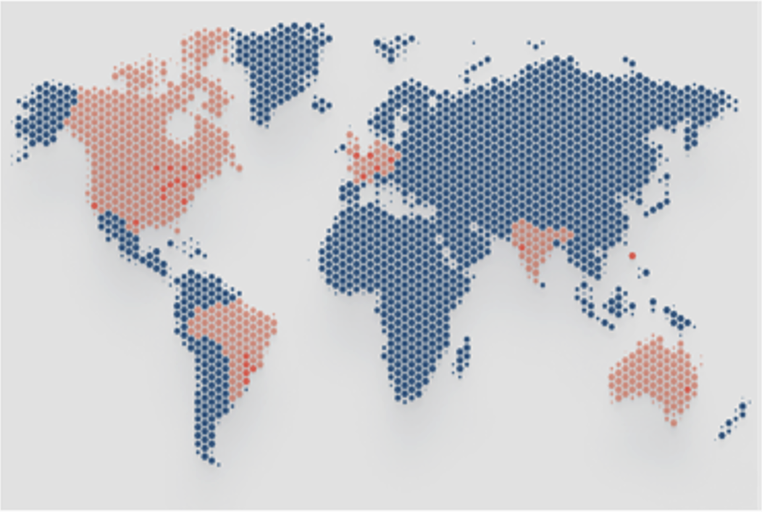
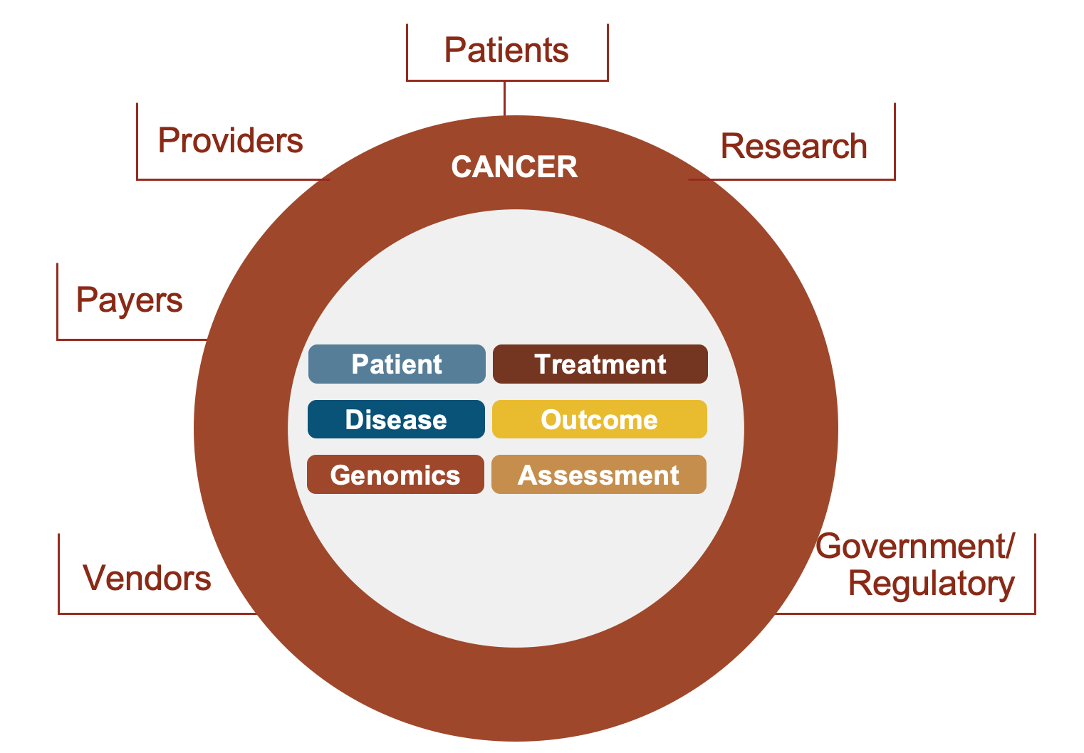
minimal Common Oncology Data Elements
FHIR-based core set of common data elements for cancer
Standardized, computable, clinically applicable and available in electronic health records for cancer patients
*countries in red exploring or actively adopting CodeX standards
50%
U.S. patient health records covered by mCODE consistent vendor systems
(in active development or already available)
80%
of North American radiation therapy sites have vendors adopting mCODE
*mCODE STU3: http://hl7.org/fhir/us/mcode/
*mCODE was co-founded by
©2024 The MITRE Corporation. ALL RIGHTS RESERVED Approved for public release. Distribution unlimited 24-01113.

Slide 2
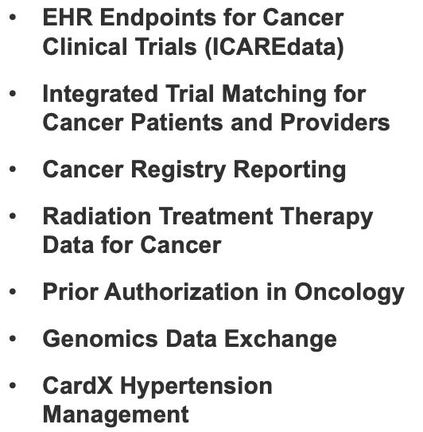
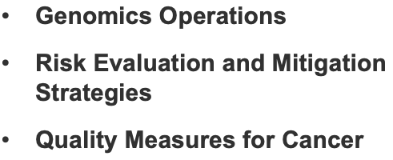
CodeX
Use Cases
An HL7® FHIR® Accelerator
We are a community dedicated to advancing clinical specialty health standards so patients have the care and research journey they deserve and should expect.
Better Data
CODEX DOMAINS:
Oncology | Radiation Oncology | Genomics | Cardiovascular Health
Better Health
©2024 The MITRE Corporation. ALL RIGHTS RESERVED Approved for public release. Distribution unlimited 24-01113.

Slide 3
Scale with Aligned Federal Initiatives
White House Cancer Moonshot initiatives leveraging mCODE:
ONC’s US Core Data For Interoperability (USCDI) + Cancer
CMS Enhancing Oncology Model
OSTP and ARPA-H noted CodeX and Vulcan as important partners in strengthening the nation’s clinical trial infrastructure
President’s Cancer Panel noted the importance of mCODE in recommendations for NCI’s National Cancer Plan
FDA championing CodeX REMS Integration Use Case
CDC’s use of mCODE for Central Cancer Registry Reporting IG
ONC included select mCODE data elements in their USCDI+ proposed Quality Data Element List
©2024 The MITRE Corporation. ALL RIGHTS RESERVED Approved for public release. Distribution unlimited 24-01113.

Slide 4
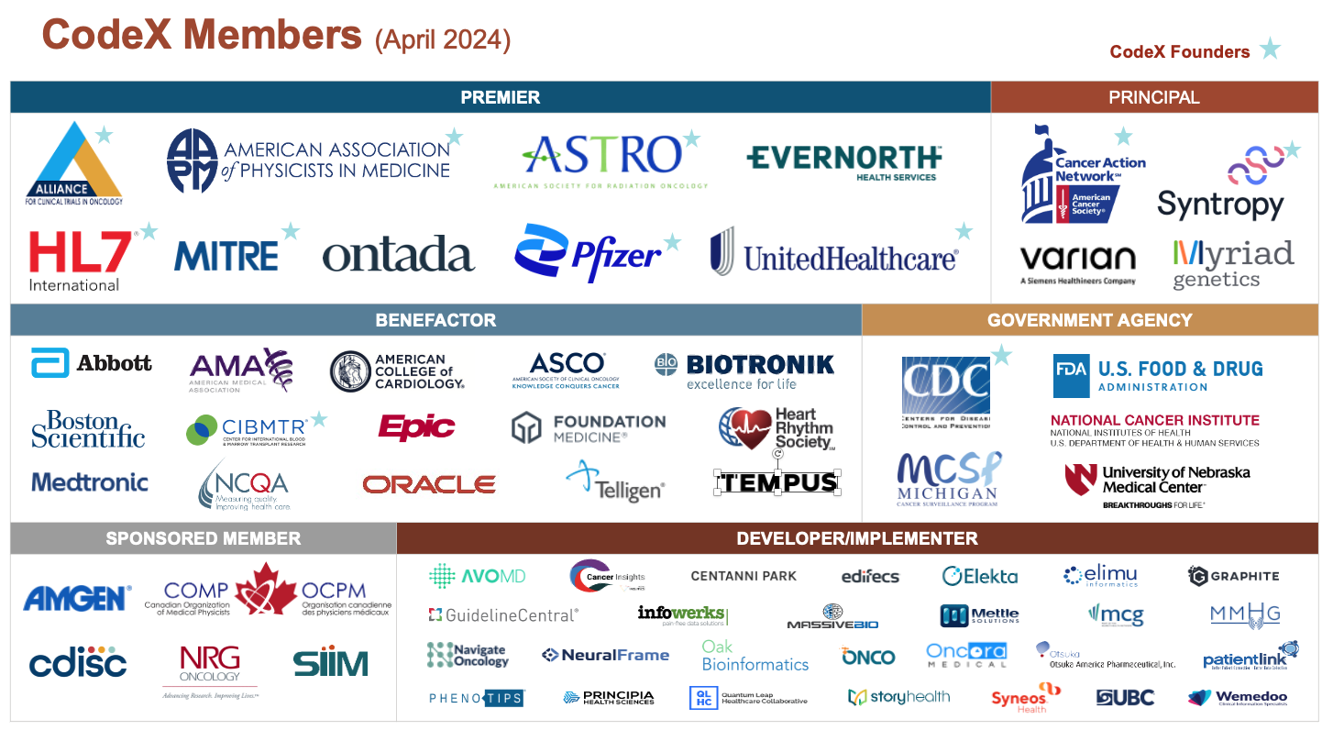
Join Us!
Build and Innovate on Our Work
GET ENGAGED
Attend Upcoming Events:
There are currently over 250+ stakeholders involved in CodeX. Spread the word and become a CodeX Member!
Share our site:
Become a Member:
email CodeX@hl7.org
EXPAND OUR REACH
©2024 The MITRE Corporation. ALL RIGHTS RESERVED Approved for public release. Distribution unlimited 24-01113.

