Slide 1
DRAFT PLENARY 1 & NOTES

Slide 2
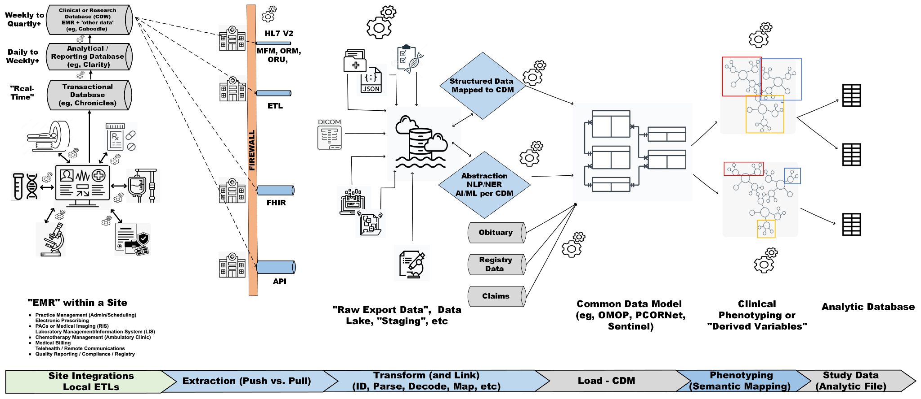
“Data Journey Pipeline”
Notes:
but is the lab sending these resources as a zip file via FTP, sending them as a binary data type embedded within an HL7 v2 message, sending them via HTTP (Restful) in some manner,

Slide 3
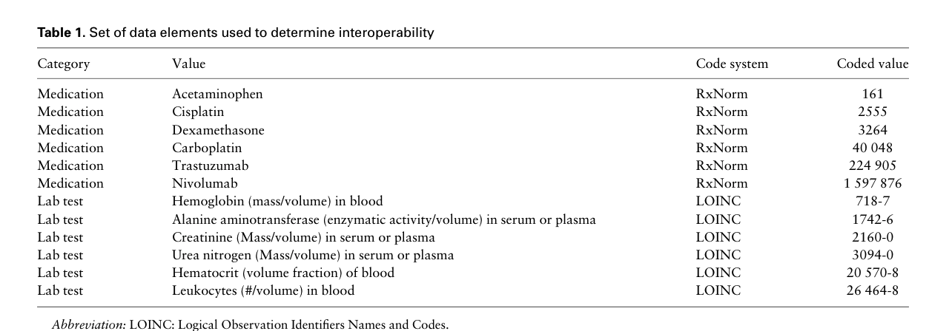
EMRs present both a Geography & a Language problem: Bernstam, 2022
CancerLinq: 68 sites, 12 data elements
EHRs represented Clarity/Epic, Allscripts, Aria/Varian, Centricity, Cerner, Intellidose, MOSAIQ, NextGen & OncoEMR.

Slide 4
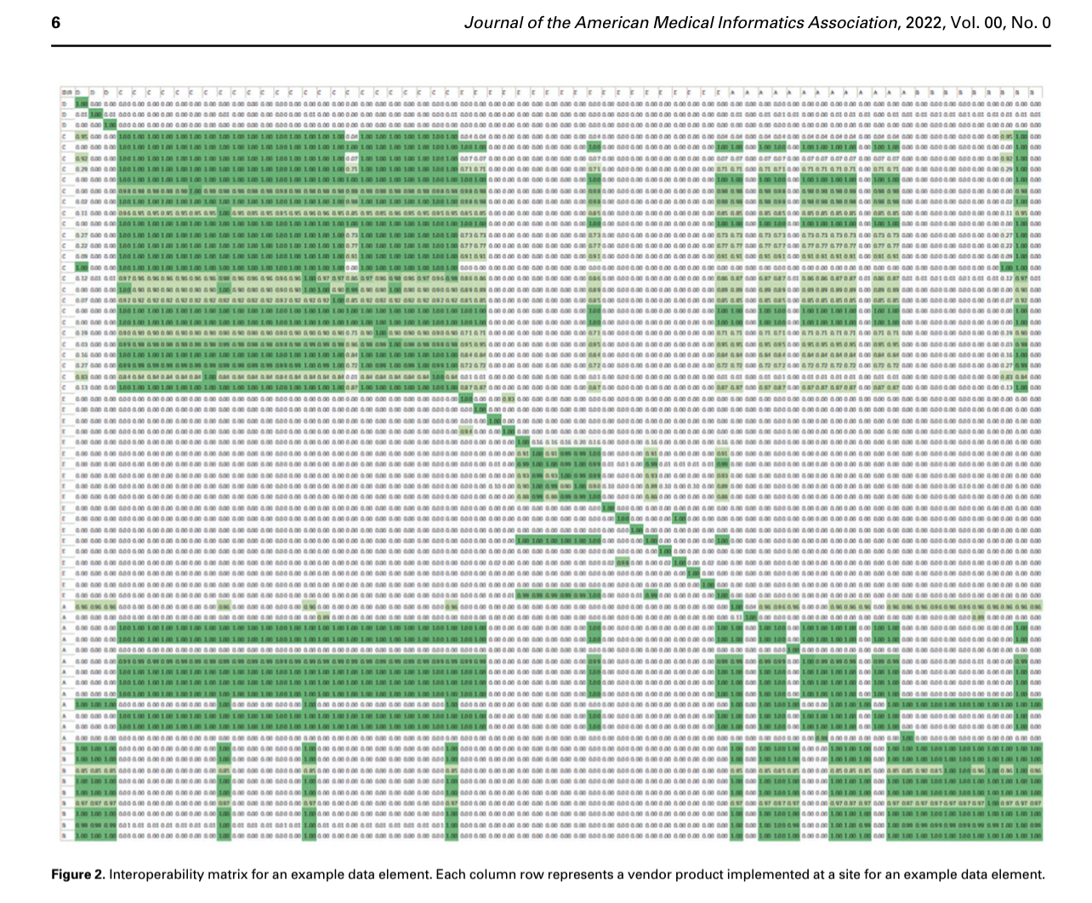
Need both Syntactic and Semantic Interoperability
Syntactic = Clustering within EMRs = Structure of where variable is located
Semantic = Clustering of match/choice of LOINC, RxNorm representation (or not!)
Overall Intra-vendor interoperability score was 0.68, compared to a mean of 0.22 for inter-vendor interoperability (weighted by number systems)
“In the most favorable case*’...approximately two-thirds of data types will be “understood” by a receiving site.”
Bernstam et al, 2022
Notes:
Figure 2. Interoperability matrix for an example data element. Each column row represents a vendor product implemented at a site for an example data element.

