Slide 1


Leadership Computing
Georgia (Gina) Tourassi, PhD
Computing and Computational Sciences Directorate
Oak Ridge National Laboratory
Presented at the Digital Twins Radiation Oncology (DTRO) Webinar
January 25, 2024

Slide 2
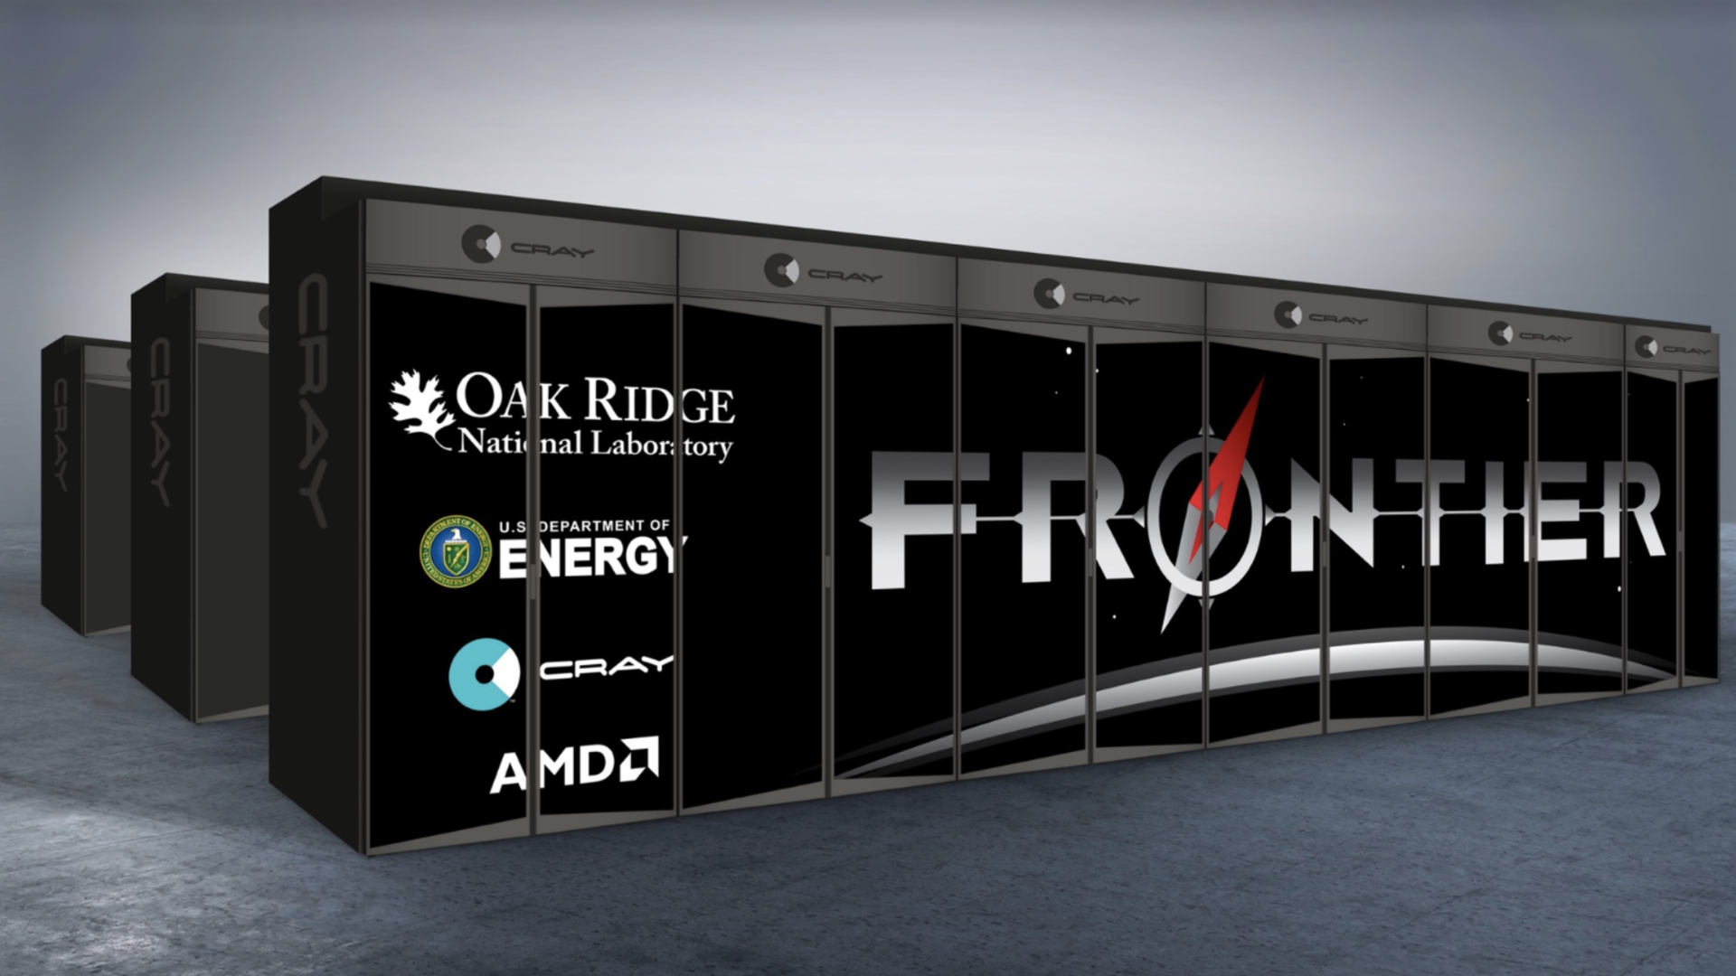
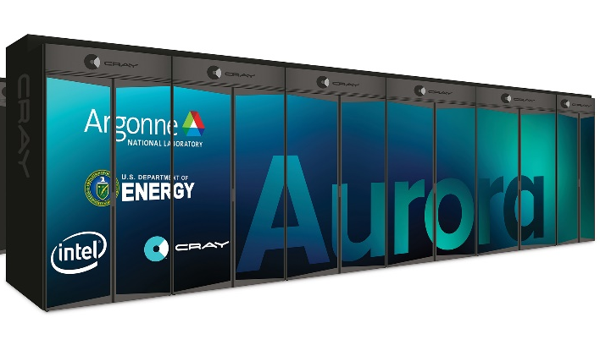
Leadership Computing Facility World leading capabilities spanning supercomputing, data analysis, & testbeds
OLCF
ALCF
Frontier: The world’s fastest supercomputer. HPE/AMD system, CPU/GPU heterogenous architecture with a peak performance of 1.6 exaflops.
Summit: A 200 petaflop IBM/NVIDIA CPU/GPU hybrid.
ATO for projects with PHI/PII/ITAR sensitive data: ORNL specializes in the design and implementation of innovative solutions for sensitive data.
ARM testbed: Fujitsu Arm SVE system with architecture similar to Japan’s Fugaku supercomputer.
Quantum testbed: OLCF has specialized IBM, Rigetti, and Xanadu hardware testbeds for studies to understand the classical/quantum computing interface.
Aurora: Available in 2023, HPE/Intel system, CPU/GPU heterogeneous architecture with a peak performance of 2 exaflop and 220 petabyte of storage; high-bandwidth memory (HBR) provides additional capabilities.
Polaris: A new 44 petaflop peak performance AMD/NVIDIA CPU/GPU system.
Theta: 11.7 petaflop Intel/Cray system, with an NVIDIA GPU extension.
Large scale data: Grand and Eagle, two 100 petabyte filesystems for compute campaigns and data sharing.
AI Testbed: ALCF’s AI testbed owns Cerebras, Samba Nova, Groq, Graphcore, and Habana Gaudi systems to prepare for post-exascale data/AI/ML needs for DOE.

Slide 3
OLCF by the Numbers
50% University
40% Federal
10% Industry
1,744 annual users 25 countries | 262 institutions 40 states | 175 industrial projects in the past 5 years | 5,700 peer-reviewed publications

Slide 4
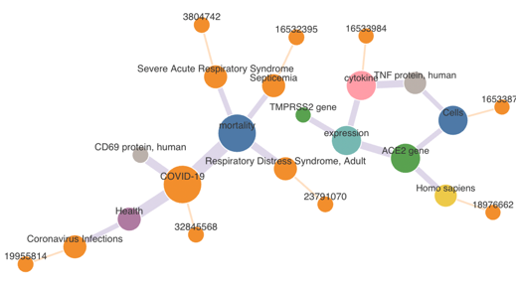
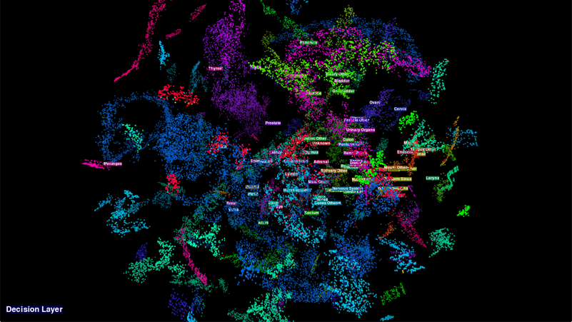
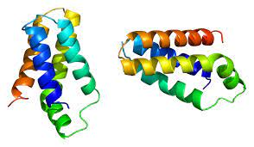
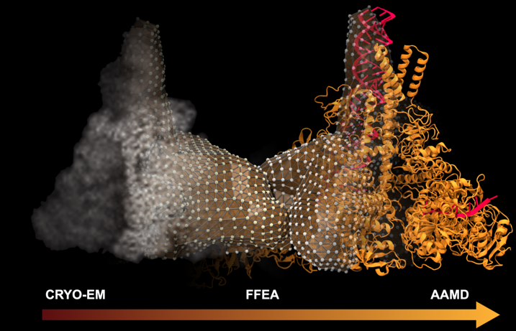

LCF enabling biomedical research
Fast-tracking Medical Discovery
Cancer Detection
Distributed Accelerating Semiring All-Pairs Shortest Path algorithm, or DSNAPSHOT, uses AI to pinpoint potential links amid millions of medical concepts across decades of scientific publications
Frontier – Gordon Bell Award 2022 Finalist
Researchers at Stonybrook U developed a multi-objective neural network that can speed up cancer pathology research on a huge scale.
Summit
Cancer Surveillance
Predicting Protein Targets and the Molecules that Bind with Them
Development and deployment of AI-based NLP tools to improve information extraction from textual pathology reports. The project is part of a DOE–NCI collaboration that is accelerating research by merging cancer data with advanced data analysis and HPC.
Summit and Frontier
TwoFold’s New AI Methodology Promises to Accelerate the Drug Discovery Process for Novel Viruses Like COVID-19. TwoFold provides two predictions at the same time: protein folding and molecule (or ligand) folding (hence its name).
Frontier - Gordon Bell Special Award 2022 Finalist
SARS-CoV-2 Reproduction
Quantum Computer–NLP
To study the SARS-CoV-2 replication transcription complex, the team built an integrated workflow that models the experimental Cryo-EM volumetric data as a finite element mesh.
Summit - Gordon Bell Special Award 2021 Finalist
Researchers developed a new quantum computer–based artificial intelligence (AI) approach for accelerating NLP applications.
QCUP/OLCF

Slide 5
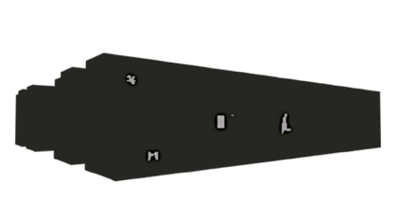
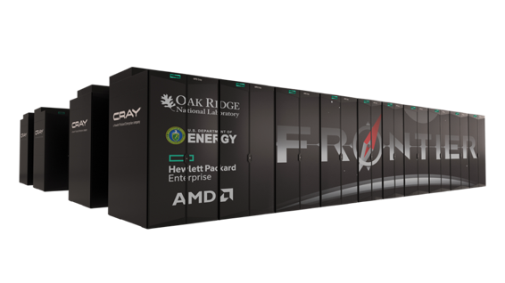
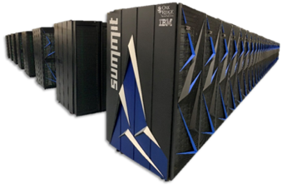
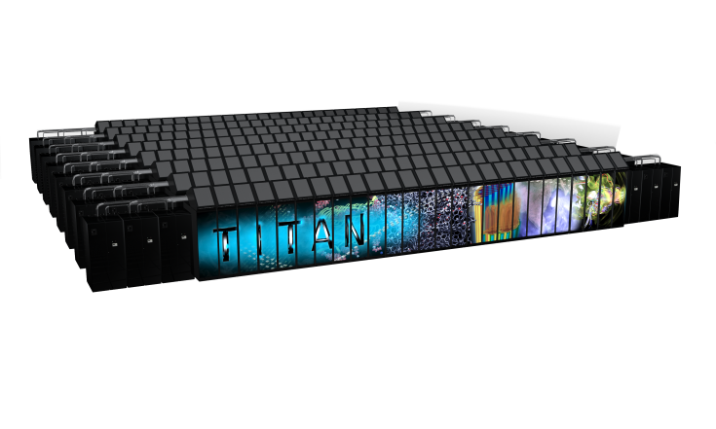
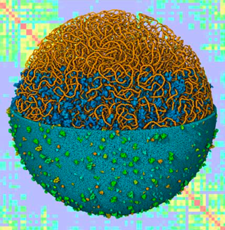
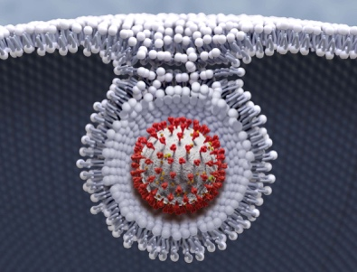
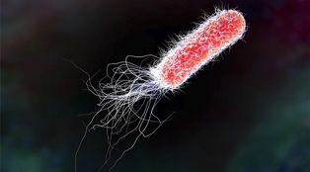
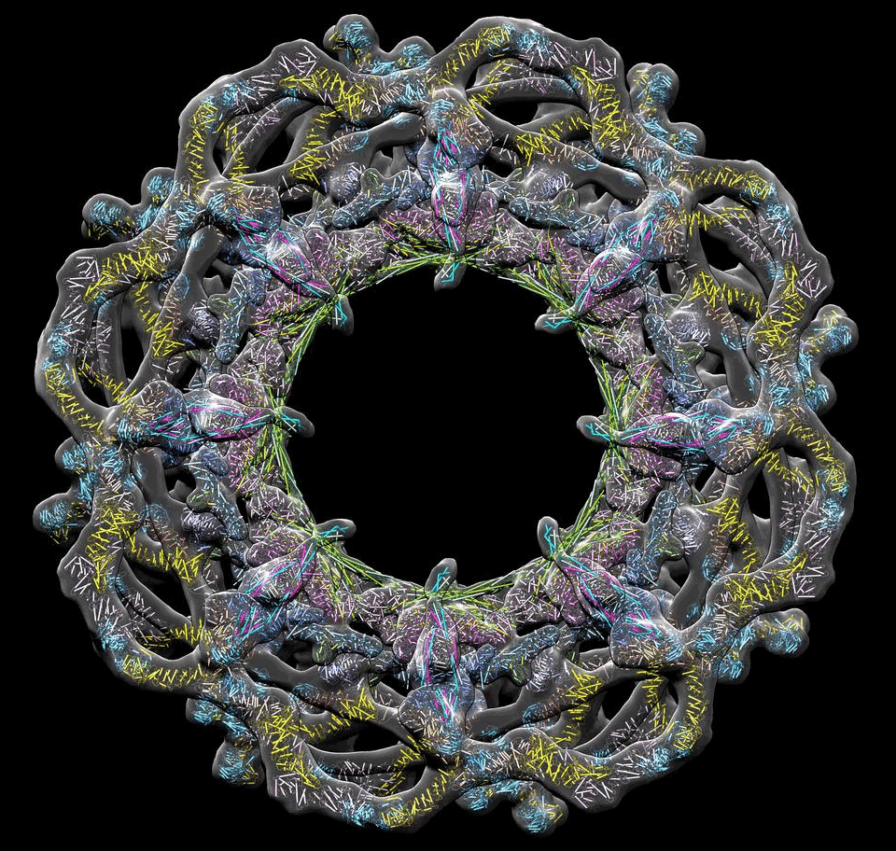
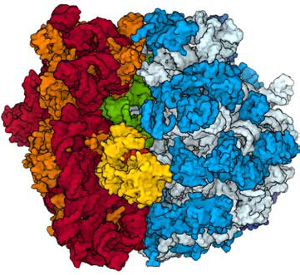
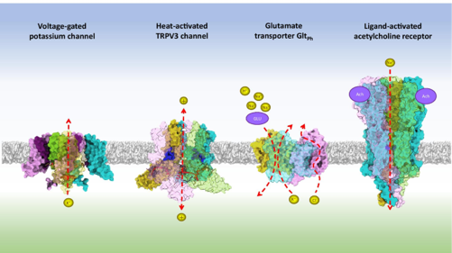
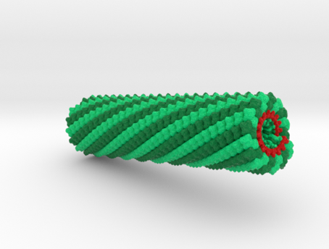
Leadership Computing is Improving Time to Insight
Better antibiotics
OLCF6
Frontier
Summit
Titan
Bacterium
10¹¹ atoms
COVID-19
10⁹ atoms
The nuclear pore complex10⁸ Atoms
The ribosome
10⁷ atoms
Tobacco mosaic virus
10⁶ atoms, 2006
Ion channel
10⁵ Atoms, 2000

Slide 6
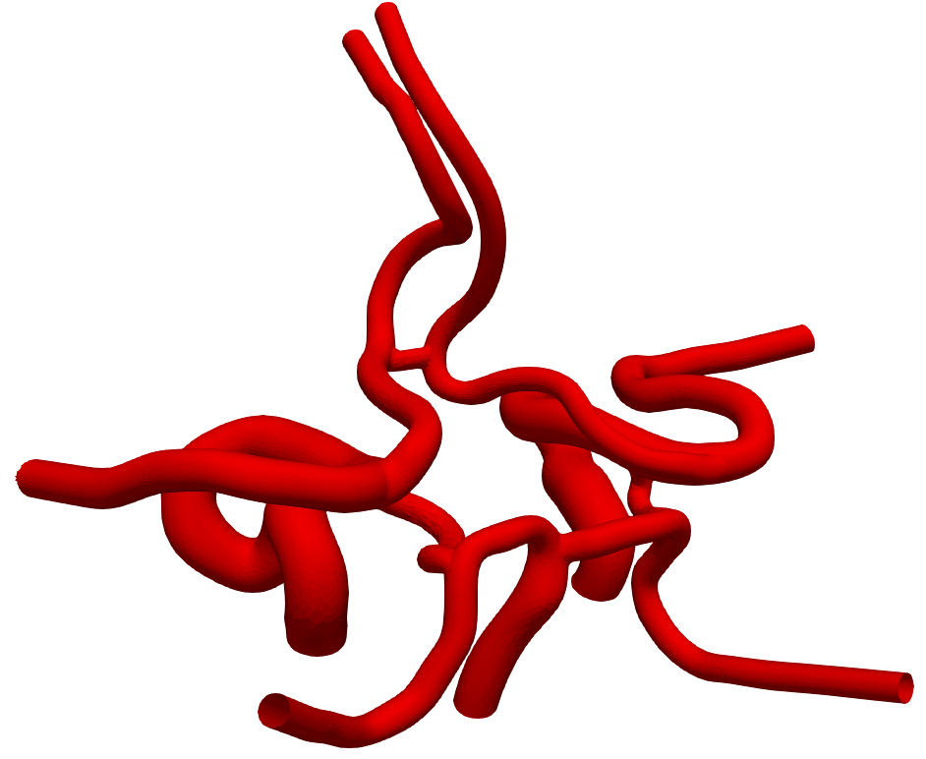
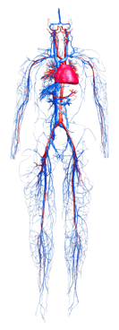
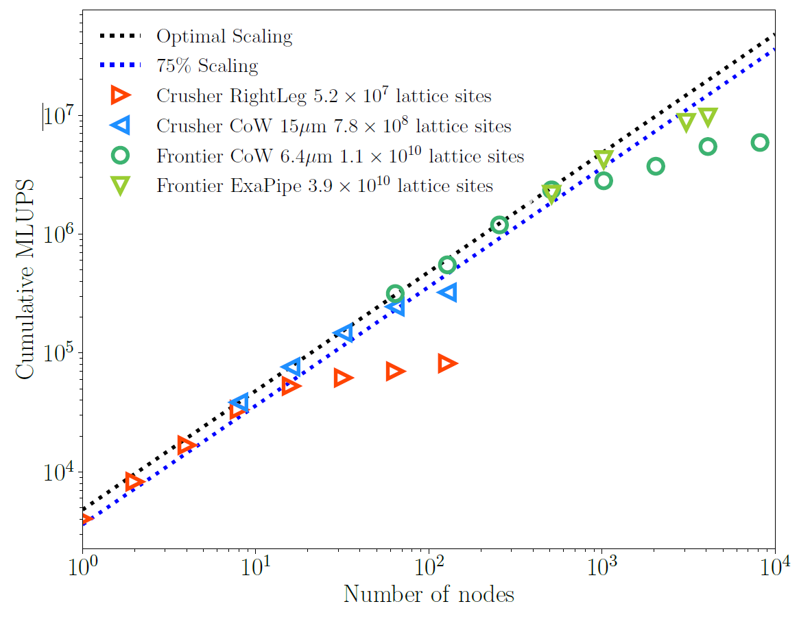
Leadership Computing Enabling Digital Twins Research
Increase in bandwidth & memory will improve the fidelity of human scale simulations of blood flow paving the way to human digital twins for personalized medicine
Frontier
OLCF-6
Summit
Full Human Simulations at High resolution
(≤25μm) using coupled models
INCITE Teams and PIs:
Peter C. Coveney (UCL)
Amanda Randles (Duke University)
Circle of Willis structure in the brain
(McCullough et. al)
Titan
Simulations of blood flow on Titan, Summit and Frontier provide insight into relevant medical scenarios: stroke, stents, cell transport etc.
Frontier is on the cusp full human scale simulations with realistic resolutions
OLCF-6: high resolution simulations of blood flow in humans coupled with models of other organs such as the heart.
Aorta Geometry
(Herschlag et. al)
C.o.W 6.4μm
C.o.W 15μm
Performance of HemeLB code on Frontier
courtesy of P.V.Coveney, S. Lo, J. McCullough, X.Xue,
I. Zacharoudiou, UCL
Performance of HARVEY on Titan
from A. Randles, 2021 OLCF UG Keynote
Herschlag et. al. IEEE TPDS 2021
Full human vasculature
(Yoon-sun model)

Slide 7
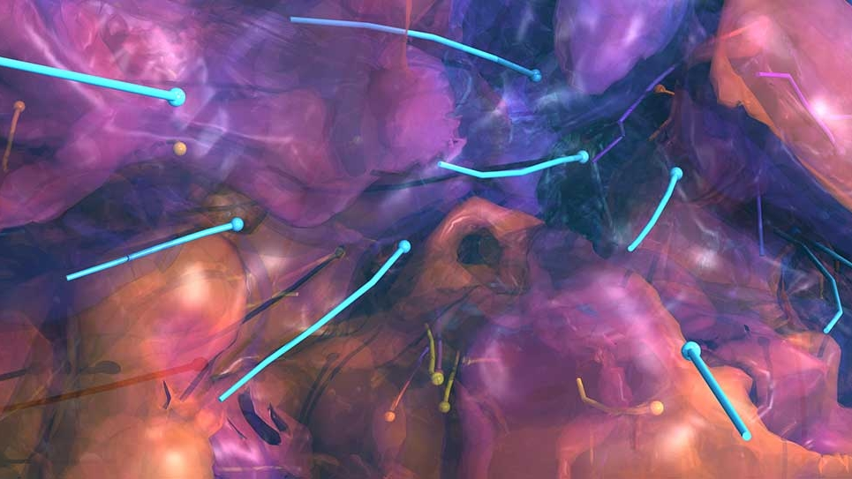
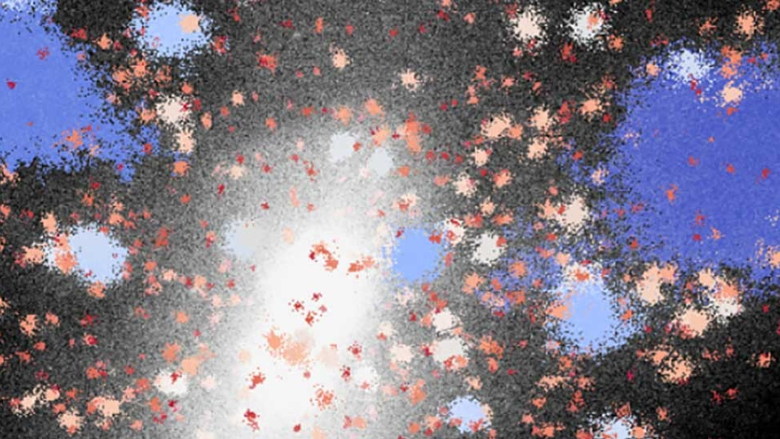
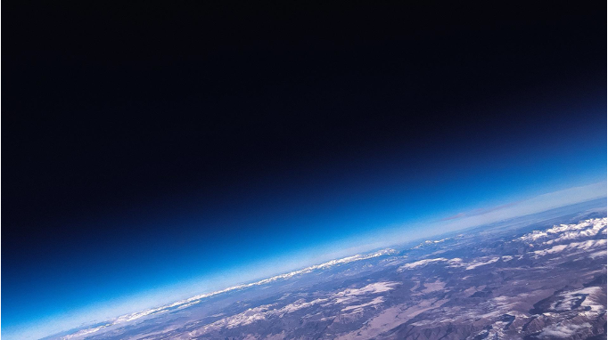
LCF Allocation Programs
INCITE
ALCC
DD
The INCITE program receives 60% of the available LCF hours annually.
Anyone can apply, worldwide
Successful applicants get liaisons to help them reach their science goals.
The deadline for INCITE proposals is typically in June.
https://www.doeleadershipcomputing.org/
The ALCC program receives 30% of the available LCF hours annually.
Anyone can apply, worldwide
Successful applicants get liaisons to help them reach their science goals.
The deadline for ALCC proposals is typically in January.
https://science.osti.gov/ascr/Facilities/Accessing-ASCR-Facilities/ALCC
The DD program receives 10% of the available LCF hours annually.
Anyone can apply, worldwide
Suitable for new investigators, new scientific endeavors to prepare for more competitive allocation programs.
Continuous application.
https://my.olcf.ornl.gov/project-application-new
https://www.alcf.anl.gov/science/directors-discretionary-allocation-program

Slide 8


Thank you tourassig@ornl.gov

