Slide 1
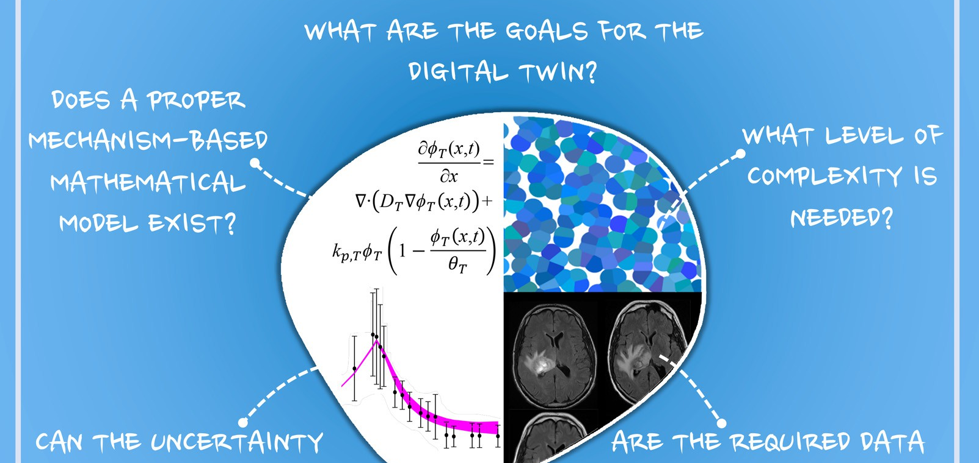
Digital Twins in Radiation Oncology: Applied Mathematics and THE Department of Energy
erhtjhtyhy
Wu, et. al. Biophysics Rev. 3, 021304 (2022); doi: 10.1063/5.0086789
Francis j alexander
Argonne National Laboratory
Presented at the Digital Twins Radiation Oncology (DTRO) Webinar
January 25, 2024

Slide 2
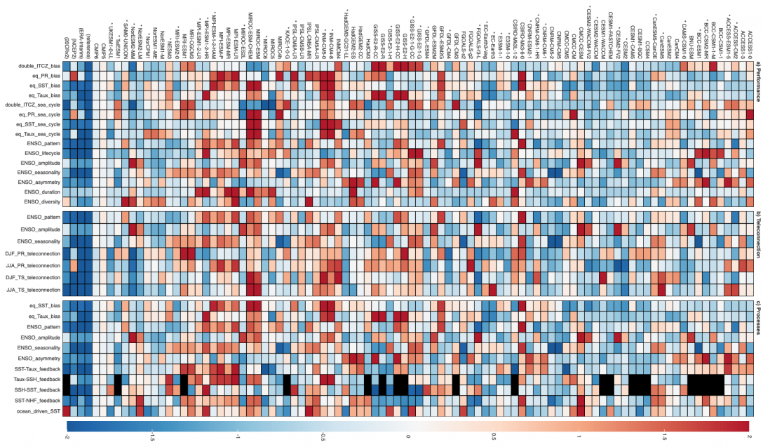
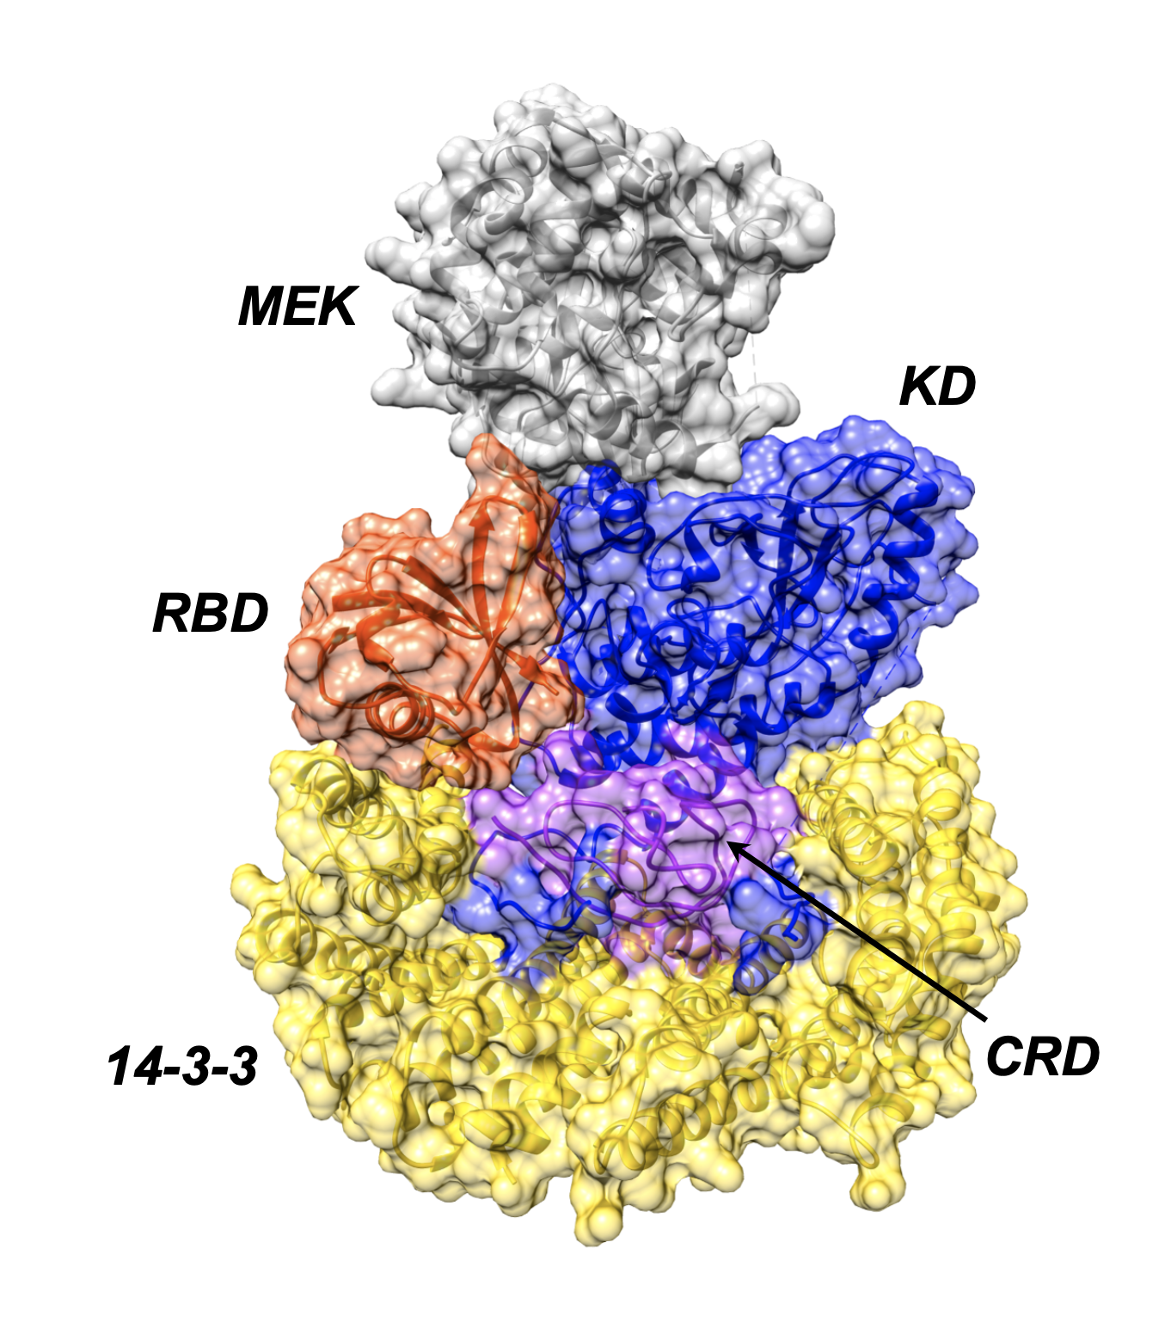
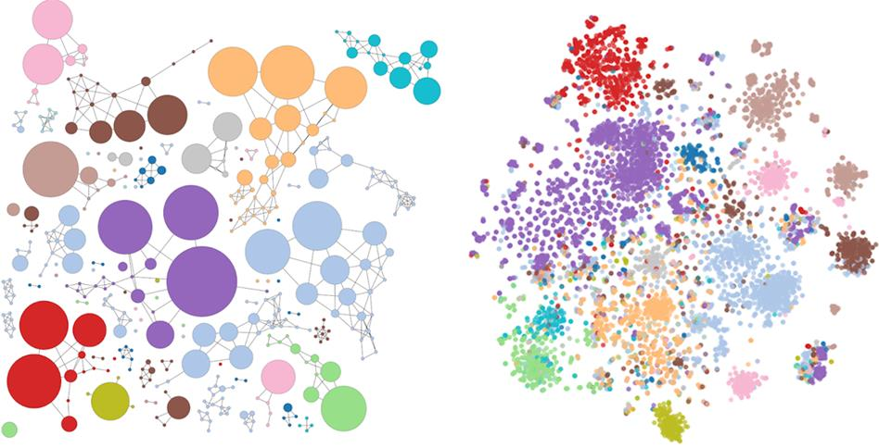
NCI-DOE hAVE A HISTORY OF WORKING TOGETHER on AdvanceD Cancer Research Using Computing
A collaboration between the Department of Energy and the National Cancer Institute
IMPROVE
Innovative Methodologies and New Data for Predictive Model Evaluation
Rick Stevens (ANL)
Ryan Weil (FNLCR)
Jeff Hildesheim (NCI)
ADMIRRAL
AI-Driven Multiscale Investigation of RAS-RAF Activation Lifecycle
Dwight Nissley (FNLCR)
Fred Streitz (LLNL)
MOSSAIC
Modeling Outcomes using Surveillance data and Scalable AI for Cancer
Lynne Penberthy (NCI)
Gina Tourassi (ORNL)
NCI
National
Cancer
Institute
Computing
driving cancer
advances
DOE
Department
of Energy
Cancer driving
computing
advances
Notes:
Pilot 1: Predictive model of drug response; UQ and improved experiment; develop hybrid (mechanistic/ML) models
Patient derived xenographs or cell lines
Pilot 3: Information capture; Information integration; Population-level modeling

Slide 3
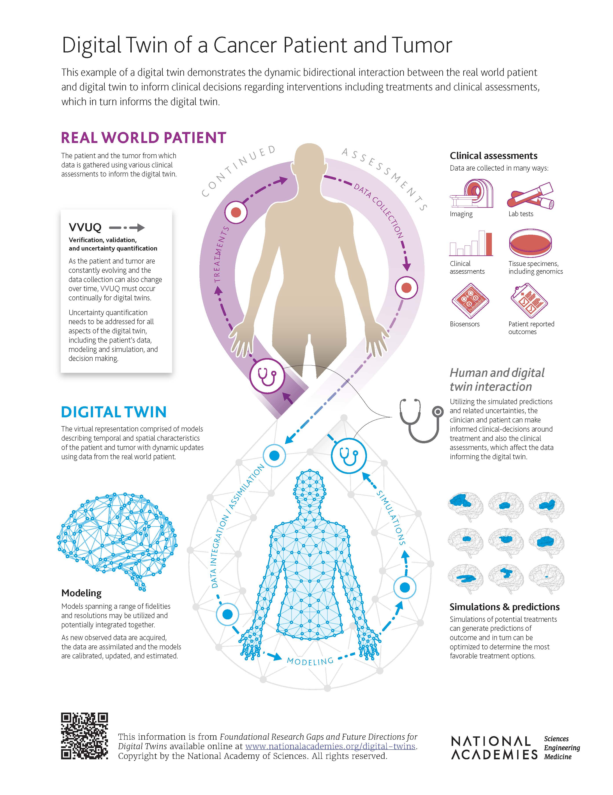
National Academy Study of Biomedical Digital Twins
A digital twin is a set of virtual information constructs that mimics the structure, context, and behavior of a natural, engineered, or social system (or system-of-systems), is dynamically updated with data from its physical twin, has a predictive capability, and informs decisions that realize value. The bidirectional interaction between the virtual and the physical is central to the digital twin.

Slide 4
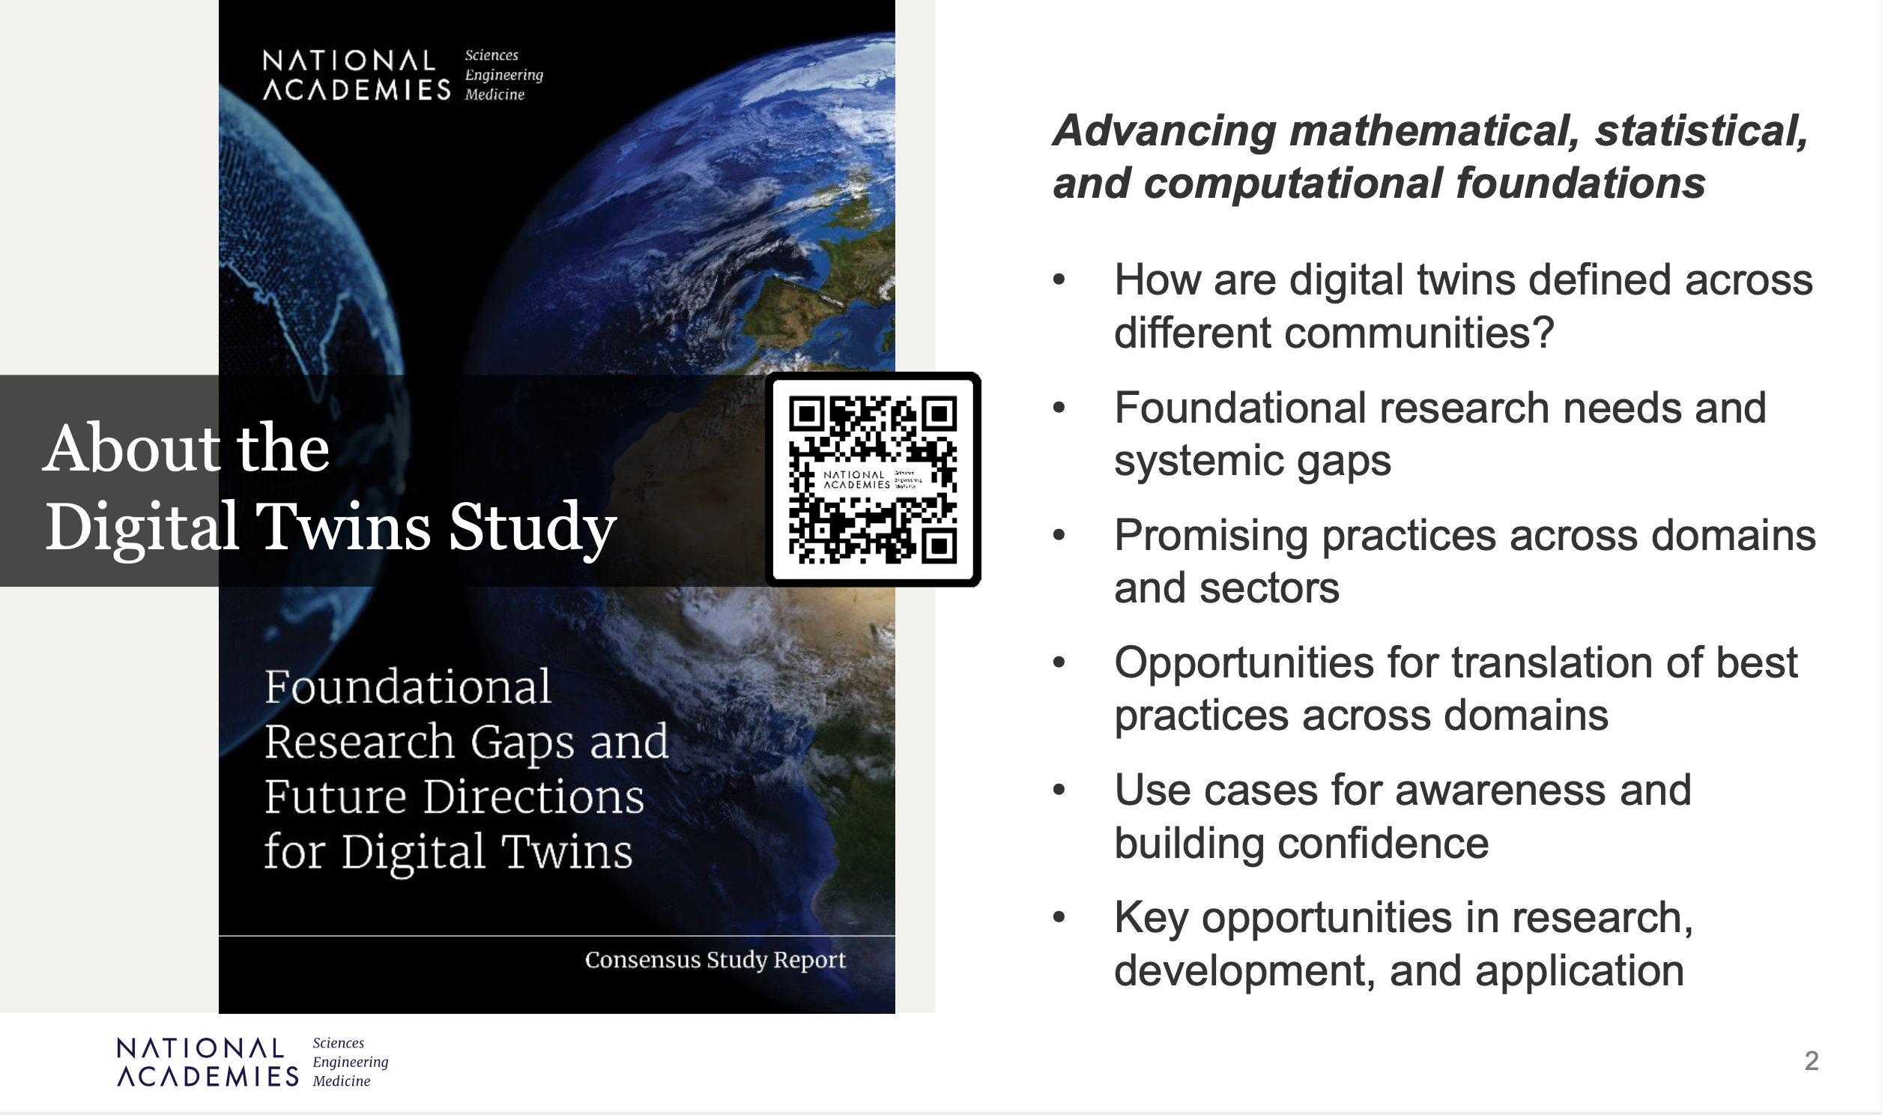
NASEM consensus study
Sponsored by DOE, NSF, NIH, DOD
Committee chaired by Karen Willcox
Outcomes:
  48 gaps
  22 findings
  19 conclusions
  8 recommendations

Slide 5
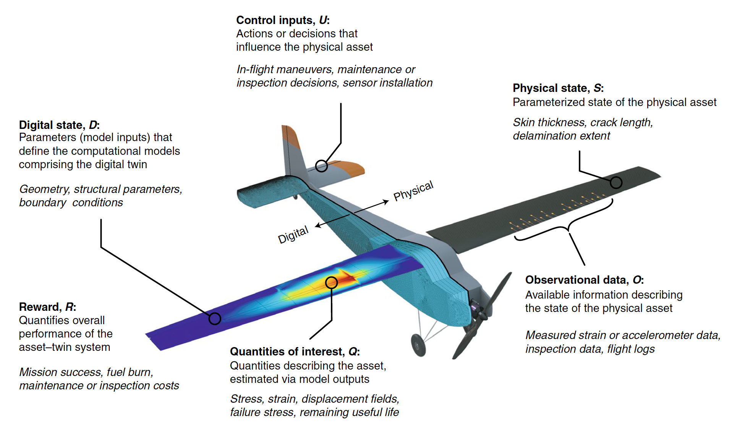
Quick overview of digital twins
A mathematical abstraction of a digital twin and its associated physical asset
Digital asset
Physical asset
Kapteyn, Pretorius, Willcox. Nature Computational Science, 2021.

Slide 6
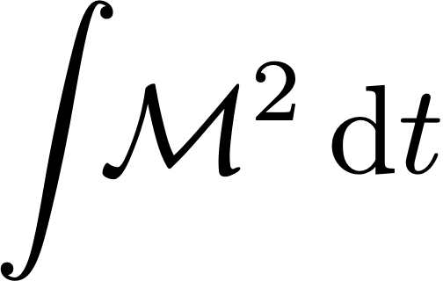





Mathematical Multifaceted Integrated Capability Centers Program (MMICCs)
Advanced Scientific Computing Research (ASCR)
Department of Energy
M2dt: Multifaceted Mathematics for Predictive Digital Twins
Center Co-Directors: Omar Ghattas & Karen Willcox
Notes:
Lab/uni logos are grouped together. Can ungroup (Arrange -> ungroup)

Slide 7
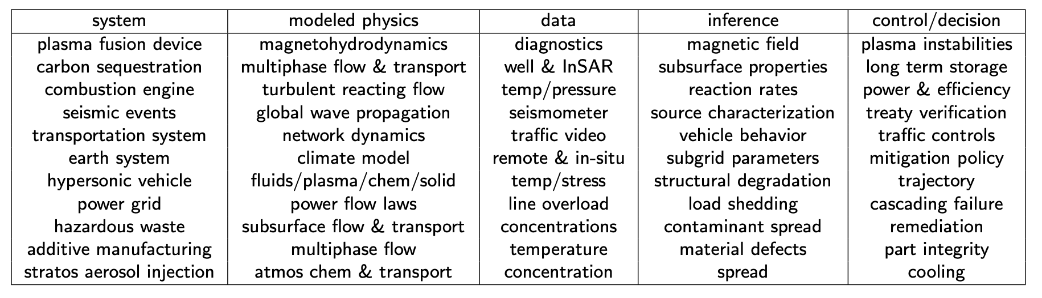
Many digital twin applications across the DOE …
DIGITAL TWINS PART OF DOE AI INITIATIVES

Slide 8
Some of the integrated multifaceted mathematical challenges…
Tight, dynamic interplay between computational models and physical systems: dynamic data assimilation and optimal decisions
Real-time operation
Uncertainty quantification for high-consequence decisions in complex systems
  Data assimilation
  Optimal control/decisions under uncertainty
  Optimal experimental design
Real-time and UQ settings demand reduced order/surrogate models that are structure-preserving, goal-oriented, and predictive over parameter, state, & decision spaces
Heterogeneity of data sources that must be assimilated
Multiphysics coupling of target systems, including coupled multifidelity models
Adaptivity of System (Cancer)

Slide 9
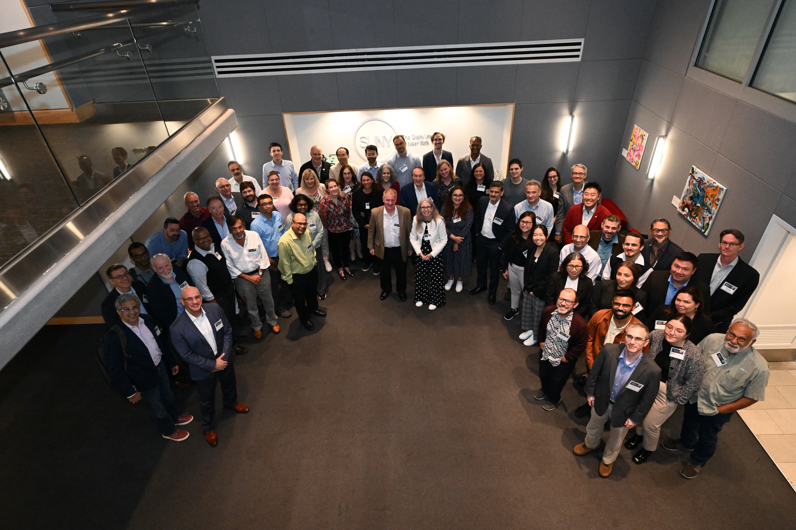
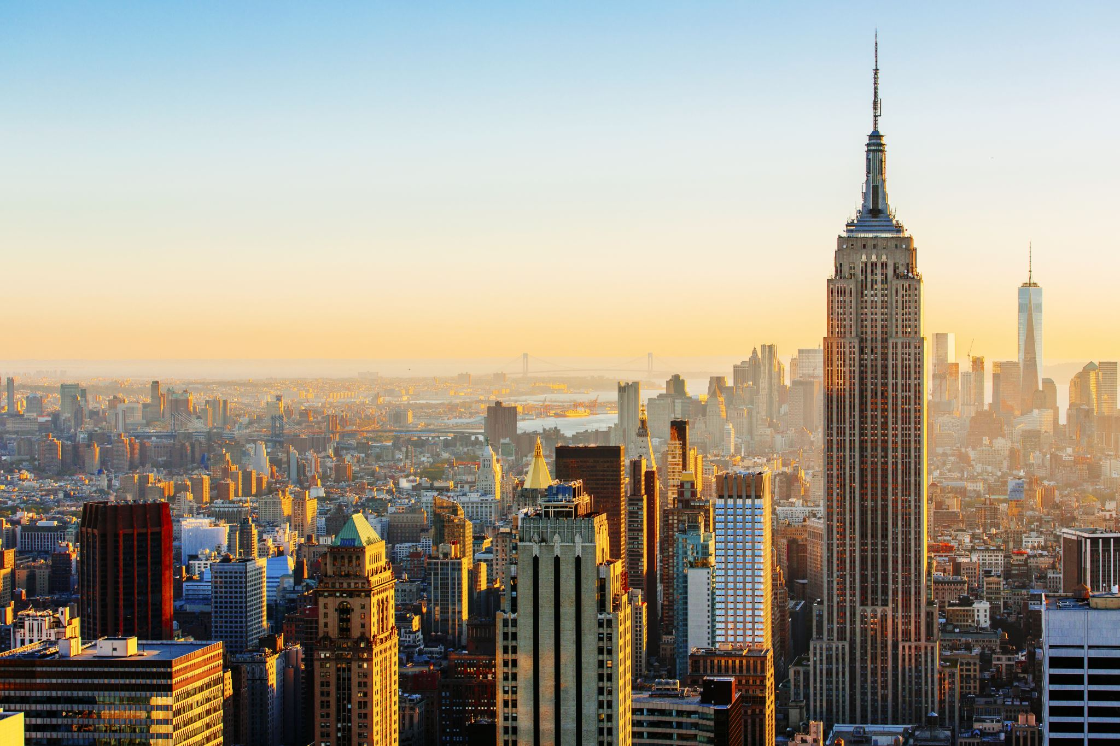
A Global Virtual Human Effort
Global experts on virtual human digital twins gathered in NYC in October 2023
Participation from academics, industry, federal agencies and national labs
Vision + Challenges + Opportunities
https://www.bnl.gov/virtual-human-global-summit/

Slide 10


Planned Digital Twin Institute
Collaborative effort between BNL and Catawba-Mohawk Accelerated Intelligence (CMAI)
Aims to build a leading hub for computational science and quantitative analysis
With an emphasis on Digital Twin research, development, exploitation and use for energy, life science, climate change, disaster recovery and pandemic response applications.
Anticipated to attract leading researchers and consumers of Digital Twin technologies into its partner network.
Planning a dedicated computing system for Digital Twin development
Build a community of Digital Twin researchers and users around this collaboration. Provide the community with a supportive eco-system that will allow a broad base of scientists and other users to contribute to the development of advanced digital twins and leverage these digital twins to transform their research, development and operations.

Slide 11
WE Would Like to collaborate on this important problem with you
Thank You!
Happy to take Your questions

