Slide 1
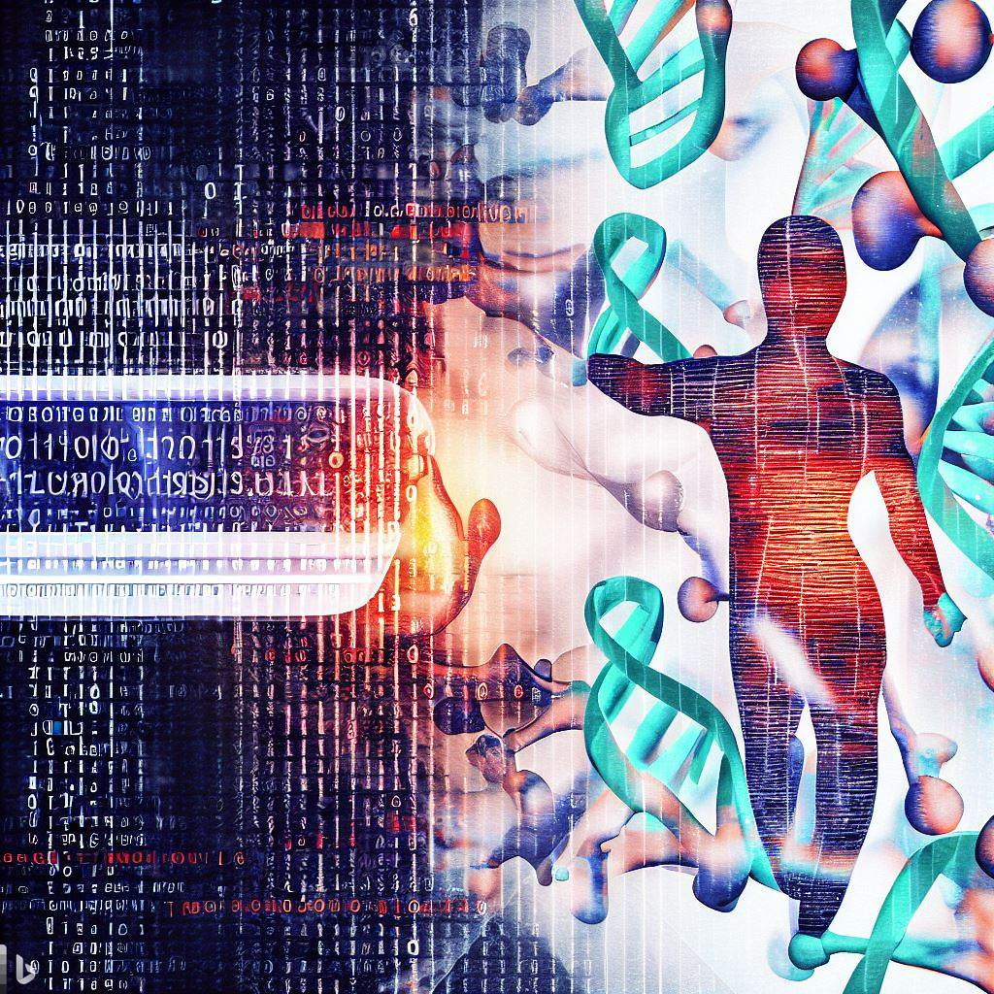
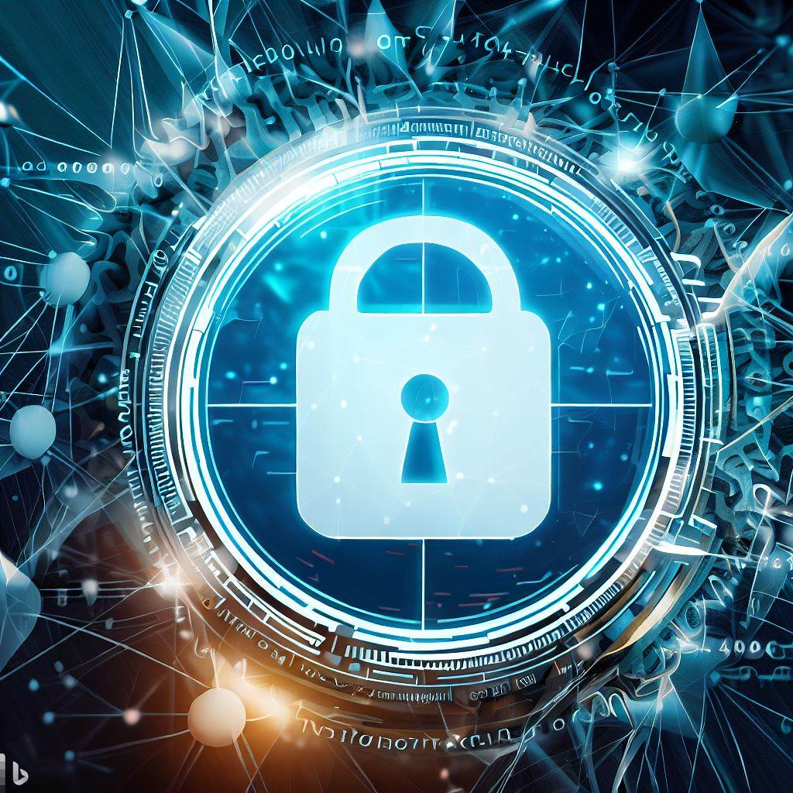
Privacy Preserving Federated Learning as a Service - A key capability for building robust AI models for Science
erhtjhtyhy
rAVI MADDURI
Computer Scientist
Data Science and Learning Division
madduri@anl.gov
Digital Twins Radiation Oncology (DTRO) Webinar on January 25,2024

Slide 2
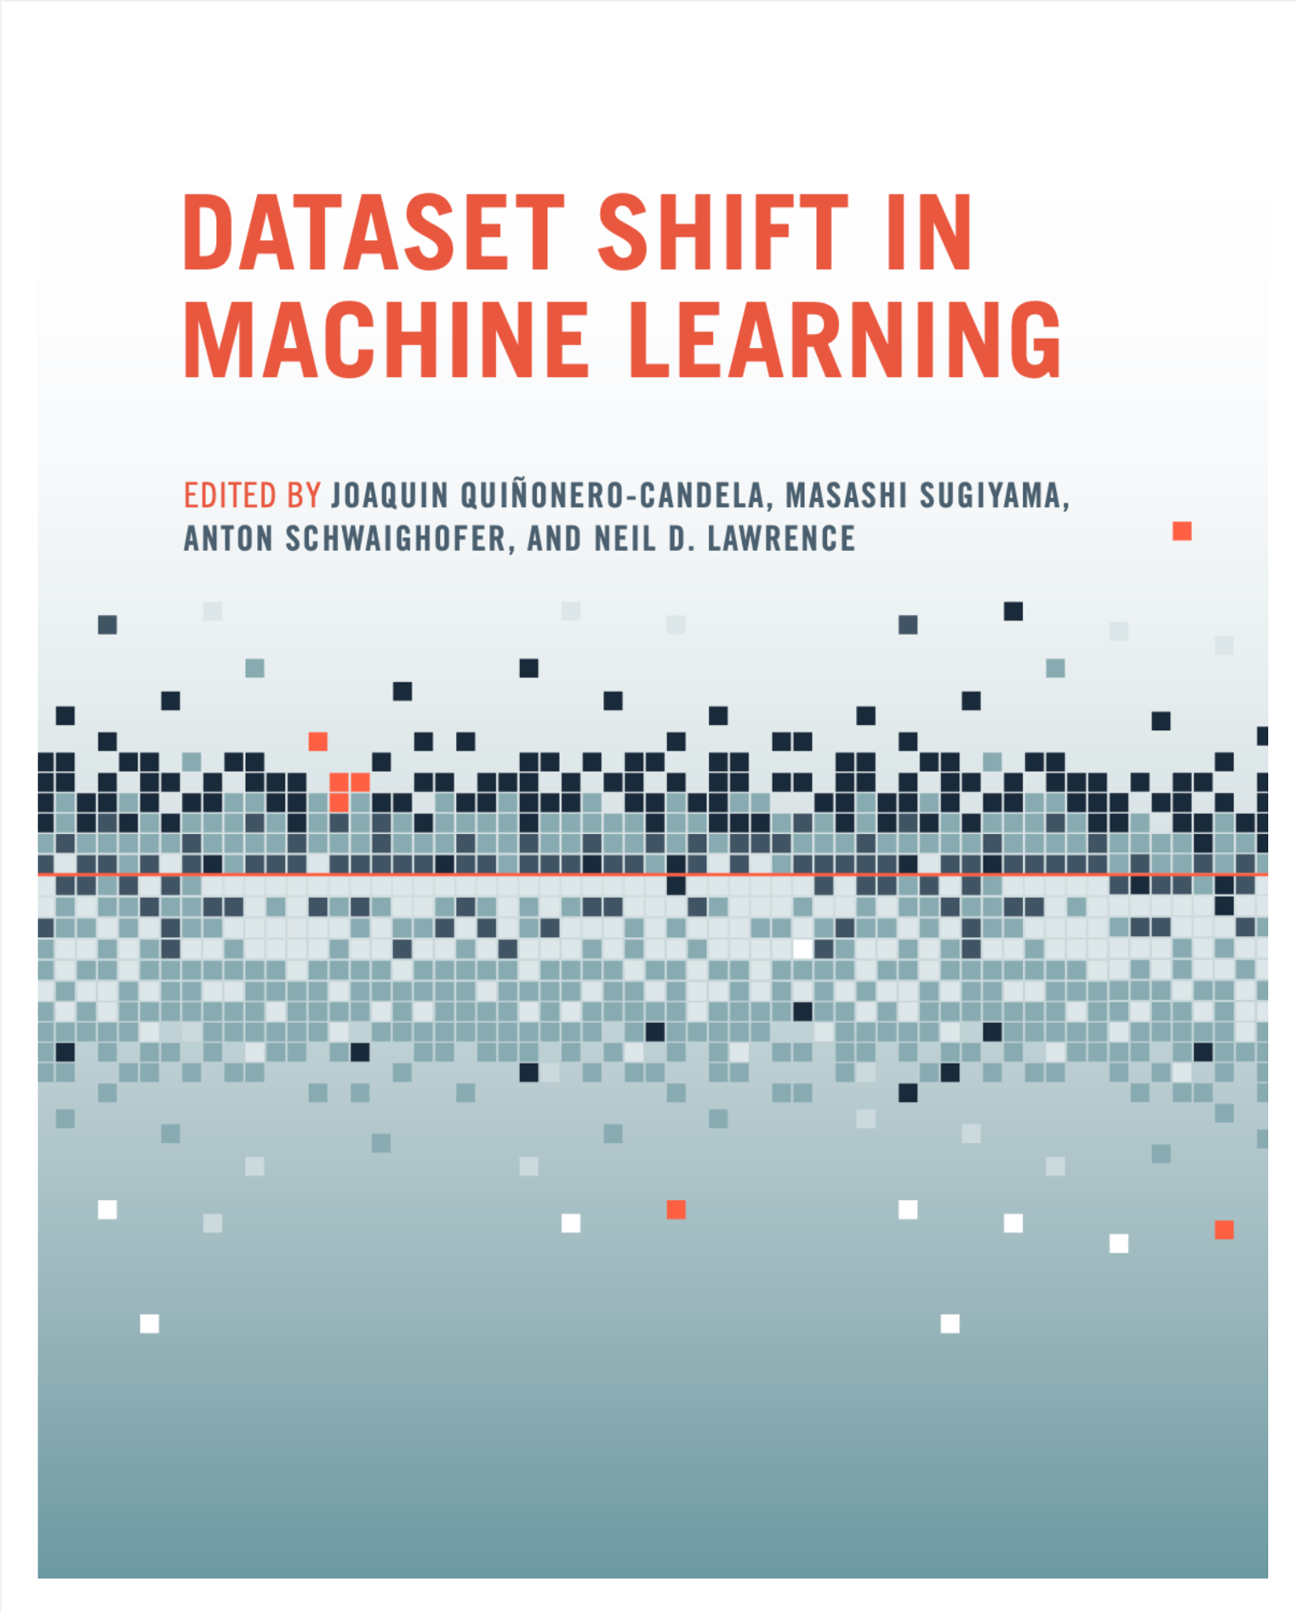

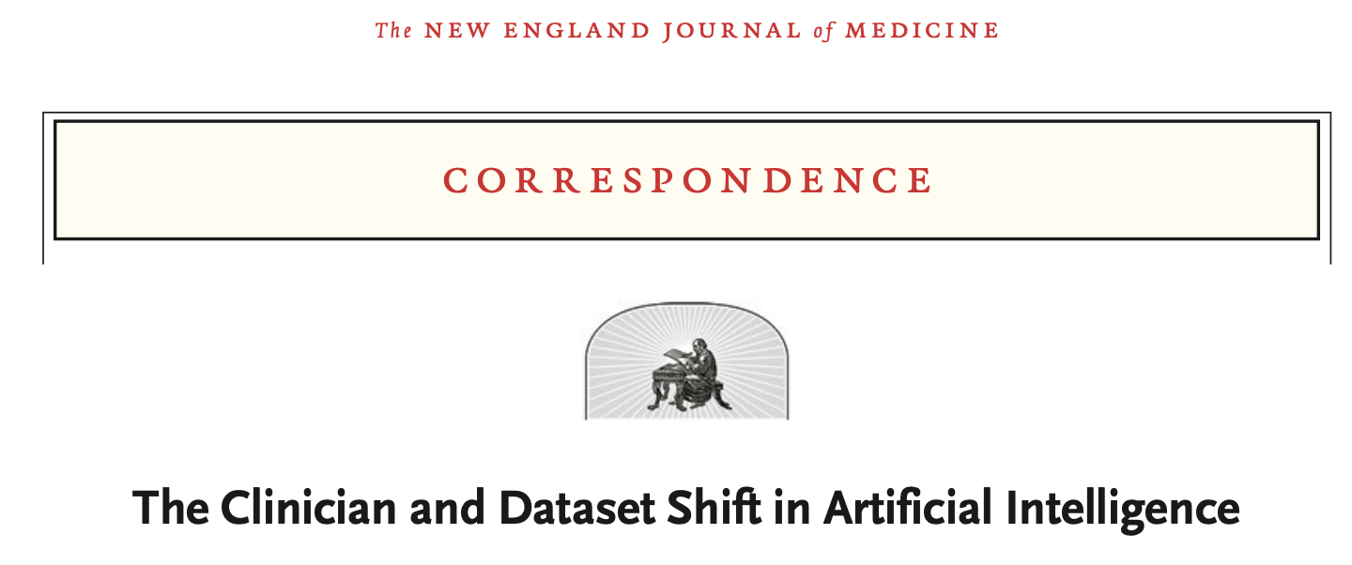
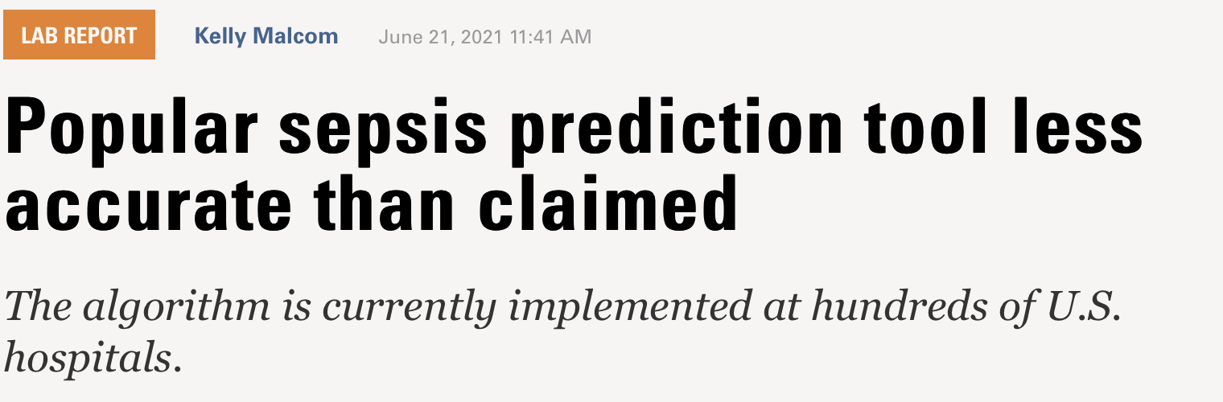
Motivation for Federated Learning
Source: PMID: 34260843 DOI: 10.1056/NEJMc2104626
Source: https://labblog.uofmhealth.org/lab-report/popular-sepsis-prediction-tool-less-accurate-than-claimed

Slide 3

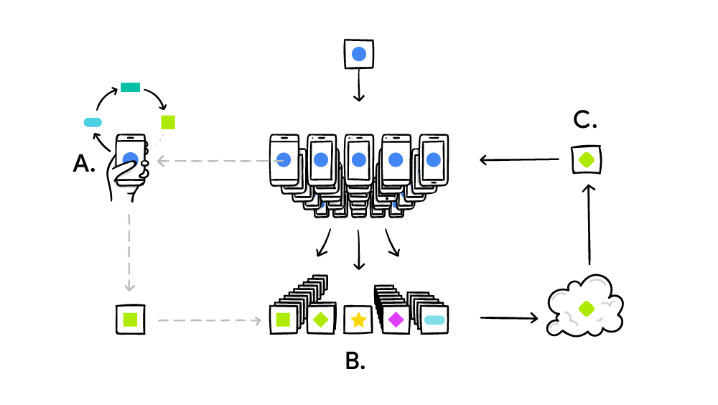
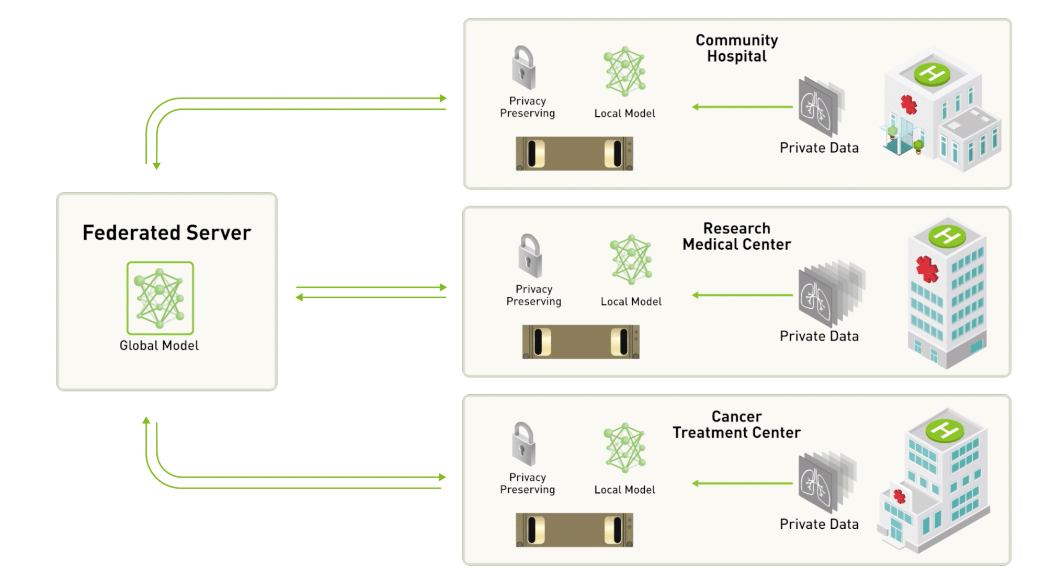
Federated Learning (FL)
Cross-device FL
Machine learning without centralizing training data
No direct data sharing or storing
Training at local and transferring model information
Finding a global model
More benefits
Learning a global/shared model
Utilizing a localized model at each client side
Personalization
Two settings:
Cross-device FL (1000s and 1Ms of small devices)
Cross-silo FL (a few large data repositories)
Challenges in algorithm design
Your phone personalizes the model locally, based on your usage (A). Many users' updates are aggregated (B) to form a consensus change (C) to the shared model, after which the procedure is repeated. (image from Google)
Cross-silo FL
Federated learning on decentralized medical datasets (image from NVIDIA)
Notes:
So then what is FL?
FL is a type of machine learning that enables training model without collecting data to a central location. The training is done at each local device or facility, and then the model information such as parameters and gradients is aggregated at a central server with the goal of finding a global model parameter.
For example, Google trains a shared model for cell phone usage without collecting data from millions of cell phone devices. The other example is that multiple biomedical institutions can train a shared model without sharing the data each other.
The example like Google is called cross-device FL setting, where millions of small devices participate in training. The biomedical institutions example is called cross-silo FL setting, where a few large data repositories participate in training. Each setting has unique challenges for designing algorithms and training model architecture.

Slide 4
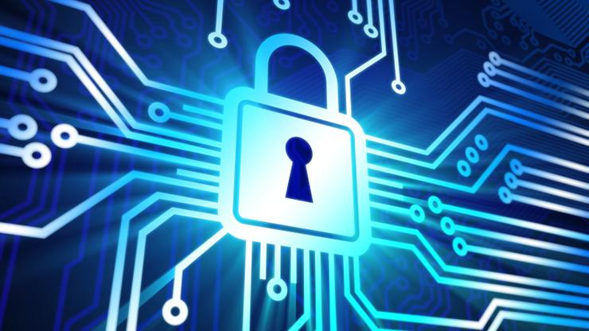
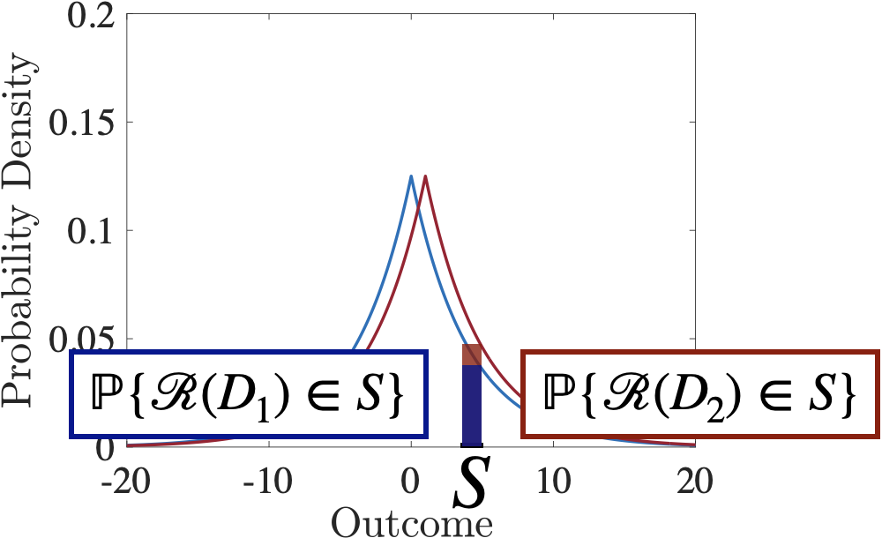
Privacy-Preserving Techniques
Some techniques in Privacy-preserving FL
Homomorphic encryption: limited to certain operations
Secure multi-party computation: computationally expensive
Differential privacy: potential accuracy loss
Differential Privacy
The two outcomes are indistinguishable for all D1 and D2 which differ in one individual’s data.
Notes:
FL is not sharing the raw data among the learning clients and the server, but the raw data is still at privacy risk. In a few minutes, I will show you how the raw data can be reconstructed from the model parameters without any privacy preserving techniques.
These are some techniques used in FL. Of course, each one has its pros and cons. We focus on differential privacy technique that achieves the privacy guarantee by adding random noise to the model training. The key idea of DP is randomizing the algorithm so that adversary cannot distinguish the change of single data point.

Slide 5
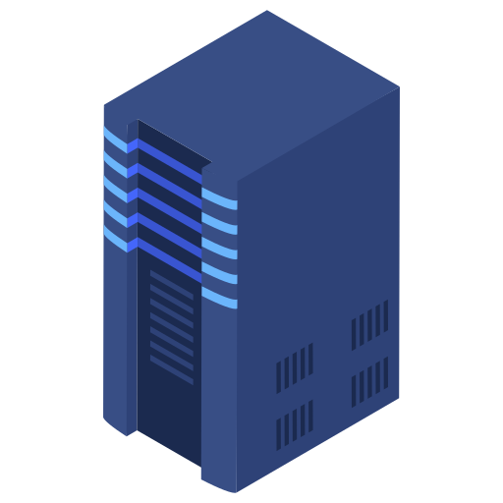
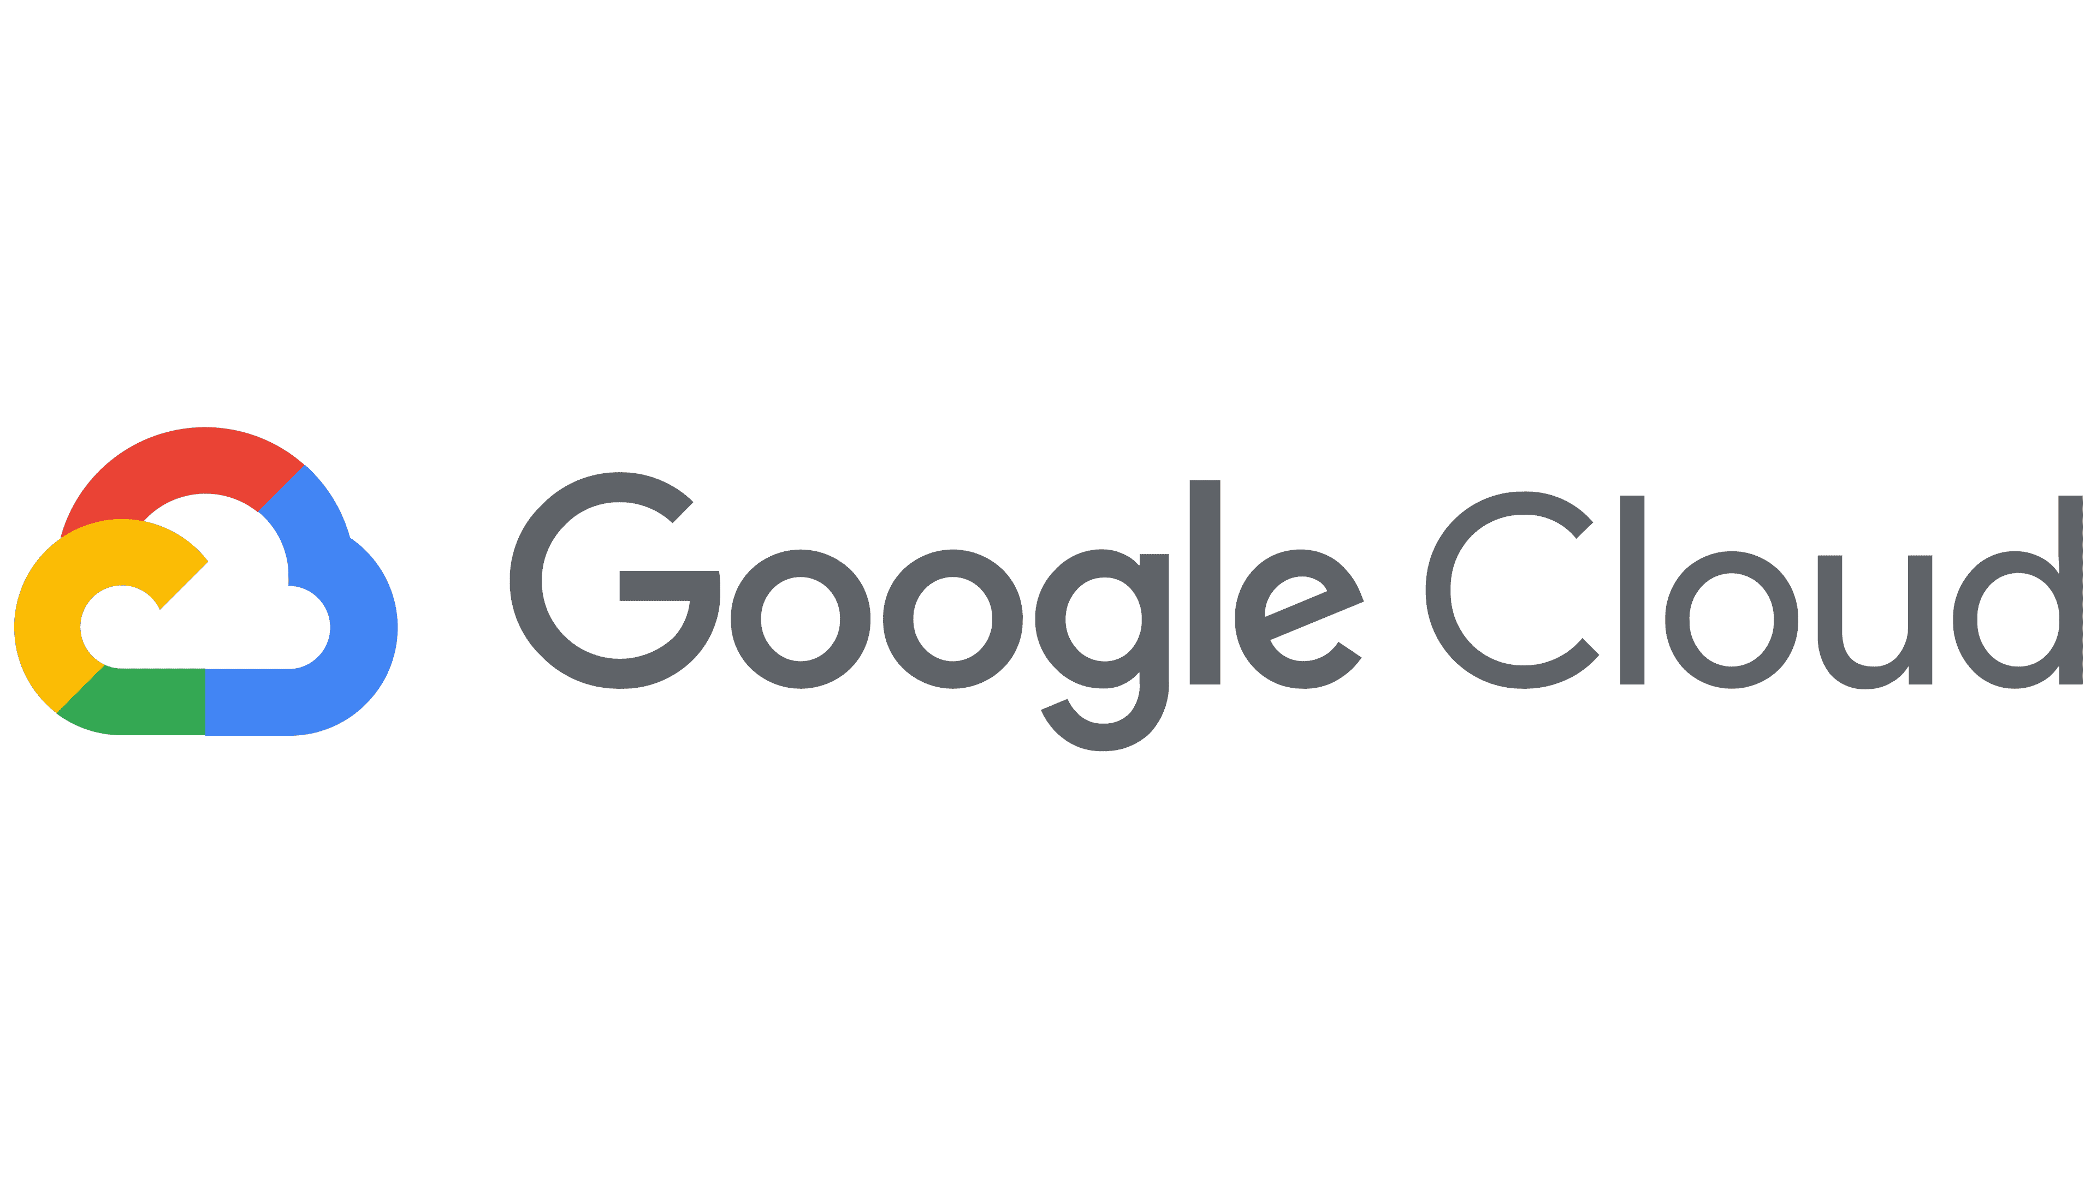
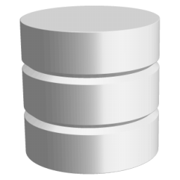
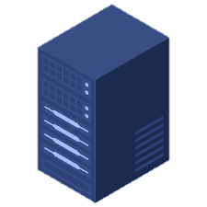

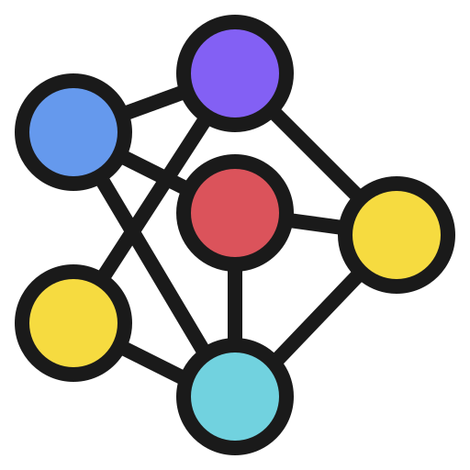
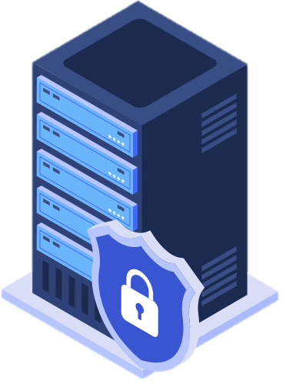
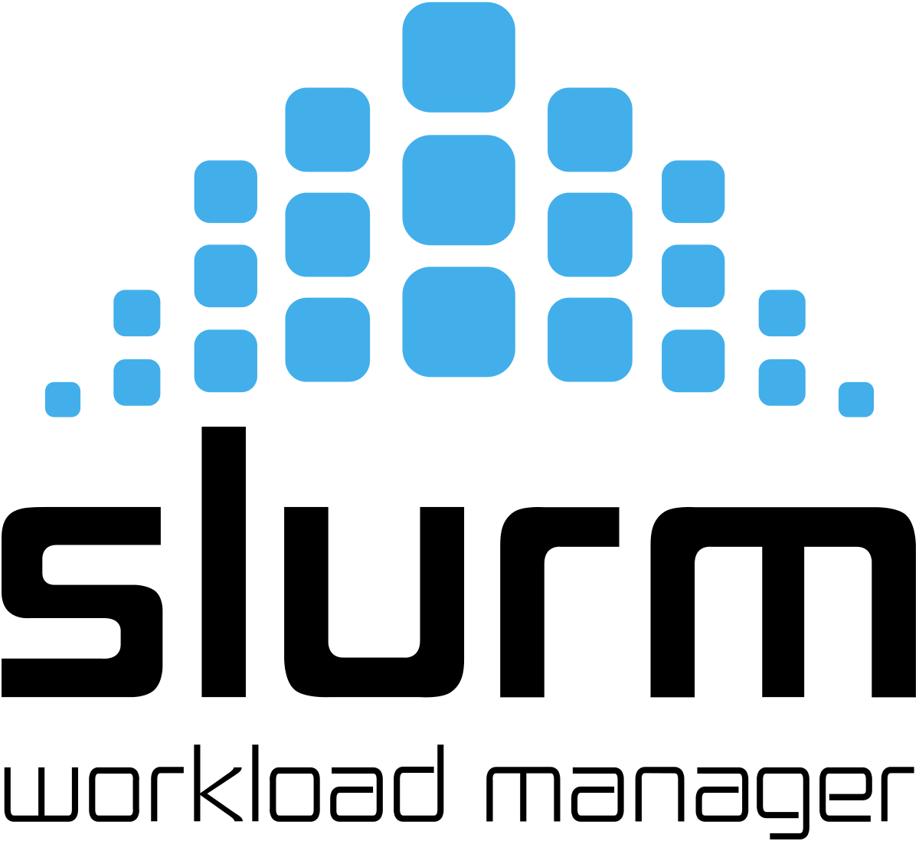
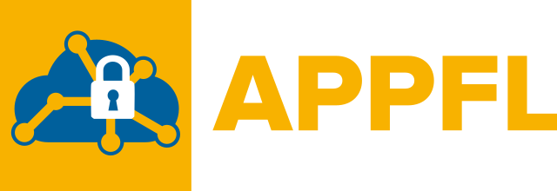
APPFL – Privacy Preserving Federated Learning Framework
Client 3
Client 2
Client 4
Server
However……
setting for federated learning can be tedious for domain experts!
Client 1

Slide 6
Major components of appfl
Training algorithms:
IIADMM, FedAvg [McMahan et al., 2017], ICEADMM [Zhou and Li, 2021]
Any user-defined FL algorithms can be added.
Privacy-preserving schemes:
Differential privacy mechanisms [Dwork et al., 2006]
Other schemes (e.g., homomorphic encryption) to be added.
Communication protocols:
gRPC: communication between multiple platforms and languages
MPI: efficient communication in a cluster environment
Globus Compute: communication in a wide area environment
User-defined model and data:
Inherits PyTorch’s neural network module, torch.nn.Module
Dataset class that inherits the PyTorch’s Dataset
Notes:
Although the framework may look fairly simple, it has multiple important components.
First, it requires a training algorithm. In particular, it is critical to the learning performance how to update (or often called aggregate) the local parameters. Our framework implements multiple algorithms, including the most famous one FedAvg and its generalization based on inexact ADMM.
We also have differential privacy component that systematically adds random noise to the training steps.
Another important component is the communication protocols. For now, we support two protocols: gRPC and MPI. gRPC enables the communication based on RPC with optionally support for TLS (transport layer security). MPI is also supported in our framework. It’s not really for FL, but allows to simulate any PPFL setting on cluster environment such as HPC.
And, our package is highly customizable and supporting any user-defined models and data based on PyTorch.

Slide 7


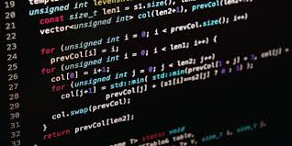
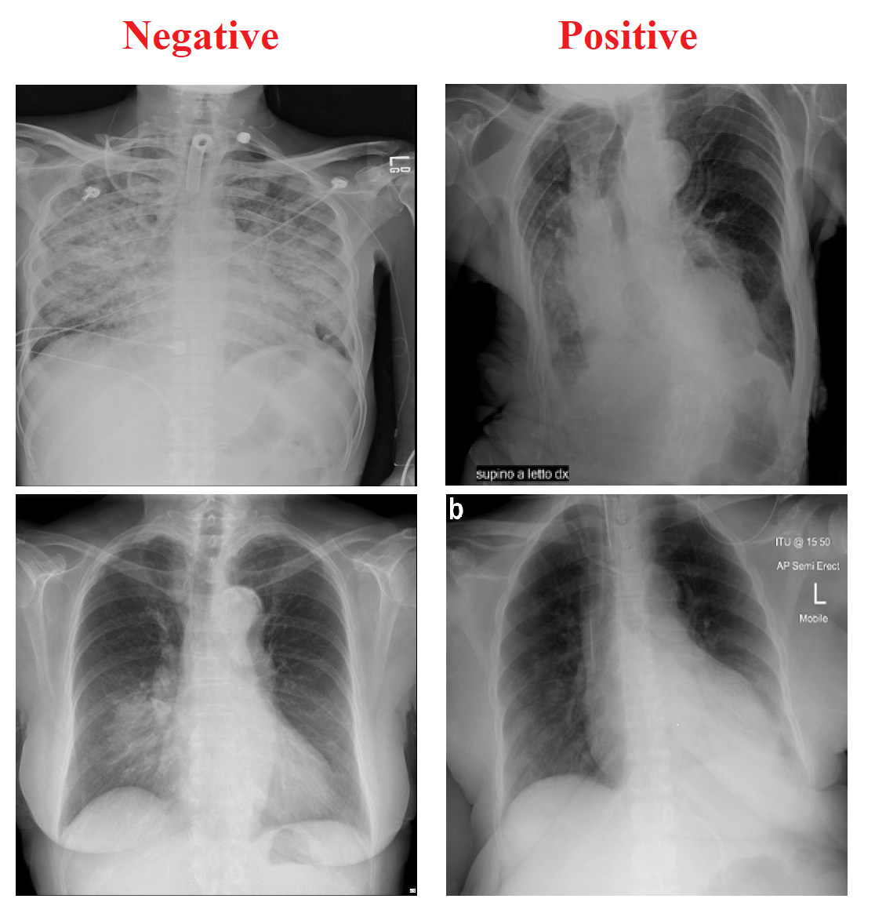

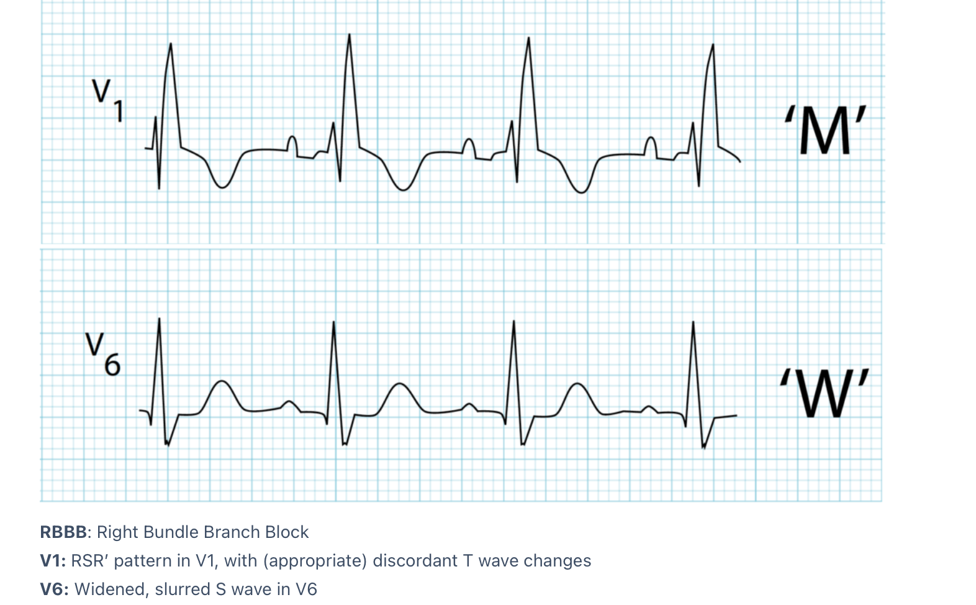
Motivation for Federated Learning As A service
Data Shift in
Machine Learning
Privacy Concerns in
Biomedical Data
Tedious Federated
Learning Setup

Slide 8
Key Capabilities of APPFLx
To Build Models that are Fair and Trustworthy using PPFL easily
Simple but effective user experience to design, run, share FL experiments with FAIR ideas applied to ML
Visualize training data distributions at different participating sites
End-to-End strong IAM
Enable setting up Secure Federation across organizational boundaries
Easy to leverage HPC for training
Integrate heterogenous computing resources and monitor usage
Ability to leverage novel Federation strategies
Creation of FedCompass Efficient Cross-Silo Federated Learning on Heterogeneous Client Devices using a Computing Power Aware Schedule
Framework to rapidly run experiments with different hyper-parameters and measure performance with Tensorboard and visualize data distributions in different sites
Integration with HuggingFace, GitHub for pre-trained models and uniform pre-processing
APIs and Plug-and-Play architecture
To integrate into existing services and add new capabilities/algorithms

Slide 9

Key capabilities – Secure enclaves
Computing, Policies
Argonne Biomedical Learning Enclave (ABLE) and Knowledge Discovery Initiative (KDI)
PROTECTED COMPUTE
SOFTWARE BUILD
(Developer Sandbox)
DGX 1
Deep Learning
DGX 2
Deep Learning
CS 1
Accelerated Deep Learning
Containers
Data Egress
Gateway
Native Runtimes
Machine Learning and General Compute Cluster
ARGONNE BIOMEDICAL LEARNING ENCLAVE
Certified for HIPAA Compliance
PROTECTED STORAGE
ACCESS ENVIRONMENT
NetApp SAN
GPFS
Encryption
Virtual Desktops
Data Ingress
Gateway
Terminals
MANAGEMENT ENVIRONMENT
Identity and Access Management, Logging, Auditing
9

Slide 10
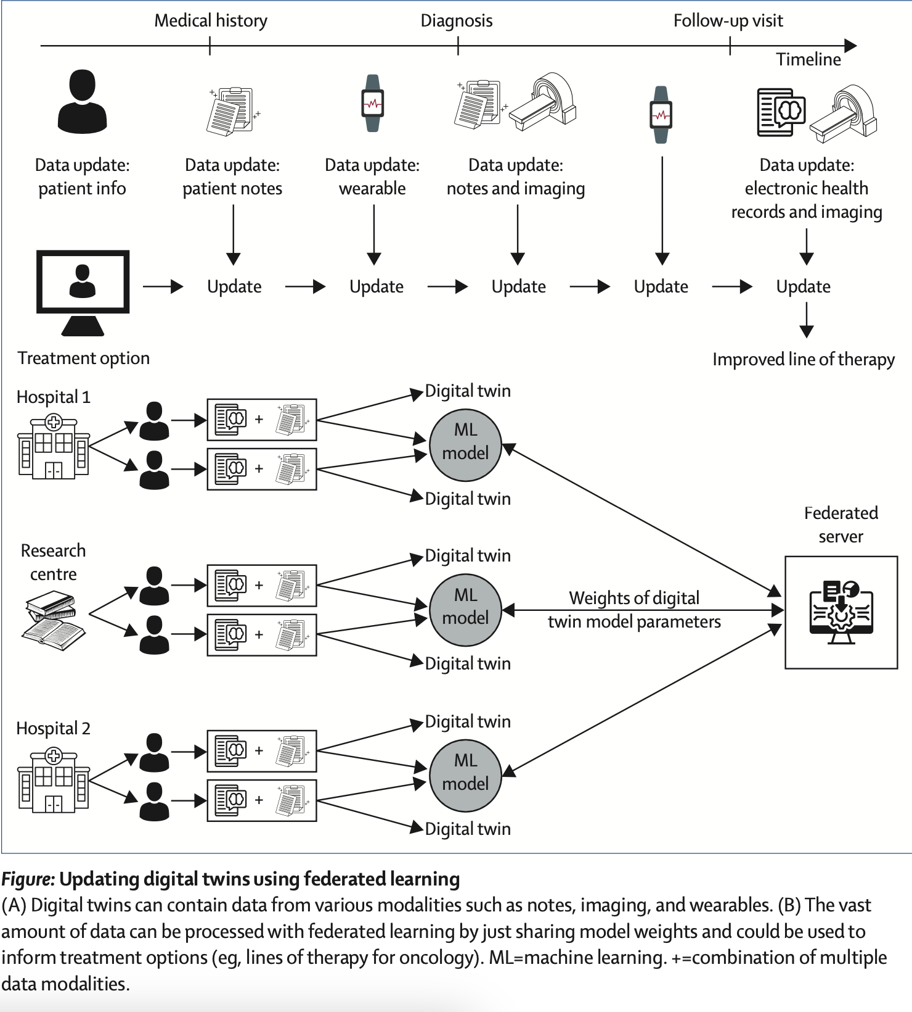
Augmenting digital twins using FL
Federated Learning can be very useful in the context of digital twins
PPFL mitigates privacy risks from centralizing sensitive patient data needed for robust digital twin models
The decentralized approach of Federated Learning aligns with the distributed nature of data needed for patient digital twins.
Nagaraj, D., Khandelwal, P., Steyaert, S., & Gevaert, O. (2023). Augmenting digital twins with federated learning in medicine. The Lancet Digital Health, 5(5), e251-e253.

Slide 11
CONCLUSION
Dataset Shift challenge in AI are real
Models don’t do well when applying in settings different from settings and data used in training
Bigger challenge in Biomedicine where data is not shared because of policy issues
We presented APPFLx where we
Developed APPFL (Argonne Privacy-Preserving Federated Learning) framework that implements end-to-end secure framework that leverages differential privacy algorithms along with capabilities to leverage heterogenous HPC resources easily
We discussed how we integrated APPFL framework with our existing computing and data infrastructure (i.e., ABLE, SEAL, KDI, HPCrypt, funcX, and DLHub) with focus on validating and evaluating APPFL framework by using the multi-institutional biomedical datasets
We presented results and lessons learned when applying APPFL to Biomedical datasets

Slide 12
REsources
Privacy Preserving Federated Learning as a Service APPFLx - https://appflx.link/ and instructions https://ppflaas.readthedocs.io/en/latest/
GitHub Repo: https://github.com/APPFL
Pre-print for APPFLx: https://arxiv.org/pdf/2308.08786.pdf
FedCompass pre-print: https://arxiv.org/abs/2309.14675

Slide 13
Q&A

