Slide 1

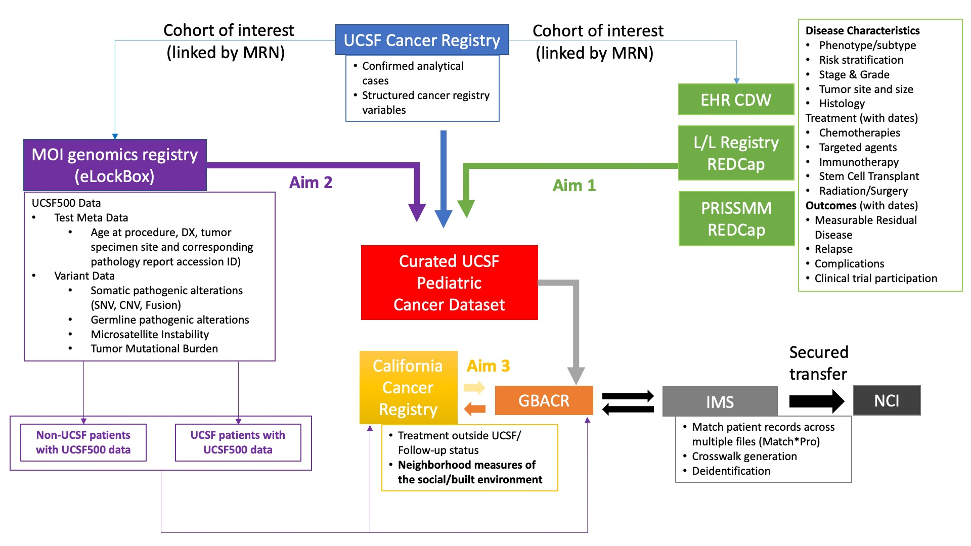
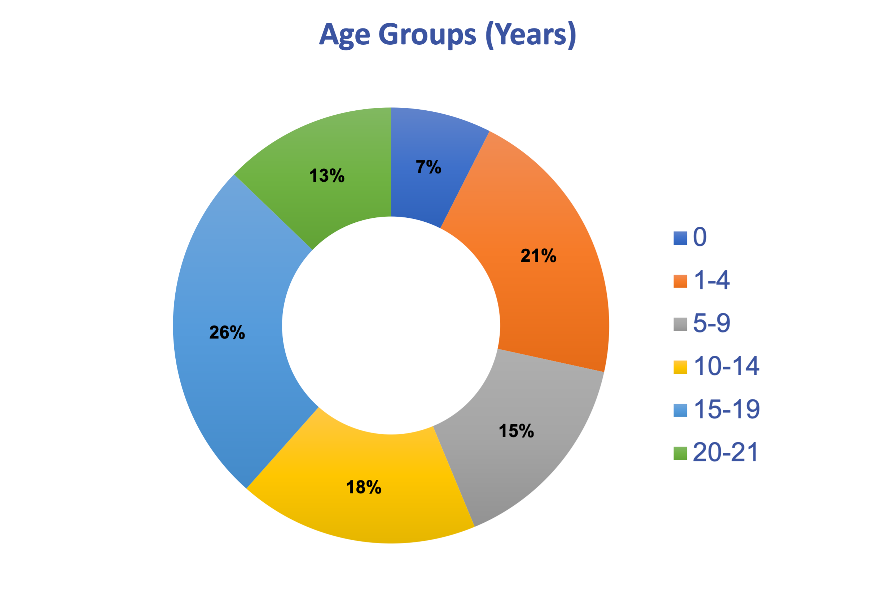
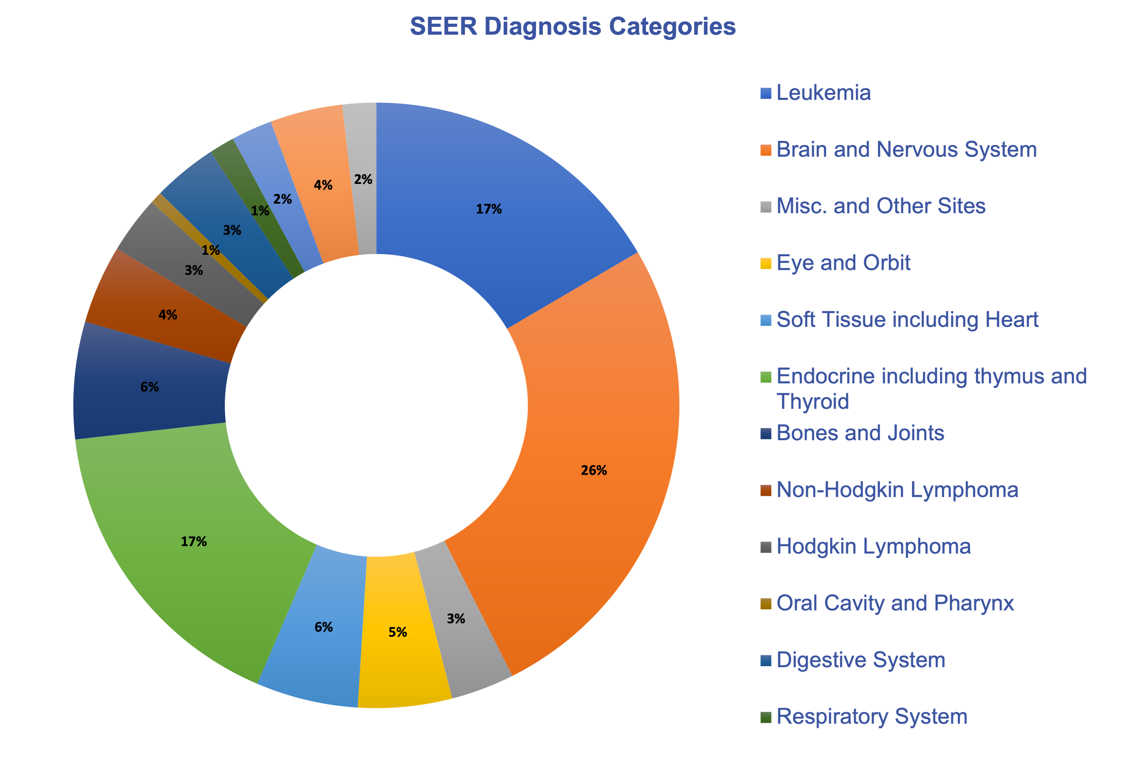
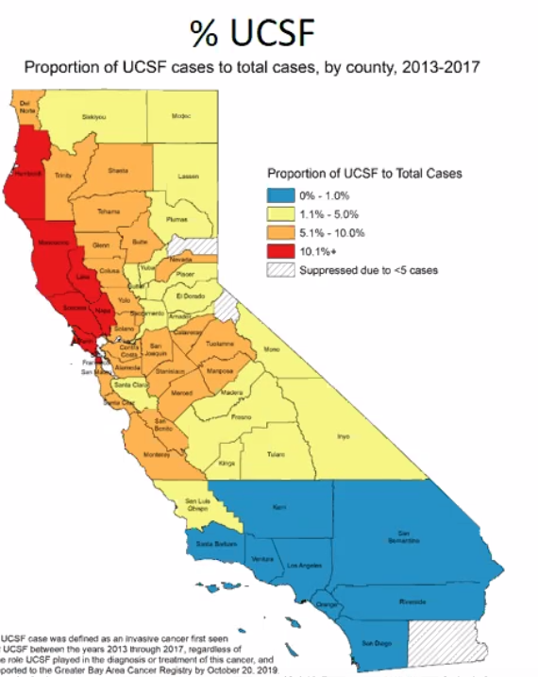
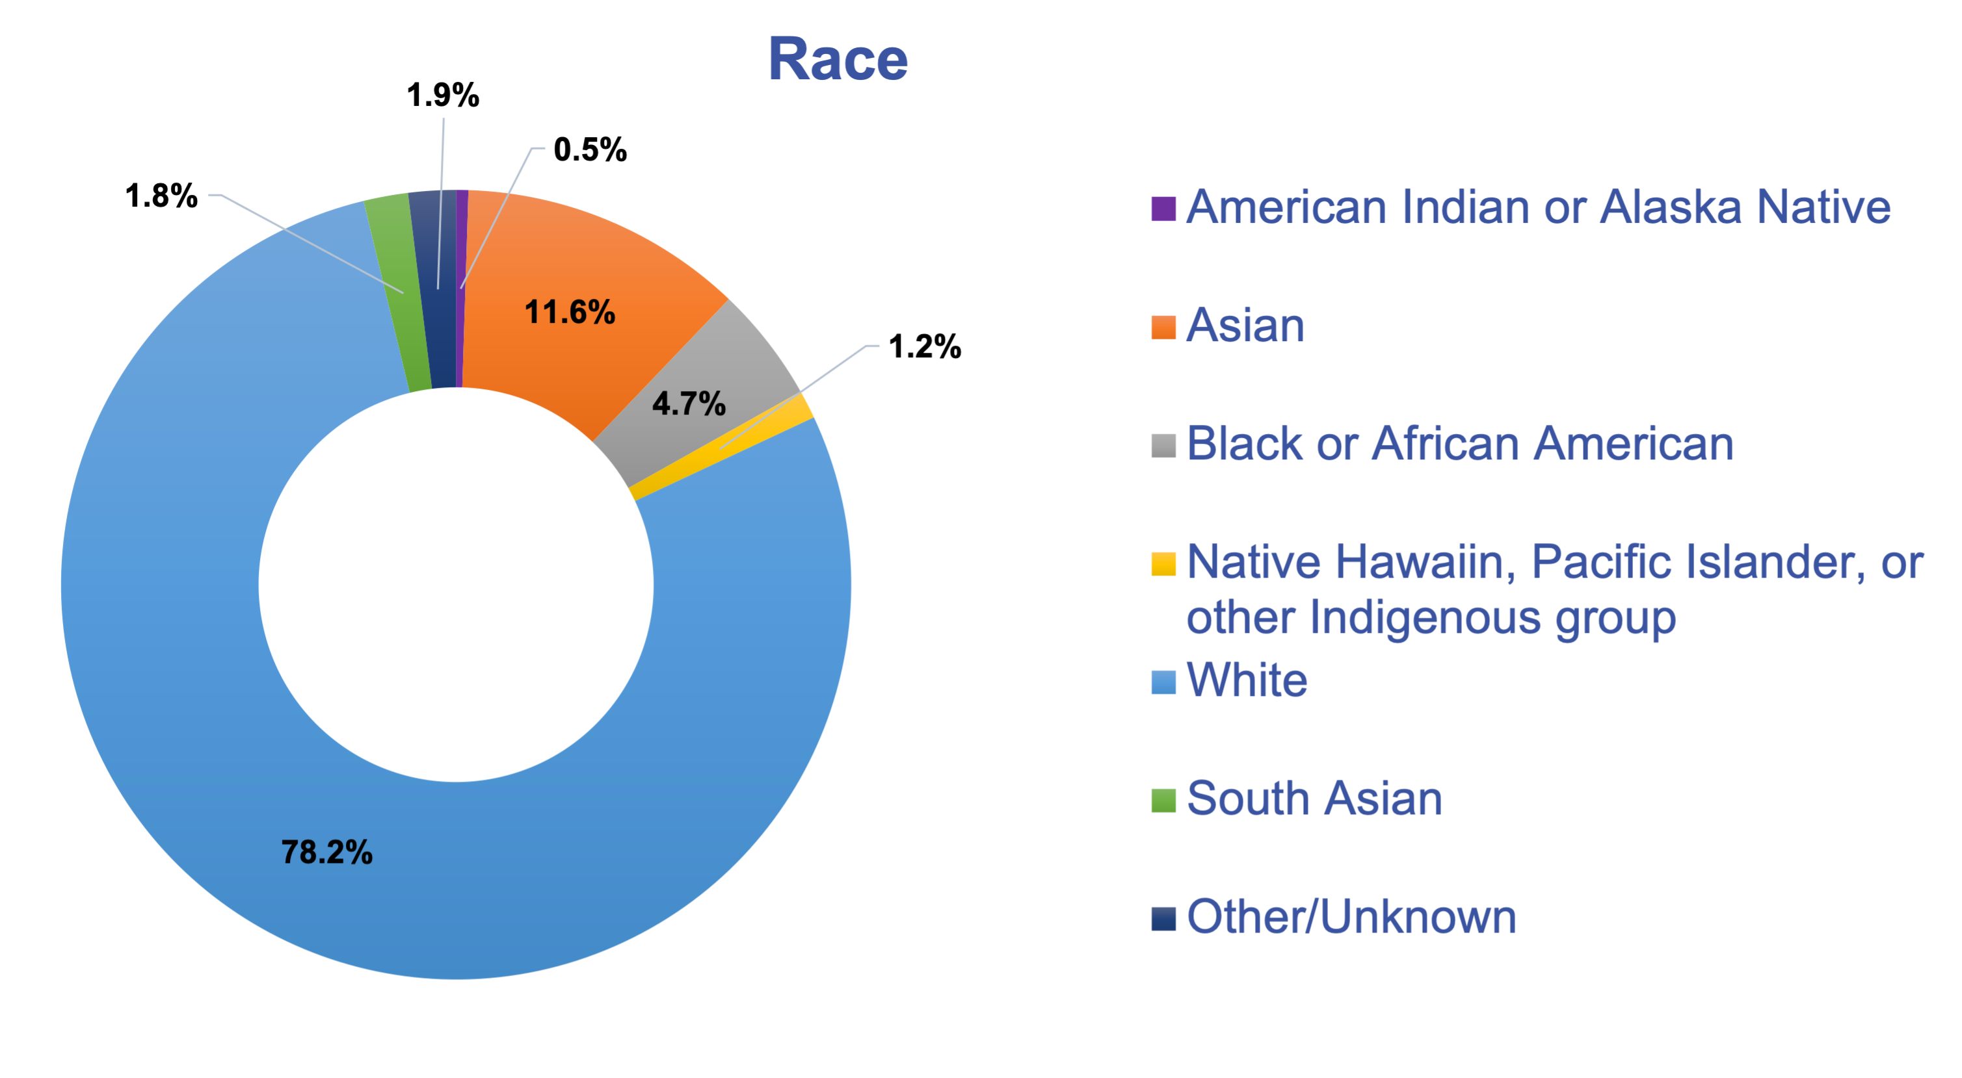
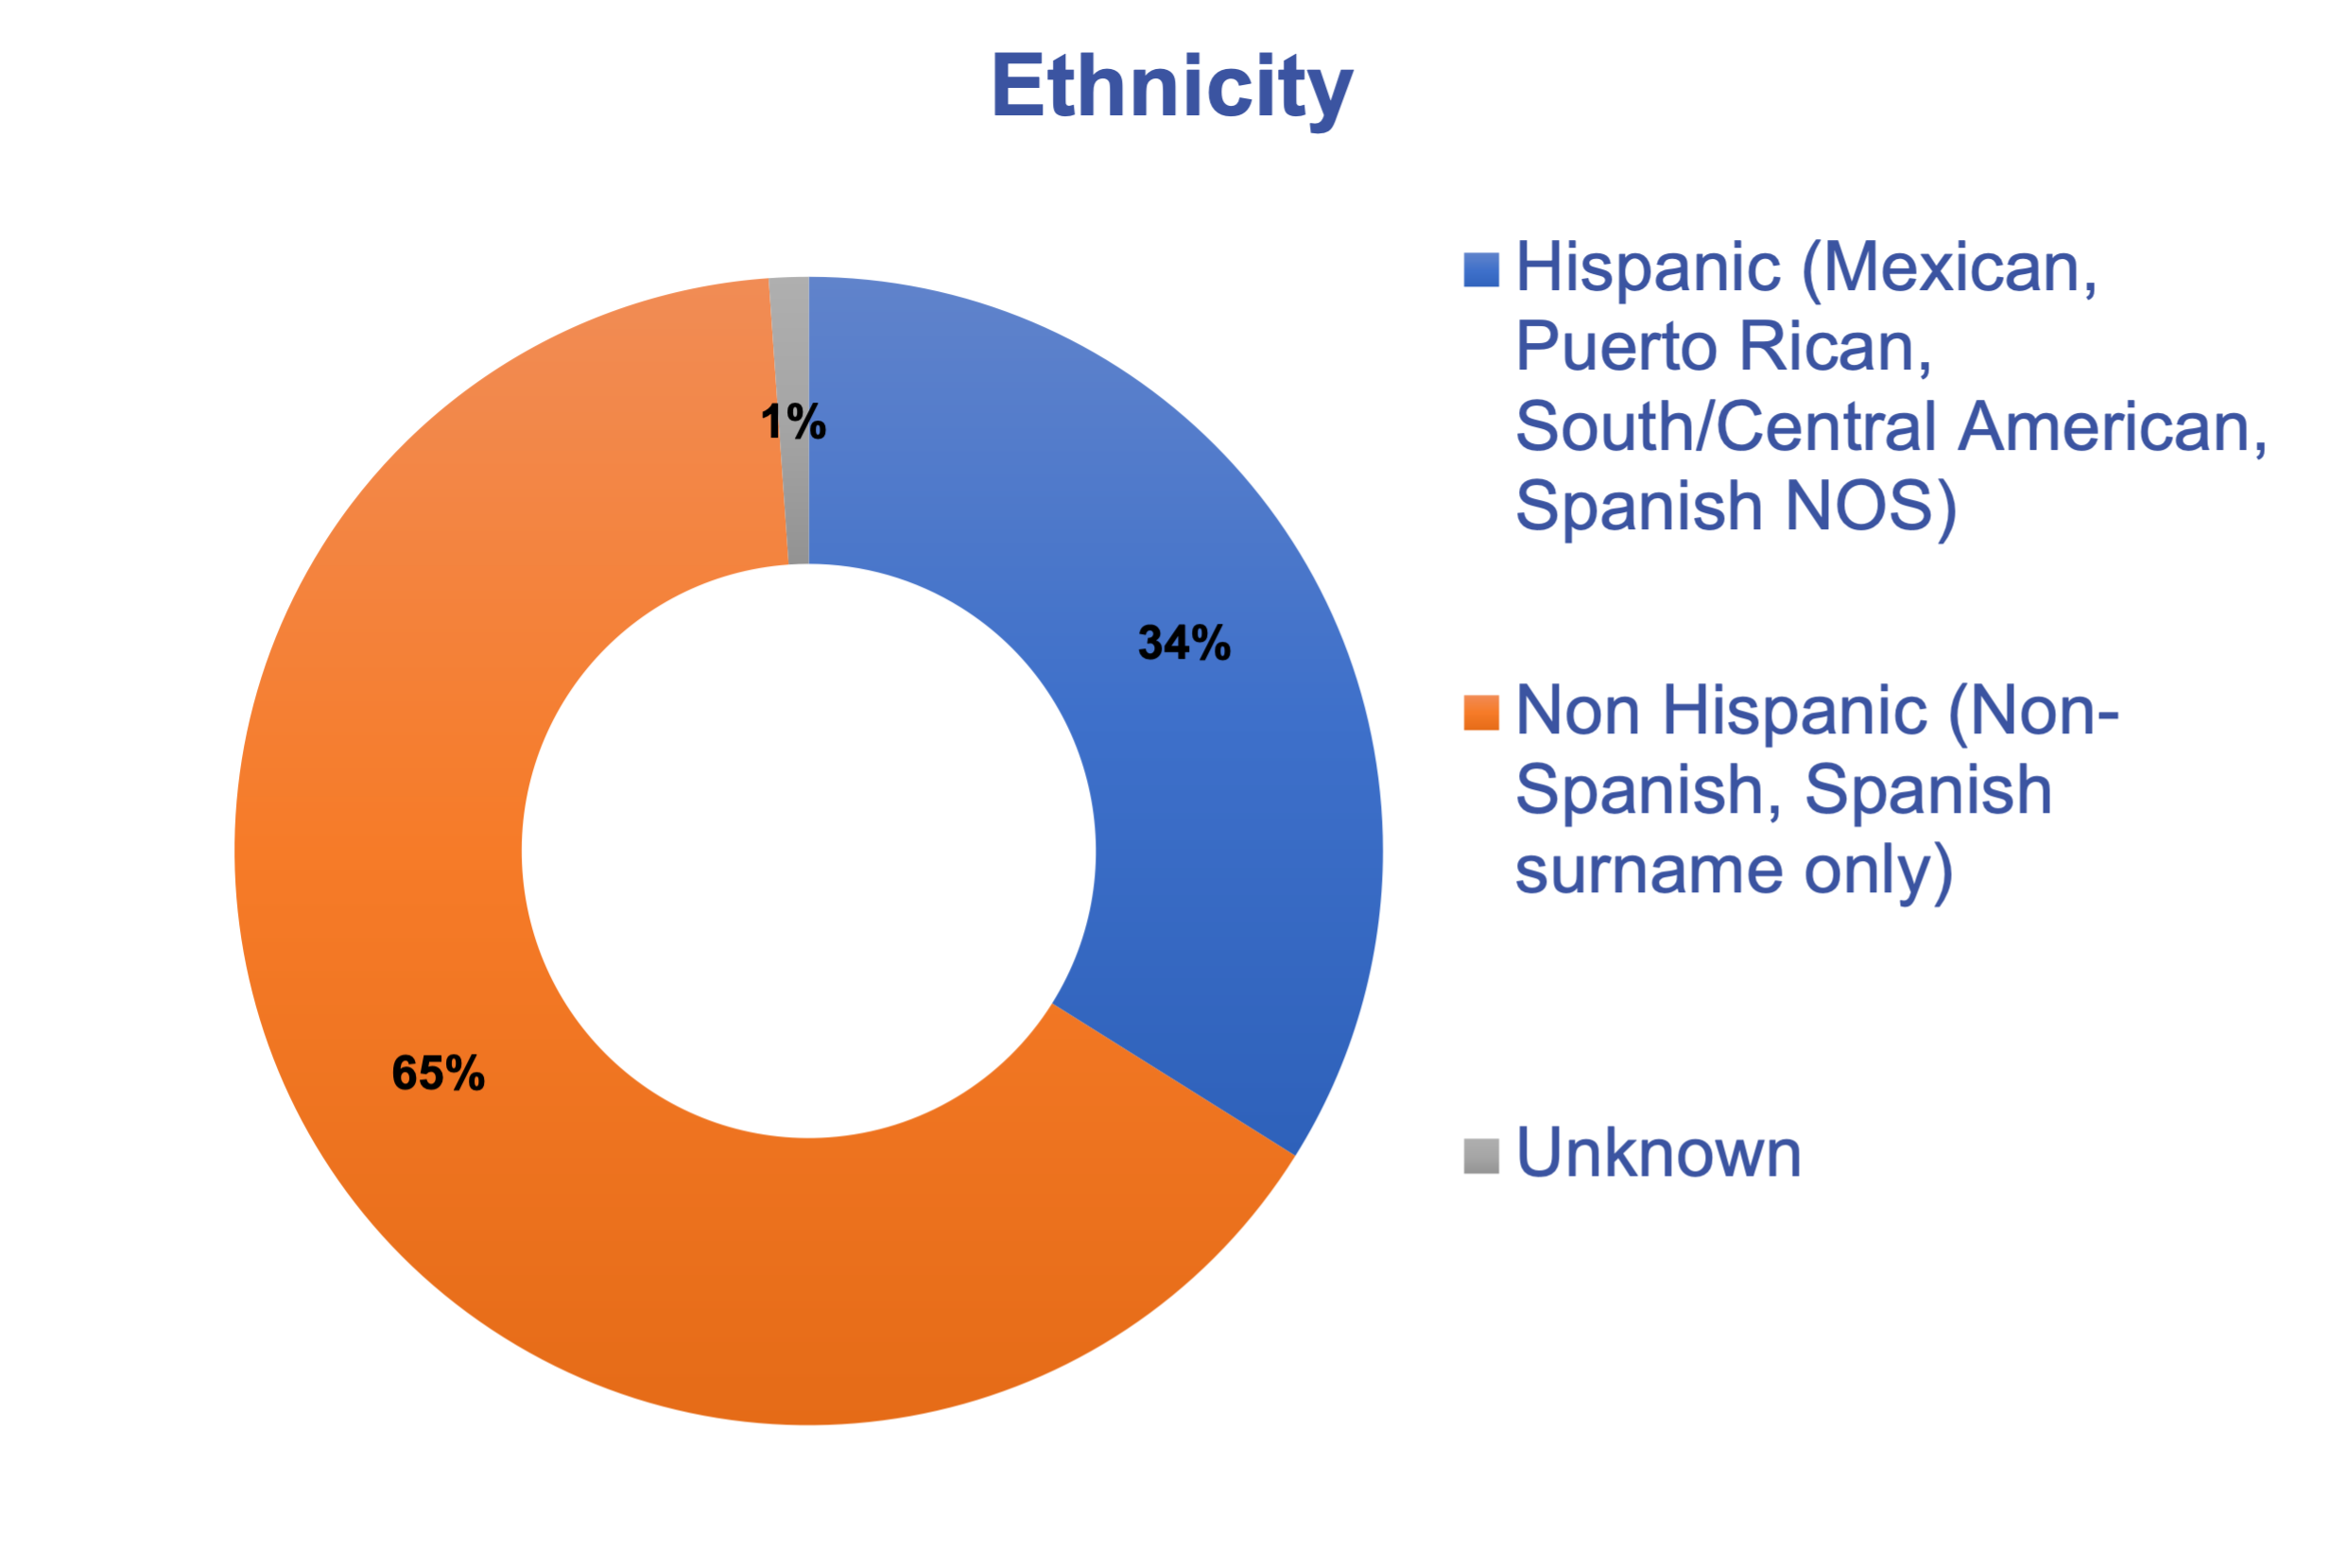
Integrating UCSF Clinical, Genomic, and Neighborhood Data into the National Childhood Cancer Registry
Aims
Integrate clinical cancer data from the EHR, including disease-specific staging, treatment, response, and outcome data for pediatric cancer patients (age <21 at diagnosis) treated at UCSF Benioff’s Children’s Hospital (2012-2019) into the National Childhood Cancer Registry
Augment clinical data with comprehensive tumor genomic profiling and/or germline testing for patients with these data
Augment clinical data with neighborhood-level measures of social determinants of health
Data Sources & Resources
Data Governance
Institutional
State
Data Source | Data Resources & Description | Data Type
Electronic Health Records (EHR) | UCSF Cancer Registry Previous manual chart abstraction for cancer patients using NAACCR defined & standardized common data elements Clinical Data Warehouse Queries for automated retrieval of clinical data elements ExtractEHR: opensource, automated data collection developed at CHOP that extracts data from EHR (demographic data, vital signs, administered medications, procedures, and lab and radiology results) PRISSMM and Leukemia/Lymphoma Registry REDCap database wherein manually abstracted clinical data elements are collected and stored using standardized framework, protocol, and data dictionary | Clinical Data Elements: Disease characteristics, treatment information, patient outcomes, pathology and imaging report data
MOI Genomics Registry | eLockBox - Repository of genomic test data (reported somatic and germline alterations) that provides bridge to other data sources at UCSF, including Clinical Data Warehouse Parsed report data and test metadata into discrete fields | Clinical-grade sequencing data (UCSF500, Foundation Medicine)
California Neighbor-hoods Data System | Measures of socioeconomic status and aspects of the social and built environment Derived at the census tract-level data and including population density, racial residential segregation, ethnic enclaves, walkable destinations, street connectivity, crime, etc GIS Resources (e.g. ArcGIS) | Socioeconomic and environmental measures
Greater Bay Area Registry | Provides routine geocodes of patient addresses as well as additional clinical information such as treatment data from outside of UCSF and long-term follow-up | Clinical Data Elements; Geocoding
UCSF IRB: Patient privacy data safeguards; sharing data by UCSF with GBACR
Risk Assessment for sharing identified patient data with 3rd party honest broker (IMS)
Data Transfer/Use Agreement: Sharing data with GBACR and NCI
Data Flow
State IRB: Patient privacy and data safeguards; sharing data by GBACR with IMS and NCI
Provocative Questions
Building a comprehensive profile of pediatric patients’ cancer from diagnosis onward by combining disease biology, genomic profile, risk stratification, trial participation, treatment approaches, relapse, and social determinants of health.
As all pediatric cancers are rare cancers, NCCR will be an important discovery resource for:
Prognostic biomarkers
New germline risk factors
Exceptional responders but also unexpected poor responders
Better understanding of clinical trial enrollment demographics
Identifying new challenging subgroups/subtypes within a specific cancer diagnosis
Identifying new predictive biomarkers for treatments and outcomes
Disparities in disease burden for sub-groups of patients and how they are distributed across the US.
Interrogating the role of structural and social determinants in disparities in disease outcomes.
Given the increasing diversity of the US population, and especially among persons identifying with multiple racial/ethnic groups, a key question is how disease risk varies by genetic ancestry.
Patient Population, N=1,796
45% Female // 55% Male
Catchment Area
Contacts
PI: Lena Winestone, MD, MSHP
Co-PI: Scarlett Gomez, MPH, PhD
Epidemiologist: Daphne Lichtensztajn, MD, MPH
Scientific/Clinical Advisors:
Mignon Loh, MD
Alejandro Sweet-Cordero, MD
Project Manager: Michelle Turski, PhD
CRC: Emma Canepa, MS, CCRP
CRC: Jacklyn Sanchez Alvarez, BS
CRC: Ana Quintanar-Alfaro, BS
Computational Biologist: Carlos Espinosa-Mendez, BA/BS
Need to output at 200%

