Slide 1
Roswell Park Child and Young Adult Cancer Registry:
Model-Driven Information Architecture
for Collaborative Research
NCCR Data Summit
February 8, 2021
Kara Kelly, MD - Project Lead (contact: kara.kelly@roswellpark.org)
Elizabeth Bouchard, PhD , Kristen Anton, MS – Co-Leads
Katerina Czup-Arnold, Maya Reed McDaniel, MS - Biomedical Data Science Shared Resource

Slide 2
Core Team
Kristen Anton, Co-Lead, Kristen.Anton@RoswellPark.org
Dr. Elizabeth Bouchard, Co-Lead, Elizabeth.Bouchard@RoswellPark.org
Katerina Czup-Arnold, Data Manager, Katerina.Czup-Arnold@RoswellPark.org
Dr. Kara Kelly, Project Lead, Kara.Kelly@RoswellPark.org
Maya Reed McDaniel, Programmer/Analyst, Maya.McDaniel@RoswellPark.org

Slide 3
Provocative Questions
Impact of SDOH (poverty, race, ethnicity, parental health literacy, psychosocial assessment, family structure, rural/urban) on clinical trial accruals
Impact of comprehensive genomic/immune profiling on pediatric cancer outcomes in real world setting
Evaluate real world toxicities of novel targeted agents across multiple pediatric cancer types and by race/ethnicity
Facilitate survivorship research by developing consistent definition of exposures to associate with late outcomes

Slide 4
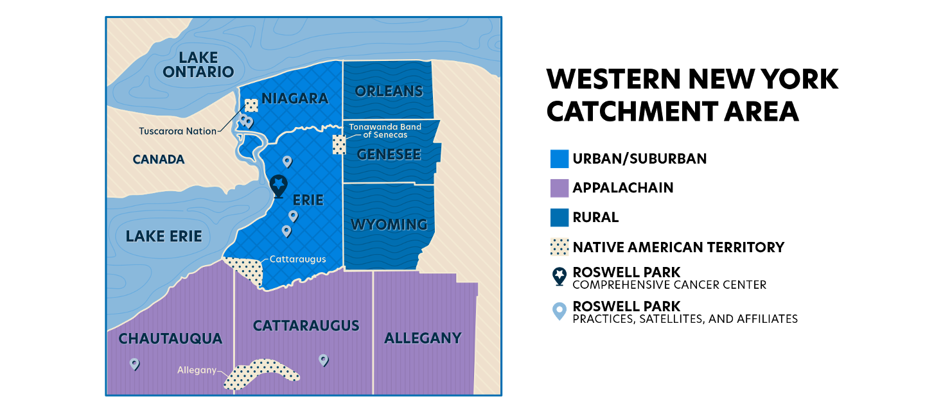
Roswell Park Catchment Area

Slide 5
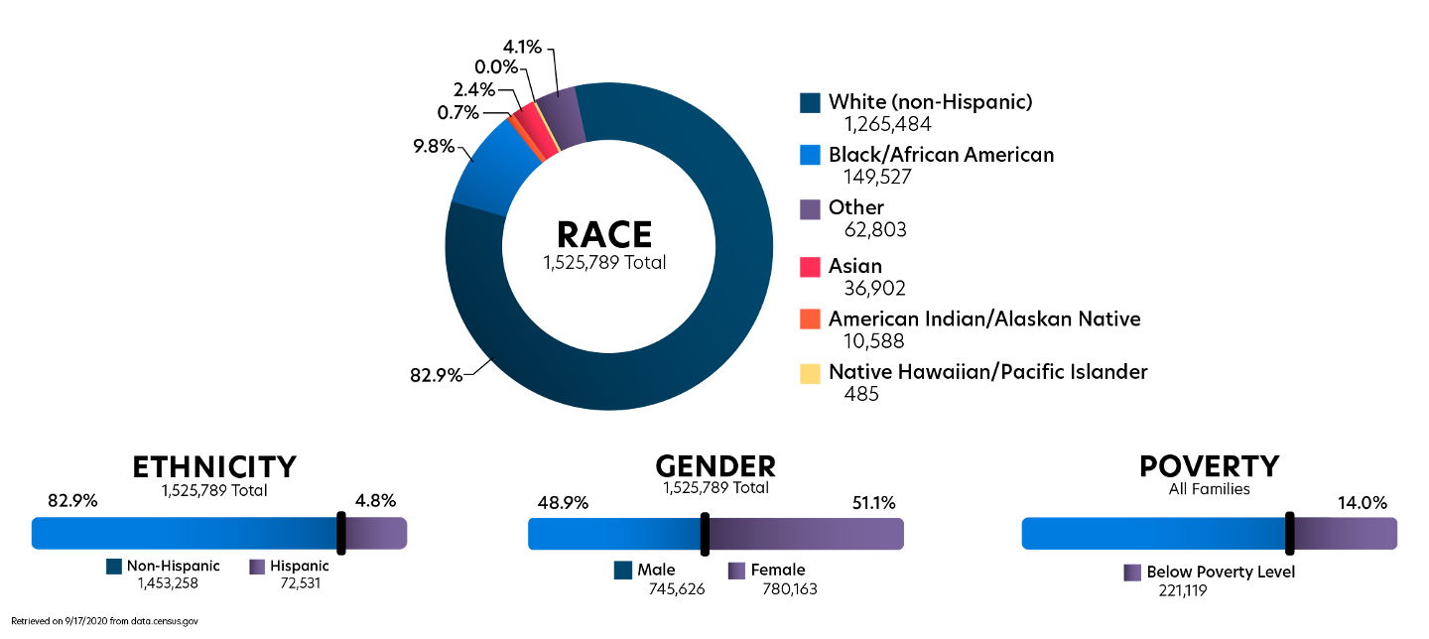
Roswell Park Catchment Area

Slide 6
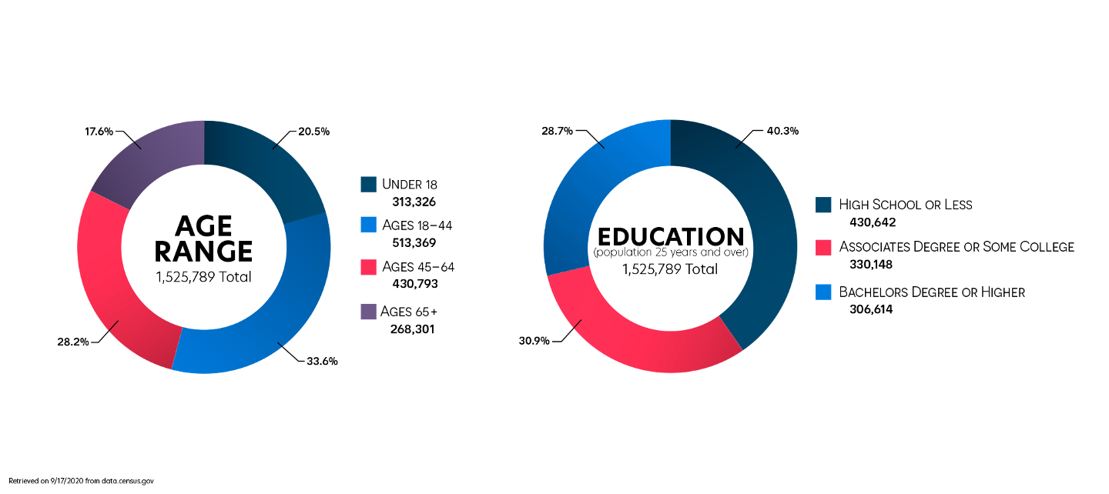
Roswell Park Catchment Area

Slide 7
Governance
Data is governed locally by Roswell IRB and HIPAA compliance policies.
To share data externally, typically Data Use Agreements (DUA) must be established with our Legal Department and appropriate IRB approved protocols must be in place.
Some challenges we may face include sharing:
Genomic data, due to legal contracts
Clinical trial information, due to proprietary information with pharma companies
Consented clinical trials, due to what patient consented to
To begin to address some of the issues internally, we set up meetings with the Director of Research Subject Protection
We also plan to have future meetings with NYS registry to discuss data transfer
Approximately 5-10% of our patients reside in PA, necessitating collaboration across NYS and PA Cancer Registries

Slide 8
Data Sources
Data Source | Description | Current State | Data Flow
Pediatric Cancer Clinical Database | Core pediatric research data (demographics, diagnoses, etc.) | RedCap | RedCap export
Clinical Research Service Clinical Trials | Clinical trials data | OnCore (vendor system) | Collaboration with Roswell’s Clinical Research Services team
Long Term Cancer Survivor Database | Survivorship data | RedCap available, but sourced from Excel | RedCap export
Pediatric Stem Cell and Cellular Therapy Program Clinical | Bone marrow transplant (BMT) and cellular therapy data | Proprietary system | Data owners will provide exports at regular intervals
Psychosocial Determinants of Health Data | Clinical interview and PAT (psychosocial assessment tool) | Clinical interview and PAT (psychosocial assessment tool) both on paper with scoring is captured in Excel and in external RedCap @ URMC | Will work with investigator for ETL of data into new system
Social Network Interactions | A collection of surveys about the self-reported mental health and other social determinants of caregivers of pediatric cancer patients | Caregivers enter data directly into RedCap | RedCap export
Adherence to Oral Chemotherapy | A collection of surveys about the self-reported adherence to oral chemotherapy of the patient, along with literacy assessment, and other social determinants provided by the caregivers of pediatric cancer patients | Caregivers fill out paper forms which are then scanned and emailed to Roswell to be entered into RedCap | RedCap export
Genomic and Immune Profiling | Genomic and immune panel results from various NGS companies | Partial abstraction from PDFs provided by external partners; MySQL database or results | Direct querying of MySQL database

Slide 9
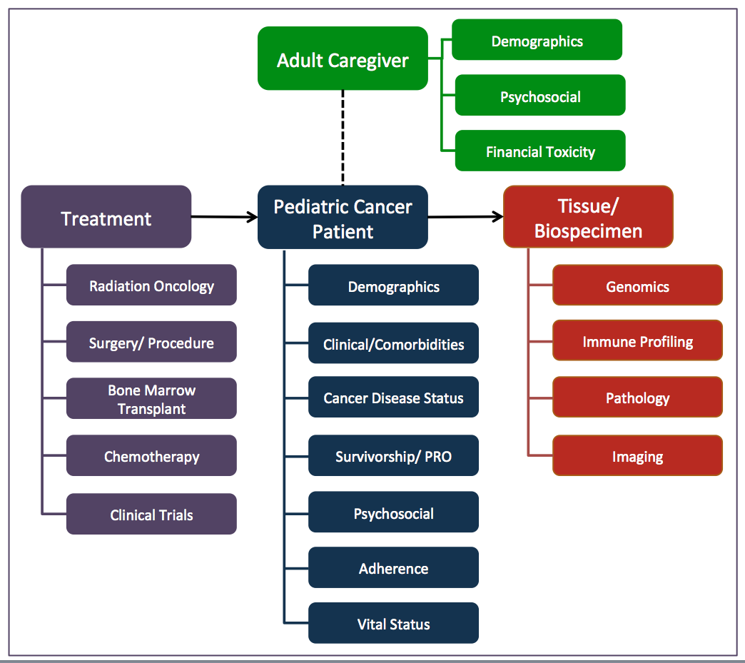
Data Organization
The Childhood Cancer information model leverages object classes for organizational structure.
Data elements from each data source are evaluated and harmonized by mapping to Roswell’s Childhood Cancer information model.
Our data is organized into object classes shown in this figure.
Development of the Childhood Cancer information model is critical to this and national data integration efforts. Carefully defined CDEs and relationships ensure meaningful data integration and promote data re-use.
Each object class is comprised of a logical grouping of common data elements (CDEs) that describe each piece of data in the registry.

Slide 10
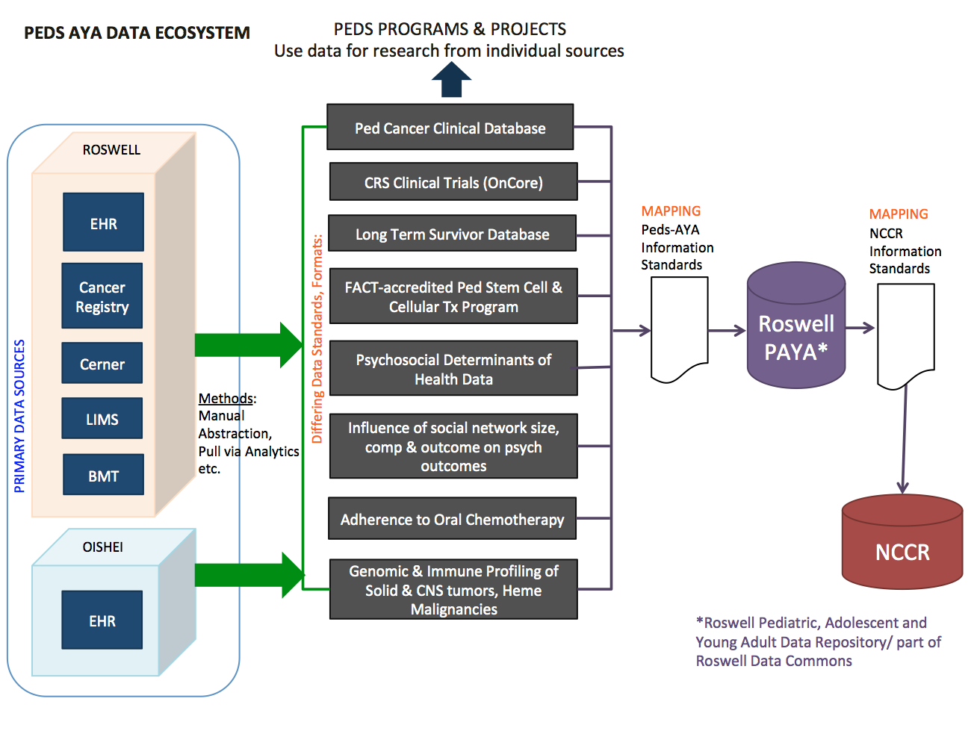
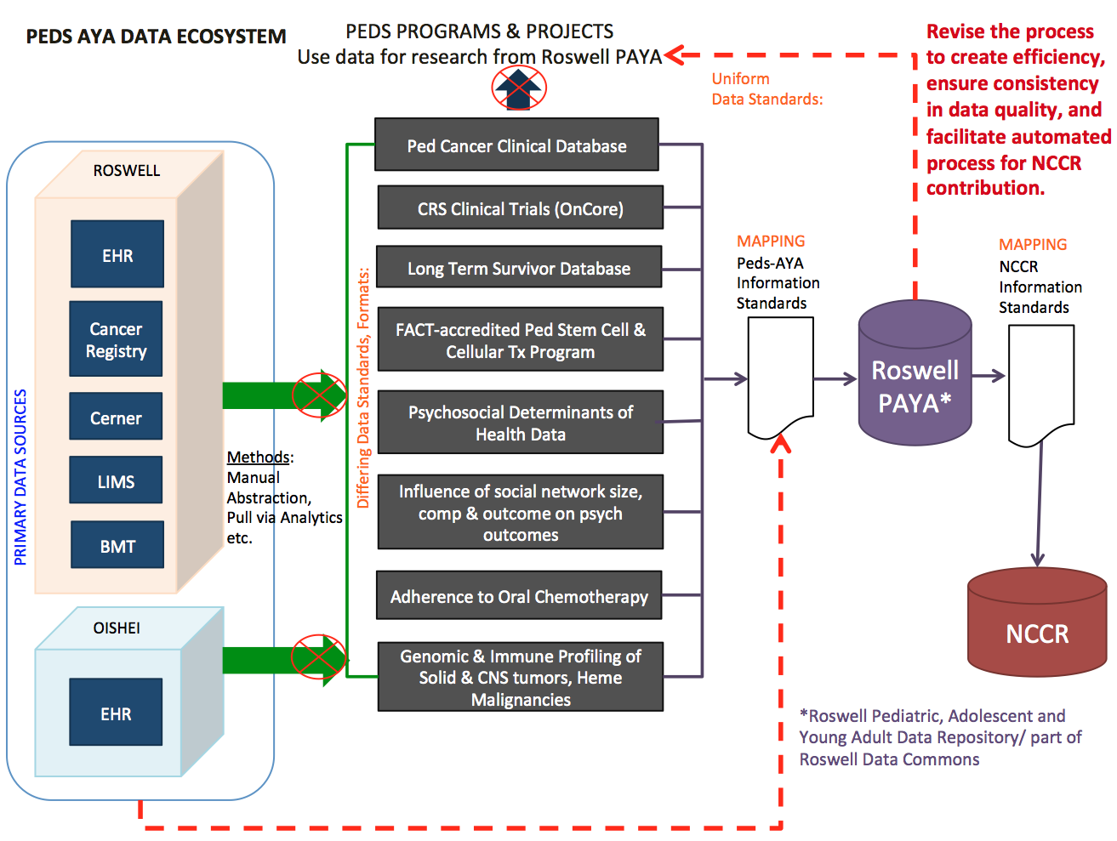
Data Flow Re-engineering

Slide 11
Technology and Architecture
Roswell Pediatric Database and UI
Export or direct querying of relational data sources
Manual abstraction under consideration for unstructured data including but not limited to clinic notes and pathology reports (TBD)
ETL performed on a source by source basis using Python
Standardized data imported into a centralized internal PostgreSQl database
Data accessible via web-based registry frontend (dockerized React application), direct querying, and specified data export

