Slide 1

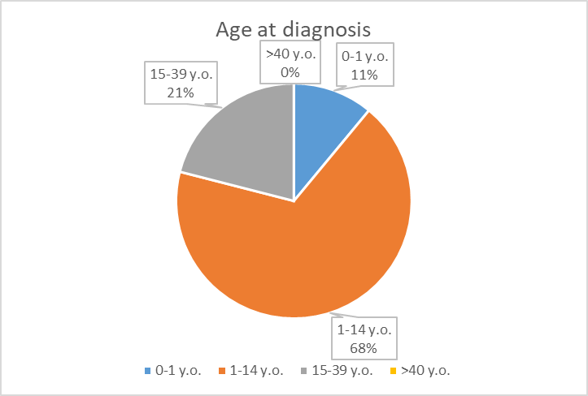
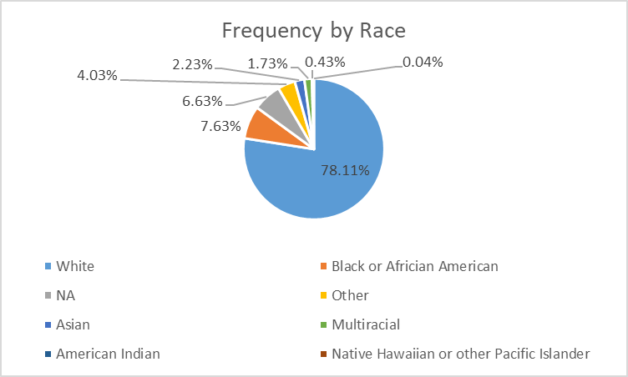
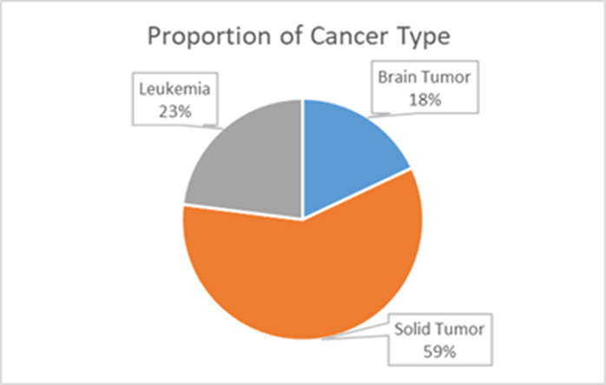
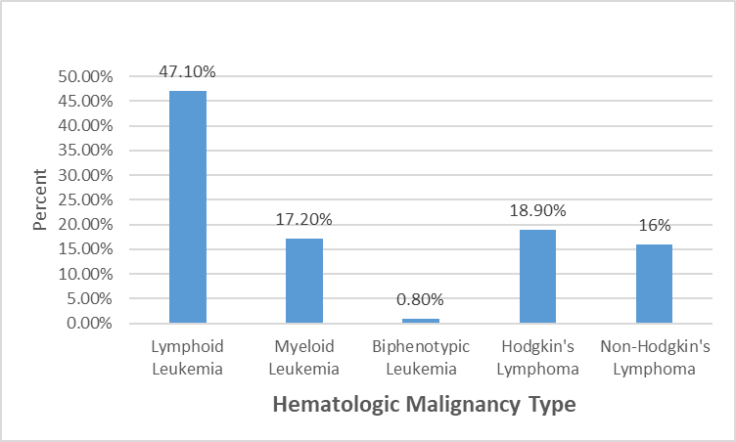
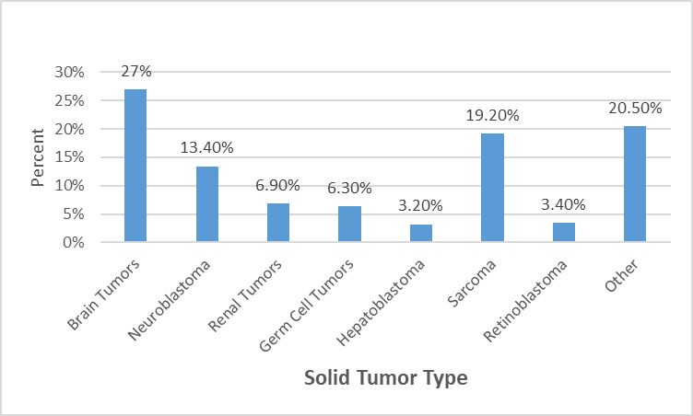
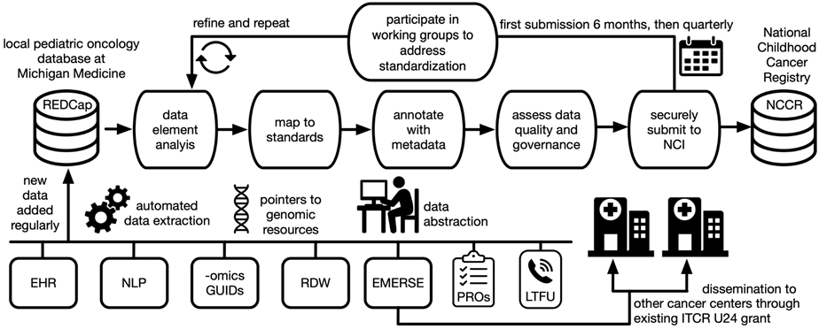
Long Term Outcomes of Children and Young Adults with Cancer
National Childhood Cancer Registry
PATIENT POPULATION
I
II
Study Team
Total patients in database: 2,897
Completion percentage in database: 72.89%
Rajen Mody, M.D., M.S. – Co-Project Lead, Pediatric Oncologist
Arul Chinnaiyan, M.D., Ph.D. –Co-Project Lead, Pathologist
David Hanauer, M.D., M.S. – Co-Investigator, Clinical Informatics
Lili Zhao, Ph.D. – Co-Investigator, Statistician
Jamie Estill, Ph.D. – Systems Analysis Manager
Ian Wolfe, B.S. – Project Manager (contact: iawolfe@umich.edu)
Rhonda McDougall, N.P. – Collaborator
Dustin Walling, M.S. – Collaborator
Stacey Meredith, C.T.R., R.H.I.T. – Collaborator
Valerie Wasson, C.T.R., R.H.I.T. – Collaborator
Jae Eun Choi– Collaborator
Stephanie Ellison– Collaborator
Figure-I: patient ages
Figure-II: racial proportions
Figure-III: proportion of cancer type
Figure-IV: frequency of hematologic malignancies
Figure-V: frequency of solid tumor malignancies
III
IV
V
GOVERNENCE
Institutional IRB will need to approve sharing of exempt clinical data transfer to state and central registry
Need clarification from IRB, State and Central Registry, Data Office, and Compliance teams regarding agreements needed to share data with other academic institutions, or honest brokers
Research tumor genomic data are approved for dbGaP deposit
Will need clarification of necessity and ability to de-identify germline DNA data prior to transmission
DATA RESOURCES AND WORKFLOW
PROVOCATIVE QUESTIONS
Includes both current and potential approaches based on local infrastructure
Methods: Datadirect (structured data), EMERSE (free text), Metamap (NLP), UMLS (coding systems)
NCCR would be an extremely valuable resource to answer questions regarding genetic basis and / or effective therapy for ultra-rare tumors and rare tumors in ethnic minorities.
Similarly, pharmacogenomics studies to identify variants responsible for unusual toxicity or unusually severe common toxicities require large sample size which is not possible with a single institution study.
Pathogenic germline variants in new genes not associated with adult cancers or novel variants in known familial cancer genes can be better identified using NCCR and genotype-phenotype correlation.
DATA SOURCES
Clinical: Epic (EHR), Phone Follow Up; Data stored in REDCap; Additional data abstracted by registrars
Genomic:
Tumor, Matched Normal DNA: WES, Oncoseq1700
Tumor RNA: RNA-SEQ

