Slide 1
Markey Cancer Center National Childhood Cancer Registry P30 Supplement
Impactful Data from a Highly Burdened Population
Principal Investigator
  B Mark Evers, MD
Key Personnel
  Eric B. Durbin, DrPH, MS, Project Lead
  Jay Christian, PhD
  Erin Haynes, PhD
  John L. Villano, MD
  Jeong Cheol Jong, PhD
  Jill Kolesar, PharmD
  Isaac Hands, MPH
  Tom Badgett, MD
Professional Staff
  Joseph Hurt-Mueller, MBA, PMP
  Justin S. Levens
  Roger Chui
  Rachel Maynard, BHS, CTR, PMP

Slide 2
Background
Kentucky children experience a high burden of childhood cancer
Kentucky is ranked 11th highest in the U.S. for the diagnosis years 2008–2017
Incidence rates in Kentucky are significantly higher than U.S. rates for leukemia, brain and CNS tumors, epithelial tumors and melanoma
Incidence rates are even higher among Kentucky’s Appalachian children
The Markey Cancer Center (MCC) P30 supplement will be contributing population-based and institutional clinical and genomic data from multiple sources
MCC is also leading the development of extensions to the North American Association of Central Cancer Registry’s XML data exchange standard to facilitate reporting of additional data from all P30 supplement participants

Slide 3
Age-Adjusted Childhood Cancer Incidence Rates
2008-2017
*
*
*
*P < .05

Slide 4
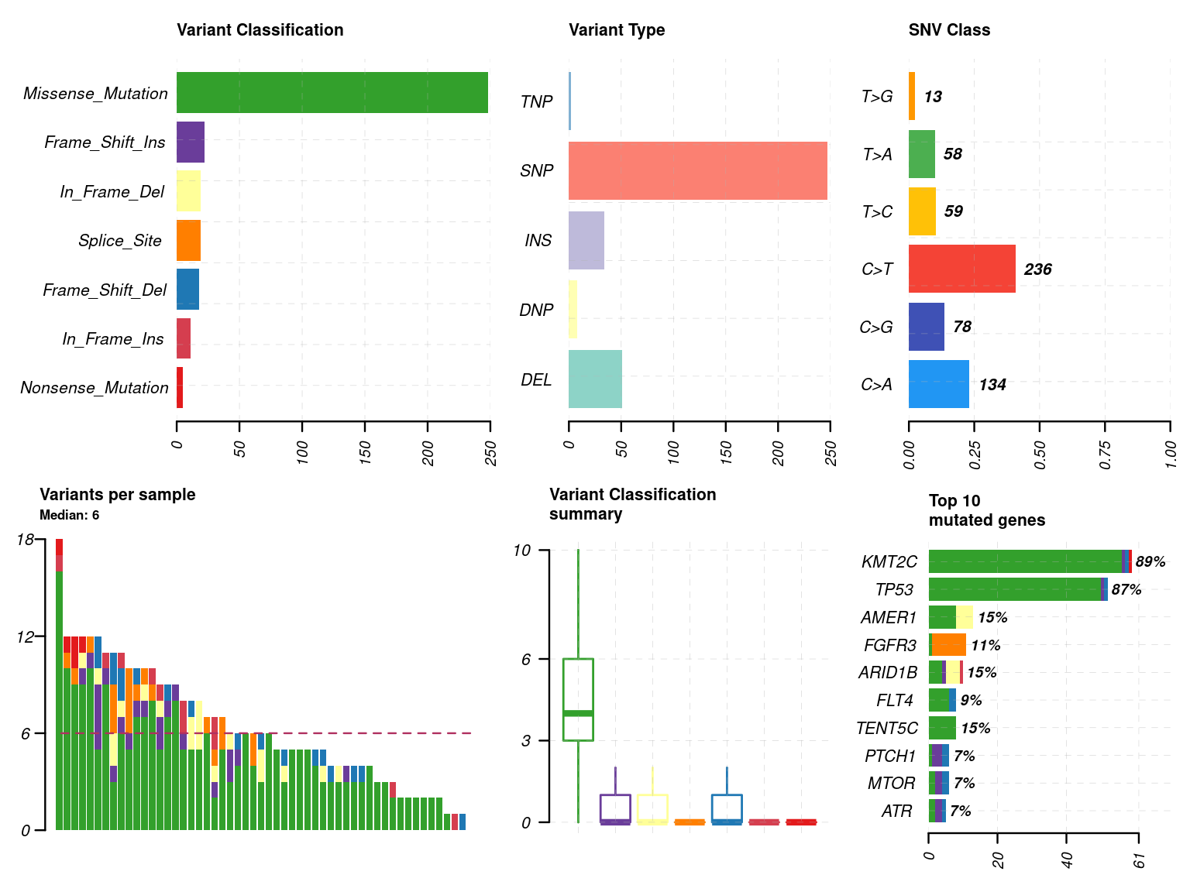
Aim 1: Multidimensional Population-Based
Childhood Brain and CNS Tumor Data
Cluster of Counties with High Rates of PBCNST in Kentucky, 1995-2017
Provocative Question: Cancer disparities exist in the incidence rates of childhood brain and CNS tumors between Appalachian and non-Appalachian children. Are there specific molecular sub-types driving these disparities?
Data Source: Three population-based studies of brain and CNS tumors in Kentucky children
Population: Kentucky children diagnosed with brain and CNS tumors 1995-2021; Childhood Brain Tumor Tissue Consortium
Governance: Supplemental data governed by SEER Kentucky Cancer Registry
Contact: Eric B. Durbin, DrPH, MS
Summary of Somatic Mutations via Mutect2 and Cosmic Census Hotspots

Slide 5
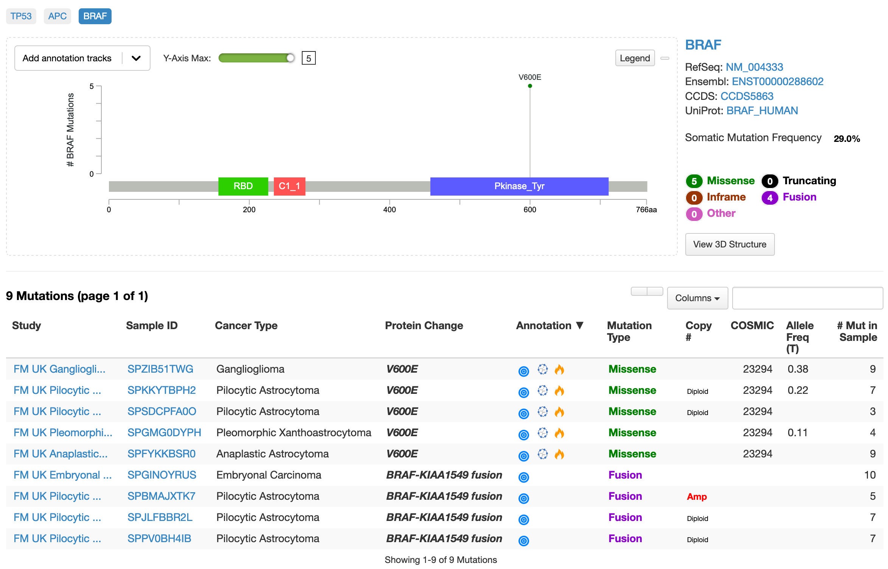
Aim 2: Genomic and Detailed Treatment Data for
MCC Childhood Cancer Patients
Provocative Question: How does treatment response vary among children by molecular and clinical subtypes using data mined from electronic medical records?
Data Resources/Sources: UKHC Data Warehouse; Foundation Medicine Data XML Reports
Population: Childhood cancer patients seen at Markey Cancer Center
Governance: Supplemental data governed by SEER Kentucky Cancer Registry
Contact: Jong Cheol Jeong, PhD
Mutations dominantly found in Age 19 and below from MCC CNS/Brain Cancer patients

Slide 6
Aim 3: Submission of Molecular, Clinical and Outcome Data from Childhood Cases from the Oncology Research Information Exchange Network (ORIEN)
Provocative Question: What molecular pathways drive treatment resistance in children?
Data Sources: MCC ORIEN TCC and Avatar (Somatic and Germline Sequencing)
Population: Childhood cancer patients consented to participate in the ORIEN TCC Protocol
Governance: ORIEN protocol at MCC
Contact: Jill Kolesar, PharmD

Slide 7
Aim 4: Extension of NAACCR XML
Data Exchange Standard
Provocative Question: Can extensions to the NAACCR XML Data Exchange Standard accelerate the harmonization and sharing of childhood cancer data?
Data Resources/Sources: NAACCR XML Data Exchange Standard; various molecular, clinical and outcome data collected at the population level on childhood cancer patients
Population: All childhood cancer cases represented by NCCN P30 Supplements
Governance: Data governance resides at each individual cancer center; data standards governance, including data vocabulary selection, will be informed through collaboration and participation with relevant NCCR workgroups
Contact: Isaac Hands, MPH

Slide 8

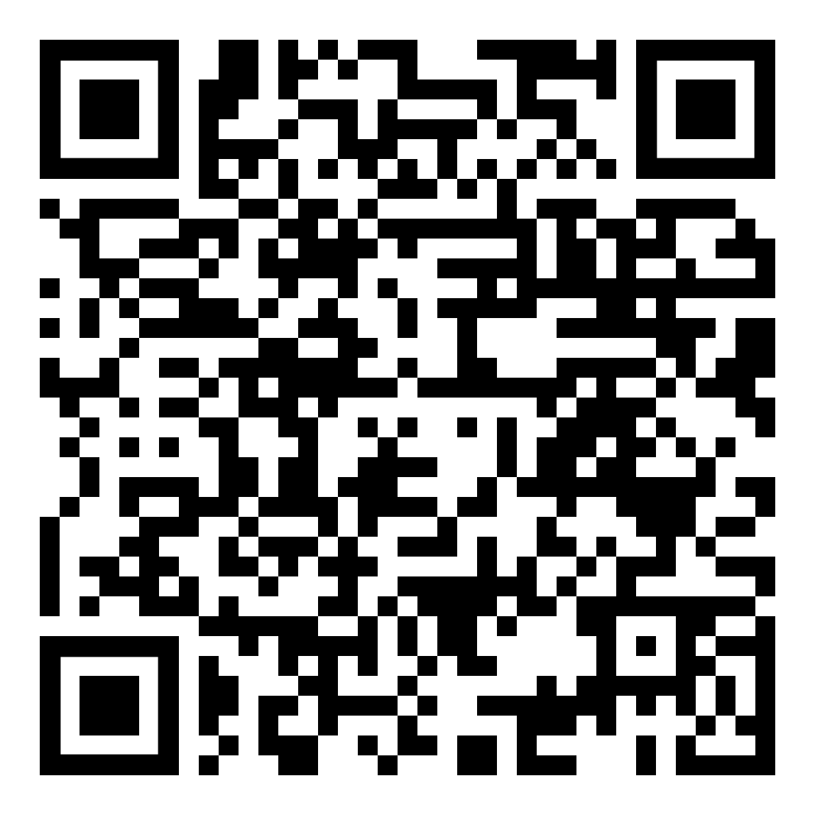
Childhood Cancer in Kentucky Annual Report
2008 - 2017
https://www.kcr.uky.edu/kcr/KCR Childhood Legislative Report_002_2020_12.pdf

