Slide 1


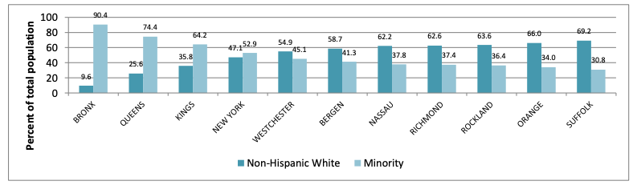
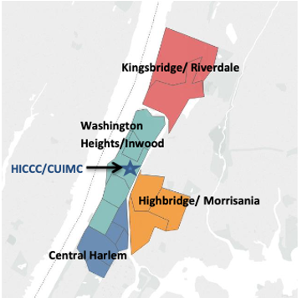
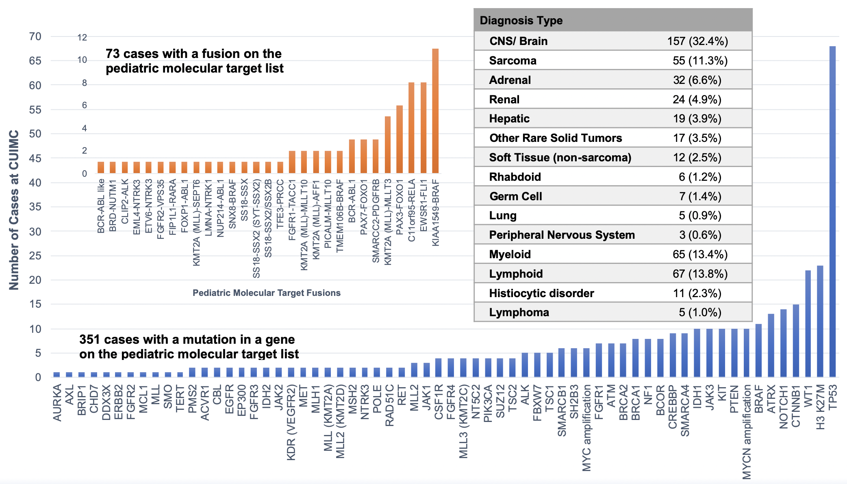
Herbert Irving Comprehensive Cancer Center Common Data Model for
Large-Scale Electronic Health Record/ Molecular Data Deposition to the NCCR
Jennifer Oberg¹, Jovana Pavisic¹, Justine Kahn¹, Tamara Marie¹, Nicholas Tatonetti², Benjamin May², Janie Weiss²
Departments of Pediatrics¹, Biomedical Informatics², Columbia University Irving Medical Center, Herbert Irving Comprehensive Cancer Center, New York, NY
PROJECT AIMS AND SCIENTIFIC GOALS
DATA RESOURCES
Specific Aims
Aim 1: Identify and contribute extensive demographic, disease, treatment, and outcome data from an integrated EHR. Will include:
Sociodemographic data from one of the most diverse patient populations in the U.S.
Linked genomic, clinical, treatment, and allowable financial data for > 450 patients sequenced through the Precision in Pediatric Sequencing (PIPseq) Program
Clinical trials enrollment and outcome data for patients enrolled on consortium-based and other trials, including those in our Developmental Therapeutics Program (DVL)
Aim 2: Develop a data packaging and transfer mechanism to report data to the NCCR. Standardize data representation through the OMOP Common Data Model (CDM) as a feasible, reproducible structure to share complex data across institutions and disparate data sources across all sites participating in the NCCR.
Aim 3: To complete a formal quality assessment of the data elements.
Scientific Goals
Create a mechanism for longitudinal follow-up over the cancer continuum
Incorporate standardized sociodemographic data including language, literacy, geolocation to annotate the clinical and genomic data for each patient
Develop consensus guidelines for molecular profiling of pediatric tumors
Catalyze clinical/translational research (e.g. genotype-phenotype studies to inform clinical decision making for patients with rare or resistant tumors)
Generate real-world data to support pediatric precision oncology, including clinical trial cohort selection, development of synthetic control arms, and identification of novel therapeutic targets and approaches
Develop predictive models using clinical and molecular features for acute and chronic treatment-related toxicities
Incorporate genetic ancestry into outcome analyses across diverse cohorts
Conduct queries, hypothesis generation, and observational studies without having to share sensitive patient-level data across institutions
Observational Medical Outcomes Partnership Common Data Model (OMOP-CDM) and Standardized Vocabularies [1]
Most widely used CDM, integral to the Observational Health Data Science and Informatics (OHDSI) community which conducts observational health research on a global scale with standardized and reproducible healthcare data elements and open-source analytics
Deep information model that specifies encoding and storage of granular clinical data; specifies encodings and relationships among concepts
Concepts defined using standardized vocabularies within the National Library of Medicine’s (NLM) Unified Medical Language System (UMLS)
Leverages distributed data networks to generate real-world evidence: treatment patterns, survival analysis, novel drug-drug interactions [6,7]
Goal: Extend OMOP-CDM to include pediatric cancer-specific data elements including genomic and clinical trial data collected at our institution
OMOP Oncology Module [4] to Support Pediatric Cancer Clinical and Genomic Data Integration into the NCCR
Abstraction of low-level cancer-specific clinical data as part of higher-level disease episodes, treatments, outcomes
Cancer diagnosis model: Captures complexity of diagnoses with clinical, histological, molecular features
Broadly defined cancer types cover a set of diagnoses (conditions in the CONDITION_OCCURRENCE table) that share attributes or diagnostic modifiers (measurements in the MEASUREMENT table)
Pre-coordinated ICD-O-3 histology, topography, and behavior define standardized single cancer diagnosis condition concepts
Cancer treatment model: Captures complex, multi-modal treatment regimens
Multi-modal treatments represented through the Procedure and Drug domains to record individual surgery, drug exposure, or RT events
HemOnc ontology integrated as reference for oncology treatment regimens [5]
Rule-based algorithm matches drug ingredients, timing, and dosing from individual medication records to treatment regimens defined in HemOnc
Cancer episode model: Supports a longitudinal disease trajectory marked by episodes of diagnosis, treatment, and outcome
Each episode record contains a concept of abstracted disease state with a concept of a cancer diagnosis or treatment
Episodes can be nested (e.g. cancer disease episode with several disease states; treatment regimen episode including multiple cycles)
Individual clinical events of Condition, Drug, and Procedure domains are linked to episodes they comprise through EPISODE_EVENT table
Tumor registry to OMOP CDM: Vocabulary-driven extract-transform-load (ETL) process converts tumor registry data into the OMOP CDM with the NAACCR data dictionary integrated into the Standardized Vocabularies
Table 4. Pediatric Oncology CDM Clinical Data Table Examples
Table | Example Data Items | Controlled Vocabulary | Data Relevant to NCCR
Person | person_id, gender_concept_id, year_of_birth, race_concept_id ethnicity_concept_id | N/A | Demographics, socioeconomic status, insurance, family construct, acculturation, health literacy
Procedure_ Occurrence | procedure_occurrence_id, procedure_concept_id, procedure_date procedure_type_concept_id, quantity | CPT-4, HCPCS, ICD-10 Procedures, LOINC SNOMED | Diagnostic/ therapeutic surgical procedures, imaging, pathology, radiation therapy, genomic tests
Condition_ Occurrence | condition_occurrence_id, condition_concept_id, condition_start_date condition_end_date, stop_reason | SNOMED | Oncology diagnosis, toxicities and late effect diagnoses, comorbidities
Drug_ Exposure | drug_concept_id, drug_exposure_start_date sig, route_concept_id, days_supply | RxNorm, (classified by drug class, indication) | Treatments received (anti-neoplastic, supportive care); medicine administration records, prescriptions (oral and intravenous)
Measurement | measurement_concept_id, measurement_date, value_as_number, value_as_concept, range_low | LOINC, SNOMED UCUM (measurement units vocabulary) | Longitudinal lab values (CBC, Chemistry, LFT, tumor marker trends), vital sign trends including height, weight
Specimen | specimen_concept_id, specimen_date quantity, anatomic_site_concept_id disease_status_concept_id | N/A | Information on genomic sequencing specimen, tissue banking
Note | note_id, note_date, note_time, note_type_concept_id, note_text visit_occurrence_id | NLM and LOINC Clinical Document Ontology (CDO) Annotations | Unstructured free text from admission, progress notes; imaging or lab reports
PROVOCATIVE QUESTIONS
DATA SOURCES
GOVERNANCE
Can the OMOP-CDM be leveraged to standardize and automate extraction and reporting of rich clinical and molecular data directly from EHRs across both academic and community sites? This could enable smaller centers to participate in creating a database of real-word evidence.
What analytical tools are needed to integrate the growing body of linked molecular and clinical data to support discovery research that will improve clinical decision making particularly for rare and relapsed/refractory disease?
Can molecular mechanisms be identified that influence disease penetrance in children who inherit cancer susceptibility genes?
Can sociodemographic or geographic barriers/ facilitators to clinical trial enrollment be identified, including for up-front trials and early phase studies?
Table 5. Source Data Collected by the HICCC for Pediatric Oncology Patients
 | Electronic Health Record | PIPseq_LEO/ Clinical Research/ DVL
Database Structure | Jupiter Database Relational database Tens of thousands of objects Maintained by CUIMC DBMI team | IBM SPSS v.27 database 2D spreadsheet and associated data dictionary Maintained by Dr. Oberg
Data Sources | Clinical, billing, administrative data stored in Clarity-Epic’s standard clinical data mart Clinical data from legacy HL7 system (iNYP) NAACCR data loaded quarterly since 2007 | Clinical and molecular pathology notes in the EHR Molecular tumor board meeting discussions Data from the Dept. of Pathology billing specialists Clinical trial enrollment logs (.xlsx)
Data Elements | Demographics Conditions (Diagnoses, Problem Lists) Drug exposure (MAR, prescriptions, med hx) Procedures (including imaging, surgeries) Measurements (labs, vital signs, pathology) Observations Specimens (including data on tissue biobanks) Clinical notes (including ancillary notes, social work, psychosocial) Health economics | ReferenceSequence (RefSeq) OncoTree Ontology for diagnoses Gene variants (somatic/germline), CNV, fusions, relative gene expression with molecular details Clinical effect of genomic findings (i.e. diagnostic, prognostic, targetable, pharmacogenomic, none) Coverage, reimbursement for molecular testing Clinical trials enrollment Response/outcome data (including patients receiving targeted therapies outside of clinical trials)
Electronic Health Record (AllScripts to Epic Transition in February 2020)
Patient data: Social determinants of health; home location, referring provider, education, literacy, poverty, socioeconomic status, immigration status
Disease data: Primary diagnosis, relevant diagnostic modifiers
Treatment data: Chemotherapy, immunotherapy, cellular therapies, novel therapies, transplant, toxicities, radiation, imaging, pathology, laboratory studies
Long-term survivorship data: Late effects
Outcome data: Response, survival, granular cause of death and vital status
Clinical Trials and Developmental Therapeutics Program
Phase I trial accruals (PEP-CTN, formerly COG Phase I consortium), response and outcomes information in accordance with reporting guidelines
Clinical data on patients receiving novel/targeted therapies outside of trials
Institutional and Local Governance
CUIMC IRB approved: #AAAT2879
Coded data submitted to NCI, code shared with honest broker (IMS) to link to state cancer registries
No additional patient consent required
Submitted data request to the Tri-Institutional Request Assessment Committee (TRAC) that provides regulatory and informatics support for data abstraction from the CUIMC Clinical Data Warehouse → will advise on needed DUA
Anticipate needing DUA between CUIMC/NYP and NCI/IMS
State Registries (New York, New Jersey – both on SEER*DMS)
NY State Cancer Registry: meeting scheduled for 2/3/21
NJ State Registry: meeting on 1/25/21 → CUIMC to report all patient data to NYSCR
NJSR to evaluate templates for the NY to NJ interstate exchange to ensure they will support transfer of our data
In general, data to go through IMS who will work with registries on reading the data structure and processing the data
Potential Challenges
Timing for non-NY patients if not submitting data directly to respective state registries
Sharing of potentially detailed treatment and outcomes data for patients enrolled on clinical trials along with their clinical trials participation information
CATCHMENT AREA & POPULATION
The Precision in Pediatric Sequencing (PIPseq) Program
Genomic-driven medicine implemented into clinical practice (2014)
Comprehensive, real-time genomic sequencing (t/n WES, RNAseq) for high-risk malignancies (<50% survival, outlier phenotypes, rare cancers with no standard therapies, predisposition syndromes, relapsed/refractory disease)
Custom-directed gene panel assays when sample adequacy is a concern
Germline WES of patient/parents for suspected constitutionally-encoded diseases
Investigates the impact of molecular findings in clinical decision making [3]
Clinically impactful results subcategorized as: (1) diagnostic; (2) prognostic; (3) targetable (druggable); (4) pharmacogenomic; (5) other clinically impactful findings that result in change of therapeutic plan; (6) recommendations for health maintenance, genetic counseling patient and/or family
Coverage and reimbursement for testing also evaluated
Supports augmentation/validation of the Relevant Pediatric Molecular Target List
Table 7. PIPseq Patient Characteristics (n=485) n (%)
Median age at genomic testing | 9 years​
Sex​
Male | 276 (57)​
Female | 209 (43)​
Race ​ | ​
American Indian/Alaska ​ | 1 (<1)​
Asian/Pacific Islander​ | 33 (7)​
Black or African American​ | 63 (13)​
White​ | 318 (66)​
Other​ | 42 (9)​
Declined/Unknown​ | 28 (6)​
Ethnicity ​ | ​
Non-Hispanic or Latino​ | 317 (65)​
Hispanic or Latino​ | 147 (30)​
Declined/Unknown | 21 (5)​
Table 8. Sequencing Characteristics n (%)
Solid Tumors | 180 (37)
CNS/ Brain Tumors | 157 (32)
Heme Malignancies | 148 (31)
Number of samples/tests | 574/580
Tumor-germline WES | 475 (82)
Constitutional WES | 30 (5)
Transcriptome | 429 (74)
Copy number variation | 386 (81)
Targeted cancer gene panel | 63 (11)
HICCC P30 Cancer Center Grant Catchment Area: 11 counties in NY / NJ
Heme
Malignancies
148, 31%
Solid Tumors
180, 37%
REFERENCES
Table 1. Baseline characteristics of N = 1,279 patients (<1 – 19 years) with cancer treated at CUIMC/HICCC (2008 – 2018) n (%)
Sex
Male | 691 (54)
Female | 588 (46)
Age (years)
<1 – 4 | 416 (33)
5 – 11 | 326 (25)
12 – 14 | 184 (14)
15 – 18 | 363 (28)
Ethnicity
Hispanic | 250 (20)
Non-Hispanic | 576 (45)
Declined/Unknown | 453 (35)
Race
White | 591 (47)
Black/African American | 111 (9)
Asian/PI | 53 (4)
American Indian/Alaska | 8 (<1)
Declined/Unknown | 515 (40)
Insurance
Private | 910 (71)
Public or Government | 165 (13)
Self-pay or Not Insured | 47 (3)
Unknown or NOS | 165 (13)
Primary Diagnosis Hematologic 35%, Solid Tumor 35%, CNS 30%
Table 2. CUIMC/HICCC Peds Onc P30 Catchment Area n (%) | N = 1279 (%)
New York | 913 (72)
New Jersey | 195 (15)
Connecticut | 39 (3)
U.S. Other | 27 (2)
Outside U.S. | 51 (4)
Unknown | 54 (4)
CNS/ Brain Tumors
157, 32%
[1] Hripcsak G, Duke JD, Shah NH, et al. Observational Health Data Sciences and Informatics (OHDSI): Opportunities for Observational Researchers. Stud Health Technol Inform. 216:574-8, 2015.
[2] Observational Health Data Sciences and Informatics: The Common Data Model. Available from: https://ohdsi.github.io/TheBookOfOhdsi/CommonDataModel.html.
[3] Oberg JA, Glade Bender JL, Sulis ML, et al. Implementation of next generation sequencing into pediatric hematology-oncology practice: moving beyond actionable alterations. Genome Med. 8:133, 2016
[4] Belenkaya R, Gurley MJ, Golozar A, et al. Extending the OMOP Common Data Model and Standardized Vocabularies to Support Observational Cancer Research. JCO Clinical Cancer Informatics. 5:12-20, 2021.
[5] HemOnc.org - A Free Hematology/Oncology Reference.
[6] Hong N, Zhang N, Wu H, et al. Preliminary exploration of survival analysis using the OHDSI common data model: a case study of intrahepatic cholangiocarcinoma. BMC Med Inform Decis Mak. 18(Suppl 5):116. 2018.
[7] Chen R, Ryan P, Natarajan K, et al. Treatment Patterns for Chronic Comorbid Conditions in Patients with Cancer Using a Large-Scale Observational Data Network. JCO Clin Cancer Inform. 4:171-83. 2020.
Table 9. Example Sequencing Reimbursement Data
Payer Mix | n (%)
Commercial | 105 (53)
Managed Government | 83 (42)
Government | 11 (5)
Reimbursement | Mean/Median %
Commercial | 35/21
Managed Government | 31/10
Government | 00/00
WES + RNAseq (CLIA, CAP, NY State DOH approved)
Tumor/ normal (buccal or peripheral blood)
≥ 150-fold coverage with > 98% of the coding sequences having at least 10-fold coverage
Fresh, Frozen, or FFPE
DNA: 200ng (40% tumor); RNA: 3,000ng
Illumina HiSeq2500 (NovaSeq under validation)
Figure 2. PIPseq identified genes & fusions associated with the FDA/NCI pediatric molecular target list
Table 3. CUIMC/HICCC Peds Onc Clinical Trial Enrollments n (%)
Total Enrollments | 1264
Non-Therapeutic | 810 (64)
Therapeutic | 454 (36)
Therapeutic Trial Phase
I | 74 (16)
I/II | 63 (14)
II | 91 (20)
III | 195 (45)
Pilot | 20 (4)
Compassionate Use | 9 (2)
Table 6. Clinical Reporting Structure
Tier 1 | Actionable somatic mutations associated with tumor type.
Tier 2 | Somatic mutations in targeted pathways. Actionable somatic mutations in other tumor types. Somatic mutations in well-established cancer genes.
Tier 3 | Other somatic mutations in cancer genes.
Tier 4 | Somatic variants of uncertain significance.
Germline | Variants affecting therapy. Secondary variants (ACMG).
Transcriptome (RNAseq) Fusions. Expression outliers.
Copy Number Variation
Figure 3: Example Sequencing Coverage by Payer
CONTACTS
Pediatric Oncology
Investigator: Jennifer Oberg, EdD, MA (jao37@cumc.columbia.edu)
Investigator: Jovana Pavisic, MD, MA (jp3679@cumc.columbia.edu)
Investigator: Justine Kahn, MD, MS (jk2034@cumc.columbia.edu)
Coordinator: Tamara Marie (tm2905@cumc.columbia.edu)
Biomedical Informatics
Investigator: Nicholas Tatonetti, PhD (npt2105@cumc.columbia.edu)
Sr. Systems Analyst: Benjamin May (blm14@cumc.columbia.edu)
Manager: Janie Weiss (jw16@cumc.columbia.edu)

