Slide 1
NAACCR XML for Data Submissions to the National Childhood Cancer Registry
CCDI NCCR Cancer Center Supplement Data Summit
February 8, 2021
Isaac Hands, MPH (isaac.hands@uky.edu)
Associate Director, Cancer Research Informatics Shared Resource Facility, UK Markey Cancer Center
Co-Chair, NAACCR XML Data Exchange Workgroup
Representative-at-Large, NAACCR Board of Directors

Slide 2
Overview
Summary of NAACCR XML
https://www.naaccr.org/xml
(Data Exchange Standard, XML Specifications for Cancer Registry Records, Version 1.4)
How to extend the NAACCR XML Data Exchange Standard
Example of NAACCR XML Extensions for NCCR

Slide 3
NAACCR XML is NOT
Clinical Vocabulary
Clinical Terminology
Formal Ontology (not really…)
Healthcare Classification System or Nomenclature
Coding System
Data Dictionary
Method of encryption or protocol for network transmission
Encounter-based EHR

Slide 4
NAACCR XML is a Data Exchange Standard
“A standardized method of encapsulating cancer registry records for transmission from a source to a target system.”
Encapsulates a standard set of data items from the NAACCR Data Dictionary
Relies on external coding standards: AJCC, CDC, NCI, WHO, CoC
Defines 2 methods for anyone to extend the standard
Notes:
Does not talk about storage or schema in the source or target systems
- Typical use cases are from hospital to central registry, central registry to national agency, cancer registry to researchers
Cancer registry records, also known as cancer abstracts, tumor records – deal with a primary cancer diagnosis
Is not a healthcare event, there are many events that are consolidated and abstracted into a cancer registry record

Slide 5
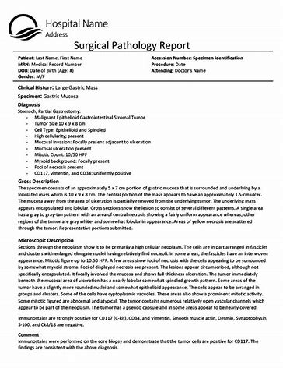







Medical Records,
Lab Reports,
Surgical Notes, etc.
Typical Cancer Registry Data Flow
Death Certificates
Medicare Data
Hospital Cancer Registry
Lexis Nexis
NCI SEER Program
Central Cancer Registry
Cancer Abstracts
NAACCR XML
NAACCR XML

Slide 6
The NAACCR XML Standard in One Slide
XML Data Files
<NaaccrData recordType=”C”>
<Patient>
<Item naaccrId="dateOfBirth">20100101</Item>
<Tumor>
<Item naaccrId=“primarySite”>C712</Item>
<Item naaccrId="histologicTypeIcdO3">9539</Item>
</Tumor>
</Patient>
</NaaccrData>
XML Dictionary Files
<NaaccrDictionary>
<ItemDefs>
<ItemDef
naaccrId="primarySite”
naaccrNum="400”
naaccrName="Primary Site”
length="4”
recordTypes="A,M,C,I”
parentXmlElement="Tumor"/>

Slide 7
How to Extend the NAACCR XML Standard Method 1: Create a NAACCR XML User Dictionary
Custom XML User Dictionary
<NaaccrDictionary>
<ItemDefs>
<ItemDef
naaccrId=”ecogStatus”
naaccrNum=”91000”
naaccrName=”ECOG Status”
length=”1”
recordTypes="A,M,C,I”
parentXmlElement=”Tumor"/>
PRO | CON
Easy to implement | Does not support hierarchical data
Works with existing NAACCR XML software, including EDITS | Does not support multiplicity
Many examples already exist

Slide 8
How to Extend the NAACCR XML Standard Method 2: Define custom XML namespace
Custom XML Namespace
<NaaccrData
xmlns:nccr="https://www.cancer.gov/nccr">
<Patient>
<Item naaccrId="patientIdNumber">12345678>/Item>
<Tumor>
<Item naaccrId="primarySite">C345</Item>
<Item naaccrId="histologicTypeIcdO3">8100</Item>
<nccr:SpecimenReport>
<nccr:Specimen>
<nccr:Item nccrId="specimenId"/>
<nccr:Item nccrId="specimenCollectionDate"/>
</nccr:Specimen>
<nccr:GenomicVariantReport>
PRO | CON
Supports hierarchical data | Requires custom software
Supports multiplicity | Open-ended requirements
 | Few examples exist

Slide 9
Data Types Proposed for P30 Supplement by University of Kentucky Markey Cancer Center
Aim 1: Multidimensional Population-Based Childhood Brain and CNS Tumor Data
Aim 2: Genomic and Detailed Treatment Data for MCC Childhood Cancer Patients
Aim 3: Submission of Molecular, Clinical and Outcome Data from Childhood Cases from the Oncology Research Information Exchange Network (ORIEN)

Slide 10
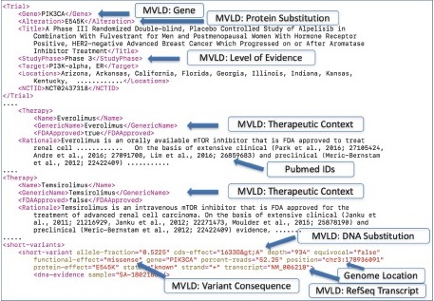
Example NAACCR XML Extensions for NCCR
Pathology Reports
MSH|^~\&|SuperLink|SuperLab^01D1012357^CLIA|Cancer Registry|CR|20190307121736||ORU^R01^ORU_R01|20190307121736_81778|D|2.5.1 PID|1||A001223/B2345676^^^^MR^St. Best Hospital~^^^^SS~3344556^^^^PI^01D1012357&SuperLab SuperState&CLIA||Doe^Jane||19420222|F PV1|1|N|||||^Welby^Marcus ORC|RE||||||||||||||||||||St. Best Hospital|11 Super Street^^Supercity^NY^122286^United States|^WPN^FX^^^123^4567891~^WPN^PH^^^123^3456788 OBR|1||1112224|26435-8^Molecular Pathology Studies^LN^^EGFR Mutation Analysis^L|||20190219000000|||||||20190226105600|^^Lung, Left|^Howser^Doogie||||||20190306121401|||F||||||MALIGNANT NEOPLASM OF UNSPECIFIED PART OF BRONCHUS OR LUNG, EGFR repeat|&Ben&Casey SPM|1|SN19-123-A|SN19-123-A|TISS^Tissue^HL70487^^Paraffin Tissue^L|||||||||||||20190219000000|20190226105600||||||||||||1112224|SN19-123-A OBX|1|TX|22637-3^Path Report Final Diagnosis^LN||EGFR Mutation: Detected||||||F||||01D1012357^SuperLab SuperState^CLIA
MSH|^~\&|SuperLink|SuperLab^01D1012357^CLIA|Cancer Registry|CR|20190307121736||ORU^R01^ORU_R01|20190307121736_81778|D|2.5.1 PID|1||A001223/B2345676^^^^MR^St. Best Hospital~^^^^SS~3344556^^^^PI^01D1012357&SuperLab SuperState&CLIA||Doe^Jane||19420222|F PV1|1|N|||||^Welby^Marcus ORC|RE||||||||||||||||||||St. Best Hospital|11 Super Street^^Supercity^NY^122286^United States|^WPN^FX^^^123^4567891~^WPN^PH^^^123^3456788 OBR|1||1112224|26435-8^Molecular Pathology Studies^LN^^EGFR Mutation Analysis^L|||20190219000000|||||||20190226105600|^^Lung, Left|^Howser^Doogie||||||20190306121401|||F||||||MALIGNANT NEOPLASM OF UNSPECIFIED PART OF BRONCHUS OR LUNG, EGFR repeat|&Ben&Casey SPM|1|SN19-123-A|SN19-123-A|TISS^Tissue^HL70487^^Paraffin Tissue^L|||||||||||||20190219000000|20190226105600||||||||||||1112224|SN19-123-A OBX|1|TX|22637-3^Path Report Final Diagnosis^LN||EGFR Mutation: Detected||||||F||||01D1012357^SuperLab SuperState^CLIA
MSH|^~\&|SuperLink|SuperLab^01D1012357^CLIA|Cancer Registry|CR|20190307121736||ORU^R01^ORU_R01|20190307121736_81778|D|2.5.1 PID|1||A001223/B2345676^^^^MR^St. Best Hospital~^^^^SS~3344556^^^^PI^01D1012357&SuperLab SuperState&CLIA||Doe^Jane||19420222|F PV1|1|N|||||^Welby^Marcus ORC|RE||||||||||||||||||||St. Best Hospital|11 Super Street^^Supercity^NY^122286^United States|^WPN^FX^^^123^4567891~^WPN^PH^^^123^3456788 OBR|1||1112224|26435-8^Molecular Pathology Studies^LN^^EGFR Mutation Analysis^L|||20190219000000|||||||20190226105600|^^Lung, Left|^Howser^Doogie||||||20190306121401|||F||||||MALIGNANT NEOPLASM OF UNSPECIFIED PART OF BRONCHUS OR LUNG, EGFR repeat|&Ben&Casey SPM|1|SN19-123-A|SN19-123-A|TISS^Tissue^HL70487^^Paraffin Tissue^L|||||||||||||20190219000000|20190226105600||||||||||||1112224|SN19-123-A OBX|1|TX|22637-3^Path Report Final Diagnosis^LN||EGFR Mutation: Detected||||||F||||01D1012357^SuperLab SuperState^CLIA
Childhood Cancer Case in Registry
<NaaccrData>
<Patient>
<Item naaccrId="dateOfBirth">20100101</Item>
<Tumor>
<Item naaccrId=“primarySite”>C712</Item>
<Item naaccrId="histologicTypeIcdO3">9539</Item>
</Tumor>
</Patient>
</NaaccrData>
Clinical Genomics Reports

Slide 11
Define XML Namespace for NCCR
Cancer Registry Record, extended with NCCR Namespace
<NaaccrData xmlns:nccr="https://www.cancer.gov/nccr">
<Patient>
<Item naaccrId="dateOfBirth">20100101</Item>
<Tumor>
<Item naaccrId=“primarySite”>C712</Item>
<Item naaccrId="histologicTypeIcdO3">9539</Item>
<nccr:SpecimenReport>
<nccr:PathologyReport>
…
</nccr:PathologyReport>
<nccr:PathologyReport>
…
</nccr:PathologyReport>
<nccr:GenomicVariantReport>
…
</nccr:GenomicVariantReport>
<nccr:GenomicVariantReport>
…
</nccr:GenomicVariantReport>
</nccr:SpecimenReport>
</Tumor>
</Patient>
</NaaccrData>
Hospital or Central Registry will Link pathology reports and genomic reports with cancer registry records
Support multiple pathology reports per Tumor record
Support multiple genomic reports per Tumor record
NAACCR XML Registry record is extended with NCCR data elements

Slide 12
Multiple ways to define custom Elements
Option 1: Embed Raw Data
Option 2: Parse into discrete items
<nccr:PathologyReport>
<![CDATA[
MSH|^~\&|SuperLink|SuperLab^01D1012357^CLIA|Cancer Registry|CR|20190307121736||ORU^R01^ORU_R01|20190307121736_81778|D|2.5.1 PID|1||A001223/B2345676^^^^MR^St. Best Hospital~^^^^SS~3344556^^^^PI^01D1012357&SuperLab SuperState&CLIA||Doe^Jane||19420222|F PV1|1|N|||||^Welby^Marcus ORC|RE||||||||||||||||||||St. Best Hospital|11 Super Street^^Supercity^NY^122286^United States|^WPN^FX^^^123^4567891~^WPN^PH^^^123^3456788 OBR|1||1112224|26435-8^Molecular Pathology Studies^LN^^EGFR Mutation Analysis^L|||20190219000000|||||||20190226105600|^^Lung, Left|^Howser^Doogie||||||20190306121401|||F||||||MALIGNANT NEOPLASM OF UNSPECIFIED PART OF BRONCHUS OR LUNG, EGFR repeat|&Ben&Casey SPM|1|SN19-123-A|SN19-123-A|TISS^Tissue^HL70487^^Paraffin Tissue^L|||||||||||||20190219000000|20190226105600||||||||||||1112224|SN19-123-A OBX|1|TX|22637-3^Path Report Final Diagnosis^LN||EGFR Mutation: Detected||||||F||||01D1012357^SuperLab SuperState^CLIA
]]>
</nccr:PathologyReport>
<nccr:PathologyReport>
<nccr:Item nccrId="specimenId">P34-098AAS</nccr:Item>
<nccr:Item nccrId="dateEpathMessage">20210106</nccr:Item>
<nccr:Item nccrId="textPathComments">
There are two lymph nodes measuring 1 x 0.7 cm and 0.5 x 0.5 cm. The entire specimen is cut into several portions and totally embedded. Specimen #2 labeled “left pelvic obturation lymph nodes” consists of an adipose tissue measuring 4x
2 x 1 cm. There are two lymph nodes measuring 1.3 x 0.8 cm and 1 x 0.6 cm. The entire specimen is cut into several portions and totally embedded.
</nccr:Item>
<nccr:Item nccrId="textPathFinalDiagnosis">
There are two lymph nodes measuring 1 x 0.7 cm and 0.5 x 0.5 cm. The entire specimen is cut into several portions and totally embedded. Specimen #2 labeled “left pelvic obturation lymph nodes” consists of an adipose tissue measuring 4x
2 x 1 cm. There are two lymph nodes measuring 1.3 x 0.8 cm and 1 x 0.6 cm. The entire specimen is cut into several portions and totally embedded.
</nccr:Item>

Slide 13
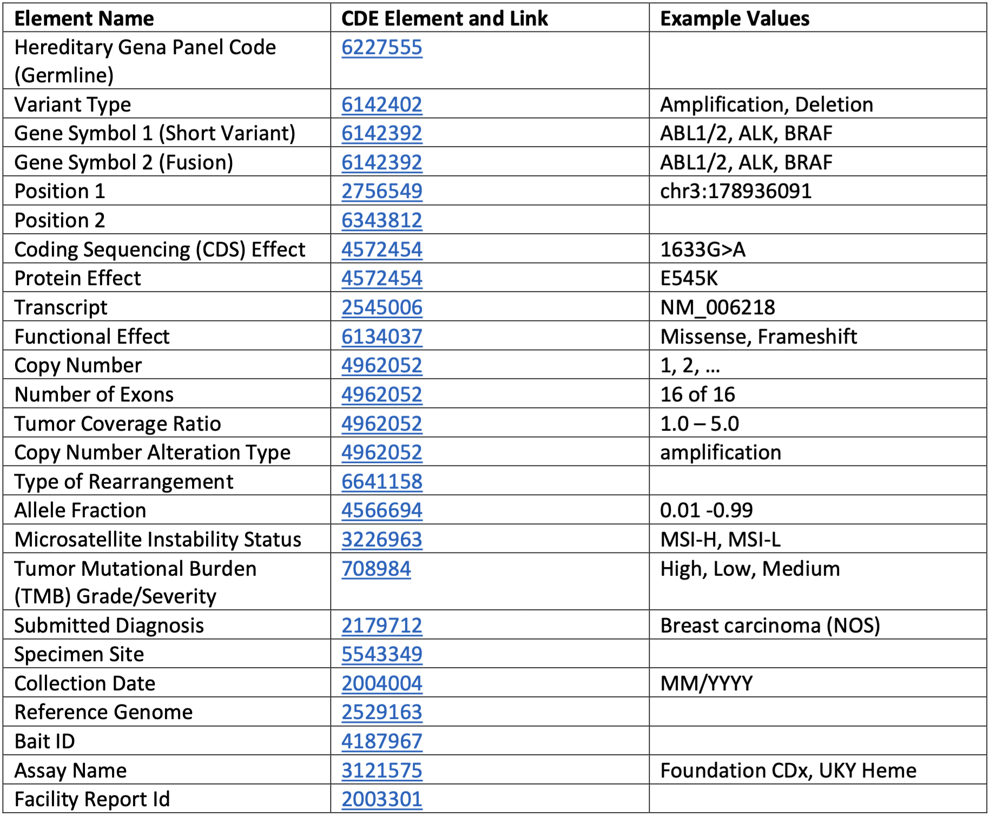
Example Genomic Variant Report for NCCR
<nccr:GenomicVariantReport>
<nccr:Item nccrId="cliaNumber"/>
<nccr:Item nccrId="variantReportProviderName"/>
<nccr:Item nccrId="baitSet"/>
<nccr:Item nccrId="referenceGenome"/>
<nccr:Item nccrId="dateReportGenerated"/>
<nccr:Item nccrId="specimenId"/>
<nccr:Item nccrId="reportSignature"/>
<nccr:Item nccrId="reportId"/>
<nccr:Item nccrId="microsatelliteInstability"/>
<nccr:Item nccrId="tumorMutationBurden"/>
<nccr:ShortVariant> <!-- 0..n -->
<nccr:Item nccrId="geneName1"/>
<nccr:Item nccrId="position1"/>
<nccr:Item nccrId="cdsEffect"/>
<nccr:Item nccrId="proteinEffect"/>
<nccr:Item nccrId="transcript"/>
<nccr:Item nccrId="functionalEffect"/>
<nccr:Item nccrId="alleleFraction"/>
</nccr:ShortVariant>
<nccr:CopyNumber> <!-- 0..n -->
<nccr:Item nccrId="geneName1"/>
<nccr:Item nccrId="position1"/>
<nccr:Item nccrId="copyNumber"/>
<nccr:Item nccrId="numberOfExons"/>
<nccr:Item nccrId="ratio"/>
<nccr:Item nccrId="alterationType"/>
</nccr:CopyNumber>
<nccr:Rearrangement> <!-- 0..n -->
<nccr:Item nccrId="geneName1"/>
<nccr:Item nccrId="geneName2"/>
<nccr:Item nccrId="position1"/>
<nccr:Item nccrId="position2"/>
<nccr:Item nccrId="description"/>

Slide 14
Thank You
Isaac Hands, MPH (isaac.hands@uky.edu)
Consider joining NAACCR and contributing to Cancer Registry Standards

