Slide 1
NAACCR Standards
CCDI NCCR Cancer Center Supplement Data Summit
February 8, 2021
Stephanie M. Hill, MPH, CTR
Associate Director
North American Association of Central Cancer Registries
shill@naaccr.org

Slide 2
Overview
Introduction to NAACCR
NAACCR Data Exchange Standards
NAACCR Data Dictionary
Change Control Process
Tools & Resources

Slide 3
NAACCR
North American Association of Central Cancer Registries
Established in 1987
All central cancer registries in the United States and Canada are members
Mission:
Develop & promote uniform data standards for cancer registration
Provide education and training
Certify population-based registries
Aggregate and publish data from central cancer registries
Promote the use of cancer surveillance data and systems for cancer control and epidemiologic research, public health programs, and patient care
Notes:
Established in 1987, NAACCR, Inc. is a collaborative organization for cancer registries, governmental agencies, professional associations, and private groups in North America interested in enhancing the quality and use of cancer registry data. All central cancer registries in the United States and Canada are members.

Slide 4










Cancer Reporting in the U.S.
Hospitals
Labs
Central Registry A
Physicians
Hospitals
Central Registry B
Labs
Physicians
Central Registry C
Hospitals
Labs
Physicians
Notes:
All these groups have data requirements -> standards
NAACCR standards cover all of this – they aren’t NAACCR’s standards

Slide 5
NAACCR Data
Patient Demographics
Last name
First name
Date of birth
Social Security Number
Race/Ethnicity
Address
Tumor Characteristics
Site & Laterality
Histology & Behavior
Grade
Prognostic & predictive factors
Date of diagnosis
Diagnostic confirmation
Stage at diagnosis
First Course of Treatment
Surgery
Chemotherapy
Radiation therapy
Hormone therapy
Immunotherapy
Hematologic transplant & endocrine procedures
Follow-Up
Date of last contact
Vital status
Date of death
Administrative Codes

Slide 6
NAACCR Standards
Data Exchange Standards: XML Specifications for Cancer Registry Records
Data Standards & Data Dictionary
Standards for Quality, Completeness, Analysis, and Management of Data (under revision)
Standard Data Edits
Pathology Laboratory Electronic Reporting
https://www.naaccr.org/
Notes:
It quickly became apparent that standards were needed to govern the exchange of all this data, and it was determined that NAACCR would be the keeper of those standards. Today, NAACCR publishes five standards. (read slide). I am going to focus on the first two.

Slide 7
NAACCR Standards
Data Exchange Standards: XML Specifications for Cancer Registry Records
Defines standard method and format for the transmission of cancer registry data
https://www.naaccr.org/xml-data-exchange-standard/
Data Standards & Data Dictionary
Detailed specifications and codes for each data item in the NAACCR data exchange record layout
Defines “Required” status of each data item by standard setter
https://www.naaccr.org/data-standards-data-dictionary/

Slide 8
Data Exchange Standards
<1993 – 2020 NAACCR Fixed-width Format
A18000000000000100000009SEVERNA PARKMD21146 999 9999999501 8801074…
Incidence Record | Confidential Record | Full Case Abstract
4,048 characters | 6,154 characters | 24,194 characters
Demographic, Tumor, Staging, Treatment, and Follow-up | + Patient and Physician Identifiers and Pathology Metadata | +Text
Source: Hands, Isaac. Guiding the Way to XML Data Exchange Implementation
Notes:
Limitations of Fixed-Width Standard
• Lack of Extensibility
• New items
• Retired items
• Custom items
• Poor Readability
• Empty Space is Wasted

Slide 9
January 1, 2021
Implementation of XML data exchange standard
Notes:
More than 5 years in the making (started looking for a new standard even earlier). Several data standards were evaluated, but ultimately XML was chosen as the best fit for the needs of the cancer surveillance community.

Slide 10
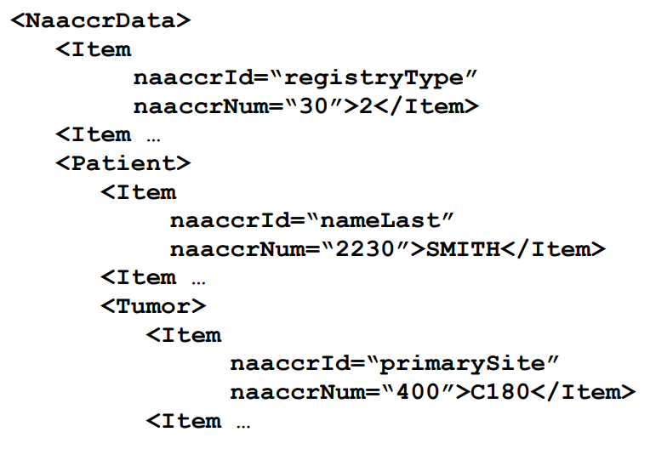
NAACCR XML Data Exchange Standard
Extensibility
Easy to maintain by NAACCR community
Simplified transition from fixed-width format
Easy to create, consume and process
Notes:
I’m sure I don’t have to tell you that NAACCR did not invent XML – there are well over 100 of organizations and groups that have defined their own XML

Slide 11
NAACCR Data Dictionary
Defines each data item in the NAACCR layout, including:
XML ID
Description
Source of standard
Rationale
Year Implemented/Retired
Allowable codes

Slide 12
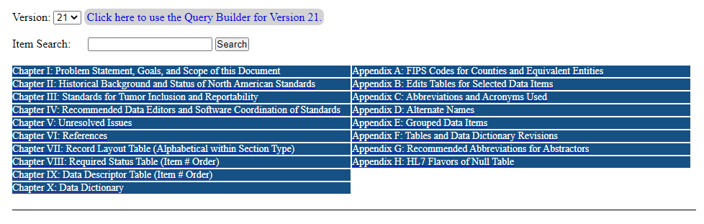
NAACCR Data Dictionary
http://datadictionary.naaccr.org/
diagnostic

Slide 13
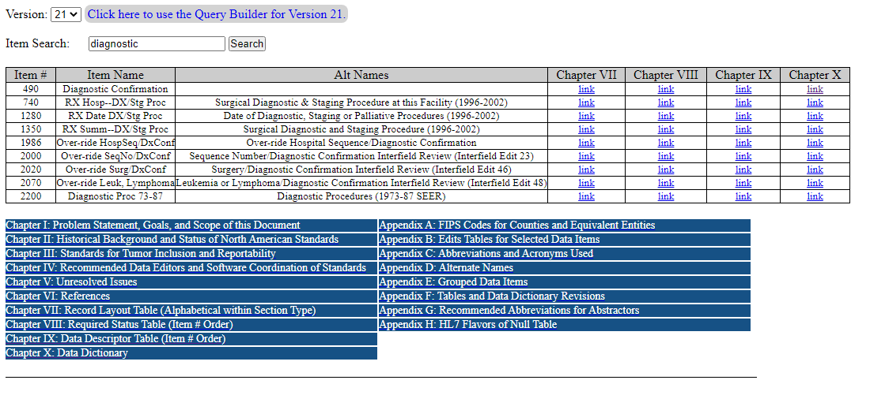
NAACCR Data Dictionary

Slide 14
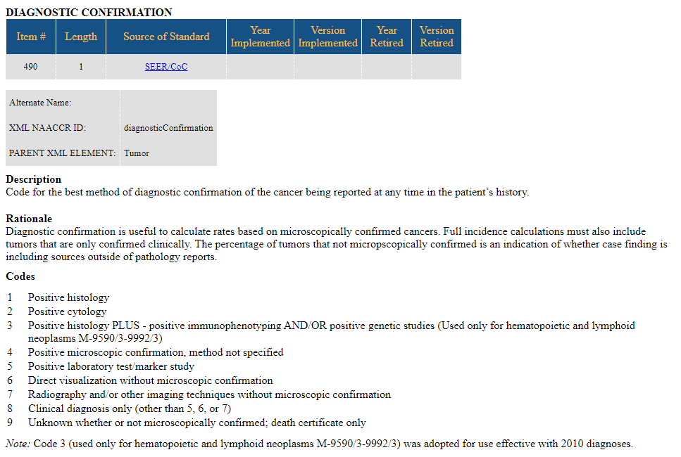
NAACCR Data Dictionary

Slide 15
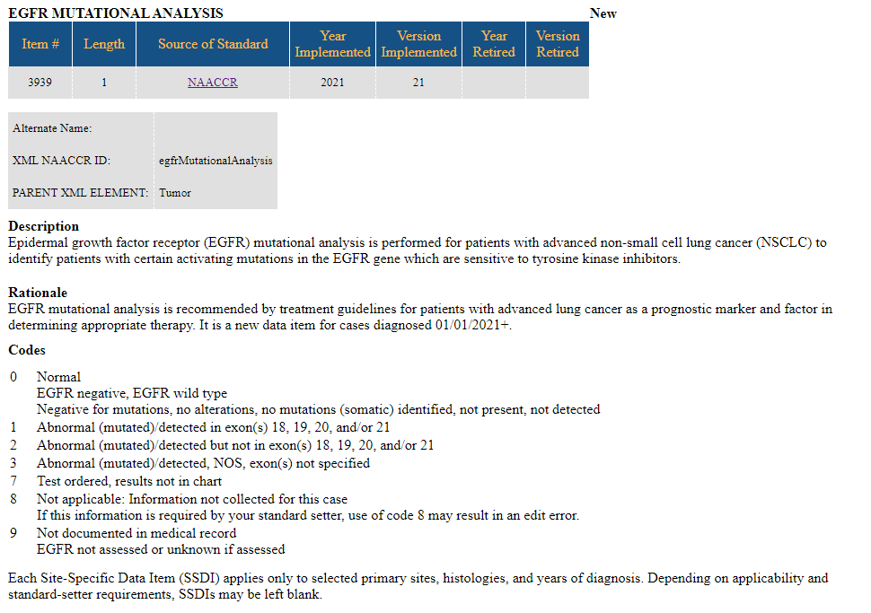
NAACCR Data Dictionary

Slide 16
NAACCR Standard Change Control Process
Implemented in 2018
Revisions to existing data items
Introduction of new data items
High Level Strategic Group
Ensure high-level coordination and communication among all cancer surveillance organizations regarding the development and implementation of major changes in standards and procedures.
Mid-Level Tactical Group
Coordinate and communicate among the cancer surveillance community the development and implementation of changes to standards and procedures as directed by the High-Level Strategic Group.
Notes:
Any change to standards has an impact on registry operations, funding agencies, and users of the data.
The purpose of the change management process is to facilitate successful implementation of change to cancer registry data collection standards, requirements, and systems.

Slide 17
High-Level Strategic Group/Mid-Level Tactical Group
Standard-Setting Agencies
NCI Surveillance, Epidemiology and End Results (SEER) Program
CDC National Program of Cancer Registries (NPCR)
American College of Surgeons Commission on Cancer (CoC)
North American Association of Central Cancer Registries (NAACCR)
Other Stakeholders
National Cancer Registrars Association (NCRA)
Central Cancer Registries
College of American Pathologists (CAP)

Slide 18
18-Month Change Control Process
Jul | Aug | Sep | Oct | Nov | Dec | Jan | Feb | Mar | Apr | May | Jun | Jul | Aug | Sep | Oct | Nov | Dec
Request for change submitted to MLTG
Field testing
Training material development
IMPLEMENTATION
Requestor
MLTG conducts initial assessment
Review UDS recommendation & field testing results
Mid-Level Tactical Group
MLTG Coordinates & monitors implementation
Send recommendations to HLSG
NAACCR UDS WG
Technical review
Final review
Volume II: Data Dictionary
High-Level Strategic Group
Final Approval
Implementation guidelines & edit metafile development & testing
Training material development
NAACCR
Software vendors
Software development

Slide 19
Tools & Resources
NAACCR XML Data Exchange Standard
https://www.naaccr.org/xml-data-exchange-standard/
XML Specification for Cancer Registry Records, Version 1.4
https://www.naaccr.org/wp-content/uploads/2020/07/Data-Exchange-Standards_20200721.pdf
NAACCR Data Dictionary
https://www.naaccr.org/data-standards-data-dictionary/
Change Request Forms
https://www.naaccr.org/data-standards-data-dictionary/#changerequest

Slide 20
Thank you
Stephanie M. Hill, MPH, CTR
shill@naaccr.org

