Slide 1
Standardizing Forces Reported by Cancer Centers National Childhood Cancer Registry (NCCR)
Data Summit 2021 Feb 08
Johanna Goderre, MPH
NCI/DCCPS/SRP

Slide 2
Thank you! - Participants - Presenters - Planners, especially Maddy and Rebekah, ICF colleagues, breakout session leaders and notetakers, and our internal team at SRP

Slide 3
Semantic
Meaning
Notes:
Photo Credits
Issac Hands: NAACCR XML Readiness for 2021!
TeachJim.weebly.com
Starwars.fandom.com
https://education.arcus.chop.edu/redcap-api/

Slide 4
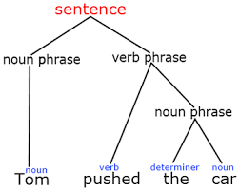
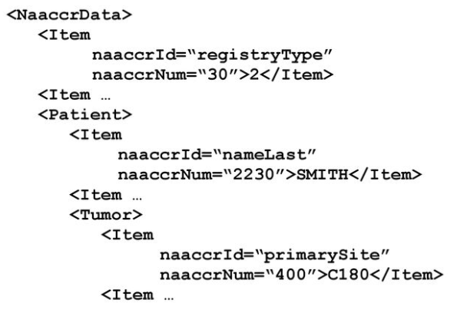
Syntax
Structure
Notes:
Photo Credits
Issac Hands: NAACCR XML Readiness for 2021!
TeachJim.weebly.com
Starwars.fandom.com
https://education.arcus.chop.edu/redcap-api/

Slide 5
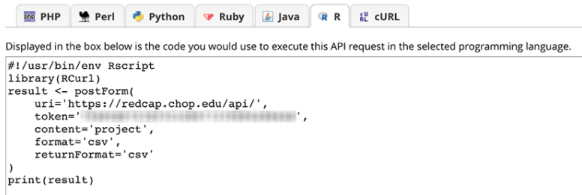
Transfer
Notes:
Photo Credits
Issac Hands: NAACCR XML Readiness for 2021!
TeachJim.weebly.com
Starwars.fandom.com
https://education.arcus.chop.edu/redcap-api/

Slide 6
Semantic
Meaning
Syntax
Structure
Transfer
Notes:
Photo Credits
Issac Hands: NAACCR XML Readiness for 2021!
TeachJim.weebly.com
Starwars.fandom.com
https://education.arcus.chop.edu/redcap-api/

Slide 7
Standardizing Force | Example
Mature data standard | NAACCR XML; CAP
Data Model | OMOP
Terminology system or Coding | ICD-O; standardized questionnaires
Software | SAS; METRIQ
Technology | REDCap; SEER*DMS
Data Repository | PCDC; dbGaP
Resource | caDSR; NCI Thesaurus

Slide 8
78
Total number of standardizing forces reported by 10 Cancer Centers for the NCCR Supplements (application, monitoring, abstracts)
N Cancer Centers cited use or familiarity:
6 | NAACCR XML
4 | REDCap; caDSR
3 | ICD-10, 9, O; RxNorm; SNOMED CT; COG forms; ORIEN
57
Total number of standardizing forces reported by only 1 Cancer Center

Slide 9
MISSION
Minimize semantic and syntactic standards to pre-coordinate Cancer Center data submissions to the NCCR
Notes:
Photo Credit:
https://abaforlawstudents.com/2017/05/31/national-security-law-student-writing-competition/

Slide 10
Modest Proposal: Data Harmonization Tiger Team
WHO | 1 representative from each Cancer Center Technical advisors: IMS, NAACCR, U Chicago
WHAT | Collaboratively review all data elements and files for NCCR submission from each Cancer Center Coordinate metadata, field names, permissible values, etc. for any data not currently captured in the NAACCR standard Share consensus on data standards and methods to transform data with their own Cancer Centers
WHEN | Frequency? Duration?
Notes:
Photo credit:
https://www.briefing.co.uk/tiger-team/tiger-team-definition/
“The Tiger Team is a problem-solving approach used by NASA to investigate, and hopefully solve, highly critical and complex issues. Most famously, it was adopted to bring the astronauts safely back to Earth when a module malfunctioned during the Apollo 13 mission. Experts in a range of areas, such as engineers and scientists, are brought together from different centres as required by a specific work project or programme.”

Slide 11
Thank you!

Slide 12
Total by Cancer Center | 3 | 27 | 7 | 13 | 6 | 2 | 12 | 30 | 8 | 5
Standard, Data Model, Resource, Tool, Software, Qx, etc. | Ohio | Michigan | Utah | Columbia | UCSF | San Antonio | U Penn | Roswell | Harvard, DFCI | Kentucky | Total by Standard
NAACCR XML | 1 | 1 |  | 1 |  | 1 | 1 |  |  | 1 | 6
REDCap |  | 1 |  |  | 1 |  |  | 1 | 1 |  | 4
NCI caDSR |  |  | 1 | 1 |  |  |  | 1 |  | 1 | 4
ICD-10 |  | 1 | 1 |  |  |  | 1 |  |  |  | 3
ICD-9 |  | 1 | 1 |  |  |  | 1 |  |  |  | 3
RxNorm |  | 1 |  | 1 |  |  | 1 |  |  |  | 3
SNOMED CT |  | 1 |  | 1 |  | 1 |  |  |  |  | 3
COG forms | 1 |  |  |  | 1 |  |  |  | 1 |  | 3
ICD-O-3 |  |  |  | 1 |  |  | 1 |  | 1 |  | 3
Oncology Research Information Exchange Network (ORIEN) M2GEN |  |  | 1 |  |  |  |  | 1 |  | 1 | 3
NCI Genomic Data Commons GDC |  |  |  | 1 |  |  |  |  | 1 |  | 2
Pathology, Radiology/Imaging, Signs/Symptoms, Medical oncologist assessment, and tumor Markers (PRISSMM) |  |  |  |  | 1 |  |  |  | 1 |  | 2
NCBI RefSeq |  | 1 |  | 1 |  |  |  |  |  |  | 2
CPT-4 |  | 1 | 1 |  |  |  |  |  |  |  | 2
National Drug Code (NDC) |  | 1 |  |  |  |  | 1 |  |  |  | 2
Genomics Evidence Neoplasia Information Exchange (GENIE) |  |  |  |  | 1 |  |  |  | 1 |  | 2
OHDSI, OMOP CDM |  |  |  | 1 |  |  | 1 |  |  |  | 2
Unified Medical Language System (UMLS) |  | 1 |  | 1 |  |  |  |  |  |  | 2
cBioPortal |  |  |  |  | 1 |  |  | 1 |  |  | 2
ExtractEHR (R package) |  |  |  |  | 1 |  | 1 |  |  |  | 2
COSMIC |  | 1 |  |  |  |  |  |  |  |  | 1
NCBI dbGaP |  | 1 |  |  |  |  |  |  |  |  | 1
Pediatric Cancer Data Commons (PCDC) |  |  |  |  |  |  |  |  | 1 |  | 1
Roswell Data Commons CDEs |  |  |  |  |  |  |  | 1 |  |  | 1
OMOP AllOfUs |  |  |  |  |  |  | 1 |  |  |  | 1
OMOP Oncology Module |  |  |  | 1 |  |  |  |  |  |  | 1
Roswell Data Commons cancer information model |  |  |  |  |  |  |  | 1 |  |  | 1
CDISC |  | 1 |  |  |  |  |  |  |  |  | 1
Commission on Cancer (COC) Facility Oncology Registry Data Standard (FORDS) |  | 1 |  |  |  |  |  |  |  |  | 1
College of American Pathologists Next Generation Sequencing (CAP NGS) |  | 1 |  |  |  |  |  |  |  |  | 1
The Cancer Genome Atlas (TCGA) |  | 1 |  |  |  |  |  |  |  |  | 1
NCBI ClinVar |  | 1 |  |  |  |  |  |  |  |  | 1
HemOnc.Org |  |  |  | 1 |  |  |  |  |  |  | 1
Human Phenotype Ontology (HPO) |  | 1 |  |  |  |  |  |  |  |  | 1
NCI Metathesaurus |  | 1 |  |  |  |  |  |  |  |  | 1
NCI Thesaurus |  |  |  | 1 |  |  |  |  |  |  | 1
OncoTree |  |  |  | 1 |  |  |  |  |  |  | 1
Hospital Anxiety and Depression Scale-Anxiety Form; HADS-A |  |  |  |  |  |  |  | 1 |  |  | 1
ATSDR Exposure History Form |  |  |  |  |  |  |  |  |  | 1 | 1
Big Five Inventory-8 item; BFI8 |  |  |  |  |  |  |  | 1 |  |  | 1
Brief COPE |  |  |  |  |  |  |  | 1 |  |  | 1
CDC BRFSS |  |  |  |  |  |  |  | 1 |  |  | 1
CDC NHIS |  |  |  |  |  |  |  | 1 |  |  | 1
Center for Epidemiological Studies Depression Scale; CES-D |  |  |  |  |  |  |  | 1 |  |  | 1
Childhood Behavior Checklist |  |  |  |  |  |  |  | 1 |  |  | 1
Childhood Cancer Survivor Study forms |  |  |  |  |  |  |  | 1 |  |  | 1
COST measure |  |  |  |  |  |  |  | 1 |  |  | 1
Gallup (Household Income Stability) |  |  |  |  |  |  |  | 1 |  |  | 1
Impact of Event Scale- Revised (IES-R) |  |  |  |  |  |  |  | 1 |  |  | 1
Marin Hispanic Acculturation Survey |  |  |  |  |  |  |  | 1 |  |  | 1
NCI HINTS |  |  |  |  |  |  |  | 1 |  |  | 1
NCI Occupational History & Exposure Questionnaire |  |  |  |  |  |  |  |  |  | 1 | 1
Psychosocial Assessment Tool (PAT) |  |  |  |  |  |  |  | 1 |  |  | 1
Patient Health Questionnaire (PHQ-9) |  |  |  |  |  |  |  | 1 |  |  | 1
Perceived Stress Scale; PSS |  |  |  |  |  |  |  | 1 |  |  | 1
Profile of Mood States (POMS) |  |  |  |  |  |  |  | 1 |  |  | 1
Short Assessment of Health Literacy (primary caregiver) |  |  |  |  |  |  |  | 1 |  |  | 1
Social Problem Solving Inventory- revised (SPSIR) |  |  |  |  |  |  |  | 1 |  |  | 1
UCLA Loneliness Scale; ULS-8 |  |  |  |  |  |  |  | 1 |  |  | 1
NCBI GenBank |  | 1 |  |  |  |  |  |  |  |  | 1
NCBI Gene Expression Omnibus (GEO) |  | 1 |  |  |  |  |  |  |  |  | 1
GitHub |  |  |  |  |  |  | 1 |  |  |  | 1
NCBI dbSNP |  | 1 |  |  |  |  |  |  |  |  | 1
NCBI dbVar |  | 1 |  |  |  |  |  |  |  |  | 1
METRIQ Cancer Registry |  |  |  |  |  |  |  | 1 |  |  | 1
SAS |  |  |  |  |  |  |  |  | 1 |  | 1
EMERSE |  | 1 |  |  |  |  |  |  |  |  | 1
Allscripts |  |  |  |  |  |  |  | 1 |  |  | 1
Globus |  | 1 |  |  |  |  |  |  |  |  | 1
LabVantage |  |  |  |  |  |  |  | 1 |  |  | 1
OnCore (vendor product) |  |  |  |  |  |  |  | 1 |  |  | 1
LOINC |  | 1 |  |  |  |  |  |  |  |  | 1
NLM Metamap |  | 1 |  |  |  |  |  |  |  |  | 1
Caboodle | 1 |  |  |  |  |  |  |  |  |  | 1
Oncolog |  |  |  |  |  |  | 1 |  |  |  | 1
PCORnet |  |  |  |  |  |  | 1 |  |  |  | 1
HL7 Fast Healthcare Interoperability Resources (FHIR) |  |  | 1 |  |  |  |  |  |  |  | 1
HL7 Version 3 (V3) |  |  | 1 |  |  |  |  |  |  |  | 1

