Slide 1
NCCR Working Groups
CCDI NCCR Cancer Center Supplement Data Summit
February 8, 2021
Stephanie M. Hill, MPH, CTR
Associate Director
North American Association of Central Cancer Registries
shill@naaccr.org

Slide 2
NCCR Working Groups
NCCR working groups serve in an advisory capacity to help NCI identify key activities, challenges and solutions related to the NCCR and to identify key areas on which the NCCR should focus.
Data Products
Data Access & Data Release
Meta Data
Genomics & Biospecimens

Slide 3
Data Products Working Group
Co-Chairs:
Dennis Deapen, DrPH (USC)
Amie Hwang, PhD, MPH (USC)
Mission: Comprehensively identify the data utilization potential for the NCCR and develop innovative data products that maximally utilize NCCR data and meet the research needs of the pediatric and AYA cancer research community, while assuring compliance with all data use and protection requirements.

Slide 4
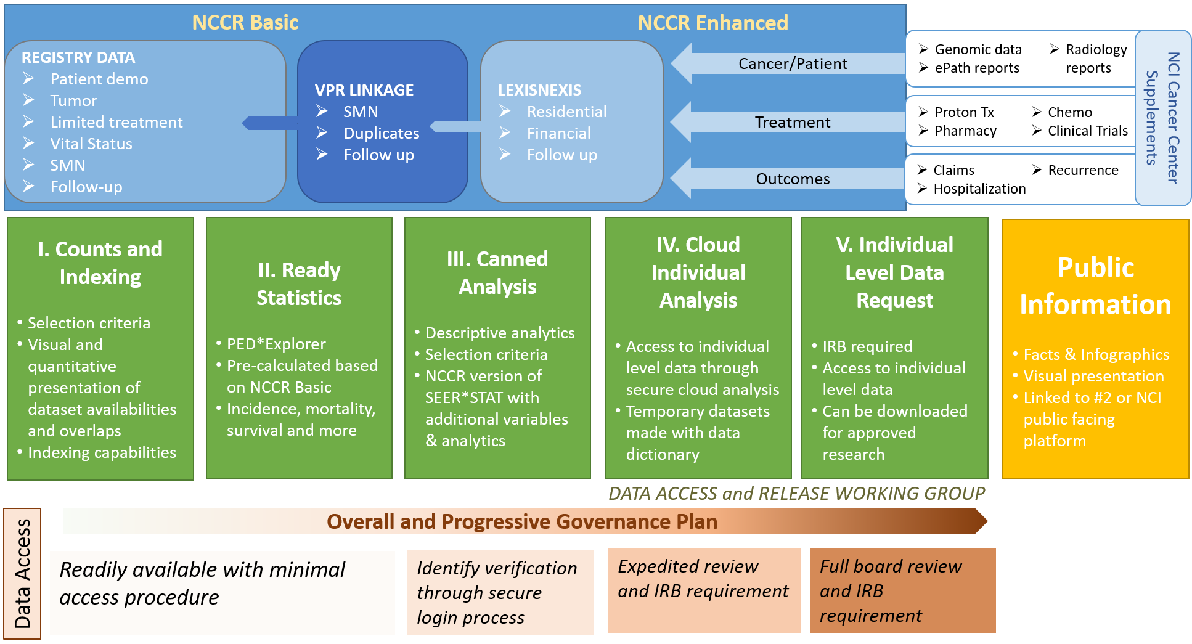
NCCR Data Products Schematic -DRAFT

Slide 5
Data Access & Release Working Group
Co-Chairs:
Stephanie Hill, MPH, CTR (NAACCR)
Castine Clerkin, MS, CTR (NAACCR)
Mission: Develop the policies, procedures and infrastructure to support efficient, confidential and secure data submission, access and release/use for the NCCR.
Data Process vs. Data Products

Slide 6
Data Process Access & Release
Common Rule and Public Health Surveillance
Sharing of data between central cancer registries
De-duplication and ownership across registries
Identification of SMNs across registries
Quality control
Central registry access to and use of linked data
Notes:
Sharing of data between central cancer registries
Both those participating in NCCR and those not

Slide 7
Data Product Access & Release
Multiple levels and modes of data access to maximize patient privacy and security while promoting data utilization to support research
Establish user authentication and authorization system
Identify access/release restrictions for linked data sources
Develop criteria to evaluate “fitness for use” of linked data
Notes:
Multiple levels and modes of data access to maximize patient privacy and security while promoting data utilization to support research
Establish user authentication and authorization system
Modeled after current reconstruction of access to SEER Stat data.
Identify access/release restrictions for linked data sources
Including cancer center supplement data

Slide 8
Meta Data Working Group
Co-Chairs:
Sumit Gupta, MD, PhD (SickKids)
Todd Gibson, PhD (NCI)
Mission: Ensure consistency across coding and identify specific cancers that may need further assessment.
Current Focus: Translating histologic/ICCC groupings into clinically-significant classifications, accounting for changes to coding schema over time.

Slide 9
Meta Data Working Group Goals
Determine ”core framework” of already existent data in registries (histology, site)
Determine what “levels” of these variables are most appropriate to clinical practice given current data
Recommendations for improving these going forward (e.g. level of detail)
Recommendations for additional data that would build upon this framework
Other data available from registries
Supplemental data awards
Linkages to other data sources
Other Registry Data
Data
Supplements
Other Data Sources
Stage?
NSPs?
Others
Harmonization
SITE HISTOLOGY

Slide 10
International Classification of Childhood Cancer (ICCC)
Leukemias, Myeloproliferative and Myelodysplastic Diseases
I(a) Lymphoid leukemias
I(a.1) Precursor cell leukemias
9835/3: Precursor cell lymphoblastic leukemia, NOS (OBS 2010+) see 9811/3
9836/3: Precursor B-cell lymphoblastic leukemia (OBS 2010+) see code 9811/3
9811/3: B lymphoblastic leuk/lymph, NOS
9812/3: B lymphobl leuk/lymph w/t(9;22)(q34;q11.2); BCR-ABL1
9813/3: B lymphobl leuk/lymph w/t(v;11q23); MLL rearranged
9814/3: B lymphobl leuk/lymph w/t(12;21)(p13;q22);TEL-AML1
9815/3: B lymphoblastic leuk/lymph w/hyperdiploidy
9816/3: B lymphobl leuk/lymph w/hypodiploidy (hypodip ALL)
9817/3: B lymphobl leuk/lymph w/t(5;14)(q31;q32); IL3-IGH
9818/3: B lymphobl leuk/lymph w/t(1;19)(q23;p13.3); E2A PBX1
9837/3: Adult T-cell leukemia/lymphoma

Slide 11
Genomics & Biospecimens Working Group
Chair:
Eric Durbin, DrPH, MS (Univ of KY)
Mission: Identify sources of biospecimens and genomic and genetic data from NCCR patients and provide strategic planning for the cataloging, sharing, linking, integration and analysis through collaborations and partnerships.
Develop a process of linkage and access with groups holding genomic data on NCCR partnerships
Opportunity to leverage the SEER VTR process for accessing specimens outside the COG environment.

Slide 12
Genomics & Biospecimens Working Group
Inventory existing genomic data sources and evaluate the potential for linkages or other mechanisms for inclusion in the NCCR.
PII for linking between data sources?
IRB approval required?
Coverage?
Known limitations?
Use restrictions?

Slide 13
Thank you
To participate in any NCCR Working Group, please email shill@naaccr.org

