Slide 1
Overview of the National Childhood Cancer Registry (NCCR)
Cancer Center Data Summit February 8, 2021

Slide 2
NCCR Purpose
Leverage and link disparate data from multiple sources to create an infrastructure that can better support research on childhood cancer
Core data derived from cancer registries- but extended and expanded to include additional relevant information such as
Detailed treatment
Genomic characterization
Trajectory of care from diagnosis throughout life including
Multiple primary cancers
Recurrent disease
Other relevant factors related to risk and outcome (residential history, SDOH etc.)
Integrate within the CCDI federated data ecosystem
Include data on a broader set of patients than covered in COG facilities
Potential disparities in who is seen/treated in COG systems
Preliminary data estimating proportion of patients seen at COG facilities in SEER: 65-77% overall

Slide 3
COG coverage assessment– Next steps
Perform analysis by age groups, racial groups
Replicate analysis performed in Kentucky
Collaboration with COG, CDC
Linking COG Clinical Trials Database and Project Every Child Database
These 2 analyses will provide information on
Proportion of patients seen at COG facilities (whether enrolled in trials or not)
Proportion of patients enrolled in trials at COG facilities
Identify population subgroups under- represented in COG facilities

Slide 4
National Childhood Cancer Registry:
Leverages existing data sources to capture all pediatric and young adult cancers in the US
Accumulate data through linkages with Cancer Registries
population based (capture all cancers within a defined geographic area)
maintain PII with ability to incorporate data on all childhood cancer cases
HIPAA Exempt
regulatory requirements in each state for health care providers to report to the state registry
Create a centralized infrastructure containing a core plus additional linked data sources
Coordinated by NAACCR
Supported by NCI
Advised by workgroups consisting of a variety of clinical, epidemiologic and genomic experts

Slide 5
Initial Registry Participation (70% of US childhood cancers)
7 NPCR Registries
Florida
SEER Registries
GA
Illinois
New Jersey
Ohio
Pennsylvania
Tennessee
Texas
2020- submission of de-identified NAACCR data in NCCR
2021 – full registry submission with PII to DMS*Lite as a repository for linkages and submission to the NCCR
Will support linkages for residential history (Lexis Nexis) and VPR to identify second
Los Angeles
Greater CA
Greater Bay area
Iowa
CT
LA
Seattle
ID
NY
MA
SEER will contractually require submission to the NCCR
Will support linkages for residential history (Lexis Nexis) and VPR to identify second primaries
KY
Goal is to achieve 100% coverage of all pediatric patients over the next few years

Slide 6
The National Childhood Cancer Registry Components
Routine linkages will be performed centrally with external data sources including:
Complete abstracts plus text documentation for each case
1995-2019+
Text documentation permits NLP/AI – key treatment information
National Death Index (NDI)
State vital records
Lexis Nexis (linkage to be performed centrally not by state)
Residential History (routinely biennially) – essential to perform longitudinal linkages
Financial Toxicity – provide data to understand the impact of cancer on patients and families
Social Determinants of Health –exploring impact on compliance with treatment, outcomes etc.
Virtual Pooled Registry (VPR)
Supports linkage across all cancer registrires
Capture subsequent Cancers (Annual linkage with ALL registry in the US)

Slide 7
The National Childhood Cancer Registry Components
Routinely link with external data sources via central linkage infrastructure
Pharmacy Data– CVS/Walgreens/Riteaid (Real Time)/ PBM United Health Care
Longitudinal Radiation oncology data acquisition
Varian, Elekta
Torunn Yock- agreed to routinely submit data for linkage with NCCR
Claims data linkages (Treatment/Comorbidity)
United Health Care (linkage in process)
Medicaid (goal)
Radiology reports + images (case finding/ recurrence)
Ambra Health (radiology data exchange platform with significant pediatric facility penetration)
AIM
Genomic Data
In discussions with FMI, Caris
Individual biomarkers available from pathology report
Goal- Link with federated genomic data in the ecosystem (St Jude Cloud, Project Every Child, New NCI supported genomic testing initiative)

Slide 8
Working Groups to support NCCR development

Slide 9
Supported by multiple Working Groups
Meta-Data
Harmonizing existing and recommending new data
Data Access & Release
Developing processes for appropriate data release
Data Products
Informing key analyses and data sets
Genomics and Biospecimens
Recommending methods for including existing genomic data and methods for biospecimen processing
A broad general/scientific working group
Including clinicians, epidemiologists, advocates
from cancer centers, registries

Slide 10
NCCR Central Repository Process

Slide 11
Conceptual Framework: National Childhood Cancer Registry
Innovative pilot data sources
Data sources currently used
National Childhood
Cancer Registry
database***
Combines de-identified data submitted from SEER and participating nonSEER registries plus linked data from additional sources
Selected state vital records
Children’s Oncology Group
Birth Records, Blood spots)
Long-term follow-up center, AACCR
Lexis Nexis
Residential Hx, financial toxicity, social determinants of health
Operational Linkages
State vital records, NDI
Selected State Cancer Registries
(including TX, TN, PA, IL, NJ, OH, FL)
Instance of DMS*Lite
For each registry to hold PII for linkages
SEER Cancer Registries
Leveraging Existing SEER*DMS servers holding PII for
Genomic & Genetic Data
FMI, Caris, Project Every, Child, CCSS,, etc
Demographic Characterization
Consolidated data, Text Documentation
Claims
Medicaid, UHC
NCI/IMS/NAACCR**
CVS, Walgreens/ Riteaid/UHC PBM
Pharmacy
Cancer Center Supplements
Cancer Center Supplements
Proposed Connections
Additional Resources
Virtual Pooled Registry* (VPR)
Virtual Biorepository
Mapping of Toronto Stage
St. Jude Cloud
Pediatric GDC
Proton Radiation Therapy Registry
***NCCR – holds de-identified childhood cancer
patient data submitted from participating registries.
Infrastructure to support research on childhood cancers
*VPR- linkage with all registries to provide information on subsequent or prior cancers
** NAACCR is the coordinating center – does not hold or access data.

Slide 12
Data Flow from Cancer Centers to the NCCR
Data will be submitted to each registry database housed at IMS
Cancer center data such as characterization of the tumor (genomics), treatment and outcomes, including factors related to etiology or outcomes, are covered under public health reporting law.
This is independent of routine hospital registry reporting
The registry will have designated IMS via a formal agreement to serve as their honest broker for these linkages
IMS will perform all linkages (patient matching) within the registry repository housed at IMS
All data files MUST have PII to enable patient matching
IMS will maintain the data repository for the registry to integrate the heterogeneous data including cancer center data
Our goal is to minimize data heterogeneity through use of standards where possible
All data will be accessible to the registry
De-identified data will be submitted to the central NCCR repository
This approach minimizes effort for both registries and cancer centers

Slide 13
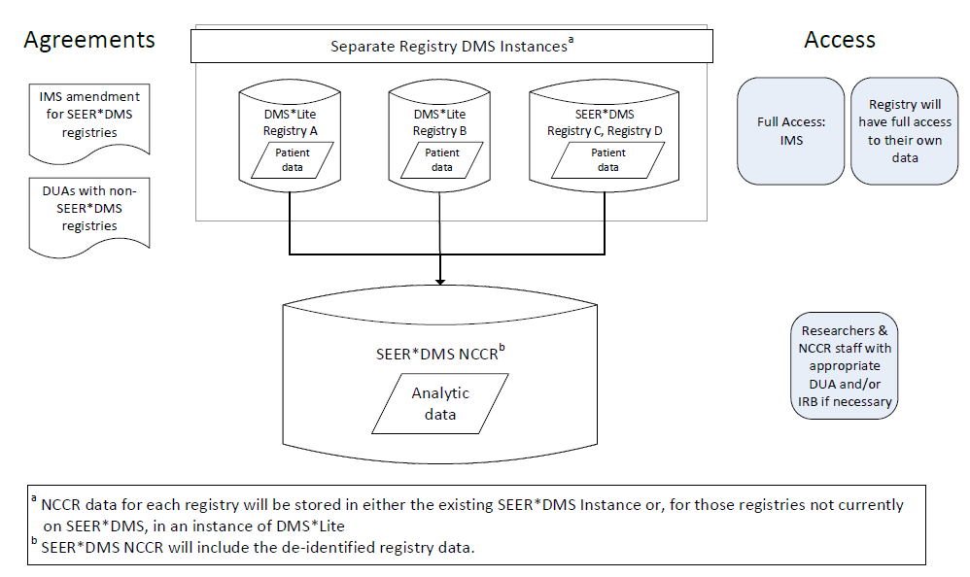
Flow Diagram for SEER and NPCR data submission to NCCR
Registry (including PII) stored in individual virtual servers in a secure enclave permitting linkage with additional data
Central repository with controlled access by researchers via robust authentication/authorization processes

Slide 14
Other special NCCR Projects

Slide 15
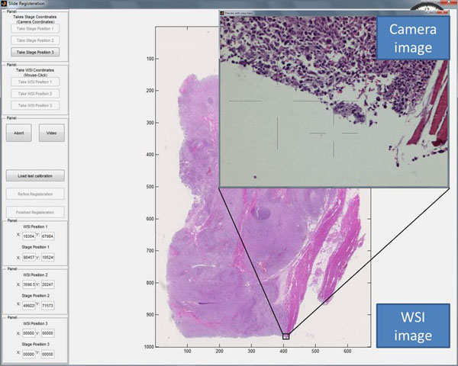
Digital Pathology Images (Whole Slide Imaging Project)
Pathology Digital images from diagnostic slides linked to abstract
Potential to collect initial diagnostic and subsequent slides for recurrent disease/second primaries
Provides information on data not included in abstract or pathology report through DL/AI (e.g. TILS, nuclear characterization etc)
Working to develop automated de-identification techniques
Goal- routinely submit images to NCCR
Develop an API with Whole Slide Imaging project to automatically identify 1-2 most relevant path images
Often 3-20 images from a resection
Each image up to 12 Terabytes
Minimizing storage of irrelevant images necessary

Slide 16
ORNL- Department of Energy Collaboration
Modify existing NLP pathology API focusing on childhood cancers
Develop an API for automated extraction of treatment from abstract unstructured text (included with current abstracts)
Adapting the DOE algorithm for use in
Capturing recurrent metastatic disease through radiology reports
Pilots in development in Los Angeles and Texas focusing on childhood cancers
Identifying missed cases diagnosed only via imaging (e.g. CNS and brain)
Capturing selected structured biomarker data from path report via modified multitask API

Slide 17
Thank you

Slide 18
COG coverage – preliminary analysis (SEER 1995-2017) aged <19 SEER
81% of Cases in state only
Between 65% and 77% of all cases seen in known COG facility

Slide 19
NCCR Participants – Data and Collaborators
Participants | Data | Collaborators
NAACCR | NCCR Coordination, Adjudication, and Working Groups | Betsy Kohler, Stephanie Hill, Castine Clerkin
IMS | SEER*DMS and DMS Lite – NCCR database | Linda Coyle, David Roney, Dave Annett, Rusty Shields, Nicki Schussler
SEER Registries | Cancer registry data | 16 SEER Registries
Selected NPCR Registries | Cancer registry data | Pennsylvania, Illinois, Texas, Florida, Tennessee, Ohio, New Jersey
Lexis Nexis | Residential history | Karen Kimbro
Virtual Pooled Registry | Subsequent cancers | Castine Clerkin, Betsy Kohler
Ambra Health | Pathology reports and digital images, radiology reports and images | Valentina Petkov, Lee Pippen, Chantel Hopper
Logan Spector | Childhood Cancer Research Network (CCRN) detailed treatment and survival data

Slide 20
NCCR Participants – Data and Collaborators

Slide 21
Cancer Center Supplements
Supplemental funding to:
aggregate, integrate, and submit existing data beyond traditional cancer abstracts receiving care at the cancer center to the NCCR to facilitate the development of an ongoing submission process to the NCCR database for the continued submission of data on pediatric cancer patients. (sustainability)
Specific Goals:
identify extensive detailed treatment and clinical data on pediatric patients not currently being reported to cancer registries,
complete an assessment of the quality of the data, and
to develop a data packaging and transfer mechanism to report the data to the NCCR.
10 cancer center supplements selected for funding to submit data to the NCCR

Slide 22
Common Data Types from supplements for NCCR

Slide 23
NCCR linkage line up and timeline

Slide 24
NCCR Working Groups
Metadata
Ensure consistency across coding with an initial focus on mapping histologies across clinical and surveillance schema and identifying specific cancers that may need further assessment
Identify and recommend new data to be captured by registries
Should coordinate with the NCI CCDI Clinical Phenomic Data Recommendations
Three initial sub-groups: Brain & CNS; Hematopoietics; Solid Tumors
Genomics & Biospecimens
Identify sources of biospecimens and genomic and genetic data from NCCR patients and provide strategic planning for the cataloging, sharing, linking, integration and analysis through collaborations and partnerships.
Develop a process of linkage and access with groups holding genomic data on NCCR partnerships.
Opportunity to leverage the SEER VTR process for accessing specimens outside the COG environment

Slide 25
NCCR Working Groups
Data Access/Data Release
Develop the policies, procedures and infrastructure to support efficient, confidential and secure data submission, access and release/use for the NCCR.
Registry access to linked data
IRB applications and review (modeled after VPR)
Data Products
Comprehensively identify the data utilization potential for the NCCR and develop innovative NCCR data output products that maximally utilizes NCCR data and meet the research needs of the pediatric and AYA cancer research community, while assuring compliance with all data use and protection requirements
NCCR Basic Data Set (PED*Explorer)
4 Tiered data products (basic + linked datasets)

Slide 26
NCCR Data Products Schematic -DRAFT
NCCR Basic
NCCR Enhanced
ePath reports
Radiology reports
REGISTRY DATA
Patient demo
Tumor
Limited treatment
Vital status
SMN
Follow up
Cancer/Patient
VPR LINKAGE
SMN
Duplicates
Follow up
LEXISNEXIS
Residential
Financial
Follow up
Proton Tx
Pharmacy
Chemo
Clinical Trials
Treatment
NCI Cancer Center Supplements
Outcome
Claims
Hospitalization
Recurrence (path)
Overall and Progressive Governance Plan
2. Ready Statistics
3. Canned Analysis
Descriptive analytics
4. Cloud Analysis
Individual level analysis
5. Data Request
NCCR version of SEER*STAT with additional variables & analytics (e.g. multiple primaries, social determinants)
Regression analysis
Model building
Facts & Infographics
Contribution from each linked dataset assessed.
6. Public Information
1. Count query/cohort Discovery
Access to individual level data
Visual presentation
Linked to #2 or NCI public facing platform
No downloading
Pre-calculated based on NCCR Basic
Incidence, mortality, survival and more
PEDs*Explorer
Counts
Visual & quantitative presentation of dataset overlaps (Health Verity model)
Indexing capabilities
Include newly linked data once initial assessment complete
Selection criteria set
Access to individual level data through secure cloud location for analysis only
Temporary datasets made with data dictionary
IRB requirement?
Varying levels of authorization depending on data level requested
Can be downloaded for approved research
IRB required
Request for patient identifiers (ie. invst-led linkages)
Request for contact studies (coordinate with VPR to facilitate direct cancer registry data release)
DATA ACCESS and RELEASE WORKING GROUP

Slide 27
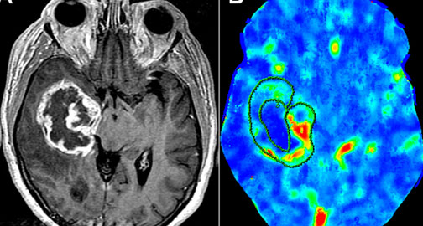
Radiology reporting for Case finding and Identification of Recurrent Metastatic disease
DOE developed algorithm for “case finding” from
pathology reports
Challenge with non-pathologic diagnosed tumor (esp CNS)
Diagnosed via imaging
Adaptation of API for path-based reportability to radiology-based reportability
Critical for non-pathologic confirmed tumors such as brain and CNS
DOE developed algorithm for capturing recurrent metastatic disease from pathology reports
Many distant recurrences for both adult and childhood cancers diagnosed without path confirmation
Imaging often the sole diagnostic methodology

