Slide 1
NCI Childhood Cancer Data Initiative

Slide 2
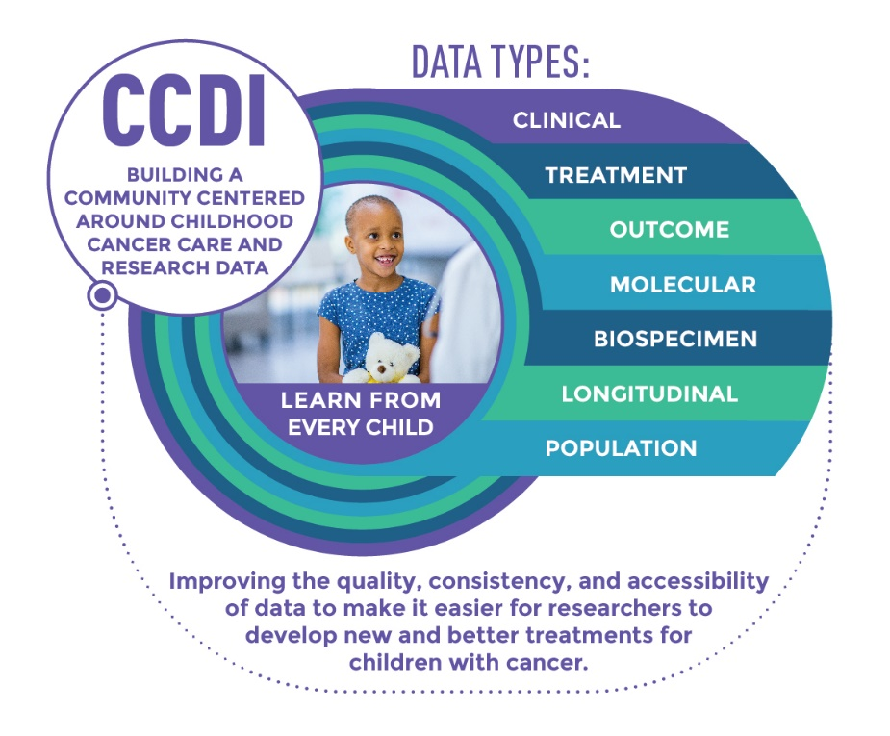
The goal of the CCDI is to build a community of pediatric cancer researchers, advocates, families, hospitals, and networks committed to sharing data to improve treatments, quality of life, and survivorship of every child with cancer.

Slide 3
CCDI Working Group Report
Types of Data for Collection and Aggregation
Landscape of Pediatric/AYA Cancer Research Data & Needs Analysis
Potential Barriers to Progress
Generating New Data
Distinction Between Research & Clinical Data
Engaging Diverse Array of Stakeholders for Input
Potential Opportunities for Transformative Discoveries
24 specific recommendations

Slide 4
Foundational Goals for CCDI
Gather data from every child/AYA diagnosed with cancer, regardless of where they receive their care
Develop core data from consented patients, including tumor and germline molecular characteristics, to enable research using patient-level data in a secure and de-identified way
Create a system that can bring data of different types, from different sources together in a way that incentivizes researchers to query the available data in new ways

Slide 5
Steering Committee
Engagement Committee
National Childhood
Cancer
Cohort
Cross-cutting Issues Team
Childhood Molecular
Characterization Protocol
Childhood
Cancer
Data
Platform
Project Management Support
4 working groups co-chaired by NCI and extramural experts - NCI staff, external experts and advocates

Slide 6
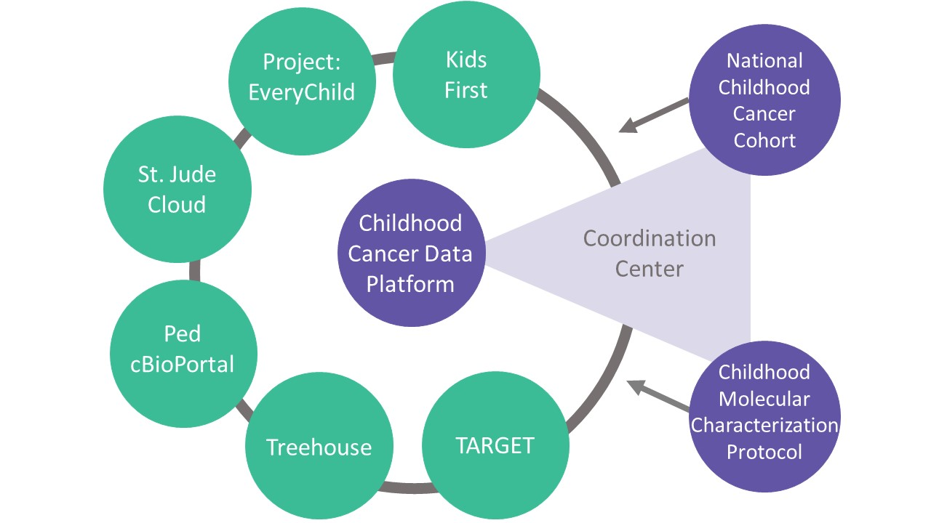
Identifying and Filling Gaps: Adding to the Existing Landscape
Notes:
Many of the items listed here are funded outside of the NCI.
This graphic isn’t comprehensive.
We are trying to fill gaps so we can build on what already exists.

Slide 7
CCDI National Childhood Cancer Cohort
Gather data from every child diagnosed with cancer in the United States
It will:
Capture the cancer care trajectory of children and AYAs, including care provided outside of COG and other networks, to identify gaps and disparities in care and outcome
Track biospecimen availability
Provide access to data from underserved patients
Provide for consistent research consent
Allow for long-term follow up of childhood cancer patients
A critical component of this effort will be the National Childhood Cancer Registry (NCCR)
Working group chaired by NCI and an extramural expert

Slide 8
CCDI Childhood Molecular Characterization Protocol
A national strategy, building on efforts including COG’s Project:EveryChild, to offer appropriate clinical and molecular characterization to every child with cancer that:
Enables discovery when these and other data are connected
Defines a minimum set of molecular diagnostics to be collected for every pediatric and AYA cancer patient
Is accessible to all children with cancer, including those treated at community-based institutions; provide access to underserved pediatric cancer patients
Clinical sequencing of ~3,000 patients
Align with Rare Pediatric Tumor Cell Atlas
Working group chaired by NCI and an extramural expert

Slide 9
Childhood Molecular Characterization Protocol
Expand access to comprehensive molecular sequencing as a step towards the goal of reaching all children with pediatric cancer
Develop NCI-recommended guidelines for clinical and molecular data collection as part of standard of care
Create a comprehensive, harmonized, and integrated database of clinical, genomic, and phenomic data for research
RFI this month to define an initial pilot
Clinical Service: Diagnostic clinical molecular characterization services for patients who might
not otherwise have access to them
Data to be collected (CLIA certified)
DNA: CLIA WES or NGS targeted panel
RNA: CLIA RNA-seq
Methylation: CLIA DNA Methylation array
Clinical annotation
Research Discovery: Molecular characterization to learn more about disease subtypes and rare cancers
Data to be collected (in additional to clinical/seq data on selected populations)
WGS/deep molecular (DNA) profiling
Longitudinal data

Slide 10
CCDI Childhood Cancer Data Platform
Designed to federate data from multiple children’s cancer institutions and community-based and NCI-supported childhood/AYA data resources, featuring:
Patient-level data from all available sources
Easy access to data to enable deep analytics
Supports interoperability among existing data resources and with tools and other resources for use by researchers
Provide a central portal to find and analyze childhood/AYA cancer data
Working group chaired by NCI and an extramural expert

Slide 11
CCDI Coordination Center
Develop guidelines and approaches to address cross-cutting needs and implement activities that align CCDI priorities, such as:
Develop common data elements (CDE)
Data harmonization
Systems interoperability
Data utility
Integrate CCDI-wide biobanking in coordination with the STAR Act
Consent and assent
Obtain scientific input from extramural communities
Data governance system to ensure long-term sustainability and function
Working group chaired by NCI and an extramural expert

Slide 12
Questions?

