Slide 1



Effect of P2Et extract alone or in combination with chemotherapy in ex-vivo derived tumor organoids from breast cancer patients.
Claudia Urueña¹*, Tito A Sandoval¹, Paola Lasso¹, Mauricio Tawil², Alfonso Barreto¹, Lilian Torregrosa², Susana Fiorentino^{1*}.
¹ Grupo de Inmunobiología y Biología Celular, Unidad de Investigación en Ciencias Biomédicas, Facultad de Ciencias, Pontificia Universidad Javeriana. Bogotá, Colombia. ² Hospital Universitario San Ignacio, Centro Javeriano de Oncología, Facultad de Medicina, Pontificia Universidad Javeriana, Bogotá, Colombia.
*email address: susana.fiorentino@javeriana.edu.co; curuena@javeriana.edu.co

Slide 2
Background
Methods
The main cause of death by cancer is metastasis rather than local complications of primary tumors. Recent studies suggest that breast cancer stem cells (BCSCs), retaining the ability to self-renew and differentiation to repopulate the entire tumor, have been associated with resistance to chemotherapy and tumor recurrence, even after tumor resection. Naturally occurring compounds, especially phytochemicals such as P2Et (obtained from Caesalpinia spinosa), can target populations of cancer cells as well as BCSC, inducing cell death and the release or immunogenic cell markers
.
Objectives
Evaluate the presence of BSCS in tumor patients who had received (or not) chemotherapy before surgery and the ex vivo response of the tumor-derived from these samples to chemotherapy alone or in conjunction with P2Et extract.

Slide 3
Results
Cancer stem cell features in breast cancer patients
Neoadjuvant chemotherapy (NAT) before surgery increase the frequency of BCSC.
BCSC markers (ALDH+) correlated with BCRP expression in triple negative patients.
Figure 1. The patients were classified in Healthy Donor (HD), Luminal A (LA), Luminal B (LB), Triple negative (TN) and Her-2+. a. Sample processing workflow of breast cancer tumors. b. tSNE of flow cytometry data by breast cancer sub-type. c. CD45+ tumor-infiltration lymphocytes. d. % Aldehyde dehydrogenase 1 (ALDH1) positive cells. e. % Lin-CD44+CD24-CD49f+EPCAM+ cells. f. % BCRP+. g. % Pgp+. h. % MRP1+ cells by flow cytometry. Data are presented as violin plots and each point represents independent samples; dotted lines indicate quartiles. Multiple comparisons were calculated by one-way ANOVA with Dunnet T3 correction, and significant exact p-values are shown.
Figure 2. a. % BCSC (Lin-/CD44+CD24-CD49f+EPCAM+) in HD, breast cancer patients (BCP) with or without NAT before surgery. b. % BCSC in LB patients with or without NAT before surgery. c. % BCSC (ALDH+) in HD, BCP with or without NAT before surgery. d. % BCSC (ALDH+) in TN BCP who received or not NAT before surgery. (AC (Anthracyclines + Ciclophosphamide), AC+TX (Anthracyclines/Ciclophosphamide + Taxanes), TX (Taxanes). shown. Data are presented as violin plots and each point represents an independent sample; dotted lines indicate quartiles. Multiple comparisons were calculated by one-way ANOVA with Tukey post-test analysis and unpaired t-test, significant exact p-value are shown.
Figure 3. Correlation of BCRP protein and ABCG2 gene expression with BCSC markers (ALDH+ and CD24-CD44+CD49f+EPCAM+) in breast cancer patients who received or not NAT before surgery a. Correlation of BCRP protein with ALDH+ and CD24-CD44+CD49f+EPCAM+ expression in all samples. b. Correlation of ABCG2 gene expression with ALDH+ and CD24-CD44+CD49f+EPCAM+ in all samples. c. Correlation of BCRP with ALDH+ and CD24-CD44+CD49f+EPCAM+ expression in breast cancer patients who received NAT before surgery. Correlation of BCRP protein with BCSC markers (ALDH+ and CD24-CD44+CD49f+EPCAM+) expression in d. LA only, e. LB only and f. TN patients who received NAT before surgery. Correlations were assessed using nonparametric Spearman correlation, determination coefficient r and p-value are shown.
P2Et extract decrease the viability of mammospheres derived from breast cancer patients after in vitro treatment
Figure 4. a. Representative confocal microscopy image of the effect of P2Et extract, DX or DX+P2Et on the mammospheres viability of breast cancer patients. Luminal A (LA), Luminal B (LB), Triple negative (TN) and Her2. Calcein AM (green), Ethidium homodimer-1 (Red). b. Cell death percentage in mammospheres by molecular subgroups of breast cancer patients after treatment. c. Cell death percentage in all mammospheres from breast cancer patients after treatment. Data are presented as violin plots and each point represents an independent sample; dotted lines indicate quartiles. Exact p-values were calculated using One-way ANOVA with Tukey post-test analysis. d. Spearman nonparametric correlation between percentage of cell death with ABCB1, ABCG2, ABCC1 gene in mammospheres from breast cancer patients after P2Et, DX or Ethanol (negative control) treatment, coefficient of determination r and exact p-value are shown.

Slide 4
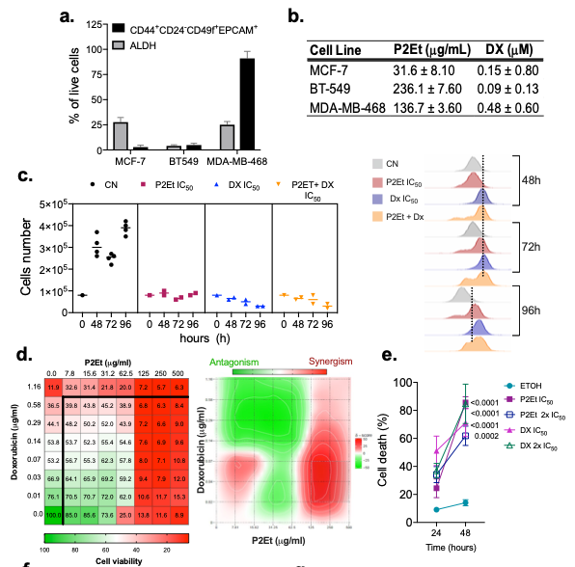
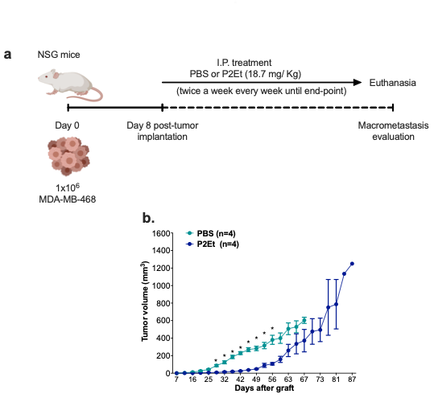
Results
P2Et extract decrease the viability and proliferation of human triple negative breast cancer cells.
P2Et extract retard initially primary tumor growth but increase survival in triple negative human breast cancer
g.
h.
Figure 5. a. Frequency of BCSC ALDH1+ and Lin-CD44+CD24-CD49f+EPCAM+ cells in MCF-7, BT-549 and MDA-MB-468 breast cancer cells measured by flow cytometry. b. IC₅₀ values of P2Et extract or Doxorubicin (DX) in MCF-7, BT-549 and MDA-MB-468 using MTT Assay. c. Left side: MDA-MB-468 cell count by trypan blue after treatment with vehicle, P2Et IC50, DX IC50, or P2Et + DX IC₅₀ for 0, 48, 72 and 96h. Right side: MDA-MB-468 cells were stained with CFSE and treated with P2Et IC₅₀, DX IC₅₀, or P2Et + DX IC₅₀ for 0, 48, 72 and 96h. For each time the proliferation was evaluated by flow cytometry. d. The combined inhibitory effects of P2Et (0 to 500 μg/ml) and DX (0 to 1.16 μg/ml) were tested over a range of combinations against MDA-MB-468 cells using MTT Assay (Left side); a dose-response matrix was generated and analyzed for zero-interaction potency method (ZIP), using SynergyFinder pipeline (Right side). e. Frequency of death (Annexin V+, propidium iodide [PI]−) and Annexin V+, PI+) MDA-MB-468 cells after 24 and 48h of treatment with Etanol, P2Et (IC₅₀ and IC₅₀*2) or DX (IC₅₀ and IC₅₀*2). f. MDA-MB-468 cells were treated with vehicle, P2Et (IC₅₀ and IC₅₀*2) or DX (IC₅₀ and IC₅₀*2) for 24h. Surface exposure of Calreticuline (CRT) was determined by flow cytometry among viable cells (Aqua negative). g. MDA-MB-468 cells were treated vehicle, P2Et (IC₅₀ and IC₅₀*2) or DX (IC₅₀ and IC₅₀*2) for 48h. After treatment cells were stained with quinacrine (1μM) and PI. Quinacrine low cells were determined among viable cells (PI negative cells).
Figure 6. a. Experimental scheme of treatment. MDA-MB-468 cells were inoculated into the mouse mammary gland, 8 days later, the mice were treated with PBS (negative control) or 18.7 mg/Kg of P2Et extract twice a week until endpoint. b. Tumor growth (mm3) of MDA-MB-468 control (PBS) mice or mice treated with P2Et extract. Multiple t-test with Holm-Sidak method correction was performed assuming significance of a = 0.05.
Conclusions
Acknowledgment
P2Et could be a good co-adjuvant in antitumor therapy in these patients, retarding the tumor growth and enabling the activation of the immune response.
The authors thank all the many patients and families who contributed to this study, and all researchers, clinician, technicians, and administrative staff who have enabled this work to be carried out. The authors would also like to acknowledge to Pontificia Universidad Javeriana for its support and the Colombian Environmental Ministry for allowing the use of genetic resources and derived products from Dividivi samples (Caesalpinia spinosa) of Colombian Origin (Contract Number 220/2018).
Contact Information
Susana.fiorentino@javeriana.edu.co
curuena@javeriana.edu.co

