Slide 1



Bitter Melon’s sweet promise: a novel chemopreventive agent by rejuvenating immune system and reprograming of metabolism in oral cancer
Subhayan Sur, Hiroshi Nakanishi, Robert Steele and Ratna B. Ray
Department of Pathology, Saint Louis University, Saint Louis, Missouri, USA
Objective: Bitter melon (Momordica charantia) extract (BME) displayed anti-proliferative and pro-apoptotic effects against oral cancer in preclinical models without any side-effects. Thus, we investigated the underlying molecular mechanism of BME in prevention of oral cancer.
Methodology: RNA-seq, qRT-PCR, western blot and immunofluorescence analyses were performed. To determine metabolites, GC/MS and ESI/MS were performed. Extracellular acidification and glycolytic rate were measured by Seahorse XF analyzer. Generation of reactive oxygen species (ROS) was measured by FACS. Statistical analysis was performed.

Slide 2
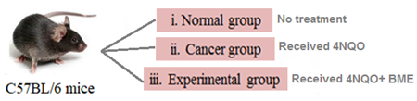
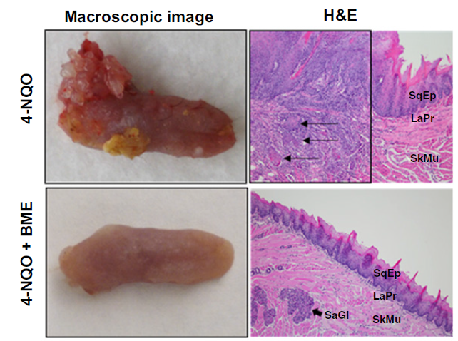
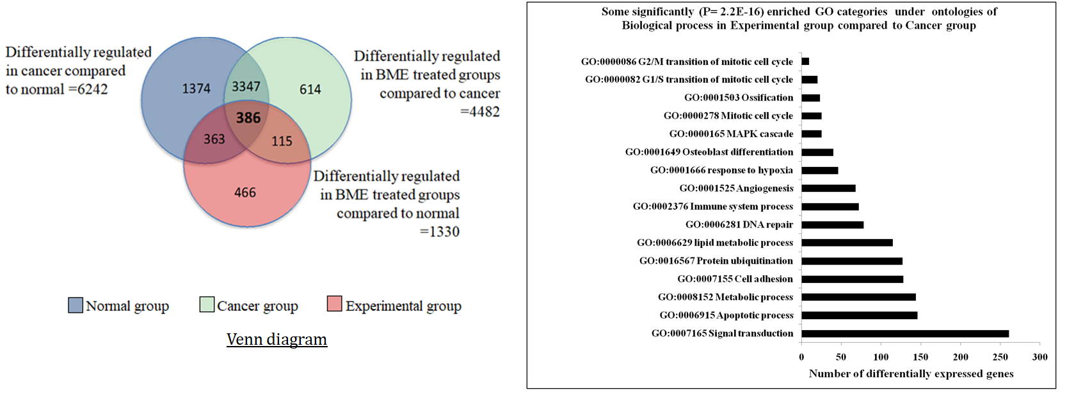
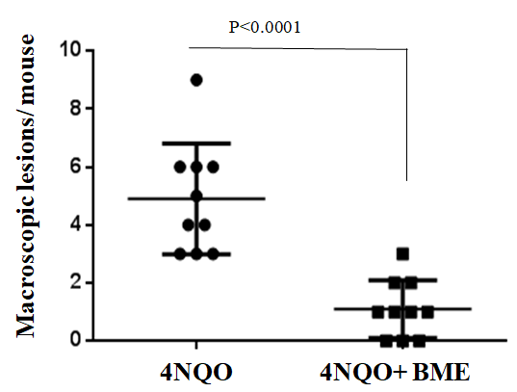
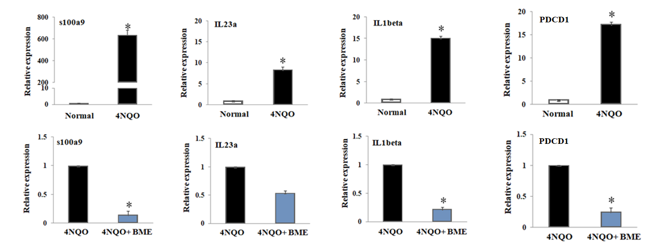
BME modulates immune system process in prevention of in-vivo oral carcinogenesis
A
B
C
Total annotated 22,782 transcripts
SqEp: normal squamous epithelium; LaPr: lamina propria; SkMu: skeletal muscle; Thin arrows: nests of invasive squamous carcinoma invading through lamina propria into skeletal muscle; SaGl: salivary gland (thick arrow)
D
RNA seq data
Genes | Cancer group(fold) | BME treated group (fold)
s100a9 | 686.7 | -3.02
IL23a | 13.41 | -7.57
IL1beta | 18.88 | -5.99
PDCD1 (PD1) | 17.61 | -1.7
E
Fig 1. A: BME prevents 4NQO induced mouse tongue tumor incidence. B: hematoxylin and eosin (H&E) staining shows invasive squamous carcinoma in cancer group and normal histology in BME treated group. C: RNA sequence analysis shows differentially expressed genes in different groups and some significantly altered biological processes in BME treated group vs. cancer group (right panel). D: RNA seq data shows high expression of immune system genes in cancer group which were significantly downregulated by BME E: Validation of gene expression of the immune system process by qRT-PCR. Data ±SD, P<0.05.

Slide 3
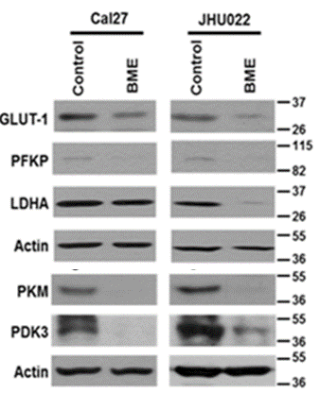
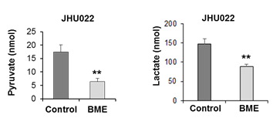
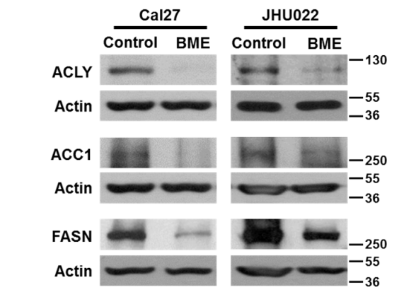
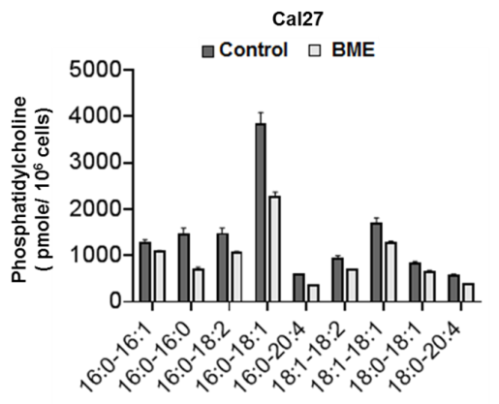
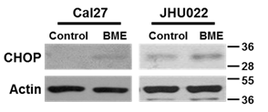
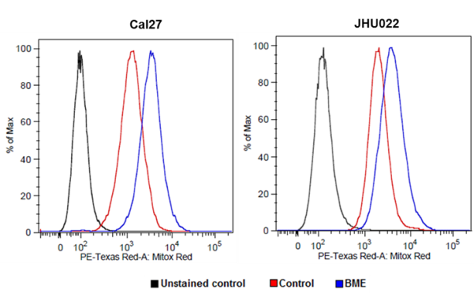
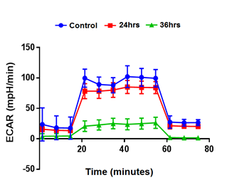
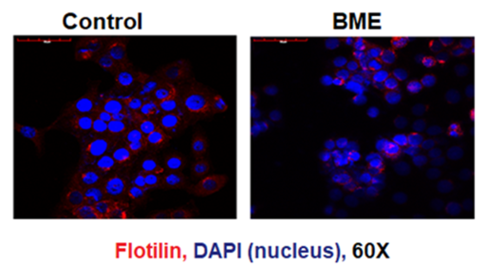
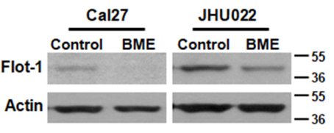
BME treatment inhibits glucose and lipid metabolism resulting stress induced cell death
Glycolysis pathway
Lipid metabolism
ER stress and ROS
A
B
A
B
A
C
B
C
D
Fig 2. A: Western blot analysis of some key glycolysis gene in control and BME treated cells. B: GC/MS analysis shows reduced levels of pyruvate and lactate following BME treatment. C: BME treatment reduces extracellular acidification rate (ECAR) (glycolysis) assessed by Seahorse XF extracellular flux analyser.
Fig 3. A: Western blot analysis of some key lipogenesis gene in control and BME treated cells. B: BME treatment reduces phospholipid analyzed by electrospray ionization-tandem mass spectrometry (ESI-MS/MS). C: Western blot analysis for Flotillin-1 and D: representative confocal microscopic images showing reduced expression of Flotillin in BME treated cells compared to control cells. Magnifications 60X.
Fig 4. A: Western blot analysis of ER- stress marker CHOP in control and BME treated cells. B: Control and BME treated cells were stained with mitoSox and flow cytometric analysis was performed to analyse mitochondrial ROS level at 510 nm

Slide 4
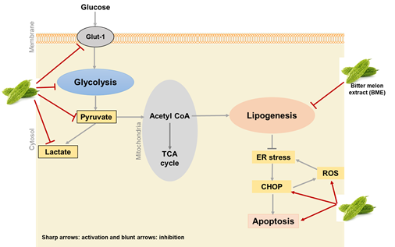


Conclusion
BME treatment prevents 4NQO induced mouse oral cancer
BME modulates immune system process by significantly reducing s100a9, IL23a, IL1beta and PD1
BME inhibits both glucose and lipid metabolisms in prevention of oral cancer and induces ROS and ER stress mediated cell death
Our result strongly demonstrates that BME will have potential clinical benefit as a chemopreventive agent
Schematic diagram showing mode of action of BME in oral cancer metabolism
Subhayan Sur (PhD),
Department of Pathology,
Saint Louis University, Saint Louis, Missouri, USA.
Email: subhayan.sur@health.slu.edu
Funding
National Institutes of Health

