Slide 1
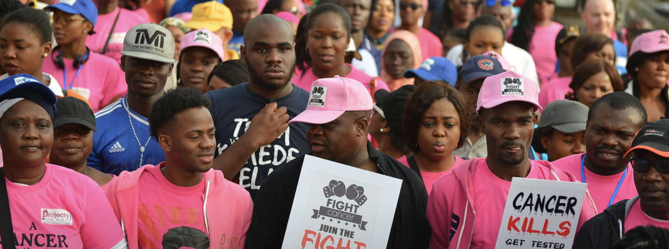

Step up to Health, Nigeria!
Runcie C.W. Chidebe¹, Leigh Leibel², Duygu Altinok Dindar³, Batuhan Kisakol⁴, Aviane Auguste⁵, Agha A. Agha⁶, Chinonso Ipiankama¹, Fabio Y. Moraes⁷, Emeka J. Nwagboso¹, Ashish Strestha⁸, Tochukwu Orjiakor⁶, Ifeoma Okoye⁶, Darlingtina Esiaka ⁹
¹Project PINK BLUE, Health and Psychological Trust Center, Abuja, Nigeria; ²Columbia University Irving Medical Center, NY, NY, United States; ³OSHU Knight Cancer Institute, Cancer Early Detection Advanced Research Center (CEDAR), Portland, Oregon, United States; ⁴Istanbul Sehir University, Computer Science and Engineering Department, Istanbul, Turkey; ⁵Vaughn A. Lewis Institute for Research and Innovation (VALIRI), Castries, Saint Lucia; ⁶University of Nigeria, Nsukka, Enugu, Nigeria; ⁷Queen’s University, Ontario, Canada; ⁸BP Koirala Institute of Health Sciences, Dharan, Nepal; ⁹Union College, Schenectady, NY, United States
Utilizing Information from Abuja's 2020 World Cancer Day Walk for Equity-Based Cancer Prevention Interventions

Slide 2
Background:
The annual World Cancer Day Walk (WCDW) in Abuja, Nigeria is an exciting grass roots event where thousands of Africans storm the streets to create cancer awareness using the theme #ChokeCancer. The day is an important tool for promoting public awareness of cancer risk factors, preventative lifestyle strategies, and importance of early screening as critical elements of prevention and control. Free screening for breast, cervical, and prostate cancer is provided to all who want it. The event is successful in promoting a change of attitude toward cancer, however, the effectiveness of the WCDW in attracting the most vulnerable populations has not been studied.
Aim:
To determine the social-demographic characteristics of WCDW participants to evaluate the impact of outreach campaigns.

Slide 3
Methodology:
Approximately 2,000 Nigerians attended Abuja World Cancer Day Walk on February 1, 2020. Trained research assistants recruited participants to complete a one-sheet questionnaire that assessed basic demographic, social, and lifestyle information. Participants gave informed consent. 237 (11%) participants, aged 18-68 years voluntarily completed survey. ClinicalTrials #NCT04248881.
Results:
The mean age for participants was 28; SD 7.71.
Sixty-eight percent were women.
Eighty-seven percent had at least an undergraduate education.
Of the 237 participants, 65% reported that they attended to obtain cancer screening.
More than 50% reported they had no health insurance.
Of those insured, more had National Health Insurance Scheme (NHIS) than private insurance.
The average body mass index (BMI) was between 24-28; BMI was highest among the mid-20 age group.
Lifestyle data revealed more men than women were concerned with their health; those with health worries were more likely to have had cancer screening at the event.

Slide 4
Analysis:
Data revealed participants are predominately associated with a lower risk of developing cancer. They have higher levels of knowledge about cancer and lifestyle/health-related behaviors beneficial for early detection and prevention.
World Cancer Day Walk is a great avenue for cancer awareness and lifestyle prevention interventions yet there is an urgent need to evaluate efficacy of current outreach to target underserved members of Nigerian population; those with lower levels of education, unemployed, lower income, and without insurance.
Conclusions:
Attendees are younger people of higher socioeconomic status with lifestyle practices that could reduce cancer risk. We must elaborate better strategies to reach populations at greater risk and encourage them to attend future events to have more impactful lifestyle/prevention outcomes. Lower middle-income countries (LMICs) may replicate this successful and sustainable model to engage their populations and advocate for national and global health priority.
Corresponding Author: Leigh Leibel, LL3125@cumc.columbia.edu

