Slide 1
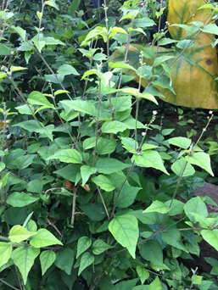
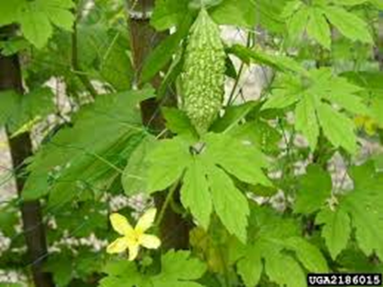
The Prospects of Croton membranaceus Mull. Arg. (Euphorbiaceae) and Momordica charantia L. in cancer treatment and or prevention
Mavis Boakye-Yiadom & Dr. Kofi Bobi Barimah
Centre for Plant Medicine Research, Mampong Akuapem, Eastern Region, Ghana

Slide 2
Introduction
Cancer is a disease associated with abnormal growth of cells in the body
Approximately 70% of deaths from cancer occur in low- and middle-income countries such as Ghana.
Also, the Daily Graphic in March, 2018 reported over 65,000 new cancer incident cases yearly in Ghana.
Study background
A capsule formulated from C. membranaceus, being used for the management of Benign Prostatic Hyperplasia at CPMR has yielded positive results. Larixol, an isolate from this same plant has a similar chemical structure as Manool; a known anti-cancer agent.
M. charantia is known to have cancer treatment activities.

Slide 3
Aim
To ascertain the prospects of Croton membranaceus (C. membranaceus) and Momordica charantia (M. charantia) in the treatment and or prevention of Cancer.
Methods
Ethanolic extracts of C. membranaceus and M. charantia will be used on various cancer cell lines such as Prostate and Breast as well as xenograft models to ascertain its effect and possible mode of action.
Clinical study will be done using products developed as tinctures or capsules from the two plants.
Recruitment of patients will be done in collaboration with Sweden Ghana Medical Centre.
Patients monitoring will be by teams from Centre for Plant Medicine Research (CPMR), Mampong- Akuapem and Sweden Ghana Medical Centre, Accra.

Slide 4
Expected outcome
Prevention of cancer cells growth by C. membranaceus and M. charantia will be ascertained. The anti-oxidant activity and the effectiveness of each plant in the treatment of Cancer will be established
Conclusion
The cancer prevention and or treatment activities of C. membranaceus and M. charantia would be ascertained
Recommendations
A comparative study could be done to compare the activities of Larixol, Manool and the whole plant extract of C. membranaceus on cancer cells.
Different parts of M. charantia could be compared for its cancer treatment and or prevention activities.

Slide 5
Contact Information
MAVIS BOAKYE-YIADOM
CENTRE FOR PLANT MEDICINE RESEARCH,
P.O.BOX 73,
MAMPONG-AKUAPEM
EASTERN REGION, GHANA
EMAIL: magaby2752001@gmail.com or mboakye-yiadom@cpmr.org
Telephone:+233235080355(WhatsApp) or +233264410358 (call)

