Slide 1
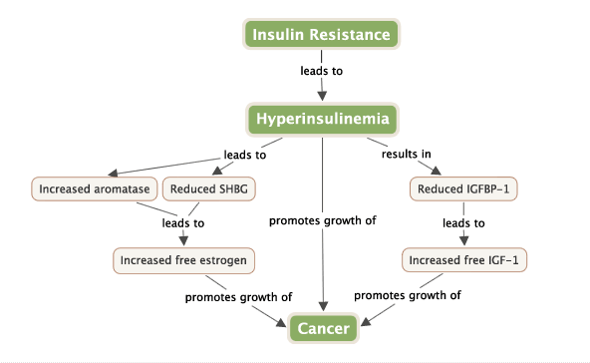
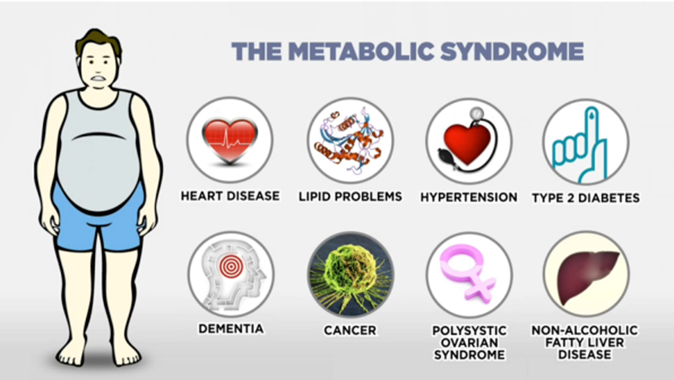
Insulin Resistance
Supportive Oncology Metabolic Syndrome Clinic Within Integrative Oncology
Bailey-Dorton, C., MD, MPH¹, Gentile, D., PhD¹; Greiner, R., PhD, PA-C¹; Yaguda, S., MSN, RN¹; Ellie Muller, BS¹
¹ Department of Supportive Oncology, Levine Cancer Institute, Charlotte NC
Purpose: to establish a Metabolic Clinic with a multidisciplinary, integrative approach to risk reduction
Metabolic Syndrome in Breast Cancer
Abdominal obesity
Dyslipidemia
Elevated blood pressure
Proinflammatory state
Insulin is a growth factor ( Frasca, 2008; Gunter, 2009).
Encourages cell proliferation. Lowers SHBG levels, raising blood levels of free estrogen ( Plymate, 1988).
Insulin signaling in inflammatory pathways ( Jialal, 2012; Vitseva, 2008).
Elevated insulin levels may promote growth of these tumors ( Belfiore, 2008).
Grundy SM, Brewer HB Jr, Cleeman JI, et al. Definition of metabolic syndrome: report of the National Heart, Lung, and Blood Institute/American Heart Association

Slide 2
Integrative Approach to Metabolic Syndrome Management
Establish diagnosis of metabolic syndrome
Labs – HgA1c, glucose, lipids
  Vitamin D, B12, thyroid, magnesium, iron/ferritin – as indicated
Psychological assessment as indicated
Address treatment side-effects
  Hot flashes, arthralgias, fatigue, digestion issues
Lifestyle changes
  Nutrition
  Exercise
  Sleep
  Stress management
  Psychological Assessment
  Health coaching – barriers to change
  Intermittent Fasting
  Supplements– DHA/EPA, turmeric, Vitamin D, probiotics

Slide 3
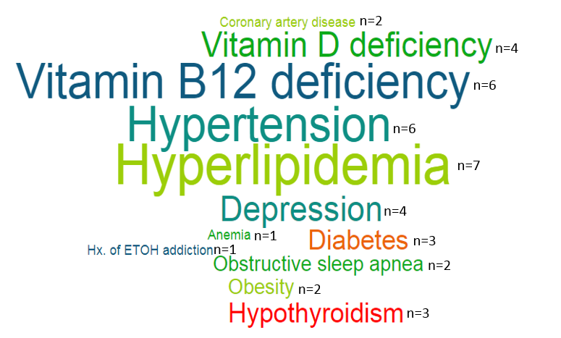
Preliminary Data
50 enrolled/ target of 50
8 returned for follow-up visit, 2 have had second follow-up visit
Preliminary data available for 14 patients
Figure 1. Comorbidities

Slide 4
Lessons Learned
Change metabolic referral criteria (any pt. at risk)
Capture # of pts. referred but ineligible by metabolic criteria
Pivot to virtual program during COVID-19
COVID-19 presented additional weight loss challenges:
-closed gyms
-social isolation
-greater stress
-difficultly obtaining labs (requires in-person visits)
-missing accountability partners
-cancer institute’s exercise groups not meeting in person
-limited healthy food access (COVID risk of shopping)
Future Directions
Follow obese/at risk pts. who do not meet metabolic criteria
Add insulin labs for insulin resistance & risk
Offer both virtual & in-person programming, even post COVID-19
Address challenges of COVID-19 on implementation
Anti-cancer lifestyle program (https://anticancerlifestyle.org/)
Contact: Chasse.Bailey-Dorton@AtriumHealth.org

