Slide 1

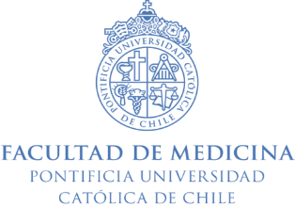


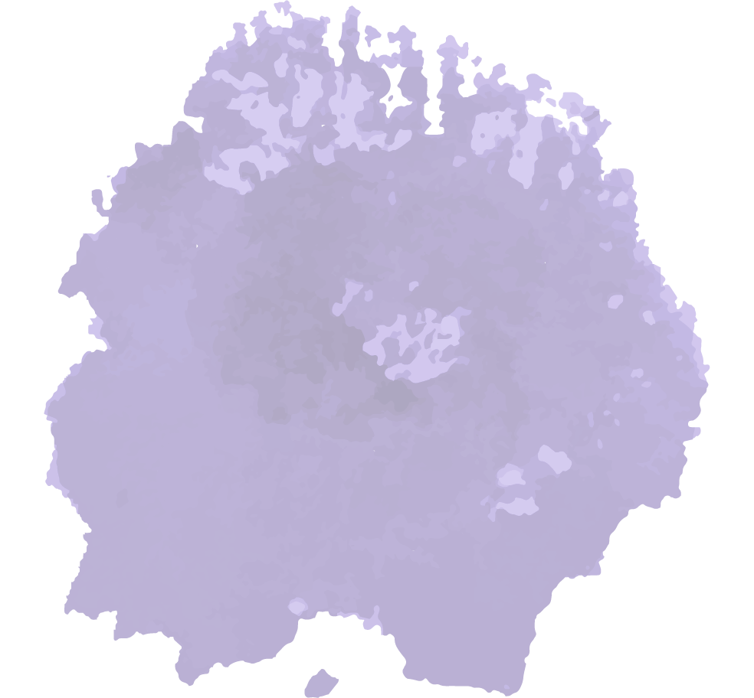
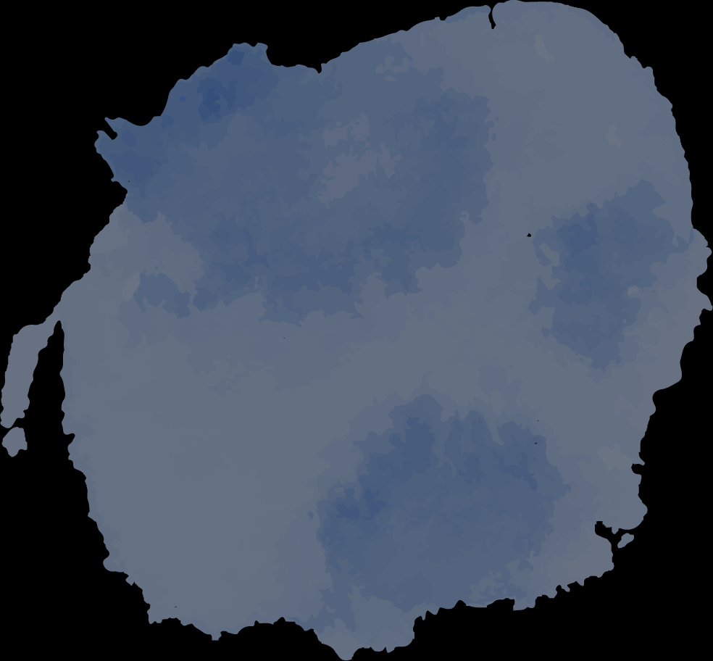
Breast Cancer and use of complementary therapies in the Chilean’s National Health Survey 2016-17
Paula Bedregal, Victoria Lermanda
Pontificia Universidad Católica de Chile, Division of Public Health and Family Medicine.
Santiago - Chile
Breast cancer in Chile is the main cause of death by cancer in women.
Adjusted Mortality rate (2016): 13 x 100.000
Incidence (2012): 34,8 x 100.000
It is included in Law of Explicit Guarantees in Health (GES)
It is one of the 85 conditions that have universal coverage to treatment in public and private healthcare.
In Chile, there has been an increase in the prevalence of use and perceptions of benefit of complementary therapies.
Naturopathy is the best considered (93.4% of satisfaction).
Breast cancer package of services in Chile does not include complementary therapies (CT)
Despite that some of them are incorporated into some evidence-based clinical guidelines.
People aged 15 years and over with suspected, diagnosed or recurrent breast cancer.
It provides detection, medical supplies, treatment (surgical, chemotherapy, radiotherapy, hormone therapy, rehabilitation) and palliative care.
7.787
4.081
5.393
Source: WHO, 2020.
AIM
According to NHS-Chile 2016-17, use of CT last year in adults was
26,4%
(IC95%: 24,3-28,6%)
To compare the use of complementary therapies in people with and without breast cancer diagnosed ever in life.
Use of herbal supplements and homeopathic products is about
7,2%
(IC95%: 6,2-8,4%).

Slide 2
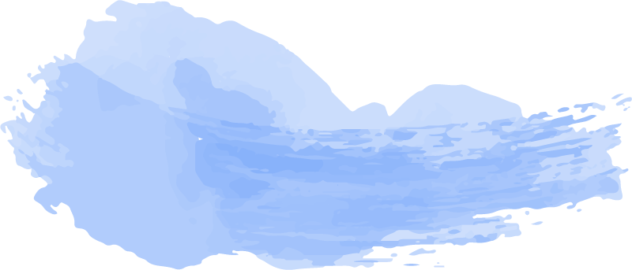

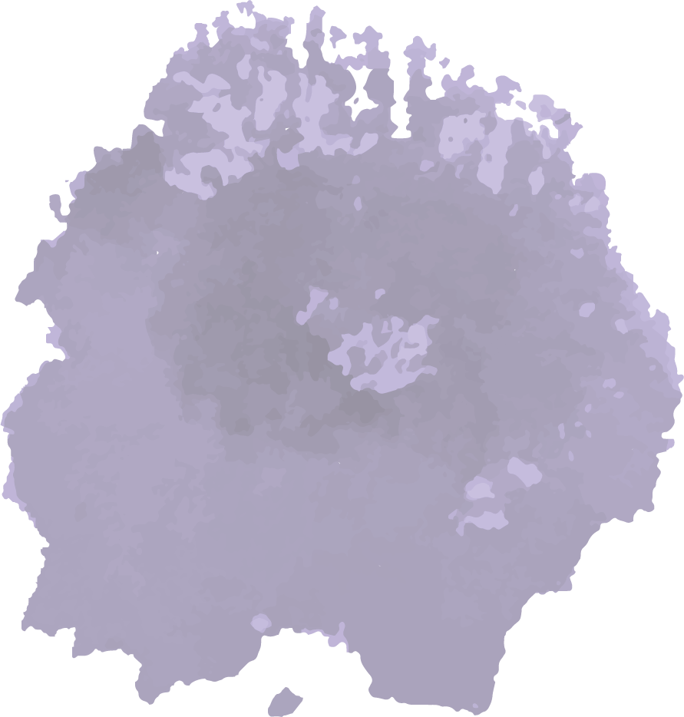

MATERIAL AND METHODS
Material
Data from last Chilean’s National Health Survey (2016-17).
It allows to estimate the national prevalence of chronic diseases and use of health services.
Sample
5,514 people over 15 years old.
It includes 2.317 men and 3.924 women.
Analysis
Descriptive and bivariate analysis between age and sex.
http://epi.minsal.cl/encuesta-ens/
Notes:
Nota:
Muestra en ENS: 5.514 (2.317 hombres, 3.924 mujeres).
Base de datos cáncer de mama: en generales sale N=2814

Slide 3

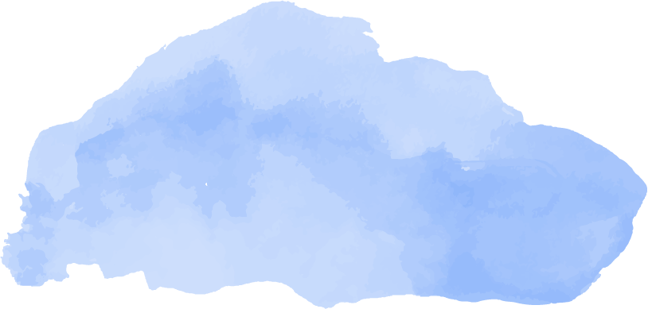
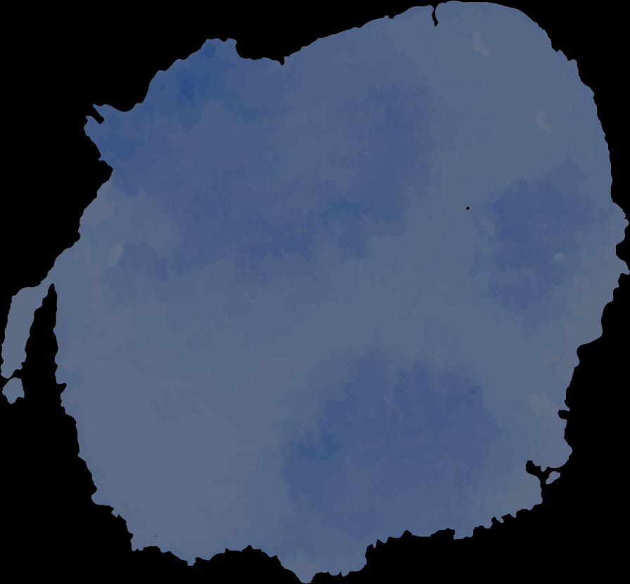
RESULTS
Comparisons
There was no difference in the use of acupuncture, Bach’s flowers, Reiki, Chiropractic and other CT.
Homeopathy and natural medicine are significantly the most used.
1.2%
Women had history of Breast cancer
66±10.4
years old (average)
95.3%
Received allopathic treatment related to GES
86%
Received surgery

Slide 4
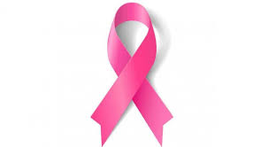
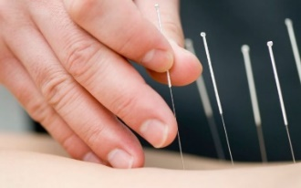

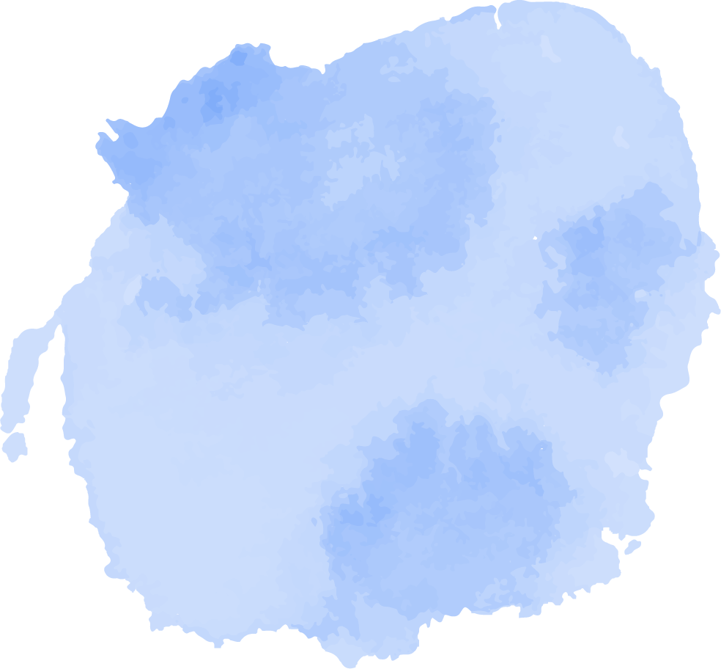

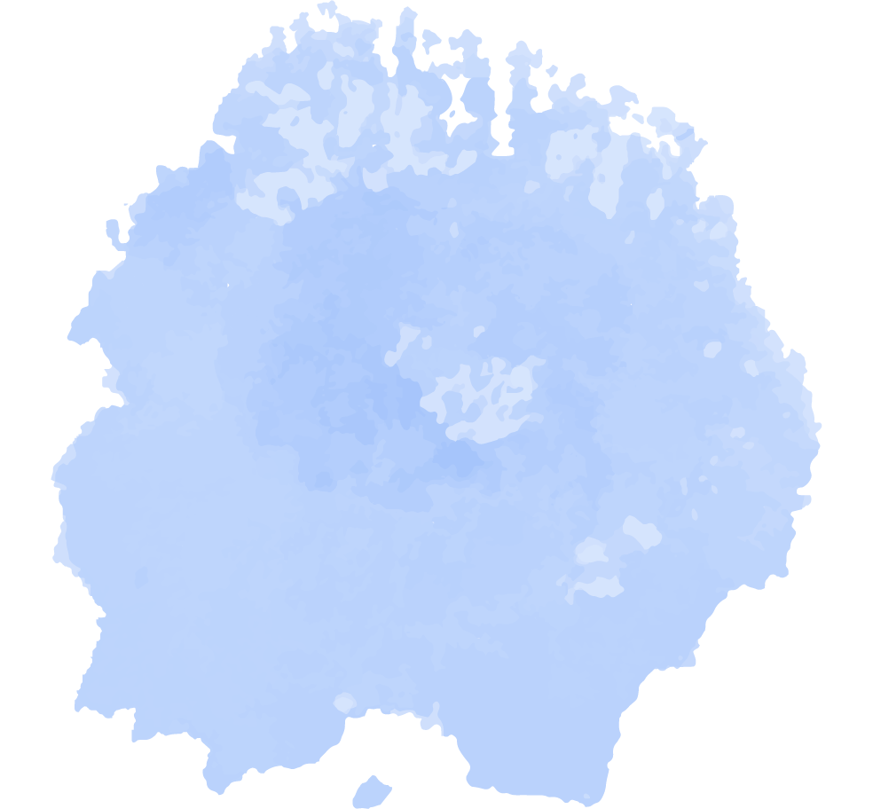


RESULTS
CONCLUSIONS
Associated factors
The use of each type of CT is mediated by educational level.
Low level
Medium level
High level
(<8 years)
(8-12 years)
(13+ years)
Despite the restrictions in access, people with breast cancer tend to use more CT.
Those therapies with the most scientific evidence, as acupuncture (i.e.), are less used.
Given the growing interest in receiving CT It would be relevant to include it in Breast Cancer package services.
29,3%
46,3%
24,4%
Perceptions
Those who received CT perceived more benefits with homeopathy and herbs, and less with acupuncture and Bach’s flowers.
Excluding Bach’s flowers, most people would like to have access to these services at the public health sector, to guarantee continuity of care and treatment.
People are requesting CT in general. There are some sociocultural factors influenced this. Is important to generate more evidence about what and why people are seeking this type of healthcare
Some economic reasons are probably at the base. Nevertheless, we need more research to affirm this. CT are not included in GES, so they don’t received fundings that allow people an equal access to them. On the other hand, educational level also influences the type of CT that it is requested.
Implementation research in this matter is necessary to support the creation of policies that integrates CT with the current healthcare services; also is necessary to study and analize how they can be inserted
Perception of benefits
Would like to have access at the public health
Acupunture
Acupunture
Bach’s flowers
25%
Bach’s flowers
75%
References
Icaza, G., Núñez L. & Bugueño H. (2017). Descripción epidemiológica de la mortalidad por cáncer de mama en mujeres en Chile. Rev. Med. Chile; 145: 106-114.
World Health Organization. (2020). Cancer country profile. Chile. Available on: https://www.paho.org/hq/index.php?option=com_docman&view=download&category_slug=4-cancer-country-profiles-2020-1&alias=51653-chile-country-profile-2020-1&Itemid=270&lang=es
Del Castillo, C., Cabrera E., Derio L., Gaete F. & Cavada G. (2017). Resultados del tratamiento del cáncer de mama, Programa Nacional de Cáncer del Adulto. Rev. Méd. Chile; 145: 1507-1513.
Others
Others
40%
100%
50%
100%
Homeopathy
Reiki
Homeopathy
Reiki
81,8%
Natural medicine
80%
85,7%
Natural medicine
66,7%
87,5%
92,9%
Contact: Paula Bedregal (dbedrega@uc.cl)

