Slide 1
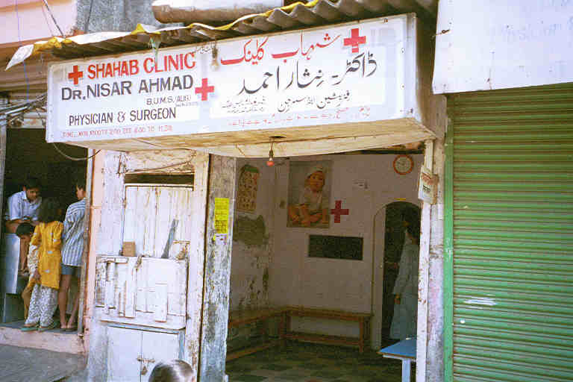
Traditional medicine
in urban poor communities in India: a resource for prevention and early detection of oral cancer
Stephen L. Schensul PhD (Schensul@uchc.edu) Jean J. Schensul PhD (Jean.Schensul@icrweb.org)
Univ. of Connecticut Sch. of Medicine (860-679-1570) Institute for Community Research (860-278-2044)
263 Farmington Ave., Farmington, CT 06030 2 Hartford Sq. West, Hartford, CT 06106
ORAL CANCERS¹¹
THE RISHTA HIV PROJECTS (201-2013)
AYUSH AND ORAL CANCER PREVENTION
AND DETECTION: A proposed project
Oral cancer is a malignant neoplasm found on the lip, mouth floor, cheek lining, gingiva, palate or in the tongue
Oral cancer is among the top three cancers in India and constitutes 30% of cancers
90-95% of oral cancers in India is squamous cell carcinoma
The incidence of oral cancer among those individuals who smoke or use smokeless tobacco (SLT) is 8.4 times higher than those who do not use tobacco
In India, 57% of men and 11% of women between the ages of 15-49 use some form of tobacco
For men, approximately 50% use SLT and 10% smoke
Almost all consumption for women involves SLT
NIMH-funded projects to develop, implement and test culturally-based approaches for the prevention of HIV/STI among men, women and couples
AYUSH providers usually do not discuss oral health or examine patients mouths. The RISHTA project shows they are amenable to training and collaboration. An intervention with AYUSH providers would involve the following:
Training of AYUSH providers on oral health, tobacco use and cancer risk, cancer signs and oral examination and encourage tobacco quitting.
Collection and assessment of oral cancer risk from patients based on tobacco use patterns.
AYUSH conduct oral examination (lips, cheeks, gums, floor, and tongue for irritation and lesions
Referral for irritation or lesions to a pre-arranged tertiary hospital closest the community
Provision of oral hygiene, tobacco and cancer education, and support for quitting or referral to quit program for all tobacco users.
Follow-up visits to include an oral examination, further information on good oral practices and assessment of tobacco use.
RCT evaluation approach (randomize AYUSH into treatment and control groups.
Outcomes – reduced tobacco use, reduced signs of irritation, early diagnosis and appropriate referrals.
THE STUDY COMMUNITY
Population 600,000
90% live in single room, average household size of 6.2 persons
Mean household income is Rs. 3272 ($75/mo)
54% Muslim, 46% Hindu
66% migrants from impoverished northern states
AYUSH PROVIDERS²
90% of the 245 providers based in the community are AYUSH
Located in every lane in the community
Signs indicate Ayurvedic (Indian), Unani (Muslim)and Homeopathic (German-derived), but credentials unclear
Considered the ”family daktur”
Need for Prevention and Early Detection with low income populations
AYUSH intervention
A three arm community design assessed the efficacy of community based providers to address men’s HIV/STI prevention and treatment among men. Arms were:
Arms 1 and 2: Training in culturally based symptoms and STI treatment for allopathic providers (community 1) and AYUSH providers (n=33, Community 2)
Arm 3: control community
Both experimental communities showed equal reductions in STIs and increase in HIV prevention behavior
Conclusion: AYUSH providers are effective collaborators in health education and referral programs.
Oral cancer is associated with lower SES groups and often diagnosed in later stages
There are limited allopathic clinics and dentists in rural and urban slum areas
Oral cancers will increase over the next decade as SLT use continues
Only prevention, via early detection and quitting SLT use will reduce oral cancers
New approaches are needed to reach the rural and urban poor
One such resource is the providers of traditional or AYUSH (meaning “life in Hindi/Urdu) consisting of Ayurveda, Yoga, Unani, Siddha and Homeopathy in most communities in India
AYUSH providers see many patients in urban slum communities for common health problems. They have not been included in tobacco or cancer prevention efforts to date.
Limitations
AYUSH providers are viewed as “quacks” by allopathic medicine.
There are occasional government efforts to “crack down” on AYUSH providers whose credentials may not be official or demonstrable.
AYUSH providers are private practitioners whose business depends on patient income. They sometimes move to other more profitable communities.
Ayush providers may be avid chewers of tobacco themselves and promote its health enefits.
But in low income communities they see more than 10x the number of patients than the allopathic system and they are key community opinion leaders for health maintenance and treatment
The NCI Women & Smokeless Tobacco Project ^{3,4}
This study (2010 and 2014) assesses the use of SLT among women of reproductive age.
30% of women in the sample (490) chewed SLT in any form.
Initiation was either early or immediately post marriage/first pregnancy and use increased over time.
50% of women had no intention of quitting, viewing SLT use s functional or healthy. Only 15% intended to quit
50% of women said fear of cancer was a reason not to use SLT
SLT use and oral cancer risk require innovative interventions
References
Varshita A. The prevalence of oral cancer in India. A/J (2015) Pharm. Sci & Research, v7(10), pp. 845-848.
Schensul S, et al. (date) Healing traditions and men’s sexual health in Mumbai, India: The realities of practiced medicine in urban poor communities. SSM 2006 pp. 2774-2785.
Schensul, J., Begum, S., & Nair, S. (2018). Challenges in Indian Women's Readiness to Quit Smokeless Tobacco Use. Asian Pac Jr Canc Prev., vol. 19(6): 1561-1569.
Nair S. Schensu, J. et al (2015). Use of smokeless tobacco by Indian women aged 18-40 years
during pregnancy and reproductive years. PloS one, 10(3), e0119814.

