Slide 1


An immunomodulatory gallotanin-rich fraction from Caesalpinia spinosa enhances the therapeutic effect of anti-PD-L1 in melanoma
Paola Lasso¹, Alejandra Gomez-Cadena^{1,2}, Claudia Urueña¹, Alena Donda³, Amaia Martinez Usatorre⁴, Pedro Romero³, Alfonso Barreto¹, Susana Fiorentino^{1*}
¹ Grupo de Inmunobiología y Biología Celular, Pontificia Universidad Javeriana, Bogotá, Colombia. ² University of Geneva, Department of Pathology and Immunology, Geneva, Switzerland. ³ University of Lausanne, Department of Fundamental Oncology, Lausanne, Switzerland. ⁴ Swiss Federal Institute of Technology Swiss Institute for Experimental Cancer Research, Lausanne, Switzerland
* e-mail address: susana.fiorentino@javeriana.edu.co; plasso@javeriana.edu.co

Slide 2
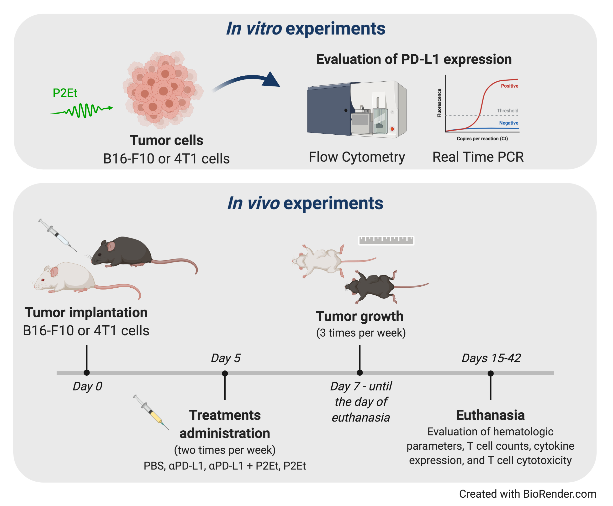
Background
The PD-1/PD-L1 pathway plays a role in inhibiting immune response. Therapeutic antibodies aimed at blocking the PD-1/PD-L1 interaction have entered clinical development and have been approved for a variety of cancers. However, the clinical benefits are only present in a restricted group of patients. Currently, the research in combined therapies, which allows for a greater response, are strongly encouraging. We previously characterized a polyphenol-rich extract from Caesalpinia spinosa (P2Et) with anti-tumor activity in both melanoma and breast carcinoma, as well as immunomodulatory activity. We hypothesize that the combined treatment with P2Et and anti-PD-L1 can improve the antitumor response through an additive antitumor effect.
Methods
Objective
We investigated the antitumor and immunomodulatory activity of P2Et and anti-PD-L1 combined therapy in B16-F10 melanoma and 4T1 breast carcinoma.

Slide 3
Results
P2Et treatment alone or in combination with αPD-L1 maintains hematological parameters in normal ranges in B16-F10 model
PD-L1 expression is modulated by P2Et extract in B16-F10 and 4T1 cells
P2Et treatment enhances the response to αPD-L1 immunotherapy in B16-F10 tumor-bearing mice
Figure 3. Hematological parameters. Hematological parameters of B16-F10 (A) or 4T1 tumor-bearing mice (B). Data are represented as violin plots showing the frequency distribution of the data, median and quartiles. The gray area shows the normal reference range for each mouse strain according to the breeding company and the dotted line corresponds to the median of the reference range. *p < 0.05, **p < 0.01.
P2Et treatment increases PD-L1 expression in tumor cells in vivo
Figure 1. P2Et treatment modulates the expression of PD-L1 on B16-F10 and 4T1 cells. (A) Geometric Mean Fluorescence Intensity (MFI) of surface or intracellular PD-L1 expression in B16-F10 and 4T1 cells after 48h. (B) PD-L1 relative expression to GAPDH gene in B16-F10 and 4T1 cultured cells during 48 hours with one-half of the P2Et IC₅₀ extract, cobaltous chloride (CoCl₂) or ethanol (EtOH) analyzed by qRT-PCR and quantitated as a fold change against the control by using the 2^{-ΔΔCT} method. Geometric MFI of surface and intracellular PD-L1 expression in (C) B16-F10 and (D) 4T1 cells treated during 48 hours with one-half of the P2Et IC₅₀, CoCl₂ or ethanol. In all cases data are represented as the mean ± SEM of at least three independent experiments. The p values were calculated using a Mann-Whitney U test or Kruskal-Wallis test with Dunn’s post-test. *p < 0.05, **p < 0.01, ***p < 0.001.
Figure 2. P2Et treatment enhances the response to anti-PD-L1 immunotherapy in B16-F10 tumor-bearing mice. (A) Experimental treatment scheme. Tumor was established by injection of B16-F10 or 4T1 cells and 5 days after tumor cell injection, treatments were administrated two times per week for 17 and 33 days, respectively. (A) Tumor volume in B16-F10 tumor-bearing mice treated with ⍺PD-L1, P2Et, P2Et plus ⍺PD-L1 or PBS. (B) Tumor volume in 4T1 tumor-bearing mice treated with each treatment. In all cases data are represented as the mean ± SEM (n=5-7). The p values were calculated using a two-way ANOVA test. *p < 0.05, **p < 0.01, ***p < 0.001.
Figure 4. PD-L1 and PD-1 expression in melanoma and breast tumor infiltrating immune cells. (A) Frequency of CD45 negative cells expressing PD-L1 in mice treated with ⍺PD-L1, P2Et, P2Et plus ⍺PD-L1 or PBS (control). (B) MFI of PD-L1 expression in CD45 negative cells. (C) PD-L1 relative expression to GAPDH gene in tumor cells from each mice group analyzed by qRT-PCR and quantitated as a fold change against the control (healthy mice) by using the 2^{-ΔΔCT} method. (D) Frequency of intratumoral CD4⁺ and CD8⁺ T cells expressing PD-1. CD4⁺ and CD8⁺ T cells were selected from live CD3⁺ CD45⁺ cells. (E) Frequency of CD45 negative cells expressing PD-L1 in 4T1 tumor-bearing mice. (F) MFI of PD-L1 expression in CD45 negative cells from 4T1 tumor-bearing mice. (G) PD-L1 relative expression to GAPDH gene in tumor cells from each 4T1 tumor-bearing mice group analyzed by qRT-PCR and quantitated as a fold change against the control (healthy mice) by using the 2^{-ΔΔCT} method. (H) Frequency of intratumoral CD4⁺ and CD8⁺ T cells expressing PD-1 in 4T1 tumor-bearing mice. In all cases data are represented as the mean ± SEM. *p < 0.05, **p < 0.01.

Slide 4
Results
Conclusions
This study shows that combined therapy of P2Et and anti-PD-L1 can improve antitumor response in a melanoma model by activating the immune response and neutralizing immunosuppressive mechanisms
P2Et treatment alone or in combination with αPD-L1 modulates the immune response
P2Et in combination with αPD-L1 enhances the effector response of cytotoxic cells in melanoma and breast 4T1 model
Acknowledgments
The authors would like to thank Pontificia Universidad Javeriana and the Colombian Environmental Ministry for allowing the use of genetic resources and derived products (agreement number 1470 of 02/08/2018; No. 220, 2018).
Figure 5. P2Et treatment alone or in combination with PD-L1 modulates the immune response in melanoma B16-F10 model. (A) Absolute numbers of CD45- and CD45+ cells per mg of tumor in mice treated with ⍺PD-L1, P2Et, P2Et plus ⍺PD-L1 or PBS (control). (B) Representative dot plots of the CD4+ and CD8+ T cell populations. (C) Absolute numbers of CD4+ and CD8+ T cells per mg of tumor in each group of treated mice. (D) Frequency of activated CD44+ CD4+ and CD8+ T cells in tumor from each group of treated mice. (E) Representative dot plots of monocytic MDSC (M-MDSC: CD11b+ Ly6Chi Ly6G-) and polymorphonuclear MDSC (PMN-MDSC: CD11b+ Ly6Clo Ly6G+). (F) Number of MDSC like cells (MDSC-LC), M-MDSC and PMN-MDSC per mg of tumor from ⍺PD-L1, P2Et, P2Et plus ⍺PD-L1 or PBS treated mice. In all cases data are represented as the mean ± SEM. *p < 0.05, **p < 0.01.
Figure 6. Effector response in melanoma and breast cancer. Cytokine levels in the serum of B16-F10 tumor-bearing mice (A) or 4T1 tumor-bearing mice (B) treated with ⍺PD-L1, P2Et, P2Et plus ⍺PD-L1 or PBS. The data were log-transformed and plotted as the mean ± SEM. (C) Cytotoxicity percentage of spleen cells from B16 tumor-bearing mice against B16-F10 melanoma cells at E:T ratios of 0:1, 10:1 and 20:1. (D) Cytotoxicity percentage of spleen cells from 4T1 tumor-bearing mice against 4T1 cells at E:T ratios of 0:1, 10:1 and 20:1. In all cases data are represented as the mean ± SEM. *p < 0.05, **p < 0.01.
Contact information
susana.fiorentino@javeriana.edu.co
plasso@javeriana.edu.co

