Slide 1
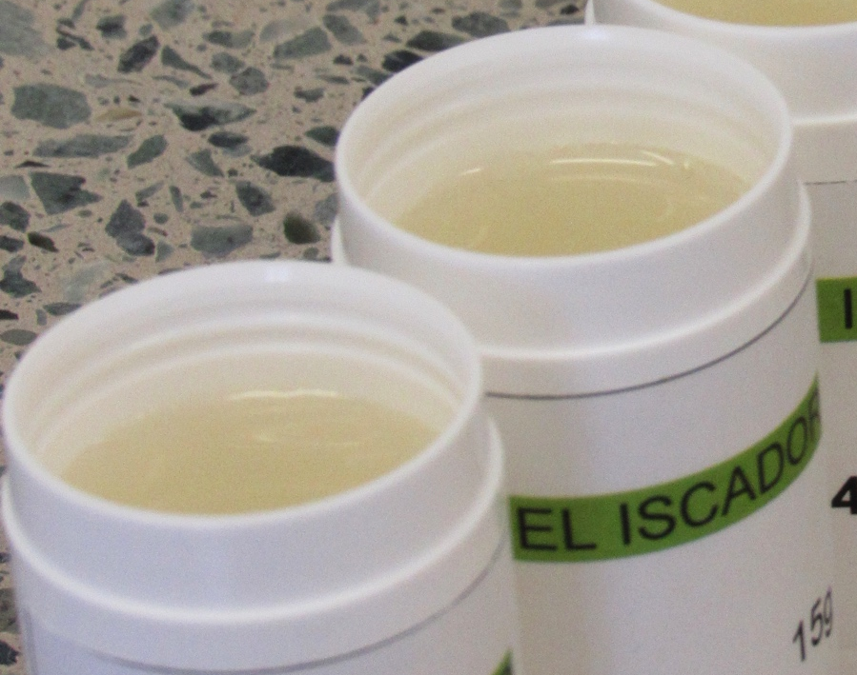
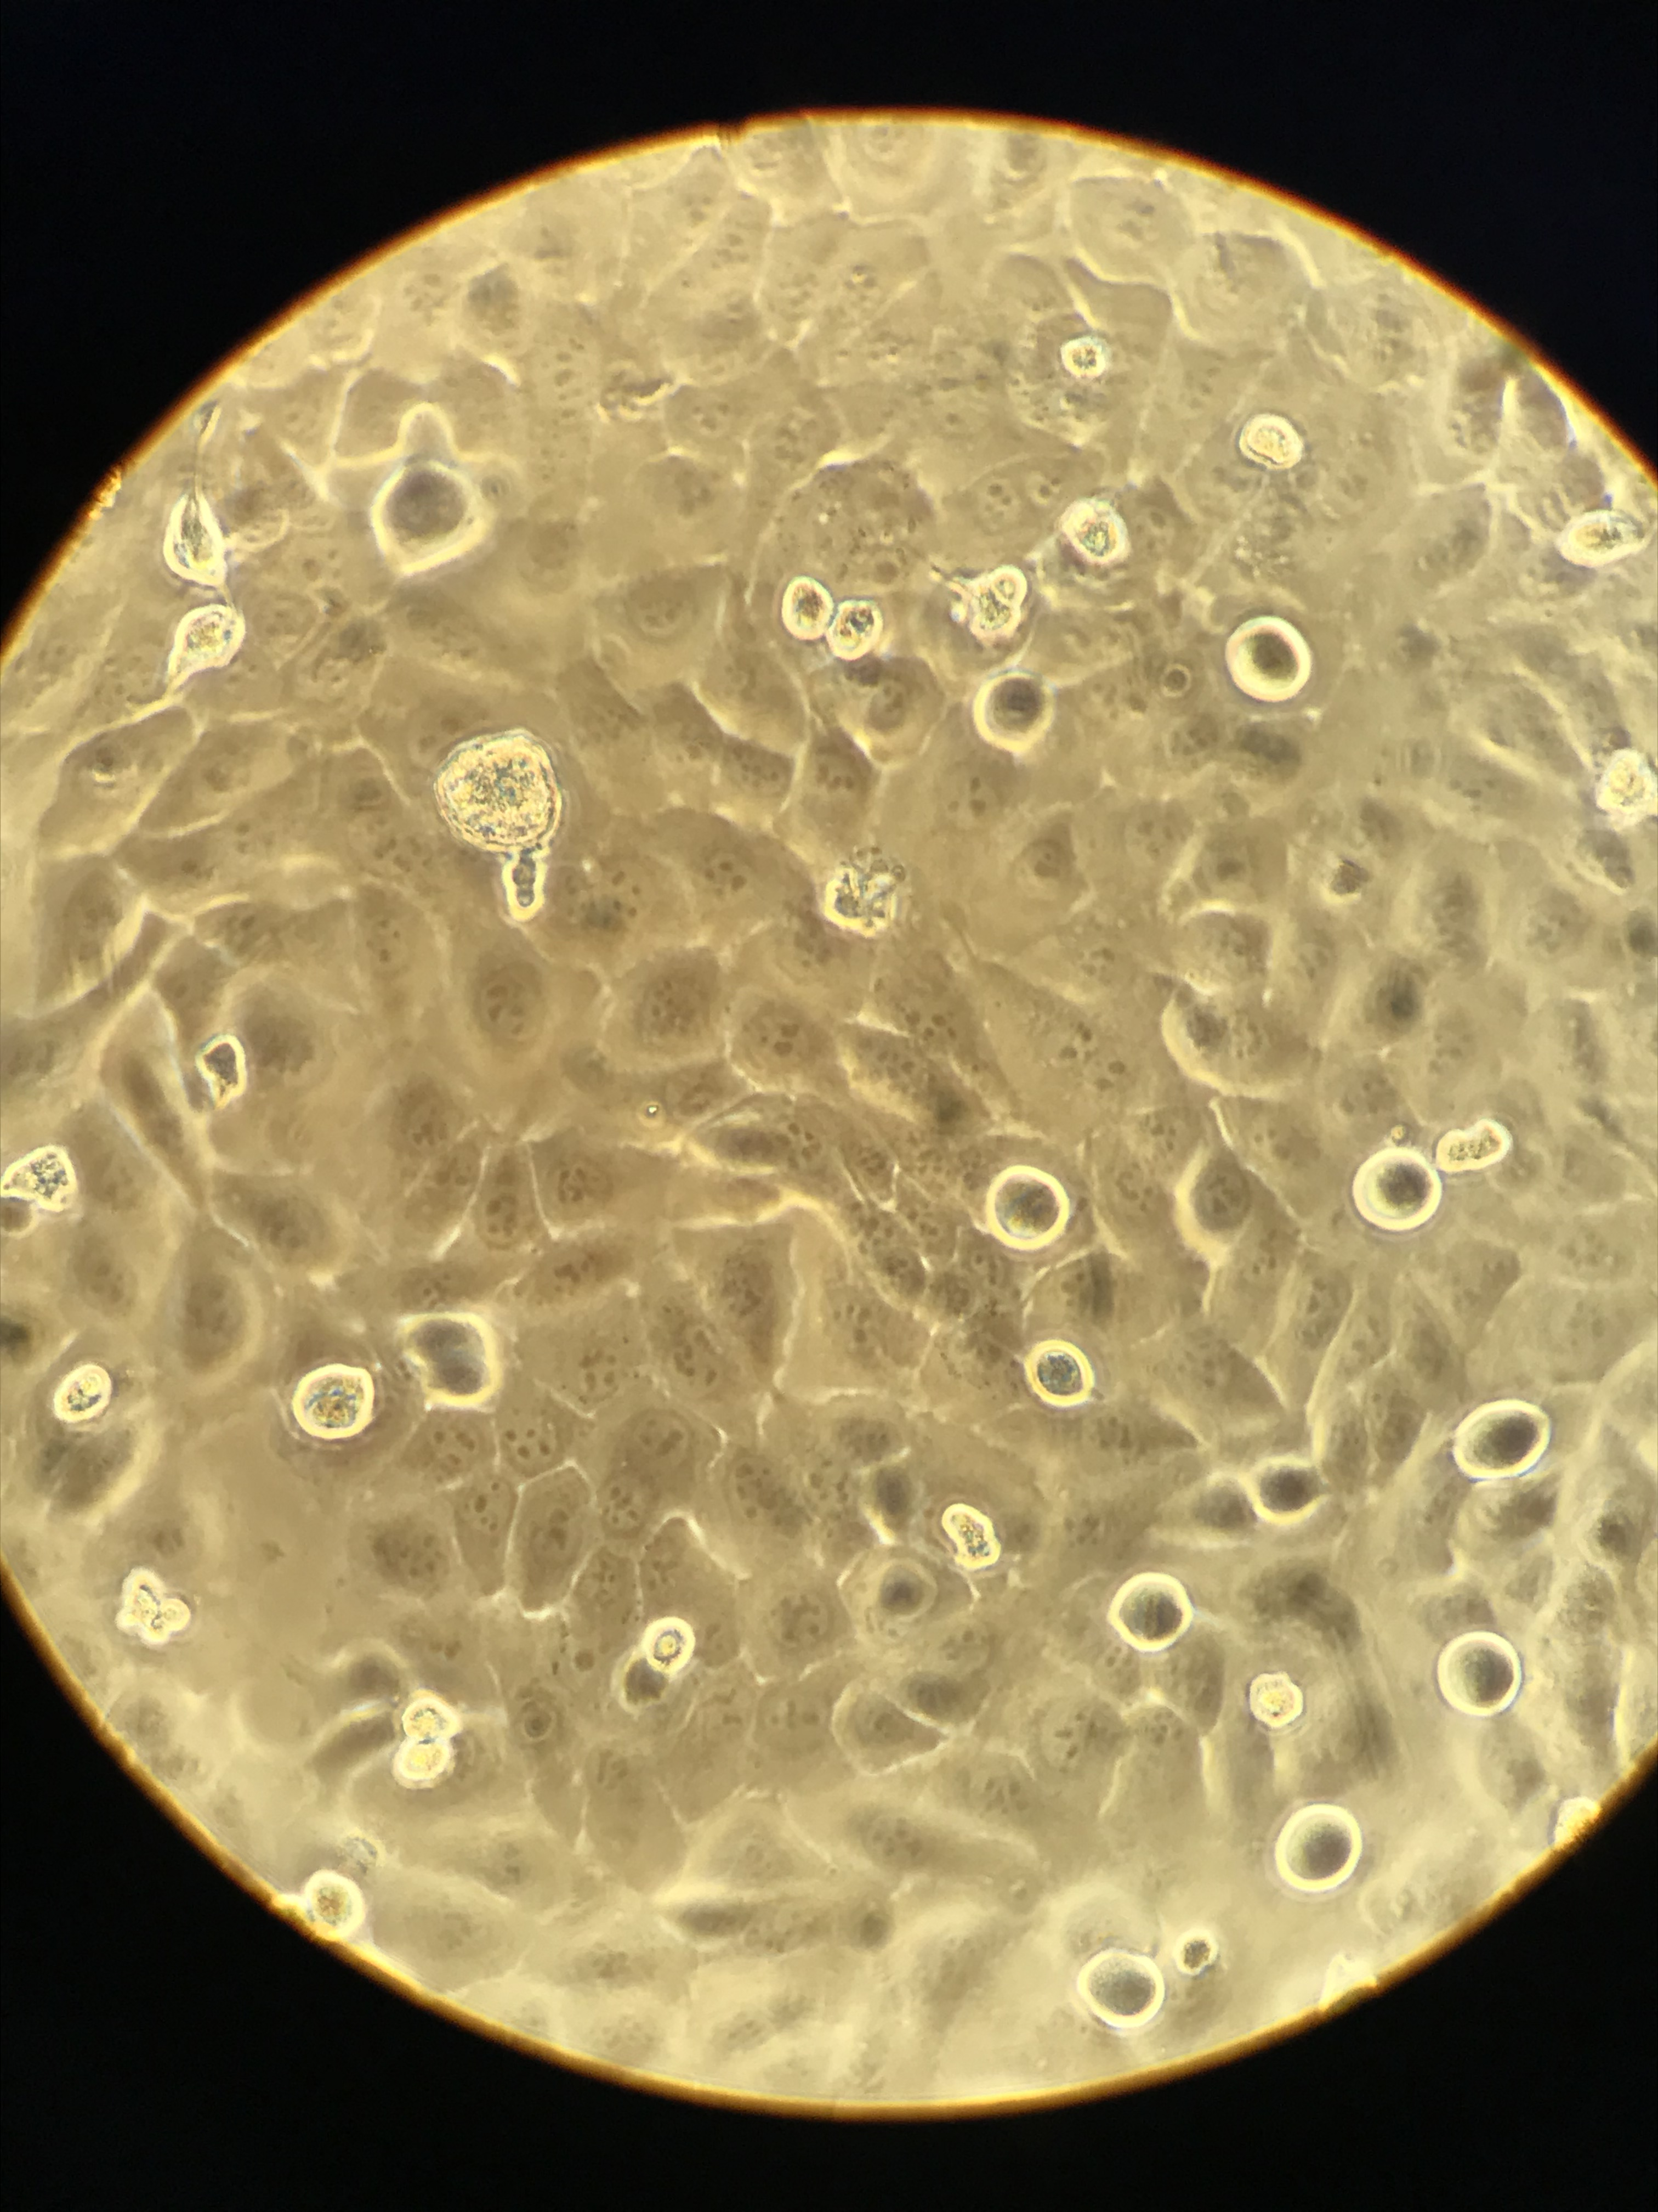
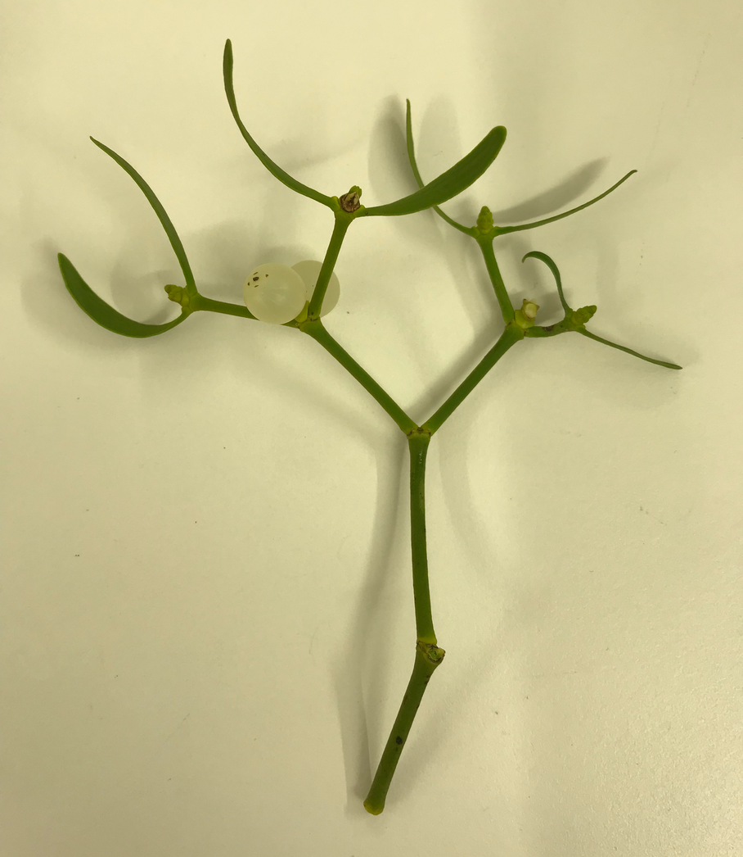
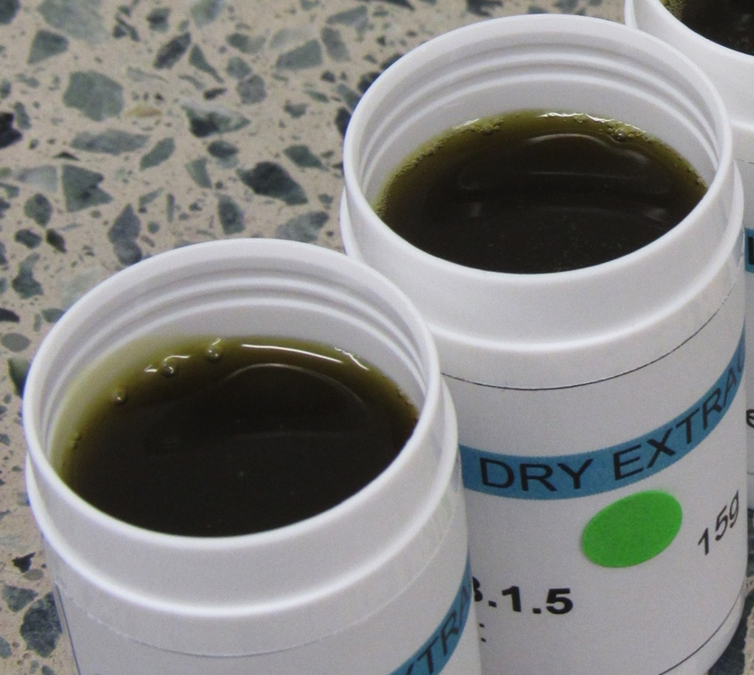
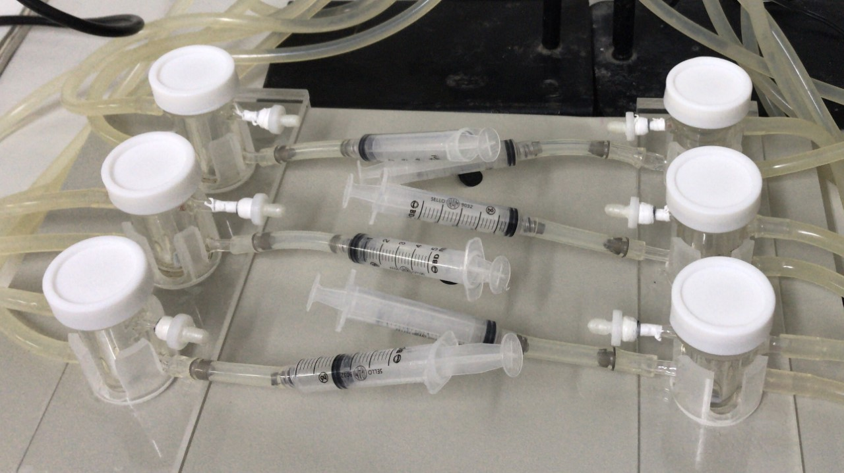

Viscum album topic and transdermal formulations: development, stability and in vitro cytotoxicity evaluation
João Vitor da Costa Batista, Adriana Passos Oliveira, Ana Paula dos Santos Matos, Eduardo Ricci Júnior, Zaida Maria Freitas, Catarina Amorim, Helena Keiko Toma, Marcia Alves Marques Capella, Leandro Rocha Machado, Mirio Grazi, Bettina Leonhard, Ulrike Weissenstein, Stephan Baumgartner, Carla Holandino
Aims:
Citotoxic activity in vitro
Viscum album ssp abietis
Formulation development
Skin permeation evaluation

Slide 2




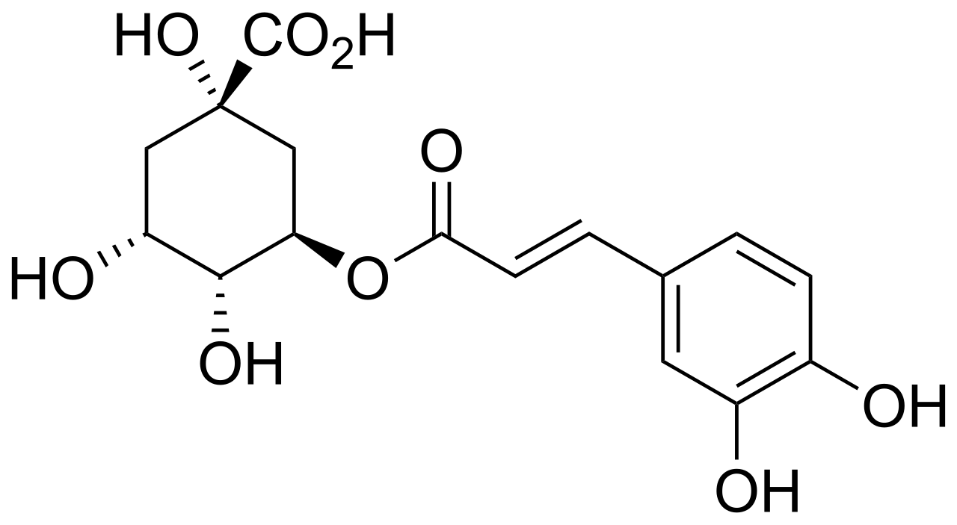
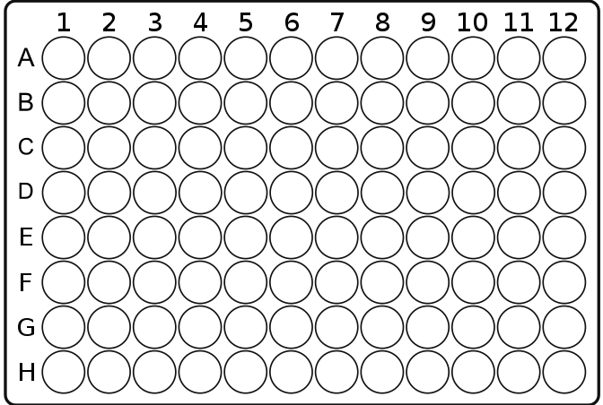
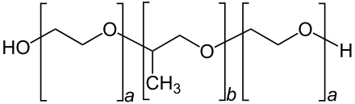

Methods
01
02
03
PLANT HARVEST
CHEMICAL
EVALUATION
FORMULATION
DEVELOPMENT
Botanical identification
Dry extract production
TLC
Flavonoids
HPLC UV, MS
Pharmaceutical solvents
Aqueous and dry extract
Rheology
Stability
Exsiccate
C.H.18.327
Trans-NCI-NIH Conference on International Perspectives on Integrative Medicine for Cancer Prevention and Cancer Patient Management
04
05
IN VITRO ASSAY
EX VIVO SKIN ASSAY
HaCat and Yoshida cells
WST-1
Permeation
Retention
Chlorogenic acid
Poloxamer 407

Slide 3
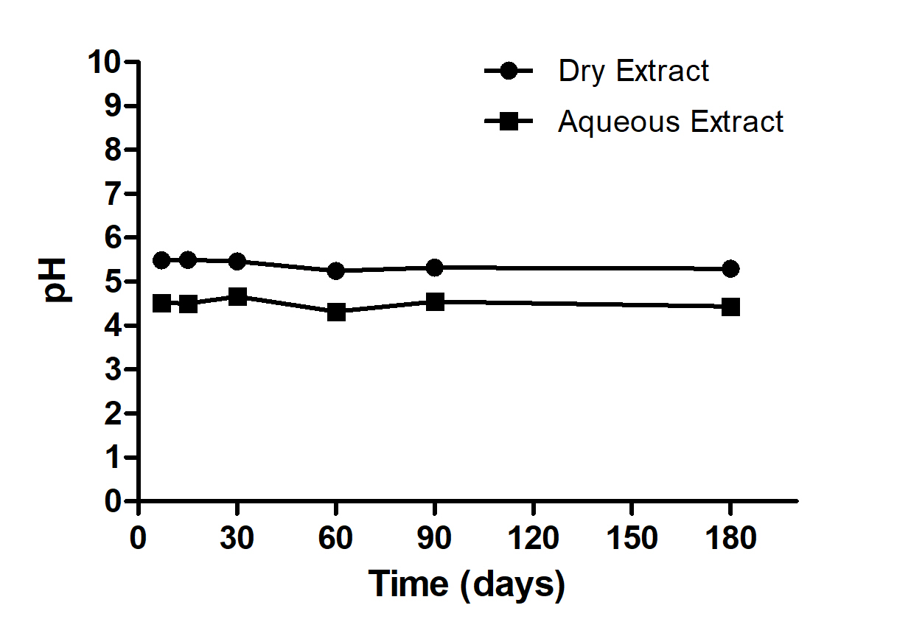
Results
12 ⁰C
Non-Newtonian fluids
18 ⁰C
Trans-NCI-NIH Conference on International Perspectives on Integrative Medicine for Cancer Prevention and Cancer Patient Management
Hydrogel dry extract

Slide 4
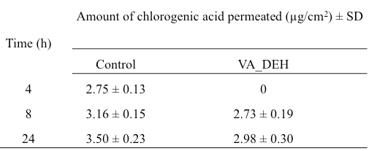
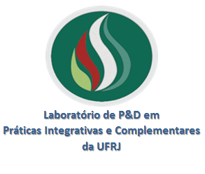



Results
Ex vivo skin permeation test
Contact information
Trans-NCI-NIH Conference on International Perspectives on Integrative Medicine for Cancer Prevention and Cancer Patient Management
Dose response effect of the Hydrogel containing V. album dry and aqueous extract after 24 hours of treatment. Cell growth was assessed with WST-1, after 1:30h of incubation. (HaCat: non-tumoral; Yoshida: tumoral). The hydrogel concentration varied between 2, 5, 10, 15 and 20 mg, corresponding to 100, 250, 500, 750 and 1000 µg of extract, respectively. Vector control (VC; hydrogel without extract) was used at a concentration of 20 mg. Mean ± SD (n=3). *p<0.05; **p<0.0001, one-way ANOVA with Tukey’s post-test.
joaovcbatista@hotmail.com
Federal University of Rio de Janeiro - Brazil
Verein für Krebsforschung - Switzerland
Conclusion: The present results highlight the new V. album transdermal application for cancer treatment, opening innovative possibilities to the current injectable formulations.

