Slide 1


Potential m-Health application for cancer prevention in Cambodians living with HIV
Thanh Cong Bui
Sopheab Heng
Michael S. Businelle
Chhorvann Chhea
Sun Penh Ly
Jennifer I. Vidrine
Summer Frank-Pearce
Damon J. Vidrine
Corresponding author:
Thanh Cong Bui, MD, DrPH,
Assistant Professor
The University of Oklahoma Health Sciences Center,
Stephenson Cancer Center,
TSET Health Promotion Research Center,
thanh-c-bui@ouhsc.edu, thanh.bui@aya.yale.edu.
T: 1-405-271-8001 ext. 50559.
October 2020

Slide 2

Introduction
Aims
With the effectiveness of antiretroviral therapy (ART), non-AIDS-defining cancers have become a leading cause of morbidity and mortality among people living with HIV (PLWH), and tobacco smoking is among the leading causes of these cancers.
In Cambodia, ~43%-65% of male PLWH smoke.
Although Cambodia has an outstanding ART coverage rate (81% of ~71,000 Cambodian PLWH), no efforts have been made to provide tobacco cessation treatment or to promote cancer prevention behaviors among PLWH.
NCI emphasizes the critical need for tailored cancer-prevention strategies for PLWH to prolong their lives.
To evaluate the feasibility of a mHealth-based intervention for smoking cessation and potential application to other cancer preventive behaviors among PLWH in Phnom Penh, Cambodia.
Methods
Fifty PLWH at a large ART clinic in Phnom Penh were randomized to Standard Care (SC, n=25), or Automated Messaging (AM, n=25).
SC consisted of brief advice to quit smoking and self-help written materials. AM consisted of the SC components plus a fully automated smartphone-based treatment program that involved interactive and tailored proactive messaging for 2 months.
This analysis and presentation focus on the feasibility of smartphone-delivered ecological momentary assessments (EMA) and daily AM intervention.

Slide 3
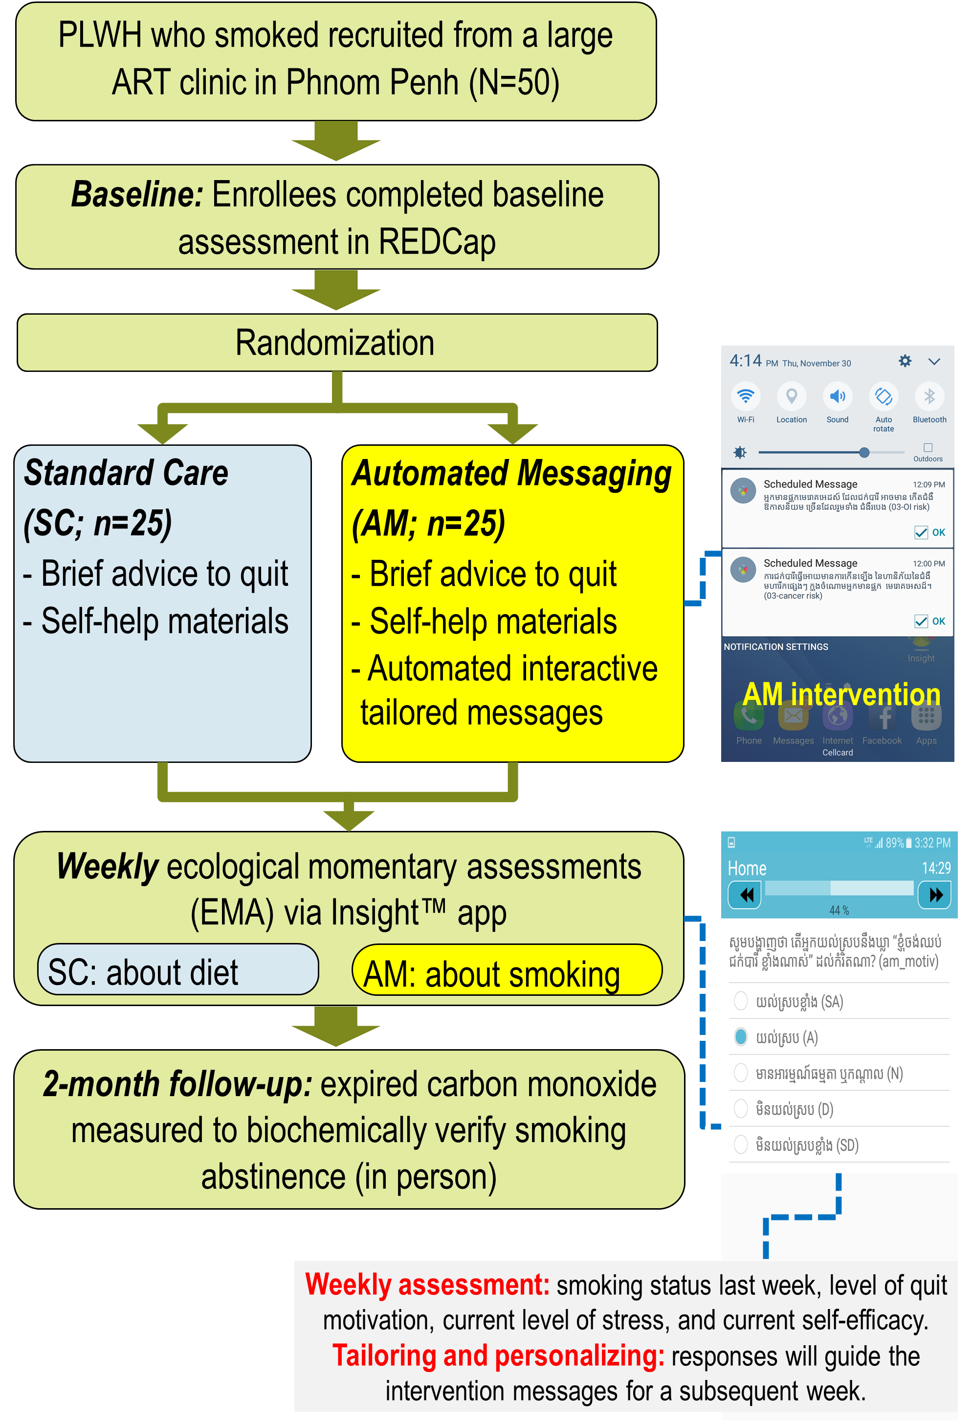
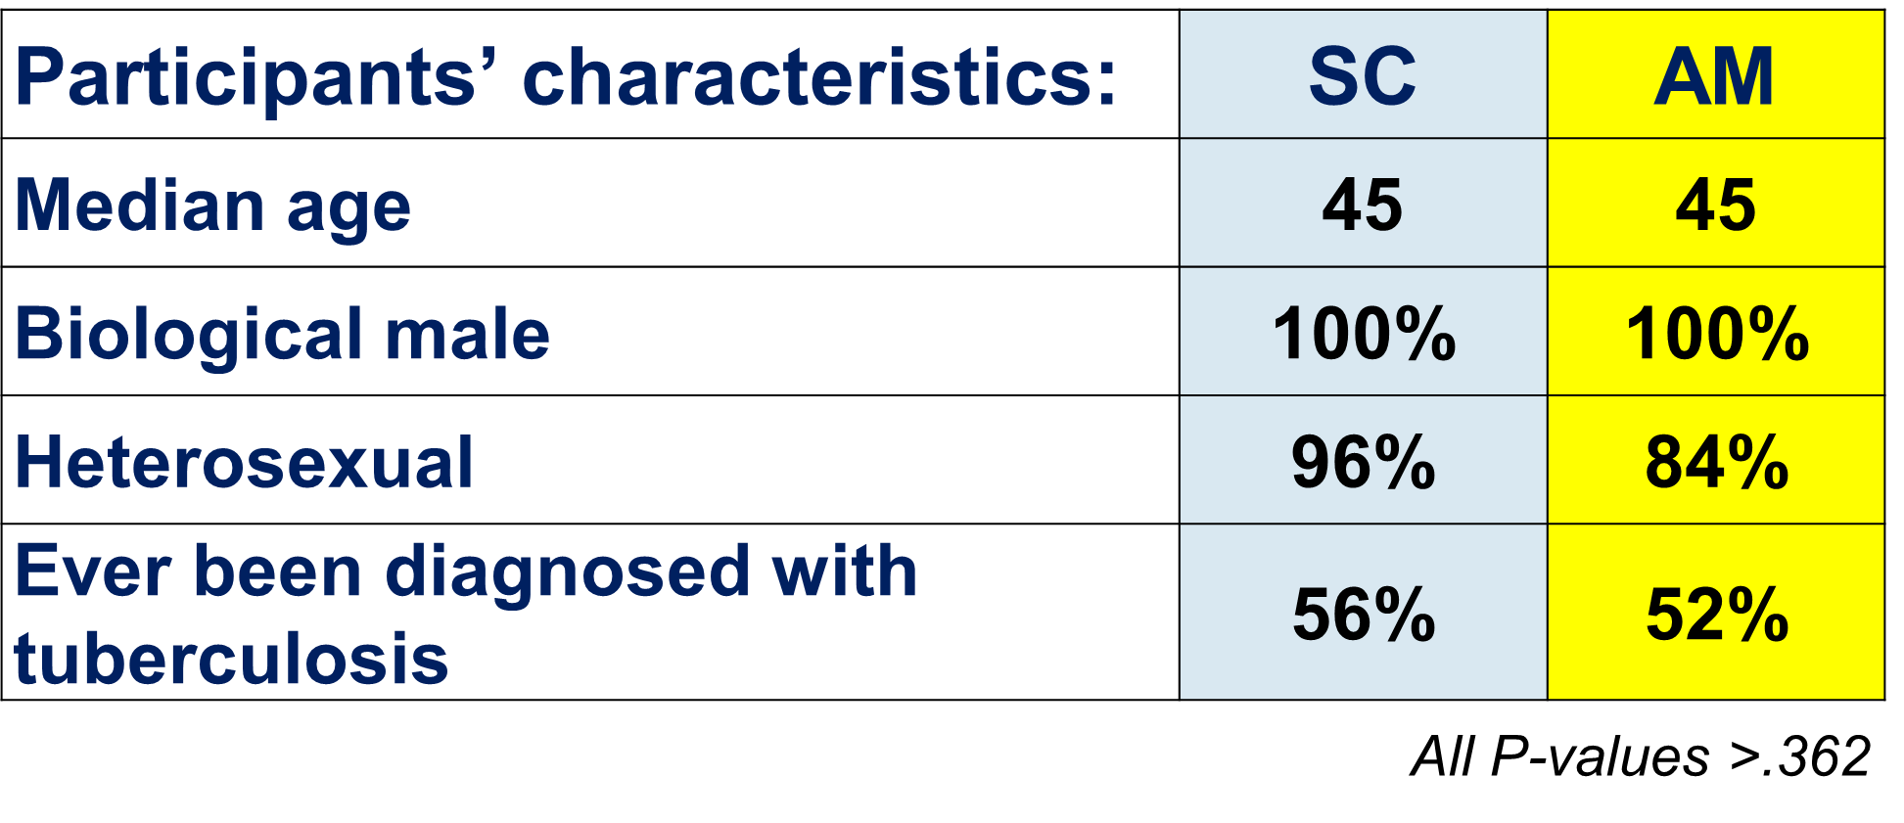
Methods (continued)
Results
Of all prescheduled events (79 for AM and 19 for SC, including weekly EMAs and intervention messages), 75% were delivered successfully (i.e., the phones were properly charged, turned on, and not lost).
Of all delivered events, 81% were read or completed as indicated by digital date/time stamp.
The mean number of times opening or having any activity in the app per day was 1.1 for both groups → participants were highly engaged and interactive.

Slide 4
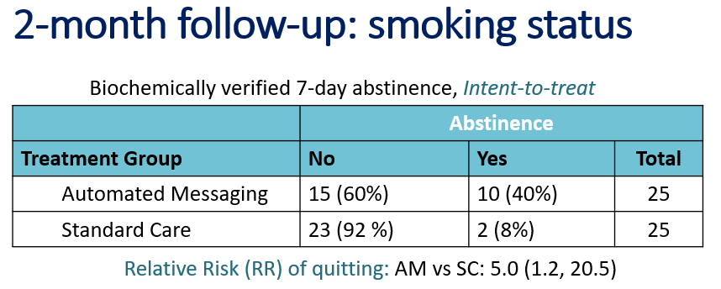

Results (continued)
Results (continued)
AM
Conclusion
mHealth-based interventions are highly acceptable and feasible in Cambodia where mobile phone services are widely used and inexpensive.
The feasibility and suitability suggest that mHealth approach has the potential for large scale implementation in promoting smoking cessation and other cancer prevention behaviors (e.g., cancer screening) in Cambodia.
SC
Acknowledgement: This work was supported in part by the US NCI Cancer Center Support Grant P30CA225520 awarded to the University of Oklahoma Stephenson Cancer Center and used the mHealth Shared Resource. This work was also supported in part by a grant from the Oklahoma Tobacco Settlement Endowment Trust (092-016-00021). Disclosures: All authors declare that they have no conflicts of interest.

