Slide 1


Clinical Studies of Sutherlandia frutescens (L.) R.Br.
a South African Botanical Used for Stress Resilience, and Mitigation of Symptoms of HIV/Mtb Infection, Cancer and Diabetes
William R. Folk, PhD
Professor of Biochemistry and Adjunct in Public Health,
University of Missouri 21st century Corps of Discovery Lecturer
(https://corpsofdiscovery.missouri.edu/)
Principal Investigator and U.S. Co-Director
The International Center for Indigenous Phytotherapy Studies (TICIPS)
The University of Missouri and the University of the Western Cape
(folkw@missouri.edu)

Slide 2
Uses of Sutherlandia and TICIPS Research
Sutherlandia frutescens (‘Sutherlandia’ / ‘Unwele’ / ‘Cancer Bush’) is extensively used in southern Africa by traditional medical practitioners (usually in combination with other plant products), and by the public seeking ‘natural’ cures.
Sutherlandia is claimed to be an ‘adaptogen’, to modulate the immune system and to help individuals manage stress and symptoms of HIV infection. Claims also are made for treating diabetes and cancers etc.
Sutherlandia is available throughout the world by internet sales (http://www.Sutherlandia.org), and is undoubtedly used in combination with allopathic/conventional medicines, but with no assurance of safety.
Sutherlandia toxicology studied in primates, found no evidence of harm at high doses. TICIPS RCT in healthy adult humans found no significant adverse events (PLoS Clin Trials. 2007, doi: 0.1371/journal.pctr.0020016)
TICIPS RCT in HIV+ adults found no effect on HIV progression, but determined potential interference with mTB prophylaxis (PLoS One. 2015. doi: 10.1371/journal.pone.0128522).
TICIPS studies in cell culture and animals indicates potential interaction with isoniazid used for Mtb prophylaxis (Neuromolecular Med. 2016. doi: 10.1007/s12017-016-8402-1).
Notes:
Host of studies in vitro and in cultured cells of rather poor quality – many used extracts made from materials that were poorly defined. Nevertheless, substantial claims made for them. MRC conducted toxicity study in vervet monkeys – no evidence of toxicity.

Slide 3
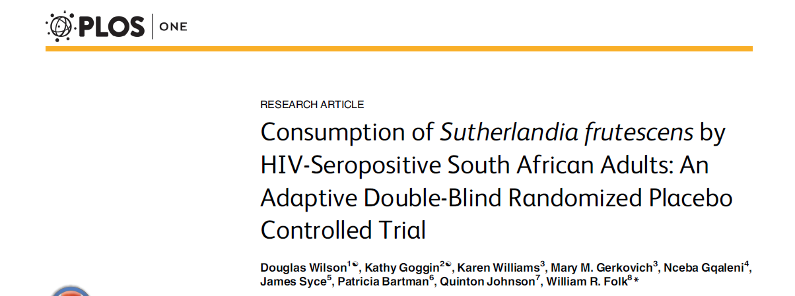
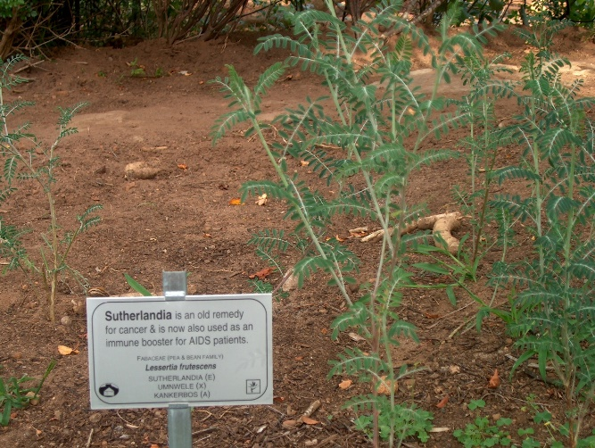
2015 doi: 10.1371/journal.pone.0128522.
Background
A two-stage randomized double-blind placebo controlled study was used to evaluate the safety of consuming dried S. frutescens by HIV seropositive adults with CD4 T-lymphocyte count of >350 cells/μL. All subjects used isoniazid preventive therapy (IPT) to control co-infection by Mycobacterium tuberculosis, which is prevalent.
Methods
In Stage 1 56 participants were randomized to S. frutescens 400, 800 or 1,200 mg twice daily or matching placebo for 24 weeks. In Stage 2 77 additional participants were randomized to either 1,200 mg S. frutescens or placebo. In the final analysis data from Stage 1 and Stage 2 were combined such that 107 participants were analysed (54 in the S. frutescens 1,200 mg arm and 53 in the placebo arm).
Results
S. frutescens did not change HIV viral load, and CD4 T-lymphocyte count was similar in the two arms at 24 weeks; however, mean and total burden of infection (BOI; defined as days of infection-related events in each participant) was greater in the S. frutescens arm: mean (SD) 5.0 (5.5) vs. 9.0 (12.7) days (p = 0.045), attributed to two active tuberculosis infections in subjects taking isoniazid preventive therapy (IPT).
Conclusion
A possible interaction between S. frutescens and IPT needs further evaluation, and may presage antagonistic interactions with other herbs having similar biochemical (antioxidant) properties.

Slide 4
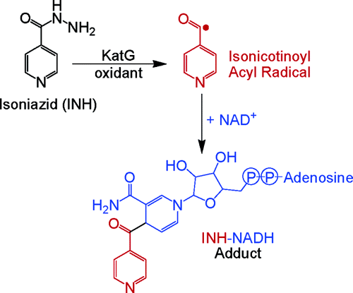
Use of botanicals containing antioxidants may compromise the activation of isoniazid, promoting Mtb drug resistance. Such interference is also likely to occur with conventional treatments of cancer, diabetes, etc.
(Neuromolecular Med. 2016. doi: 10.1007/s12017-016-8402-1).
Anti-oxidants in botanicals

