Slide 1
FIPOL: An Initiative to Develop Networks, Collaborations, and Educational Opportunities in Psychosocial Oncology for Latin America
Rosario Costas-Muñiz, PhD^{1,2}, Oscar Galindo-Vazquez, PhD³, Maria F. Montana, Mg⁷, Lourdes Ruda-Santolaria, Mg⁶,
Jose C. Sanchez-Ramirez, Mg⁵, Normarie Torres-Blasco, PhD⁴, Eida Castro-Figueroa, PsyD MS⁴, Loida Esenarro-Valencia Mg⁵,
William Breitbart, MD^{1,2}, Francesca Gany, MD, MS^{1,2}
¹Department of Psychiatry & Behavioral Sciences, Memorial Sloan Kettering Cancer Center, New York, NY, US; ²Weill Cornell Medical College, Department of Psychiatry, New York, NY, US; ³Instituto Nacional de Cancerología (InCan), Mexico City, Mexico; ⁴Department of Psychiatry and Human Behavior, Ponce Research Institute, Ponce Health Sciences University, Puerto Rico US; ⁵Instituto Nacional de Enfermedades Neoplásicas, Lima, Perú; ⁶Pontificia Universidad Católica del Perú, Lima, Perú; ⁷Hospital Británico, Buenos Aires, Argentina
Aims: FIPOL is an international collaboration, founded in 2017, aiming to connect Spanish-speaking clinicians and researchers interested in psychosocial oncology, complementary treatments (i.e. mind-body approaches, physical activity), palliative care and behavioral medicine from Latin America, the US, and Spain. The goal of the network is to develop collaborative research projects and programs, develop and host webinars, disseminate the latest research in psychosocial oncology, facilitate exchanges, and offer information about training opportunities, collaborations, and developments in the field.
Design/Methods: FIPOL achieves it goals through initiatives in Research, Training, Resources Development and Communication.
Our current research agenda includes five studies (three are CoVID-19 related).
Our training initiative includes the development of over 20 webinars accessible on our YouTube page (youtube.com/c/FIPOLLatino) taught by cancer and psychosocial providers and researchers.
Our network has developed research, webinars and resources during the pandemic to serve the needs of patients and professionals, (see our website www.fipol.info).
Our communication approach includes our website and social media presence (i.e. LinkedIn, Facebook, and Twitter).

Slide 2
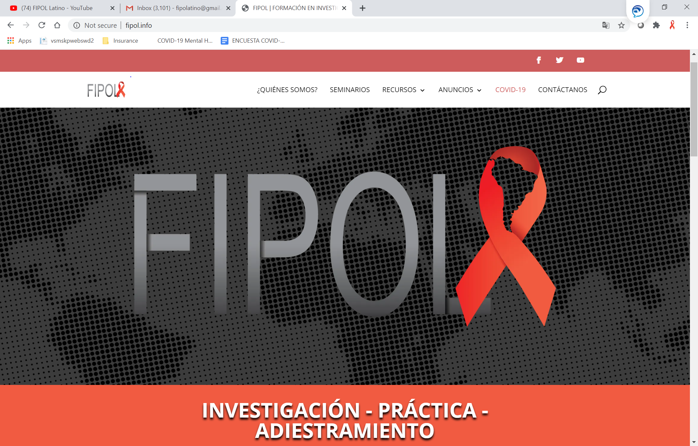
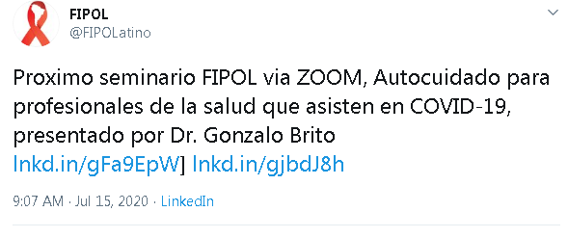
Results & Achievements Formación en Investigación Psicosocial Oncológica para Latinoamérica Training on Psychosocial Oncology Research for Latin America
Training www.youtube.com/c/FIPOLLatino
Over 20 webinars on
psychosocial oncology,
supportive care, and
health services
Next webinar July 24:
Self-care in health care
professionals
who provide care during COVID-19
Resources https://www.youtube.com/playlist?list=PLIy9_bNTIalhz_3z3o73HbCVKt-ivuaZd
Series of videos for
patients on
Coping with Stress
and Self-care
during COVID-19
Communication www.fipol.info
Website
Social Media
585 clinicians and researchers receive the FIPOL announcements and invitations to the monthly webinars. Our publications have focused on the practice of psychosocial oncology, training, and collaborative projects¹⁻⁶. Some of the initiatives developed as a response to the pandemic have been: two webinars for professionals, three COVID-19 related studies (two ongoing studies and one under review for approval), research articles (one publication and 3 manuscripts in progress) and resources for patients and community members that include seven videos and handouts.
Notes:
FIPOL is a international collaboration that aims to connect psycho-oncologists, clinicians, and researchers interested in the area of Psychosocial Oncology and behavioral medicine from Latin America including Central America, South America, the Caribbean as well as Spain and the US.
Our goal is to develop capacity, training opportunity, research collaboration, and awareness about the latest events and developments in the field of psychosocial oncology.
FIPOL has two main components a website and a monthly webinar.
Website (https://sites.google.com/view/fipola)
Monthly webinar (https://www.youtube.com/channel/UC7R-91vM3Q5v3wSrqrYL-mw) FIPOL is a international collaboration that aims to connect psycho-oncologists, clinicians, and researchers interested in the area of Psychosocial Oncology and behavioral medicine from Latin America including Central America, South America, the Caribbean as well as Spain and the US.
Our goal is to develop capacity, training opportunity, research collaboration, and awareness about the latest events and developments in the field of psychosocial oncology.
FIPOL has two main components a website and a monthly webinar.
Website (https://sites.google.com/view/fipola)
Monthly webinar (https://www.youtube.com/channel/UC7R-91vM3Q5v3wSrqrYL-mw)

Slide 3
Formación en Investigación Psicosocial Oncológica para Latinoamérica Training on Psychosocial Oncology Research for Latin America
Steering Commitee
R. Costas-Muñiz USA, MSKCC
X. Rocha-Cadman USA, City of Hope
O. Galindo Mexico, Instituto de Cancerologia
F. Montaña Argentina, Hospital Britanico
E. Castro Puerto Rico, Ponce Health Sciences Univ.
N. Torres, Puerto Rico, Ponce Health Sciences University
M.L. Ruda Peru, Sociedad de Psico-oncología Peruana
J. C. Sanchez Peru, Instituto de Enfermedades Neoplasticas
L. Esenarro Peru, Instituto de Enfermedades Neoplasticas
Collaborators
S. Cano Chile, Instituto de Cancerologia
F. Gil Spain, Instituto de Cancer de Cataluna
M. Llanta Cuba, Instituto de Cancer
C. Bergerot Brasil, Centro de Cancer de Brasilia
J. Restrepo Colombia, Country Hospital
V. Cardenas San Diego Moores Cancer Institute
Publications
Pérez-Ramírez*, E., Torres-Blasco*, N., Garduño-Ortega*, O., Castro, E., Costas-Muñiz, R.. Necesidades de entrenamiento de investigación en medicina conductual, psicología de la salud y psicooncología en estudiantes graduados en Puerto Rico. (“Behavioral Medicine, Health Psychology and Psycho-oncology Puerto Rican Graduated Students Research Training Needs”). Puerto Rican Journal of Psychology. 2017 Jul-Dec;28(2):296-313.
Galindo Vázquez O, Cu Menes M, Ramirez Osorio M, Espinoza Bello M, Costas Muñiz R., Aspectos Psicosociales en el paciente oncológico del Manual de Oncología del INCan, Psychosocial Aspects of the oncological patient, Handbook of Oncology of the Mexican Cancer Institute.
Galindo-Vázquez O, Costas-Muñiz R. Evidence-based psycho-oncology: A priority in mental health. Salud mental (Mexico City, Mexico).Volume 42, Issue 3, May-June 2019; 42(3):101-102.
Oscar Galindo Vázquez, Mónica Ramírez Orozco, Rosario Costas Muñiz, Luis Alberto Mendoza Contreras, Germán Calderillo Ruiz, Abelardo Meneses García Síntomas de ansiedad, depresión y conductas de autocuidado ante la pandemia de COVID-19 en población general. Gaceta Medica de Mexico, in print
Costas-Muñiz, R, Normarie Torres-Blasco, Castro-Figueroa, EM, Gany, F, Maintaining Hope”: Challenges in Counseling Latino Patients with Advanced Cancer, an International Perspective, Journal of Psycho-Oncoloyg Research and Practice, accepted
Costas-Muñiz, R, Normarie Torres-Blasco, Castro-Figueroa, EM, Galindo-Vázquez, O, Narang, B, Gany, F, Practice of Psycho-oncology with Latino Patients: An International Study, Journal of Psycho-Oncology, accepted
Collaborative Research
Ongoing Protocols
Changes in Professional Practice in Psychosocial Oncology after COVID-19
Literacy, myths and misinformation about COVID-19 in Latinos
Compassion Fatigue and Burden in Cancer Care Professionals during COVID-19
Scale Validation of three instruments for Mexico, Argentina, and Peru
Protocols in development
Review of mental health interventions during COVID-19 in Latin America
Implementation of ehealth interventions for cancer prevention and control in Latin America
COVID-related Manuscripts under Review
Delivery of Mental Health Services to Latino Cancer Patients During the COVID-19 Epidemic in Latin America and United States
COVID-19 Epidemic Related Concerns of Latino Cancer Patients: Perspectives of Providers from US and Latin America
Conclusion: The approach of the FIPOL network is interdisciplinary with primary involvement of psychosocial providers, clinicians and researchers that offer complementary treatments to cancer patients (i.e. psychotherapy, body-mind) and support of traditional providers of oncology care (i.e. oncologists, palliative care physicians, etc.). These cancer care experts often present on webinars and serve as investigators and consultants in the different FIPOL initiatives.

Slide 4
Acknowledgments
Memorial Sloan Kettering Cancer Center
Immigrant Health and Cancer Disparities Service
Rosario Costas-Muñiz, PhD
Francesca M. Gany, MD MS
William Breitbart, MD
Javier Gonzalez, MA
Collaborators
Ponce Health Sciences/ Puerto Rico
Eida Castro, PsyD MS
Normarie Torres PhD
Instituto Nacional de Cancer, Mexico
Oscar Galindo, PhD
Hospital Britanico, Argentina
Fernanda Montana, Lic
Mariano de Murias, MD
Instituto de Enfermedades Neoplasicas, Peru
José Carlos Sánchez Ramírez, Mg
Loida Esenarro, Mg
Pontificia Universidad Catolica, Peru
Lourdes Ruda, Mg
City of Hope, US
Xiomara Rocha, MD
Author Contact Information
Rosario Costas-Muñiz, Ph.D.
Assistant Attending Psychologist
Memorial Sloan-Kettering Cancer Center
Department of Psychiatry & Behavioral Sciences
Immigrant Health & Cancer Disparities
Email: costasmr@mskcc.org
Weill Cornell Medical College
Assistant Professor of Psychology
Department of Psychiatry
Visit FIPOL
Follow us Twitter, Facebook, & Youtube
Notes:
An the staff of the Immigrant Health & Cancer Disparities Service

