Slide 1



Safety Evaluation in Healthy Colombian Volunteers of P2Et Extract Obtained from Caesalpinia Spinosa: Design 3+3 Phase I Clinical Trial
María I Duran¹, Ricardo Ballesteros¹, Lilian Torregrosa², Silvia Galvis³, Claudia Urueña¹, Susana Fiorentino¹*
¹ Grupo de Inmunobiología y Biología Celular, Unidad de Investigación en Ciencias Biomédicas, Facultad de Ciencias, Pontificia Universidad Javeriana. Bogotá, Colombia.
² Hospital Universitario San Ignacio, Centro Javeriano de Oncología, Facultad de Medicina, Pontificia Universidad Javeriana, Bogotá, Colombia.
³ Centro de Investigaciones, Hospital Universitario San Ignacio, Bogotá, Colombia.
*email address: susana.fiorentino@javeriana.edu.co; duran_maria@javeriana.edu.co

Slide 2
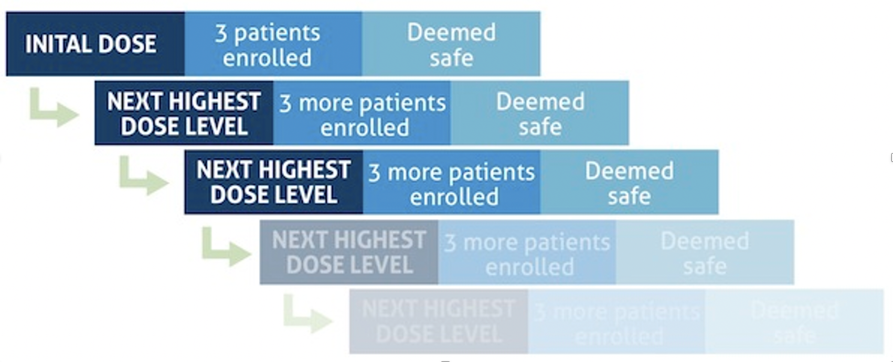
Background
Figure 1. Clasic Design 3+3: Phase 1 Trials
The P2Et extract derived from Caesalpinia spinosa had antitumor and immunomodulatory activity reported in breast cancer, leukemia and melanoma. In healthy mice was observed that P2Et modulates immune response. Protective effects have been reported in healthy humans, but they could have risk of toxicity.
Objective
Adapted from Hansen A, et al. Cancer control. 2014.
To evaluate the safety and maximum tolerated dose (MDT) of P2Et extract in Colombian healthy volunteers
Healthy volunteers were included who met the key eligibility criteria, over 18 years old, without multi-organic dysfunction, prior use of phytomedicines, history of substance abuse or smokers.
P2Et extract was administrated in capsules of 600 mg orally daily during 28 days according to dosage level. Adverse events (AEs) were evaluated based on the National Institute of Health Common Terminology Criteria for Adverse Events (CTCAE) version 4.0 and general measurements of health status were performed.
Methods
Phase 1 clinical trial, open labelled, single arm, traditional dose-escalation design 3 +3 study (Figure 1) . It was conducted in clinical research center from Hospital Universitario San Ignacio (Bogota, Colombia).

Slide 3
Results
7 healthy volunteer subjects were enrolled. Median of age was 33 years (Table 1); range of exposure to P2Et was 2 to 28 days, with an adherence more than 80% in subjects who completed level 1 dosage.
MDT for P2Et extract was 600 mg dose. Serious AEs were not reported.
Table 1. Baseline Characteristic in Healthy Volunteers
Table 2. Incidence of AEs: Level 1 Dosing. 42 AEs were reported, no severe and majority grade 1 (94.6%) of AE were grade 1 and AEs most frequence were gastrointestinal

Slide 4
Results
There were not clinical significant changes out of normal ranges for safety parameters assessed since basal (day 1) to end visit. (day 28).
Table 3. Safety Assessments: Kidney, hepatic, electrolyte, metabolic and hematological parameters.
Immunological parameters such as lymphoid and myeloid quantification were kept within ranges, there were some relevant changes such as the mean of CD3+/CD5+/CD45, CD3+/CD4+ and CD3+ /CD8+ T lymphocytes below the normal lower limit in baseline to final visit; additionally, percentage of change of monocyte-derived dendritic cells CD45 ++/ CD38+/ CD4+ and LT CD4 + / CD8 was of 66% and 40%, respectively.
Conclusion
Oral administration of P2Et extract was safe in healthy humans with a maximum tolerated dose of 600 mg. There was no severe toxicity, most of AE were mild, without significant changes in the safety parameters evaluated. This trial provide data for next steps in tha clinical research developement of P2Et extract.
Acknowledgment
The authors thank all the many patients and families who contributed to this study, and all researchers, clinician, technicians, and administrative staff who have enabled this work to be carried out. The authors would also like to acknowledge to Pontificia Universidad Javeriana and Hospital Universitario San Ignacio.

