Slide 1

"Acupuncture in the treatment of cancer pain in a public Chilean Hospital"
Integrative Medicine Unit of the Dr. Sótero del Río Hospital
2020
Sebastián Norambuena S. – Soledad Gutiérrez

Slide 2
Background: Cancer is a condition associated with pain and deterioration in quality of life (QoL). Studies on acupuncture and chronic and oncological pain have not been conclusive.
Aim: This study seeks to assess the impact of acupuncture on pain and QoL of cancer patients at Dr. Sótero del Río Hospital (HSR), a public hospital in Santiago, Chile. Treated patients are expected to experience a decrease in pain sensation and improvement in QoL.
Study Design: Quasi-experimental “before-after”, where each individual is their own control (before the intervention) and their case (after the intervention). All patients over 15 years old with cancer related pain referred to the Integrative Medicine Unit, were included between January 2016 and January 2018. The WHOQol-Bref QoL survey and the Visual Analog Scale (VAS) were applied at the beginning and end of treatment. The paired t-test for QoL and Wilcoxon for EVA Scale was used, with a significance level of 0.01.
Quasi-experimental
Before
After
Patients over 15 years old
Cancer related pain referred to the Integrative Medicine Unit
Information gathering techniques / Variables
WHOQol-Bref QoL survey / Quality of life
Visual Analog Scale (VAS) / Pain

Slide 3
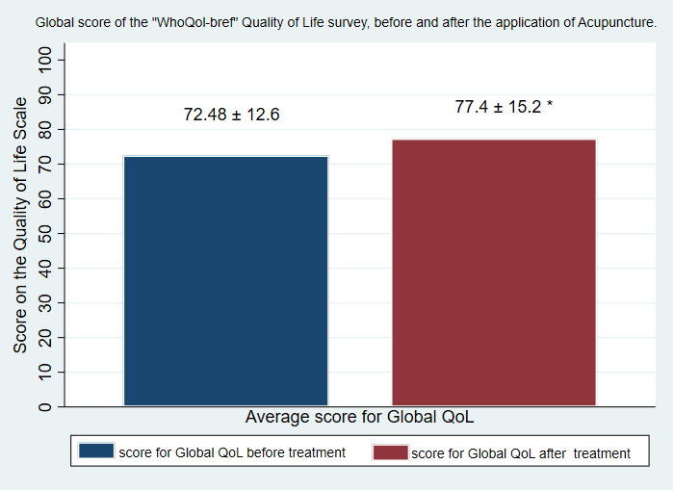
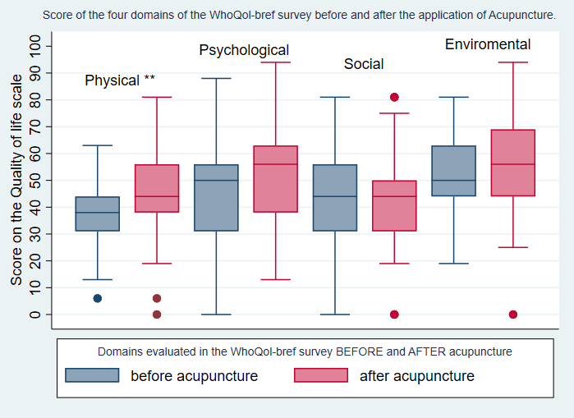
Results in Quality of Life
From a total of 403 patients referred to the Integrative Medicine Unit, 12,1 % (n=49) were from the Oncology service for the treatment of pain due to breast, colon, testicular and multiple myeloma cancer, among others. 85.7% of this patients corresponds to women and 14.3% to men with an average age of 56.56 ± 12.8871 years.
After 12 sessions, the average score for Global QoL was 72.48 ± 12.6 and 77.4 ± 15.2 before and after treatment (p = 0.0082)*. A difference of 7.6 ± 14.8 points (P = 0.008) was also found in the Physical Health Domain**, and a non-significant trend in Psychological Health, Social and Environmental Domains.

Slide 4
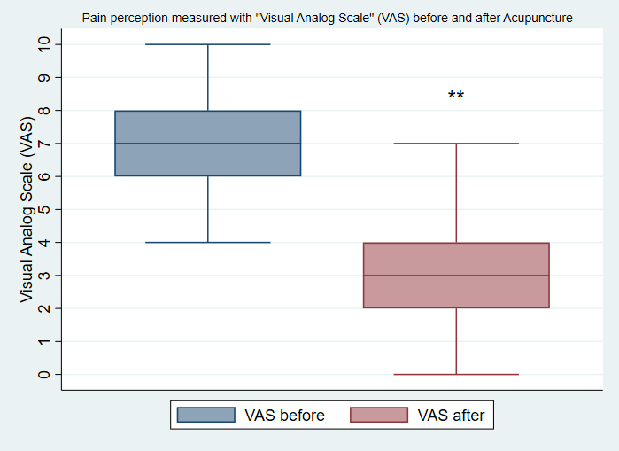
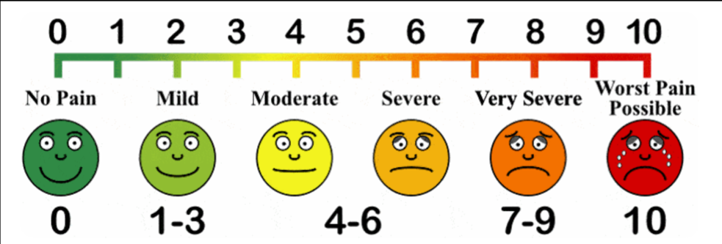
Results in Pain
Pain decreased by 50% or more in 34 (79.5%) of patients with a difference of 4.7 ± 1.6 points in VAS (0-10) (p = 0.0001)**. No adverse effects were reported

Slide 5

Conclusion
Acupuncture is a safe treatment and seems to be a valid alternative to improve some aspects of the quality of life, and in the management of pain associated with cancer. Confirmation is required from controlled studies to establish the causality of such effects.
Image from: http://acupuncturebylois.com/acupuncture-for-cancer-treatment-support
Contact:
Sebastián Norambuena Silva – snorambuenas@gmail.com
Soledad Gutiérrez – sxgutier@uc.cl

