Slide 1
Background
mPalliative Care Link (mPCL): Examination of a mobile solution to palliative care coordination among Tanzanian cancer patients
African POS
Q1. Please rate your pain during the last 3 days | 0 (none) - 5 (worst)
Q2. Have any other symptoms (e.g. nausea, coughing or constipation) been affecting how you feel in the last 3 days? | 0 (none) - 5 (overwhelming)
Q3. Have you been feeling worried about your illness in the past 3 days? | 0 (not at all) - 5 (overwhelming)
Q4. Over the past 3 days, have you been able to share how you are feeling with your family or friends? | 0 (not at all) - 5 (freely)
Q5. Over the past 3 days have you felt that life was worthwhile? | 0 (not at all) - 5 (all the time)
Q6. Over the past 3 days, have you felt at peace? | 0 (not at all) - 5 (all the time)
Q7. Have you had enough help and advice for your family to plan for the future? | 0 (not at all) - 5 (as much as wanted)
Improved end-of-life symptom control for cancer patients is a public health priority in Tanzania impacted by limited palliative care (PC) specialist access
The African Palliative care Outcome Scale (POS) is a validated brief Likert-scaled assessment and used to collect patient/caregiver-reported symptoms
Community-based cancer patients and their family caregivers lack an easy way to report symptoms and receive prompt symptom-responsive care
Mobile health solutions hold promise
Study Goal
To assess the effectiveness of a mobile/web application, mPCL, to facilitate interdisciplinary care coordination (specialists and local health workers) aimed at community-based symptom monitoring and control among Tanzanian cancer patients

Slide 2

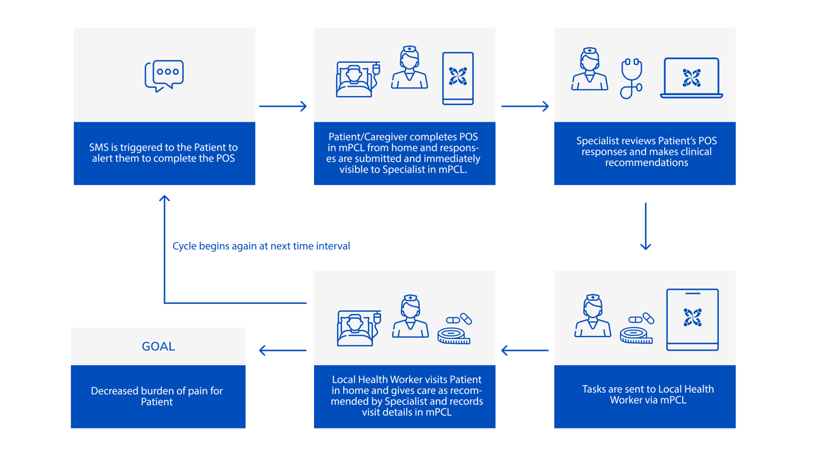
Methods
Design: Field study of untreatable cancer patients randomized at discharge from a large urban Tanzanian cancer hospital to mPCL (intervention) or phone contact for POS collection
Data Collection:
Baseline sociodemographic, clinical and POS data
POS responses collected twice-weekly and managed via mPCL versus via phone-contact with study personnel in mPCL and non-mPCL arms, respectively for up to 4 months
Patient end-of-study care satisfaction assessed via phone survey
Analysis: Baseline characteristics, POS score trajectories & end of study survey results analyzed by group and compared
mPCL
Built on cloud-based, open-source, HIPPA-compliant CommCare platform
Smartphone/web accessible
Interfaces for specialists, local health workers, and patients/caregivers for symptom collection and control via community-based interdisciplinary care coordination

Slide 3
Results
Average POS item scores by group with comparisons
98 patients completed study (n=49/arm)
There were more women and cervical cancer patients plus higher use of discharge morphine in the mPCL vs phone-contact arm
Near-equal numbers of participants/arm died within the study period (n=27 and 29 mPCL vs phone-contact, respectively)
mPCL
Phone Contact
Week

Slide 4




Conclusions
Symptom severity scores were significantly higher in the mPCL arm across the study period compared with phone-contact arm
Between-group sociodemographic/clinical differences, unintended additional support provided through phone-contact coupled with a potential bias posed by phone collection of POS responses likely explain some of these findings
Symptoms decreased over time in both arms, likely reflecting cumulative deaths
Post-intervention assessment of quality-of-care revealed near-equal satisfaction between the two arms
Limitations included small sample size and lack of true usual care group
As access to phone-based palliative care is not generalizable or sustainable, a larger randomized study of mPCL to study its cost-effectiveness and impact on clinical outcomes throughout Tanzania is needed to assess the true value of this innovation
*Dr Mamsau Twalib Ngoma
Phone:+255685377273
email: mamsaungoma@yahoo.com
Address: Ocean Road Cancer Institute
P.O Box 3592
Dar es Salaam, Tanzania
Mamsau Ngoma*, Beatrice Mushi, Robert Morse, Twalib Ngoma, Habiba Mahuna, Kaley Lambden, Y Xian Ho, F Lee Lucas, Joshua Mmari, Susan Miesfeldt *corresponding author
Supported by the National Institutes of Health Fogarty International Center (Grant award no. R21 TW010190)

