Slide 1
Conceptualizing Pain in Ayurvedic Protocols for Chronic Pain Management: A Case Study of Ayurvedic Physicians from India
Vinita Agarwal, PhD
Salisbury University USA
Virtual Poster Presentation (PowerPoint) to the Global Approaches of Integrative Oncology session at the National Cancer Institute, Trans NCI-NIH Conference on International Perspectives on Integrative Medicine for Cancer Prevention and Cancer Patient Management, Natcher Conference Center, NIH Main Campus, Bethesda, MD USA
Author note:
*The study was supported by Salisbury University’s Office of Graduate Studies institutional Building Research Excellence grant.
*Part of the study data was accepted for presentation at the 70th Annual Meeting of the International Communication Association on May 22, 2020, Gold Coast, Australia.
Agarwal, V. (May, 2020, virtual conference presentation). Nature, Cycles, and Balance in Ethnomedicine: Ayurvedic Protocols in the Treatment of Chronic Pain. 70th International Communication Association Conference, Melbourne, Australia.
*Agarwal, V. (2020). Patient assessment and chronic pain self-management in ethnomedicine: Seasonal and ecosystemic embodiment in Ayurvedic patient-centered care. International Journal of Environmental Research and Public Health, 17(8), 2842. https://doi.org/10.3390/ijerph17082842. Published in the special issue: Beyond Conventional Medicine: Ethnomedical Approaches for Health Promotion and Disease Prevention

Slide 2
Aims/Objectives
Aim: To examine chronic pain (CP) through explicating the conceptualization of diet, time, and mental strength in Ayurvedic physician pain protocol approaches.
Background:
About one in five people suffer from CP globally (Goldberg & McGee, 2011).
Complementary and alternative medicine (CAM) therapies are increasingly sought by chronic pain patients and used in integrative settings to treat chronic pain syndromes (Eisenberg et al., 2001; Sherman et al., 2004).
Gaps in philosophical understanding of diverse medical systems risks appropriation of their practices decontextualized from their knowledge frameworks (Agarwal, 2017; Naraindas, 2005; Street et al., 2018) and suggest a need for greater conceptual alignment of distinct diagnostic and treatment approaches for their successful integration.
Explication of fundamental tenets of Ayurvedic medical system can facilitate opportunities for integrative CP in management and improved patient-centered care
Ayurveda’s multimodal approach comprising mind-body, nutrition, and yoga-based components may be efficacious in CP domains (e.g., chronic musculoskeletal pain, neuropathic pain, ankylosing spondylitis, chronic low back pain, CLBP) has furthered recent interest in building an evidence base validating Ayurvedic approaches.
Investigators involved in Ayurvedic research face the challenge of conducting clinical research in abstract Ayurvedic concepts and principles such as dosha, prakriti, and agni that are distinct from and poorly understood in biomedical ontologies.

Slide 3
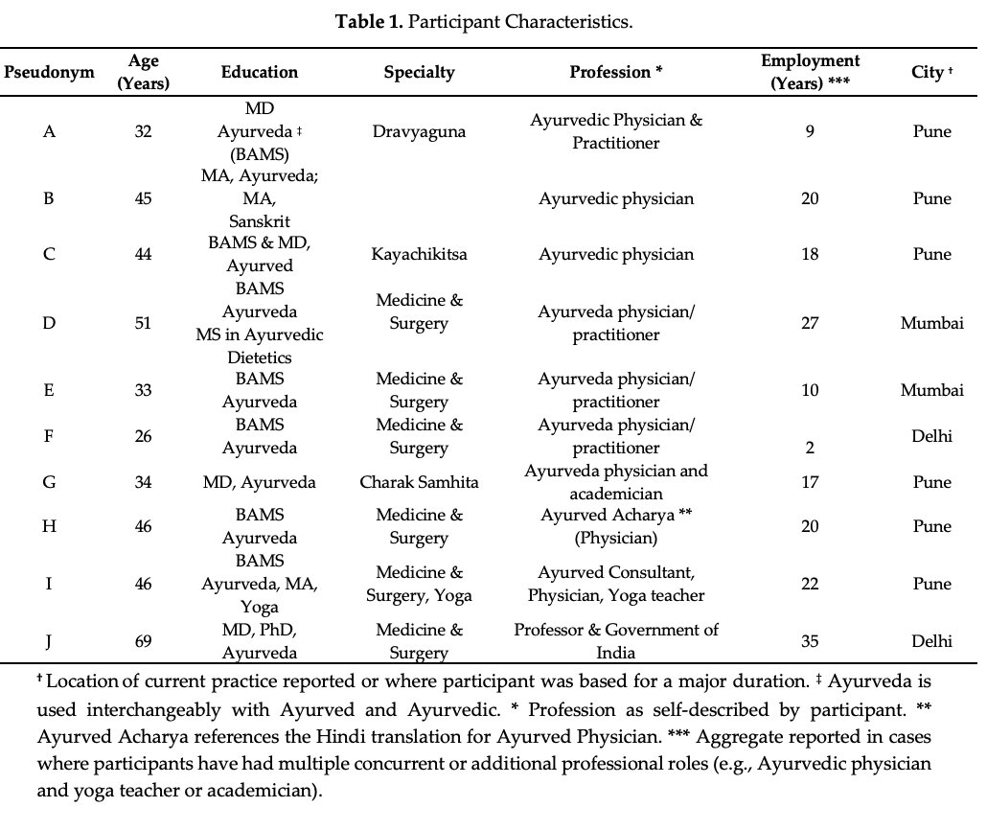
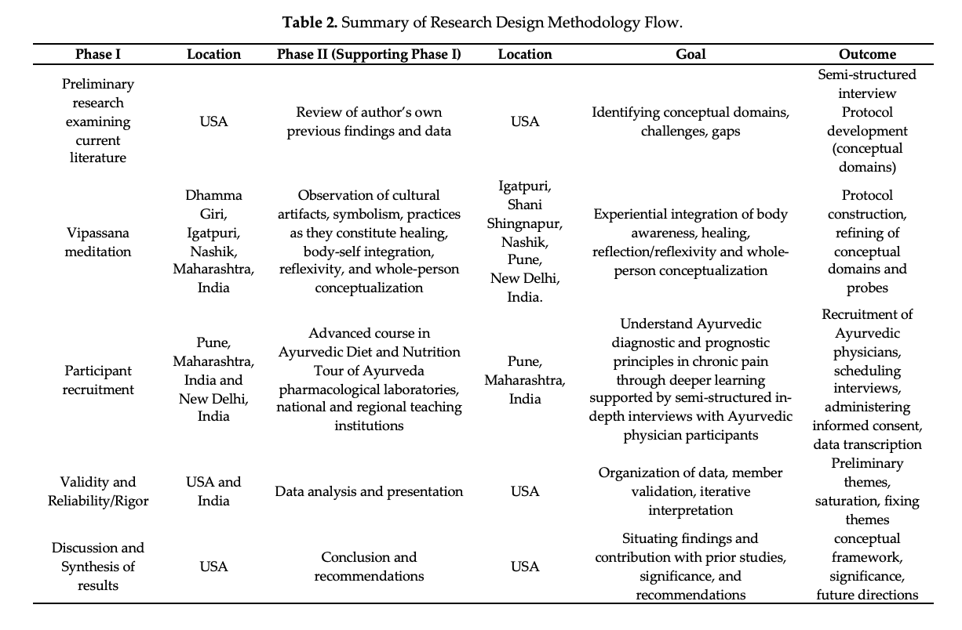
Methods
Participants:
Expert participants who were Ayurvedic physicians (N=10) in India with a Bachelors of Ayurvedic Medical Science (BAMS) degree
Participant Recruitment:
Purposive and snowball sampling from a professional center of training and practitioners identified by public searches using purposeful maximum variation
Based on data saturation in a tightly focused content domain with low variability, identification of sufficient depth and breadth of information and beliefs
Recruited from a city in the south-west and one from the north-west region of India. Inclusion criteria included completion of recognized degree in Ayurvedic medicine and being currently in practice or teaching of the modality as an Ayurvedic physician for greater than the past year.
Data Gathering:
A semi-structured interview protocol was employed to gather data.
Participant interviews were audio-recorded, professionally transcribed verbatim, and analyzed using grounded theory. Member validation, participant voice, and researcher self-awareness of limitations helped address reliability and validity.
Methods:
Case study using inductive qualitative content analysis
Desired Outcomes:
To construct a thematic framework of Ayurvedic physicians’ conceptualization of diet, time, and mind-body factors in treatment of chronic pain.

Slide 4
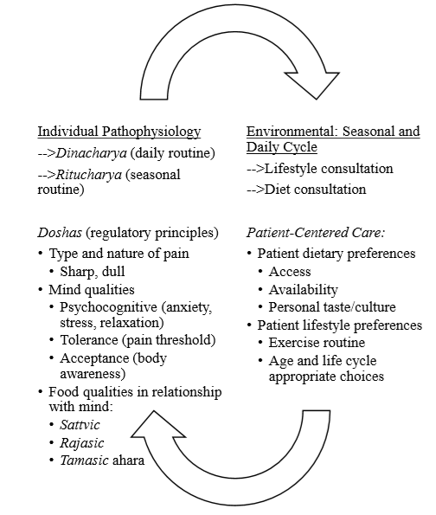
Results & Conclusion
Theme 1:
In patient consultation, the Ayurvedic physician considered the relationship of seasons with each individual patient’s unique lifestyle and examines its attributes to understand the effect of daily rhythms on pathophysiology
Theme 2:
The physiological processes called doshas (vata, pitta, and kapha), whose balance and aggravation shapes individual pain perception, intimately connected with diet (ama, and daily routine or dinacharya)
Theme 3:
Food comprises the body such that the body, psycho-cognitive qualities (e.g., sattvic, rajasic is comprised of their daily diet, or ahara.: “sattvic ahara” is food that nourishes the higher, reflective, contemplative, and thoughtful qualities of the mind (Participant A). Rajasic and tamasic ahara nourish the active (outward agency) and the lower contemplative qualities of the mind
Findings:
Pain is conceptualized through its relationship with (see Figure 1):
Theme 1: daily and seasonal time cycles
Theme 2: individual energy balance (doshas) and diet, and
Theme 3: mental strength.
Analysis:
Primary outcomes: Pain is conceptualized in the Ayurvedic physicians’ approach as embodied through the individual’s relationship with time as interdependent with their diet, doshas, and mental strength.
Ongoing challenges: Identifying and constructing diagnostic criteria of embodiment that can be used in integrative teams.
Conclusions:
Embodiment can be a useful first step in constructing protocols for identifying the categories of time, diet, and mental strength for the individual patient in the context of their lifestyle.
Figure 1. Patient-Centered Care in Ayurvedic Chronic Pain Management Protocol: Integrating Seasonal and Daily Cycles in Chronic Pain.
Contact Information: Vinita Agarwal, Ph.D., Department of Communication, 1101 Camden Ave., FH 272, Fulton School of Liberal Arts, Salisbury University, Salisbury MD USA 21801
Email: vxagarwal@salisbury.edu | Telephone (Office): 410-677-0083 | URL: https://www.salisbury.edu/faculty-and-staff/vxagarwal

