Slide 1
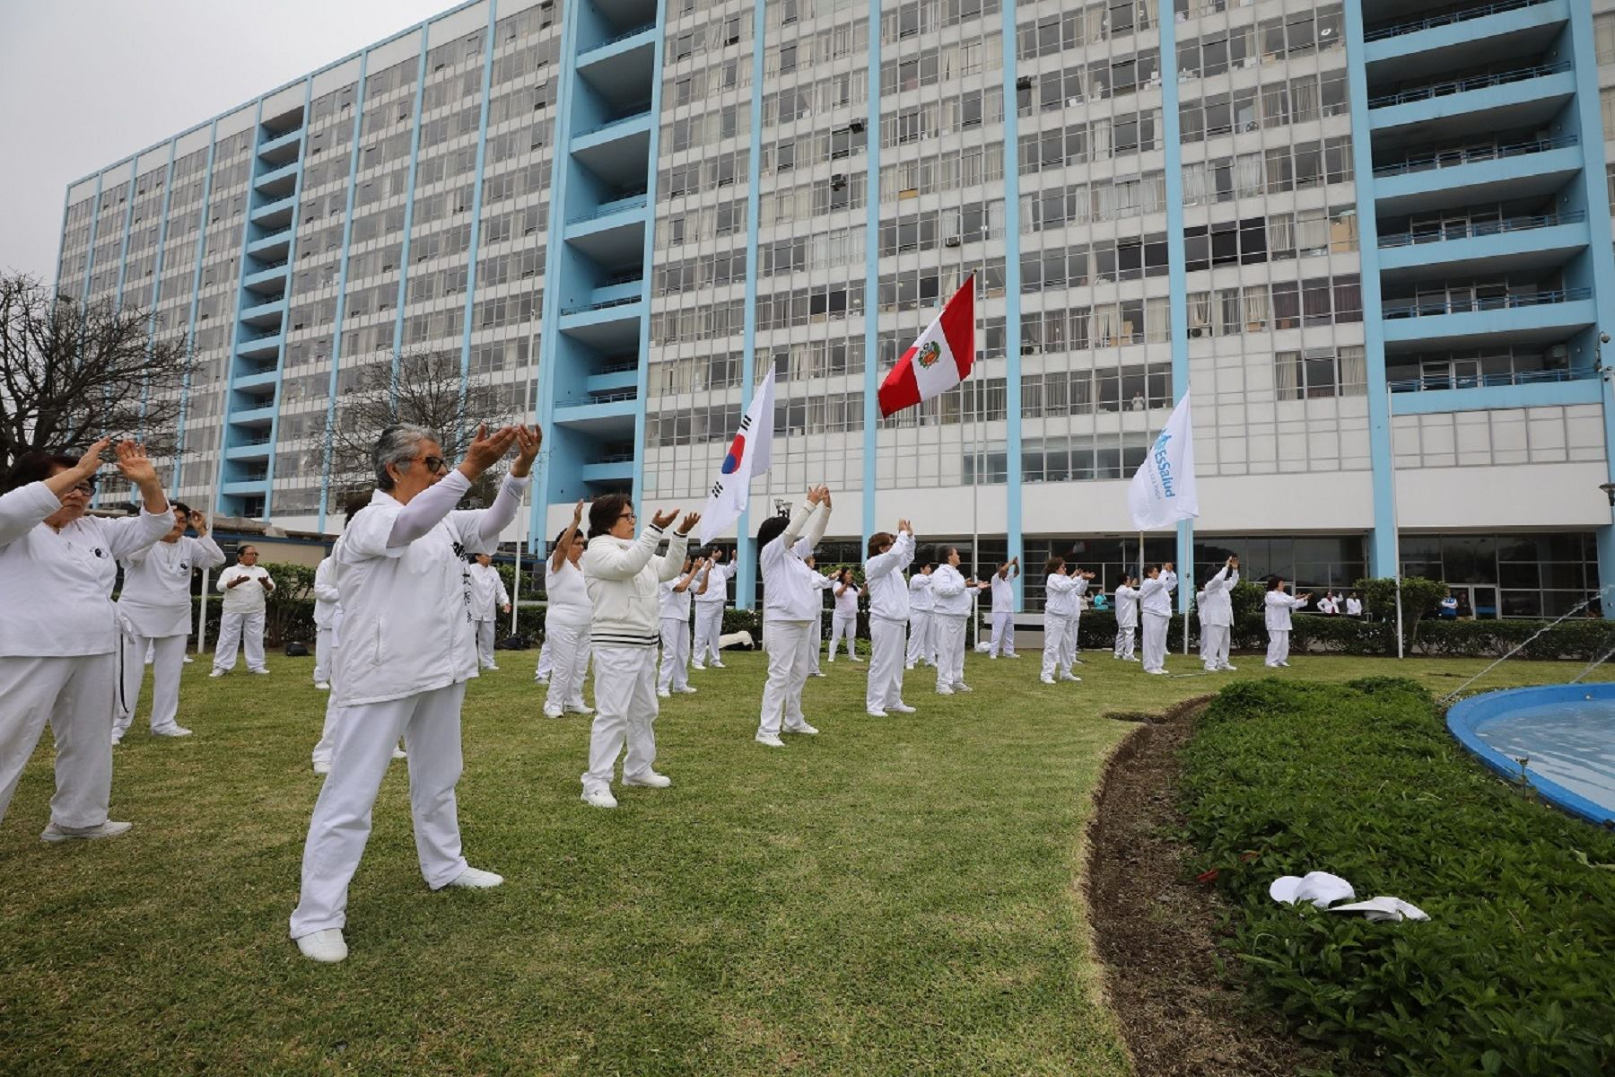
Introduction and Purpose
QUALITY OF LIFE IN PATIENTS WITH BREAST CANCER ONCOLOGY AND COMPLEMENTARY MEDICINE SERVICES
Breast cancer is the most prevalent in women.
The different therapies for breast cancer produce unpleasant side effects for patients, affecting their quality of life.
Approximately 40% of the individuals diagnosed with cancer in the world use complementary therapies during their treatment.
This study aims to compare the quality of life (QL) of the patients treated in the Oncology service, and those treated in Oncology and Complementary Medicine (MEC).

Slide 2
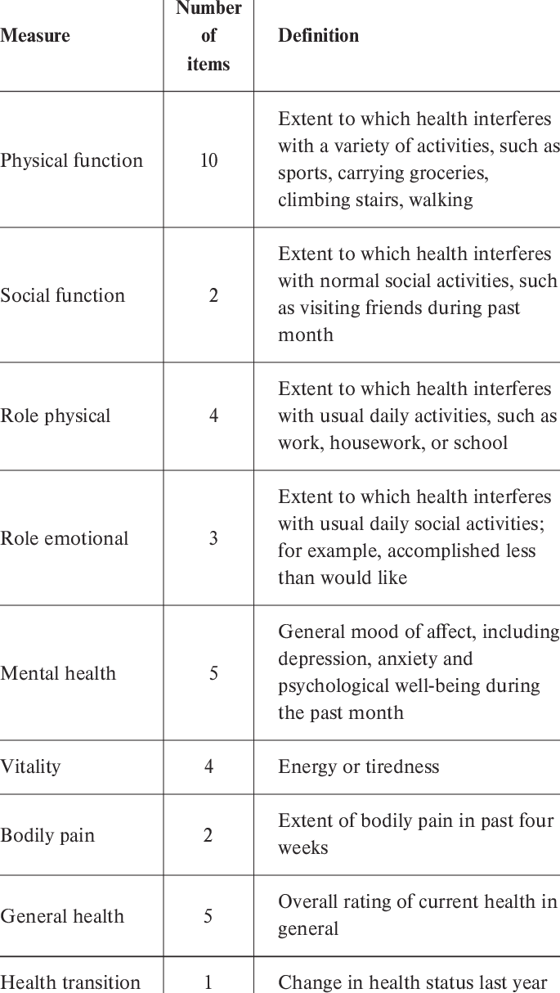
Methods
This was a exploratory cross-sectional study. We surveyed 100 patients with breast cancer attended in external Oncology and Complementary Medicine offices.
We administered SF-36 quality of life questionnaire through a targeted survey.

Slide 3
Results
Las pacientes con cáncer de mama presentaron CV media o baja en la mayoría dimensiones: Rol Físico (RF) (54%), Función Social (FS) (55%), Salud Mental (SM) (55%), Función Física (FF) (56%), Salud General (SG) (60%), Dolor Corporal (DC) (64%) y Vitalidad (VT) (79%), a diferencia del Rol Emocional (RE) en el cual prevaleció una CV alta (51%).
20% of patients received care in CM, which was significantly associated (p <0.05) with a high QL in the dimensions: ER (p = 0.02), FS (p = 0.04), VT (p = 0.02 ), MH (p = 0.04) and GH (p = 0.04), however with a medium / low QL with the PF (p = 0.03), the age was inversely associated with the PF (p = 0.03), the Diagnostic time was directly associated with ER (p = 0.01)
3

Slide 4
Conclusion and Implications
The attention in the CM service is associated (P <0.05) to a high QL in the ER, SF, VT, HM and GH compared to patients with breast cancer who were only treated by Oncology.
Autors: Rushmely Perez-Mendez, Juan Huaccho-Rojas, Andrea Anampa-Guzmán, Martha Villar-Lopez
Facultad de Medicina San Fernando, Universidad Nacional Mayor de San Marcos.
Contact information:
Juan Huaccho-Rojas
Facultad de Medicina Humana, Universidad San Martin de Porres.
Mail: drjuanhuaccho@gmail.com
Phone: +51962330501
Adress: St. Yasila 150, Ate, 15022, Lima - Perú

