Slide 1
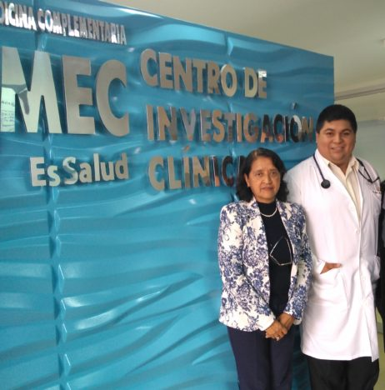

Introduction and Purpose
Health Care Quality of Peruvian Breast Cancer Patients ONCOLOGY AND COMPLEMENTARY MEDICINE SERVICES
The overall health care quality perception of patients in Lima, the capital of Peru, was reported to be 68.9% according to the SERVQUAL questionnaire, which grades as acceptable.
This study aims to determine the perception of the quality of health care for breast cancer patients in Lima.
Andrea Anampa-Guzmán

Slide 2

Methods
Cross-sectional study. The perspectives of 182 breast cancer patients about the quality of care at the largest hospital in Lima were assessed.
117 patients (64.29%) were only seen at the Oncology Department, and 65 patients (35.71%) were seen at both the Oncology Department and Complementary Medicine Department.
The quality perception is based on five dimensions: Reliability, responsiveness, assurance, empathy, and tangibility. The percentage has to be 60 to be an acceptable level.
Andrea Anampa-Guzmán

Slide 3
Results
The overall and oncology only groups quality perceptions were not acceptable, 57.32%, and 53.65%, respectively
The oncology and the complementary patient group reported adequate overall perception (63.92%).
Perception of empathy and assurance were at acceptable levels for both groups. Reliability and tangibility did not receive a satisfactory grade in any group. The responsiveness level was only adequate in the complimentary and oncology group
The breast cancer patients’ perception of the health care quality who received Complementary Medicine services was significantly higher than the oncology only group.
Andrea Anampa-Guzmán
3

Slide 4

Conclusion and Implications
The patients who were seen at the oncology and complementary medicine reported a better perception of the quality of healthcare. More studies are needed to improve healthcare in breast cancer patients.
Autors: Andrea Anampa-Guzmán, Juan Huaccho-Rojas, Rushmely Perez-Mendez, Martha Villar-Lopez
Facultad de Medicina San Fernando, Universidad Nacional Mayor de San Marcos.
Contact information:
Juan Huaccho-Rojas
Facultad de Medicina Humana, Universidad San Martin de Porres.
Mail: drjuanhuaccho@gmail.com
Phone: +51962330501
Adress: St. Yasila 150, Ate, 15022, Lima - Perú
Andrea Anampa-Guzmán

