Slide 1

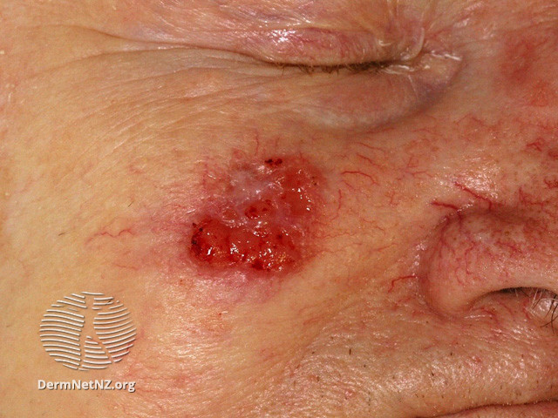
A preventive vaccine targeting both Human Papillomavirus α genotypes causing anogenital cancers and β genotypes causing non-melanoma skin cancers
Pola Olczak¹, Margaret Wong¹, Ken Matsui², Huimin Tan², Joshua W Wang², Richard BS Roden¹
¹Department of Pathology, Johns Hopkins University, 1550 Orleans St, Baltimore, MD 21287; ²Pathovax LLC, 1812 Ashland Ave, Suite 100, Baltimore, MD 21205
Introduction:
α HPV can cause anogenital and oropharyngeal cancers
β HPV can cause benign cutaneous infections
β HPV is hypothesized to increase risk of initiation of skin cancer in UV exposed and immunosuppressed individuals
TMC6/8 KO is a mouse model for Epidermodysplasia verruciformis (EV)
Organ transplant recipients (OTR), HIV+ and EV patients with βHPV are at higher risk for NMSC
Currently no available vaccine that targets the βHPVs
Patient with squamous cell skin cancer
Objectives:
Develop chimeric HPV18 L1 VLP-based vaccine to complement existing HPV16 L1-RG1 VLP vaccine
Aim to target clinically relevant cutaneous β and mucosal α Human papillomaviruses
Compare bivalent HPV RG1 vaccine to licensed Gardasil9 vaccine
Test if the vaccine is protective against βHPV in EV mouse model (TMC6/8 KO)
To compare vaccine responses in male vs. female mice, and wild type vs. EV model mice

Slide 2
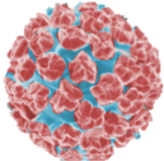
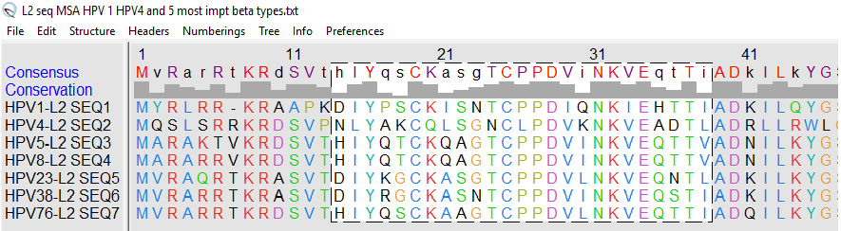
Methodology
Existing HPV vaccines
360 x HPV L1 Capsid protein
Type restricted protection
One particle type-one strain
Up to 9 HPV types per vaccine (Gardasil 9)
Our approach: RG1-VLP technology
RG1 epitope of L2
AA 17-36 of L2
Conserved across multiple HPV types
HPV16L1 + RG1
360 copies of RG1 peptide displayed on VLP surface
Combination of HPV RG1 epitopes: 16 and 18
Bivalent formulation to cover broader range of clinically relevant HPV types
Protection not restricted to the particle included
RG1
HPV18L1 + RG1
RG1

Slide 3
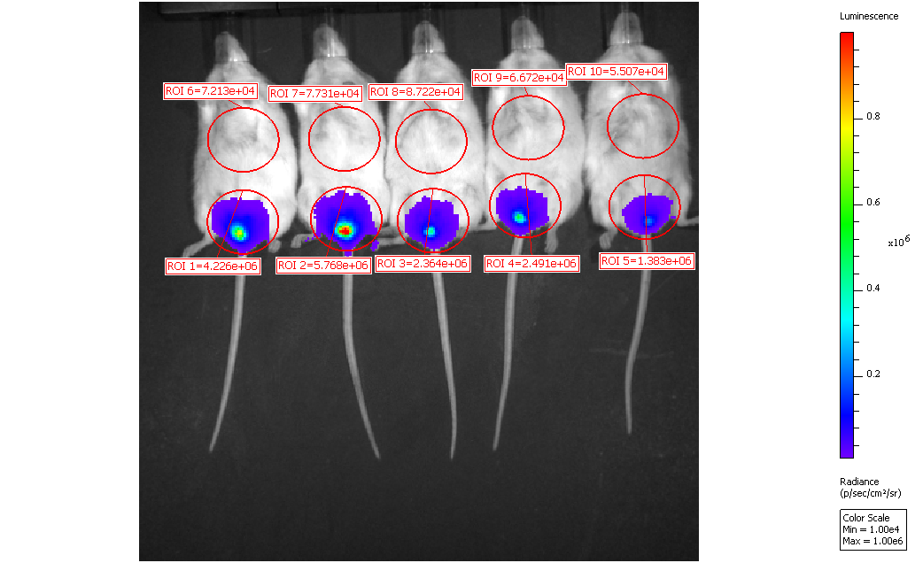
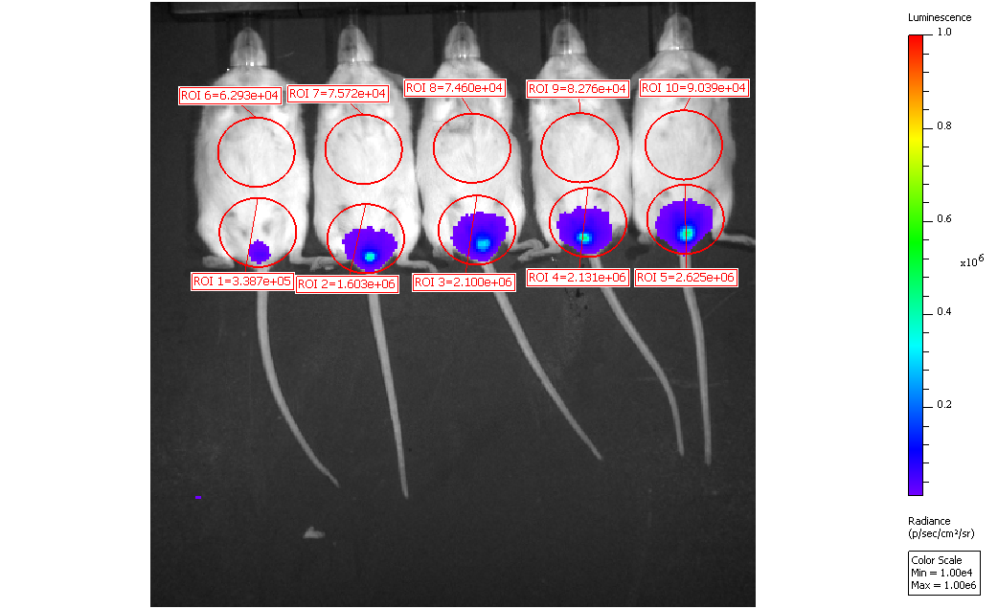
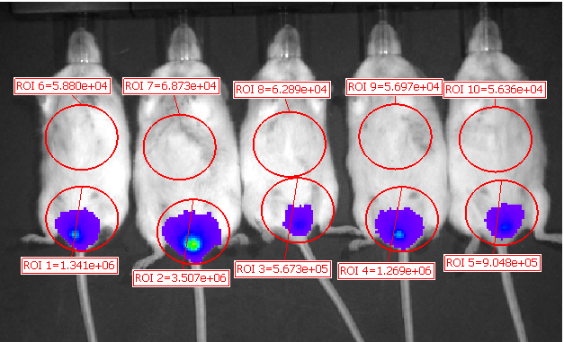
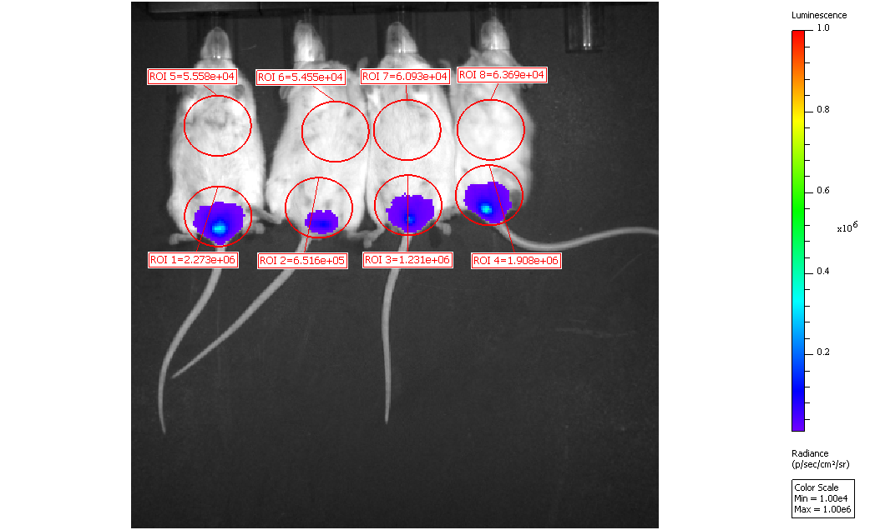
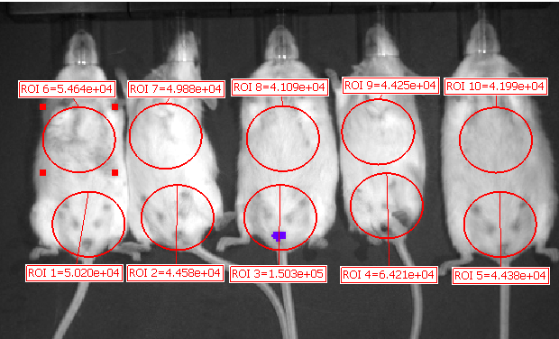
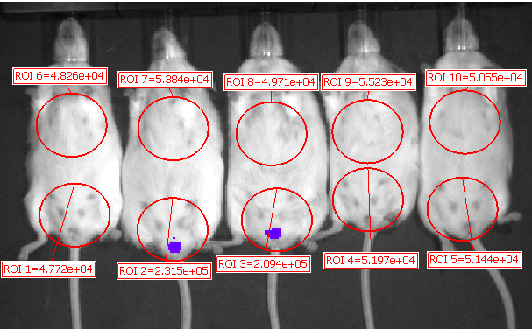
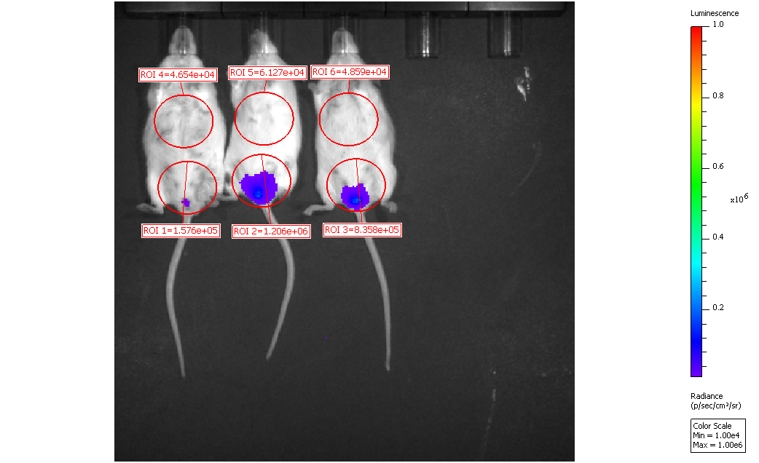
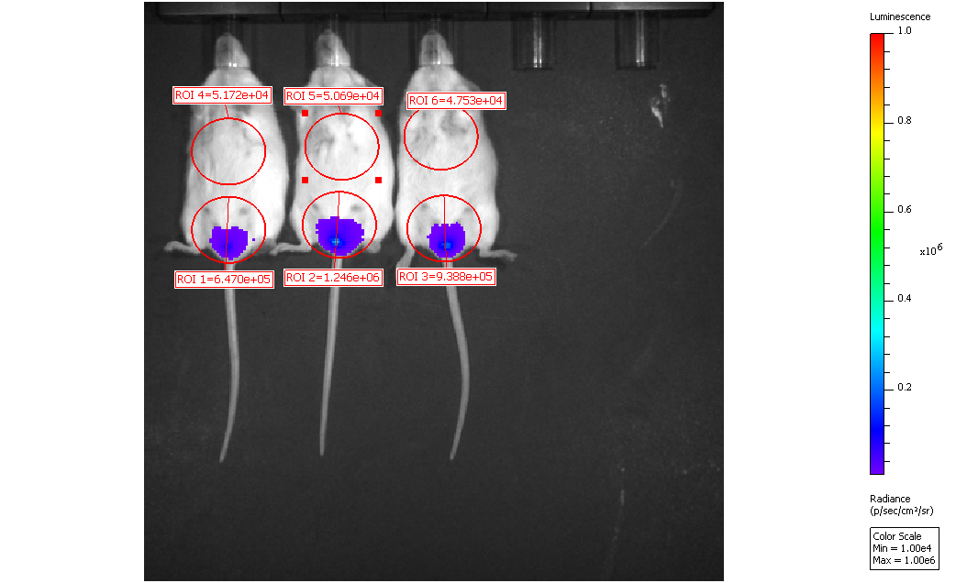
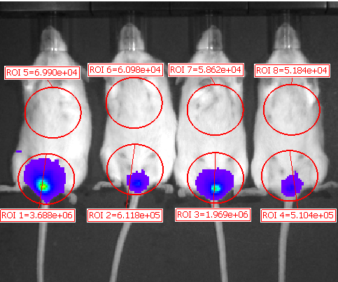
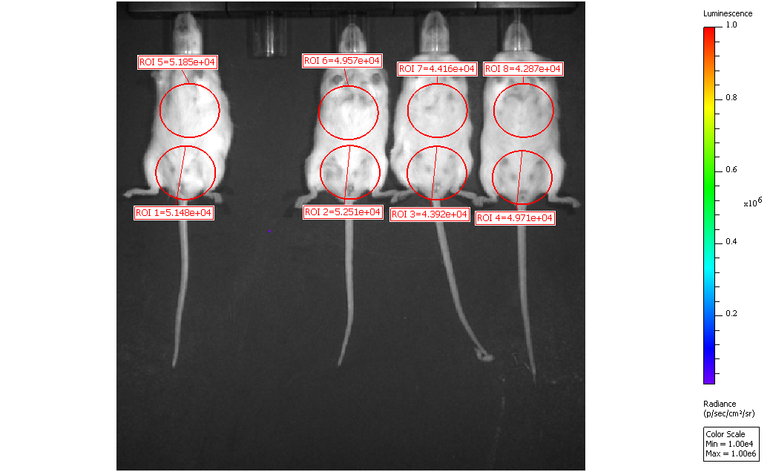
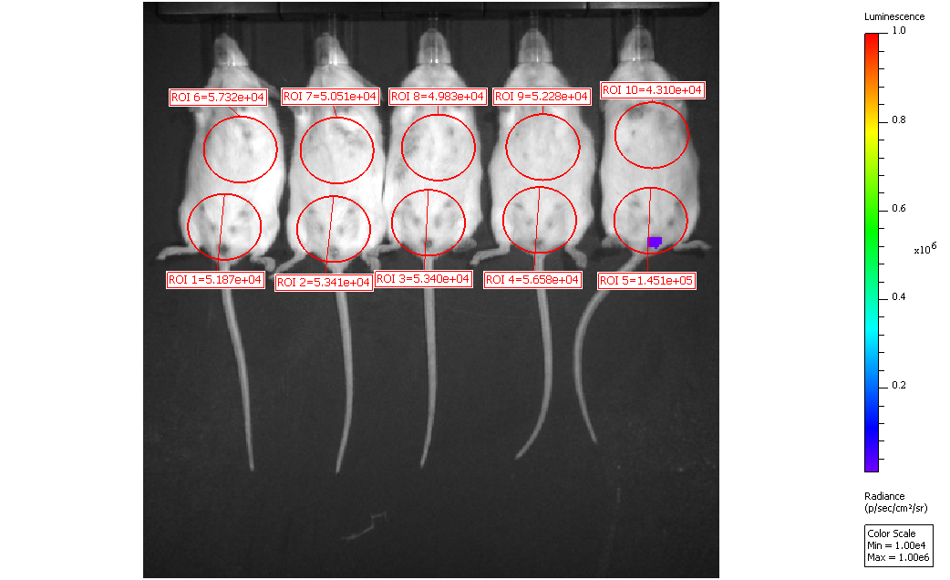
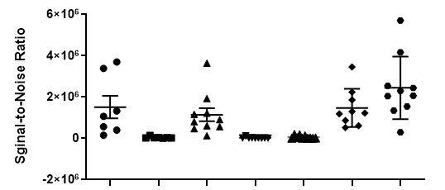
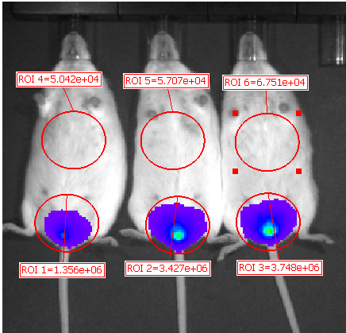
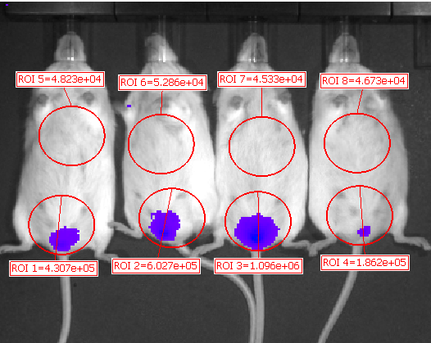
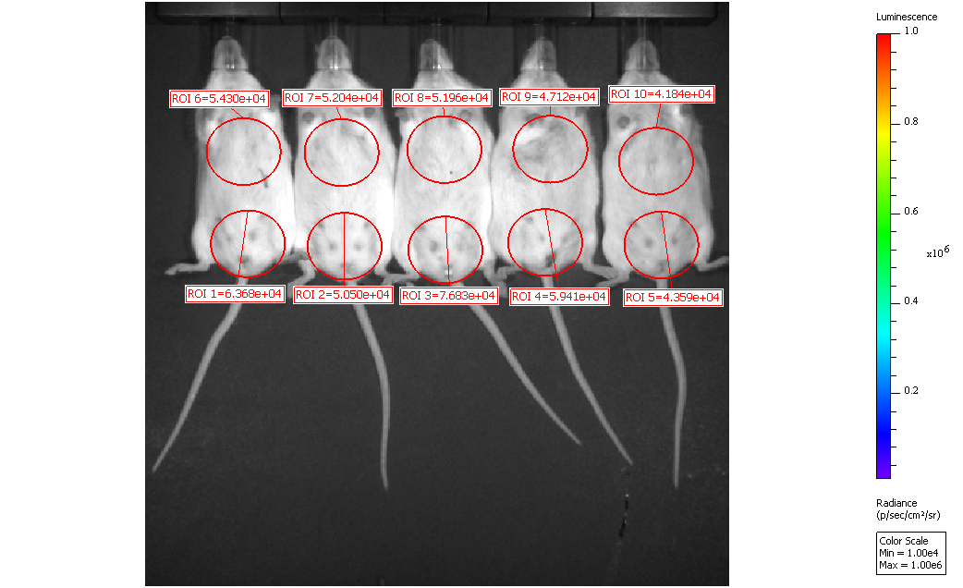
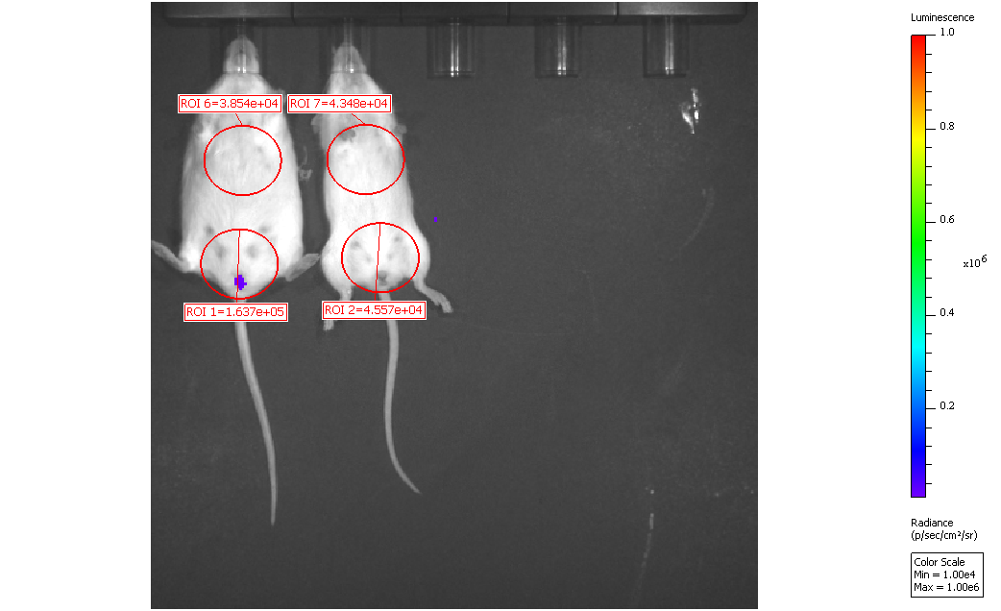
Bivalent vaccine is protective against βHPV5
In vivo challenge with HPV5 PsV
WT Alum
WT Gardasil 9
WT Bivalent
TMC6 KO
TMC8 KO
WT
TMC8 KO Alum
TMC8 KO Bi-valent
Bivalent
Bivalent
Bivalent
Gardasil9
Alum
Alum
Alum
TMC6 KO Alum
TMC8 KO Bi-valent
Bivalent vaccine is protective against HPV5 in WT and TMC6/8 KO mice
In vitro ELISA assay
Sera from bivalent HPV16/18-RG1 VLP vaccinated mice:
Elicited a neutralizing antibody response various HPV PsV Beta types
Elicited similar level of response in males compared to females
TMC8 KO mice- Alum only
TMC8 KO mice- Bi-valent vaccine

Slide 4
Results and Conclusions
Mice in all vaccination groups (WT, TMC6/8 KO) showed protection against HPV5
Gardasil 9 does not protect mice against HPV5
Bivalent vaccine potentially offers broader protection than licensed vaccines
Vaccination induced robust serum titers of L2-specific antibodies reactive against all βHPV genotypes tested
Sera from vaccinated mice elicited similar level of response in males compared to females
Bivalent RG1 vaccine has a potential of protection against multiple HPV types
Bivalent RG1 vaccine has a potential to be protective against NMSC in EV and other patients (and anogenital cancers, data not shown, in healthy patients)
Contact Information:
Pola Olczak: polczak2@jhu.edu
Johns Hopkins School of Medicine
1550 Orleans St, CRBII Rm 316 Baltimore, MD 21287

