Slide 1




Patients Refusing Anticancer Treatments and Complementary and Integrative Medicine
Elio Rossi*, Cristina Noberasco*, Marco Picchi*, Mariella Di Stefano*, Francesca Bosinelli*, Gianni Amunni**
* Clinic for Complementary Medicine and Diet in Oncology, North-Western Tuscan Local Health Authority, Lucca, Italy
**Institute Cancer Prevention Research and Oncological Network (ISPRO), Florence, Italy
TRANS NCI-NIH CONFERENCE ON INTERNATIONAL PERSPECTIVES ON INTEGRATIVE MEDICINE FOR CANCER PREVENTION AND CANCER PATIENT MANAGEMENT
OCTOBER 2020, BETHESDA, MARYLAND, USA

Slide 2
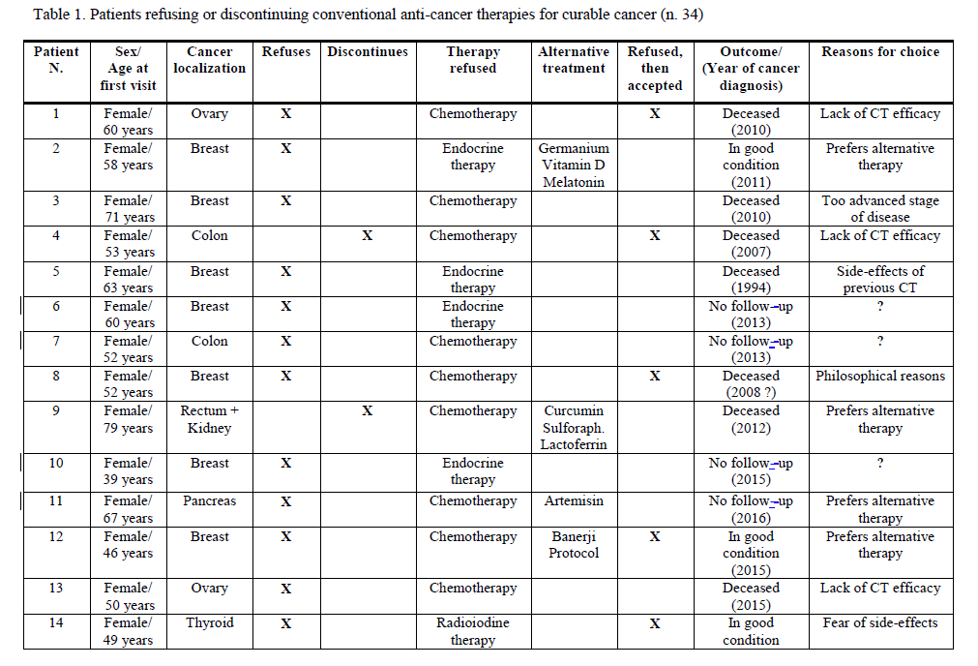
Aims and Methods
Aims: This observational prospective study was conducted at the Clinic for Complementary Medicine and Diet in Oncology, Campo di Marte Hospital, Lucca, Italy, and aimed at better clarifying why and when cancer patients tend to refuse conventional treatments.
Methods: Overall, 549 cancer patients (M=15.3%, F=84.7%), with a median age of 57 years (age range: 19–89 years), were consecutively visited at our Clinic for Complementary Medicine and Diet in Oncology from September 2013 to December 2019. Among those patients, a subsample of 35 patients refusing conventional treatments was recruited.
Furthermore, a specific Questionnaire was developed in order to explore the possible reasons why patients refuse conventional treatments, as well as their expectations and feelings related to conventional treatments themselves.
Anticancer Therapies Refused | Frequency | Percentage
Refused Chemotherapy | 21 | 60.0%
Refused Endocrine Therapy | 6 | 17.1%
Refused Radiotherapy | 3 | 8.6%
Refused Surgery | 2 | 5.7%
Refused Immunotherapy | 1 | 2.9%
Refused Growth Factors | 1 | 2.9%
Total | 35 | 100%

Slide 3
Results
Our sample was distributed as follows: 21 patients (60%) refused chemotherapy; 6 patients (17.1%) refused hormone therapy; 2 patients (5.1%) refused radiotherapy; 2 patients (5.7%) refused surgery; 2 patients (5.7%) refused any conventional treatment; 1 patient (2.9%) refused immunotherapy and 1 patient (2.9%) refused growth factor therapy. The main reasons underlying their refusal were investigated through our Questionnaire and are listed
Noteworthy, after the first (baseline) Complementary Medicine visit, 17 patients (48.7%) from the sample decided to undergo conventional treatments.
To date, 17 patients (48.6%) are currently in good conditions, 3 patients (8.6%) are currently in a disease progression phase, 9 (25.7%) patients passed away, while 6 patients (17.1%) dropped out the visits.
 | Frequency | Percentage
Philosophical Reasons | 11 | 31.4
Prefers Alternative Therapies | 6 | 17.1
Side Effects on a Significant Other’s Conventional Treatments | 4 | 11.4
Avoidance of adverse effects | 3 | 8.6
Lack of chemotherapy efficacy | 3 | 8.6
Unknown | 2 | 5.7
Too advanced stage of disease | 1 | 2.9
Side effects of previous chemotherapy | 1 | 2.9
Concerns about toxicity | 1 | 2.9
Fear of side effects on mobility | 1 | 2.9
Fear of side effects on sexuality | 1 | 2.9
Functional/esthetical reasons | 1 | 2.9
Total | 35 | 100.0
Table 1: main reasons underlying patients’ refusal to conventional treatments.

Slide 4
Conclusions
Conclusions:
Indeed, the present study suggests that a Complementary Medicine Clinic with experts in Integrative Oncology may effectively contribute to improve the communication with patients, especially with those who tend to refuse conventional treatments, and may thus play a positive role in treatment refusal management.
References:
- Huchcroft S.A., Snodgrass T. Cancer patients who refuse treatment. Cances Causes Control 1993; 4:179-185.
- van Kleffens T.I., van Leeuwen E. Physicians’ evaluations of patients’ decision to refuse oncological treatment. J Med Ethics 2005; 31(3): 131-6.
Thank You for Your Attention
e-mail to: eliogiovanni.rossi@uslnordovest.toscana.it
e-mail to: omeopa@usl2.toscana.it

