Slide 1
Integrative Oncology in the Region of Tuscany: a Successful Integration in Public Health
Elio Rossi*, Sonia Baccetti*, Mariella Di Stefano*, Gianni Amunni**
* Clinic for Complementary Medicine and Diet in Oncology, North-Western Tuscan Local Health Authority, Lucca, Italy
**Institute Cancer Prevention Research and Oncological Network, Florence, Italy
TRANS NCI-NIH CONFERENCE ON INTERNATIONAL PERSPECTIVES ON INTEGRATIVE MEDICINE FOR CANCER PREVENTION AND CANCER PATIENT MANAGEMENT
OCTOBER 2020, BETHESDA, MARYLAND, USA

Slide 2
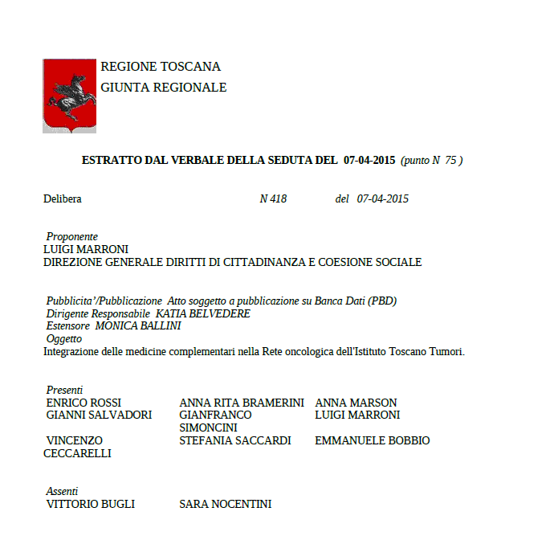
Aims, Methods and Results (I)
Aims and Methods: To describe the process of integration of Complementary Medicine (CM) in the network of Cancer Departments of Tuscan Public Healthcare System by means of a retrospective collection of documents.
Results: In 2009 the Tuscan Tumor Institute and the Tuscan Network of Integrative Medicine (TNIM) established a working group of experts in CM and medical oncologists to review the literature on the use of CM in cancer care. In 2013-2015 the TNIM participated in the European Partnership for Action Against Cancer-EPAAC (7th Framework Programme), with the purpose of collecting evidence on the use of CM in cancer and mapping the European centers offering Integrative Oncology services.
In 2015, a Resolution of the Tuscan Regional Government established to develop the use of some CM to treat cancer-related symptoms and side effects of conventional anticancer therapies (see Figure 1). They were acupuncture for nausea and post-chemotherapy and post-surgery vomiting, cancer pain, hot flashes of iatrogenic menopause, xerostomia; homeopathy for hot flushes of iatrogenic menopause and the side effects of radiotherapy; herbal medicine for pain, nausea and vomiting and anxiety, depression. A Panel of CM experts and medical oncologists defined how to apply this Resolution.
In 2019, Regional Guidelines (Diagnostic and Therapeutic Care Pathway) on breast cancer have been approved, including a section on complementary and integrative medicine as supportive cancer care. The Tuscan Integrated Medicine Network for people with cancer (Re.To.M.i. Tumors) is currently underway.
Figure 1: in 2015 the Resolution n. 418 of the Tuscan Regional Government ratified to develop the use of some CM in the treatment of cancer-related symptoms and side effects of conventional anticancer therapy.

Slide 3
Results (II)
 | Frequency | Percentage
Breast | 325 | 59.2
Colon | 35 | 6.4
Lung | 28 | 5.1
Ovaries | 19 | 3.5
Uterus | 14 | 2.6
Rectum | 13 | 2.4
Brain | 11 | 2.0
Stomach | 10 | 1.8
Prostate | 10 | 1.8
Pancreas | 10 | 1.8
Melanoma | 10 | 1.8
Others | 7 | 1.3
Lymphoma non Hodgkin | 5 | .9
Kidney | 5 | .9
Bladder | 5 | 9
Esophagus | 4 | .7
Liver | 3 | .5
Cholangiocarcinoma | 3 | .5
Head/neck | 2 | .4
LMC | 2 | .4
Thyroid | 2 | .4
Multiple myeloma | 2 | .4
Tongue | 2 | .4
Others | 22 | 3.8
Total | 549 | 100.0
Symptoms | G0 Frequency | G1 Frequency | G2 Frequency | G3 Frequency |  | p-value
Hot flashes (first visit) | 0 | 15 | 45 | 27 | 87 | .000
Hot flashes (last visit) | 24 | 23 | 12 | 2 | 61
Nausea/vomit (first visit) | 0 | 7 | 22 | 15 | 44 | .001
Nausea/vomit (last visit) | 7 | 6 | 4 | 0 | 17
Constipation (first visit) | 0 | 2 | 4 | 9 | 15 | .025
Constipation (last visit) | 5 | 2 | 0 | 1 | 8
Asthenia (first visit) | 0 | 7 | 41 | 38 | 86 | .000
Asthenia (last visit) | 16 | 16 | 6 | 3 | 41
Anxiety (first visit) | 0 | 2 | 20 | 15 | 37 | .000
Anxiety (last visit) | 9 | 8 | 3 | 0 | 20
Depression (first visit) | 0 | 1 | 19 | 24 | 44 | .000
Depression (last visit) | 11 | 6 | 2 | 0 | 19
Insomnia (first visit) | 1 | 2 | 21 | 8 | 32 | .000
Insomnia (last visit) | 12 | 5 | 2 | 0 | 19
Mucositis (first visit) | 0 | 1 | 13 | 9 | 23 | .002
Mucositis (last visit) | 10 | 3 | 0 | 0 | 13
Significance at Wilcoxon test for paired samples
Tables 1 and 2 and Figure 1: A highlight on the activities of the Clinic for CM and Diet in Oncology, Campo di Marte Hospital, Lucca, Italy, from 2013 to 2019. Noteworthy, the vast majority of patients visited at the Clinic was represented by women diagnosed with Breast Cancer (59.2%). This is in line with recent literature, since Breast Cancer is the most common cancer diagnosis among women in Italy. Table 2 also lists the main therapeutic outcomes for patients after CM treatment (Wilcoxon Test).

Slide 4
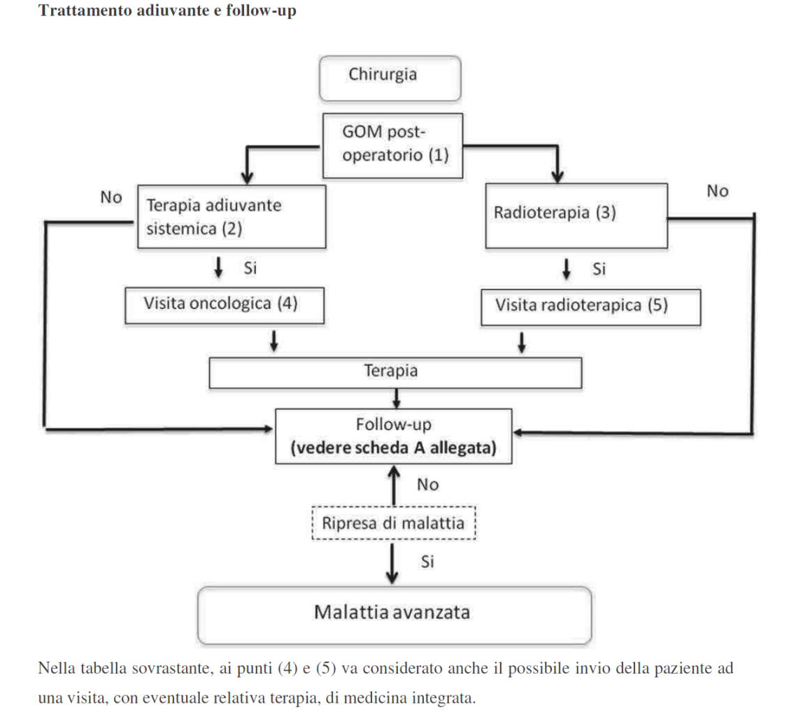
Results (III) and Conclusions
Results (continued): The Network aims at coordinating complementary integrative medicine interventions in oncology, to ensure cancer patients effective, safe, high quality and uniform treatments and improve their quality of life, reducing the side effects of anticancer therapy in a multidisciplinary approach to therapy.
Conclusions: The integration of evidence-based complementary treatments as a part of a Comprehensive Cancer Care Network contributes to respond safely and effectively to the demand coming from cancer patients combining safety and equity of access in Public Healthcare Systems.
References:
- Giunta Regionale Toscana: Delibera n. 993 del 09/11/2009: “Commissione Formazione per le Medicine Complementari (MC): approvazione criteri di accreditamento e verifica degli Istituti di formazione extra-universitaria, nelle single discipline di MC, di cui all’art. 2 L.R. 09/2007”.
Integrative
medicine
visit
Thank You for Your Attention
e-mail to: eliogiovanni.rossi@uslnordovest.toscana.it
e-mail to: omeopa@usl2.toscana.it

